Slide 1


How not to IoT
2025

Slide 2
Table of
Contents
How not to IoT
Eken/Aiwit cheap doorbell
Ecovacs vacuum robot cleaner
Cheap Android smart TV box
Zyxel NAS vuln
How to IoT

Slide 3

Why this talk?
How not to IoT
Learn from past mistakes
Beware of IoT devices *
Beware of IoT developers **
Know your IoT devices

Slide 4

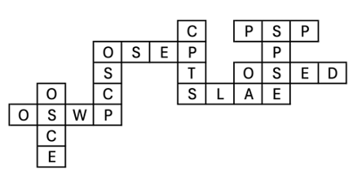
whoami
How not to IoT
Principal Vulnerability Researcher, Team Lead @ CUJO AI
Zombie Browser Toolkit
https://github.com/Z6543/ZombieBrowserPack
HWFW Bypass tool
Similar stuff was used in PacketRedirect in Danderspritz FlewAvenue by EQGRP
https://github.com/Z6543/hwfwbypass
Malware Analysis Sandbox Tester tool
https://github.com/Z6543/Sandbox_tester
Played with crappy IoT devices – my RCE exploit code running on ~600 000 IP cameras via Persirai
https://jumpespjump.blogspot.hu/2015/09/how-i-hacked-my-ip-camera-and-found.html
https://jumpespjump.blogspot.hu/2015/08/how-to-secure-your-home-against.html
Invented the idea of encrypted exploit delivery via Diffie-Hellman key exchange, to bypass exploit detection appliances
https://www.mrg-effitas.com/generic-bypass-of-next-gen-intrusion-threat-breach-detection-systems/
Co-organizer of the Hackersuli meetup

Slide 5

Eken/Aiwit doorbell story
tl;dr: with physical access to the doorbell(!) an attacker can factory reset the device and add his account as master

Slide 6
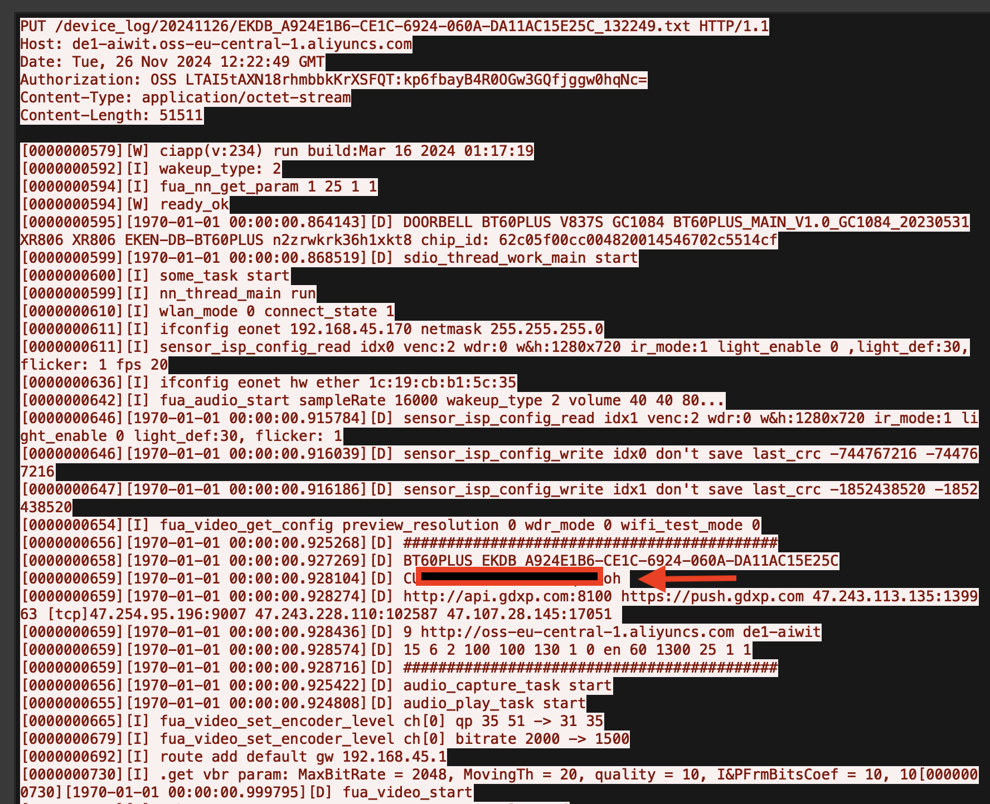
Guess what was here?

Slide 7
Ecovacs story: Pairing the mobile app with the vacuum robot cleaner
How not to IoT
Pairing is easy, you only have to:
Find their app in the app store, install their app, open the app, ask app not to track, set region, language, accept user agreement, accept the privacy policy, accept notifications, accept user agreement, privacy policy again(!), register new user (email, password), refuse newsletter subscribe, allow/disable location, name your home, search for device, enable Bluetooth search, Bluetooth will fail, use QR code - enable camera, type your Wi-Fi password, push button o vacuum cleaner, click “I have heard the beep”, join the vacuum robot Wi-Fi, do not send the App to the background, name your robot, update firmware version, READY TO START!!!!

Slide 8
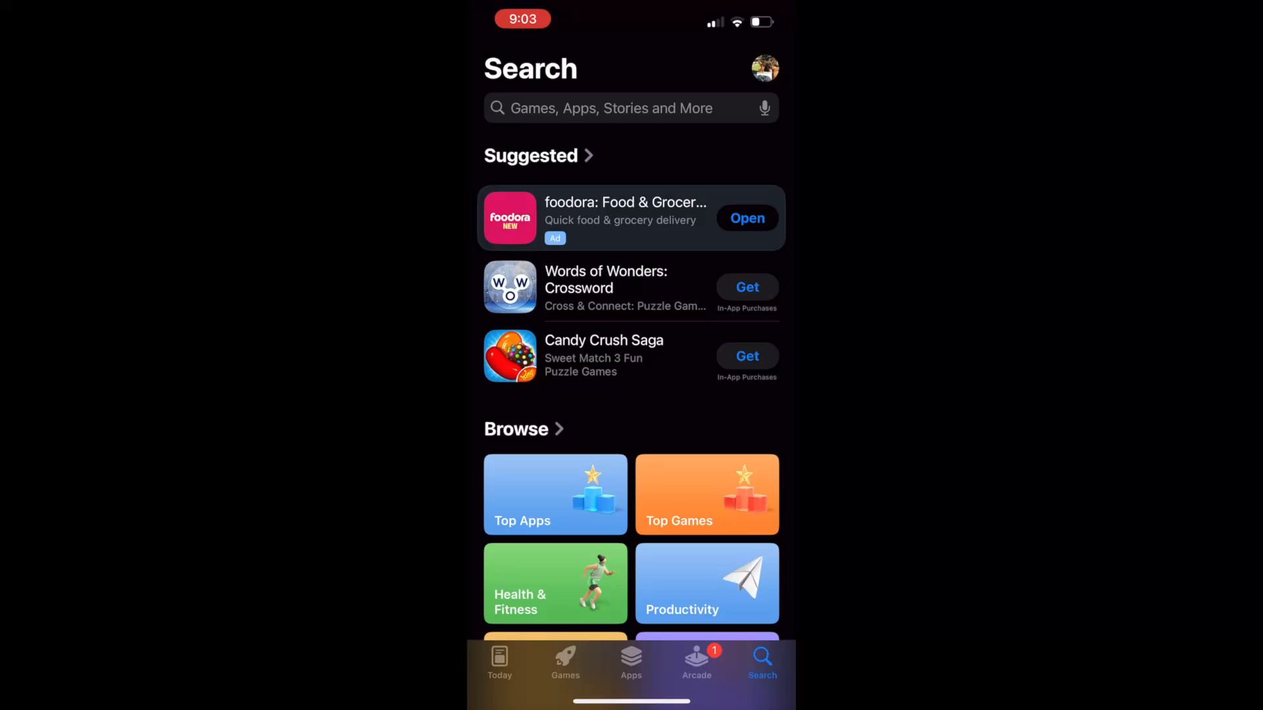
How not to IoT

Slide 9
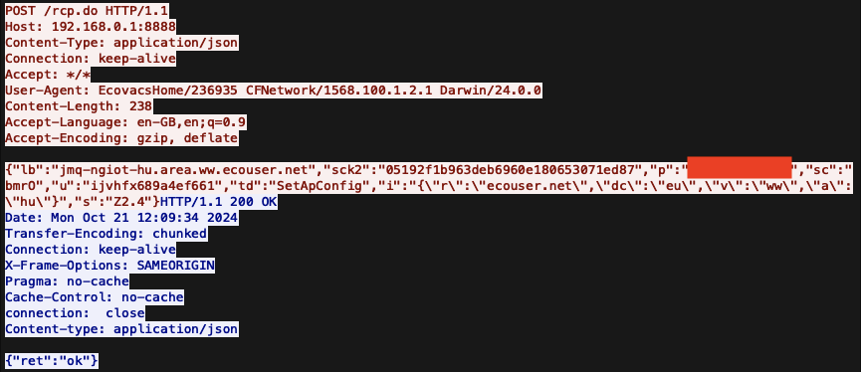
Pairing the mobile app with the vacuum robot cleaner
How not to IoT
This traffic is over open, unencrypted Wi-Fi, HTTP, clear-text
CVE-2025-44251

Slide 10
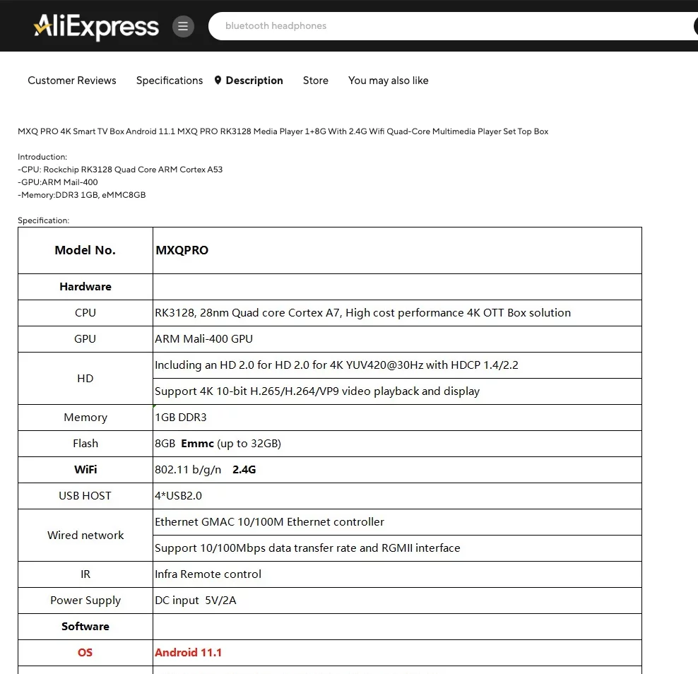
Android smart TV box - a.k.a v01d

Slide 11
Android smart TV box - a.k.a v01d
# begin build properties # autogenerated by buildinfo.sh ro.build.id=NHG47K ro.build.display.id=rk322x_box-userdebug 11.1 NHG47K ro.build.version.incremental=eng.txcz.20211207.160910 ro.build.version.sdk=25 ro.build.version.preview_sdk=0 ro.build.version.codename=REL ro.build.version.all_codenames=REL ro.build.version.release=11.1 ro.build.version.security_patch=2017-04-05 ro.build.version.base_os= ro.build.date=2021年 12月 07日 星期二 16:09:10 CST ro.build.date.utc=1638864550 ro.build.type=userdebug ro.build.user=txcz ro.build.host=txcz-host2
There is no Android 11.1 version
Patch date from 2017, Android 11.0 released in 2020 …

Slide 12
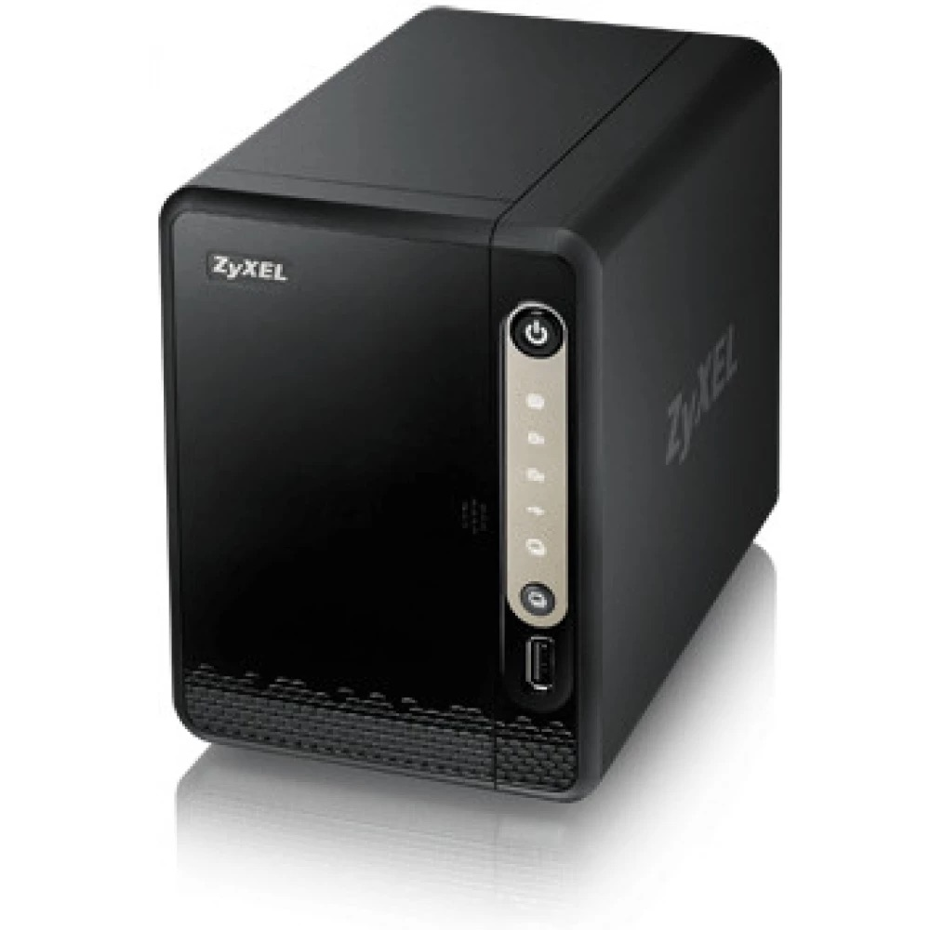

Zyxel NAS CVE-2020-9054 n-day

Slide 13
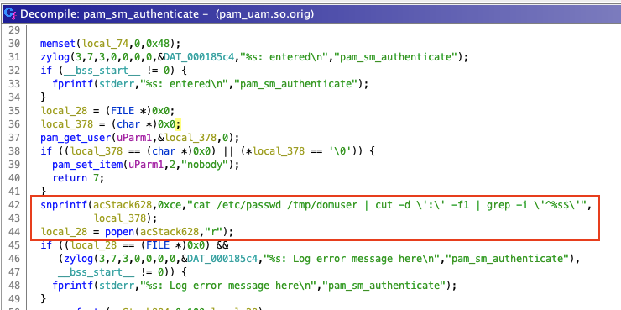
Zyxel NAS CVE-2020-9054 n-day

Slide 14
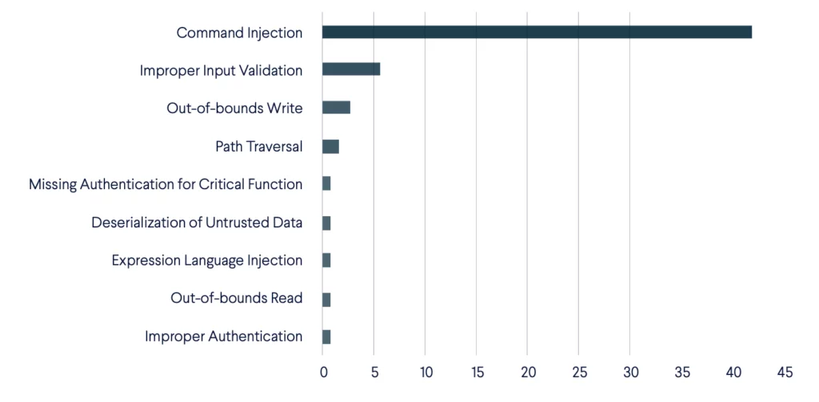
Command injection, always command injection
How not to IoT
Botnet exploit - CWE distribution
https://cujo.com/blog/the-2022-2023-iot-botnet-report-vulnerabilities-targeted/

Slide 15
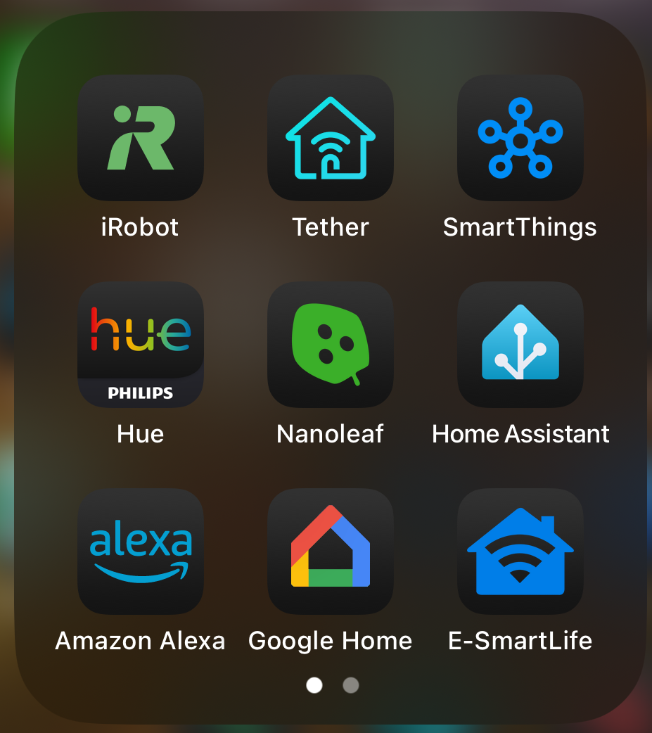
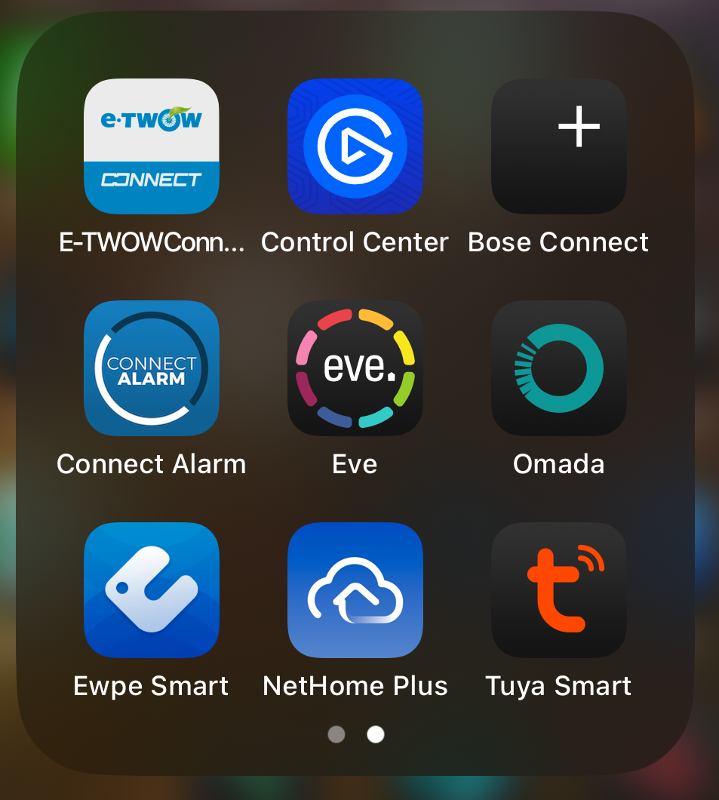
Universal problem: Ecosystem
How not to IoT
New device - new mobile app
Mobile app name does not match the IoT vendor
Vendor name not
present in the app
name
„Please register”
„Logged out due
to reasons ..”

Slide 16
My ideal IoT device
Fully functionality without cloud/Internet connectivity
Seamless auto-update
No undocumented backdoor ports/accounts
Vendor specific mobile app not needed for control
Open source
Secure
Private

Slide 17
How to IoT ? A way forward
Disclaimer: The company I work for is a member of the alliance creating Matter.
Following is my personal and professional opinion

Slide 18




How not to IoT
OS layer
Open Source
Secure boot
No Linux, no Busybox - no command injection :D
https://github.com/zephyrproject-rtos/zephyr
App layer
Open source
One ring to rule them all
Promise: control all your IoT devices from whatever ecosystem you want
Device should work without Internet connectivity, built with privacy in mind
https://github.com/project-chip/connectedhomeip
https://csa-iot.org/wp-content/uploads/2022/02/Matter-Security-Privacy_one-pager_102921-B.pdf
Network layer
Open Source
It is like Zigbee++, but more modern, faster, reliable
“Server” layer
Open Source
Private - no cloud “feedback”

Slide 19

Hack the planet!
One computer at a time …
How not to IoT
zoltan.balazs@cujo.com
https://hu.linkedin.com/in/zbalazs
zh4ck.bsky.social
www.slideshare.net/bz98
httpscolonforwardslashforwardslashwwwdotzoltanbalazsdotcom.com

