Slide 1
DevSecOps
in Action
November 2019

Slide 2
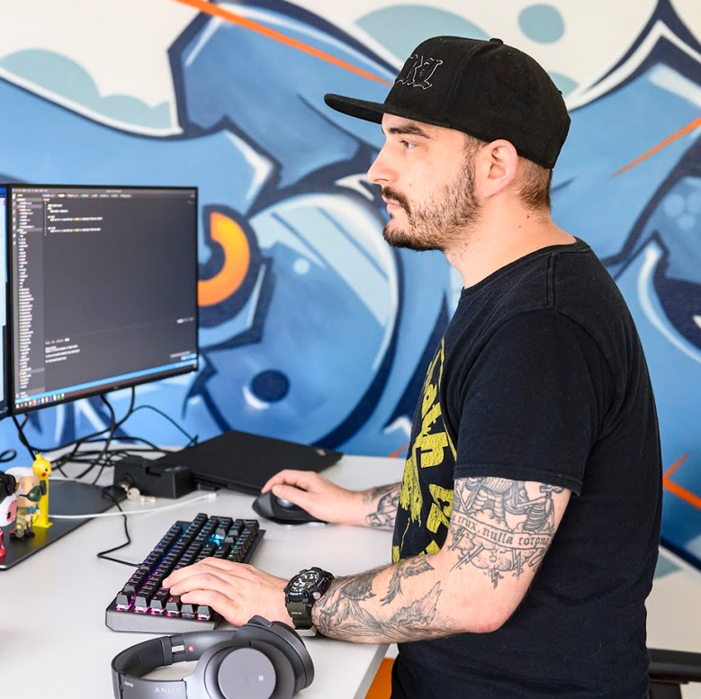
$ whoami
Jozsef Ottucsak (@fuzboxz)
Senior AppSec Engineer @TrueMotion
OSCP, SLAE, CCSKv4, eCPPT, eMAPT, CEHv9...
5+ years in security
4 in appsec

Slide 3
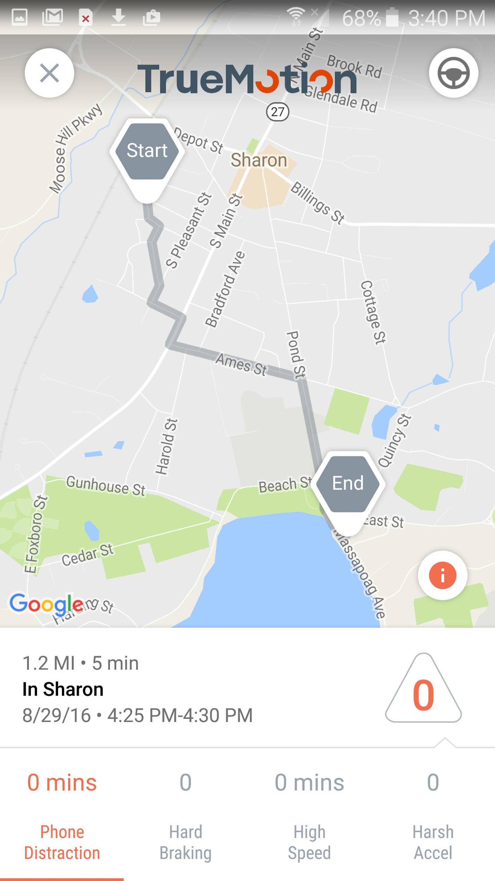
What Does TrueMotion Do?
Founded six years ago
Fastest growing telematics service provider
Eliminate distracted driving
Make insurance companies smarter with data
HQ in Boston, dev office in Budapest
17 customers, several of the Top 20 insurers in the US

Slide 4
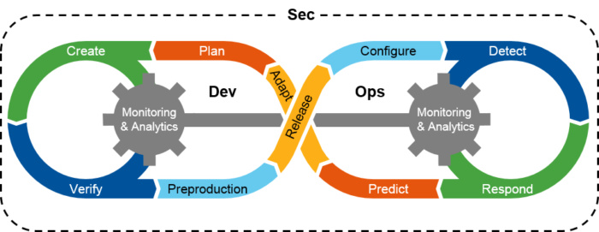
What is DevSecOps?
Bring security closer to development
Leverage automation to achieve scalability
Security becomes part of every phase in development
Expectations
Fewer vulnerabilities
Quicker fixes
Faster deployment
Security can focus on long-term projects

Slide 5
Where we started

Slide 6
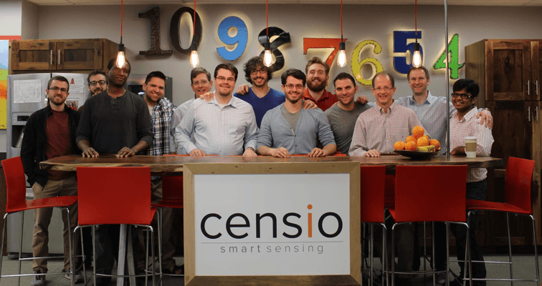
The Good Old Days
Talented engineers
Focus on building MVP
“Move fast and break things”
No security processes
Lack of structured policies
Budapest office opens in 2017 EOY

Slide 7
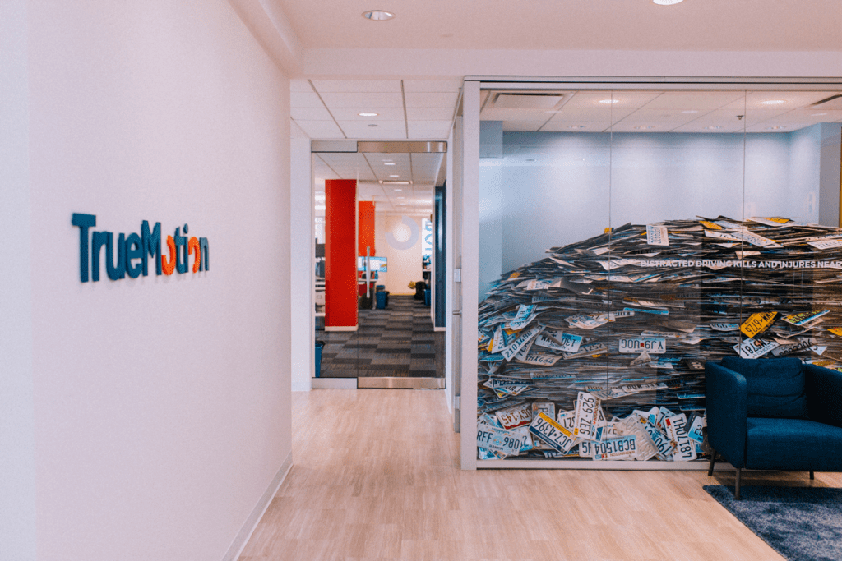
Stepping up our game
Investment in security and reliability in 2018
SRE team no longer in charge of security
Dedicated security team is built
Fundamental security capabilities built out
SOC 2 Type II (Security) compliance
No appsec program

Slide 8
Building up the program

Slide 9
Security and Compliance Organization
Flat hierarchy in the security group
Three different areas with shared goals
Day-to-day communication and collaboration
Projects ownership is assigned based on area of expertise
TechOps
SRE
IT
Security and Compliance
Compliance
Infrastructure Security
Application Security

Slide 10
What we had
Buy-in from management
Strong contractual and regulatory obligations
Data protection is expected from customers
Most developers were senior engineers
No legacy technologies
Everything is code

Slide 11
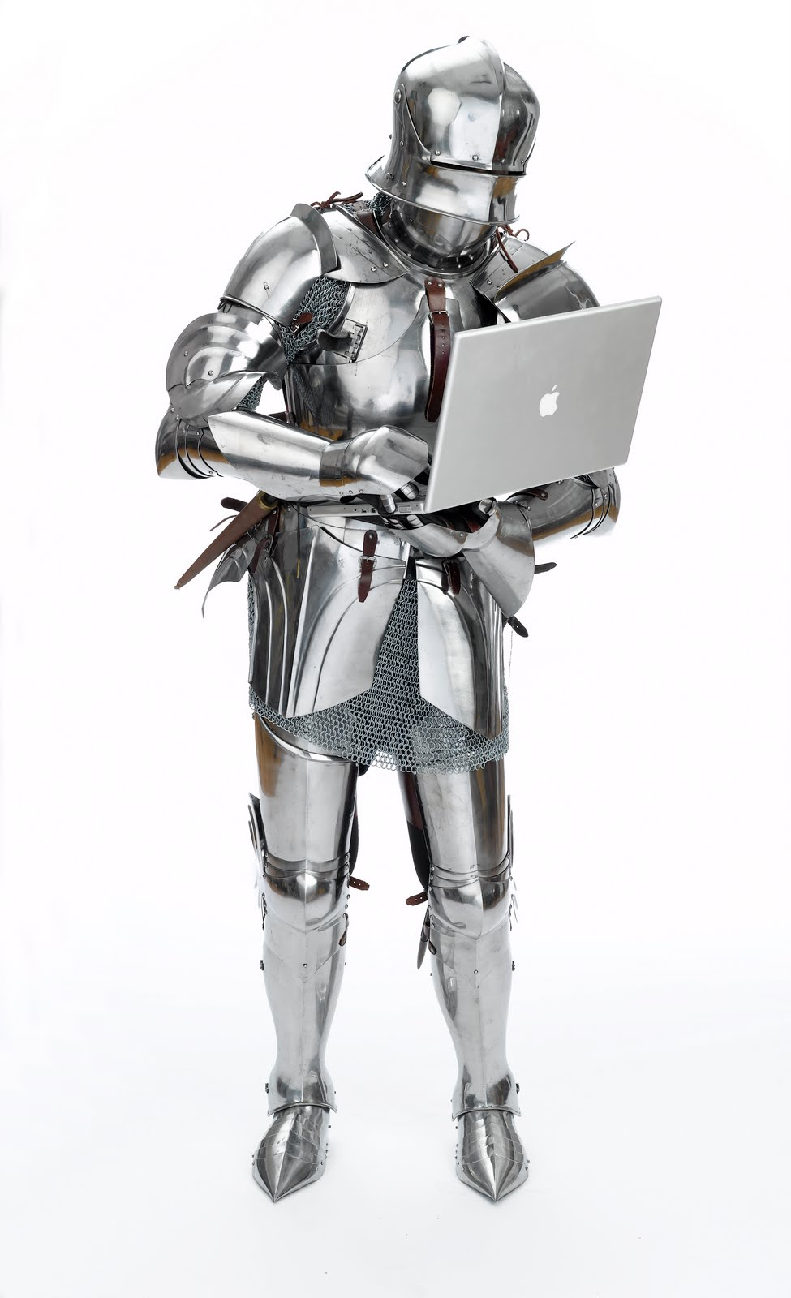
Building a culture of security
Security Champion program
Engineering focused, owned by appsec
Regular meetings about development efforts
Separate for Boston and Budapest
Accelerate and communicate security efforts
Champions are rewarded for participation
Security Lunch and Learn / Security Standup
Company wide
Security & Compliance ownership
Data protection and privacy evangelization

Slide 12
Manual processes
Security involved in design discussions with SRE
Code review on security sensitive code
Review before release
Sign-off required before major changes/features

Slide 13
Piggybacking developer tools
Leveraging familiar tools is a great way to funnel into existing processes
Using GitHub to track 3rd party dependencies
Accurate license tracking
Security alerts on vulnerable dependencies
Pull requests that automatically fix vulnerabilities
JIRA is used to track security vulnerabilities
Bug/story to differentiate vulnerability/improvement
Security label to identify relevant tickets
Priority is NOT severity

Slide 14
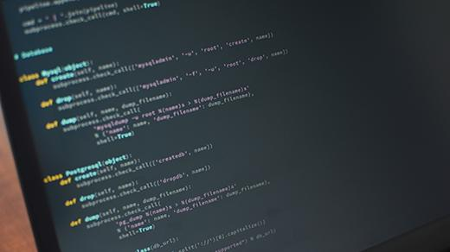
Bake security into the build
Production services are covered by static code analysis
Python - Bandit / node.js - nodejsscan
Good project for security champions
Requires initial time investment
Reduce barrier of entry - use wrapper functions
Use automation to track rollout percentage

Slide 15
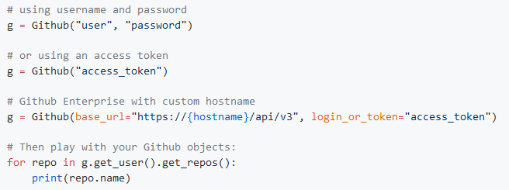
Collecting metrics
GitHub API is great to collect metrics (PyGithub)
Figuring out what to report on is the biggest challenge
Dashboard automation planned for next year
Interfacing different tools is the biggest challenge

Slide 16
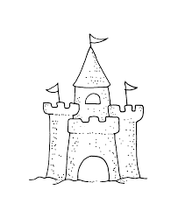
Guarding the perimeter
Taking away developer production access
Web application scanning authenticated
Unauthenticated scans are generally not that effective
Public assets exposed to vulnerability scanning
Don’t rely on static IP addresses if you use cloud (duh...)
IPS/IDS and anti-malware solutions deployed in all environments

Slide 17
Next steps

Slide 18
Plans for next year
100% tool coverage with breaking builds
Extend static analysis to Cloudformation templates
Container vulnerability scanning
Software security training part of the onboarding process
Internal bug bounty

Slide 19
Summary
Get management buy-in
Build out security culture first
Leverage partnerships to do more
Integrate into existing tools and processes
Face time is a must
Automate what you can

Slide 20
Thank you

