Slide 1
Why Go?
Szabó Dávid, PhD
Senior Software Engineer
@szabvid

Slide 2
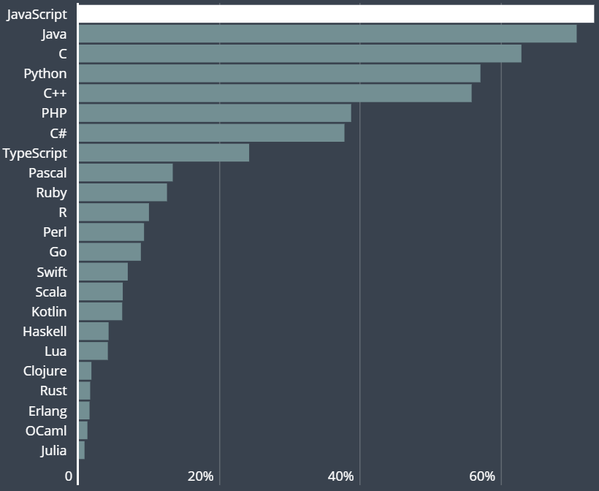
Does Go is The Most Popular Language?
2019 – HackerRank Developer Skills Report based on ~71k developers
https://research.hackerrank.com/developer-skills/
www.leannet.eu
Notes:
Vannak más források, de ezt megbízhatónak tartom, illetve ikább csak az első 4 sorrendben volt eltérés, de maguk a népszerűségek egyeztek mindenhol.

Slide 3
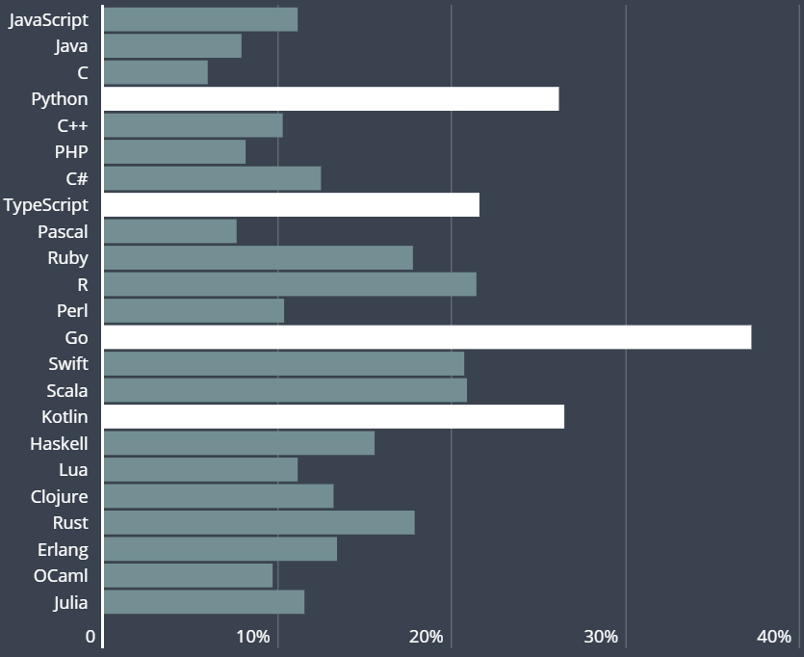
What Developers Have on Their To-Do List?
2019 – HackerRank Developer Skills Report based on ~ 71k developers
https://research.hackerrank.com/developer-skills/
www.leannet.eu
Notes:
Vannak más források, de ezt megbízhatónak tartom, illetve ikább csak az első 4 sorrendben volt eltérés, de maguk a népszerűségek egyeztek mindenhol.

Slide 4
The First Impressions When You Start
Go-is-not-good
https://github.com/ksimka/go-is-not-good
Created in 2015
2.6k stars
Some points from the list:
no function / operator overloading
too simple / lack of syntactic sugar
error handling
no exceptions
no generics
bad dependency management
too opinionated
www.leannet.eu
Notes:
Összehasonlítás más nyelvekkel

Slide 5
The Philosophy of Go: Simplicity
Rob Pike, Ken Thompson and Robert Griesemer
Among the pioneers of computer science with huge legacy:
B, C, UNIX, Java HotSpot JVM, UTF-8, …
Rob Pike:
“If the languages all converge, we will all think the same
We don’t want just one tool, we want a set of tools, each best at one task
Languages evolve and compete by adding features (that originate elsewhere)
Languages grow in complexity while becoming more similar”
Keep it simple:
Go does not try to be like the other languages
Go does not compete on features
As of Go 1 (2012), the language is fixed
Adding more features would make Go less interesting by being less different
All three of them must agree on what goes in --> not so many features
www.leannet.eu
Notes:
Ők hárman elég nagy rálátással rendelkeztek a programozási nyelvekre és a Google-nél dolgoztam, pontosan tudták mit akarnak. Mindhármuknak bele kellett egyeznie, hogy mi megy a nyelvbe. Azóta is stabil.
Hasonló nyelvek: Java, ECMAScript, C#, C++)

Slide 6
The Goal of Go
What were the challenges of Google in 2008?
Computing landscape totally changed since C++, Java, Python had been created:
Multicore processors
Rise of containers
Distributed systems (e.g. Microservices)
Massive Computation clusters
Hundreds or even thousands of programmers
Large compilation clusters
Average time a developer stay with a company is decreased to 1,5-2 years
Answers 21st century problems from Google’s point of view
www.leannet.eu
Notes:
Mi volt a Go célja?

Slide 7
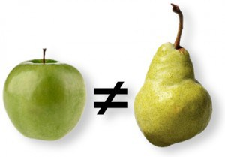
Let’s compare!
Go
Java
Python
www.leannet.eu
Notes:
Mi volt a Go célja?

Slide 8
Go vs. Java
www.leannet.eu
Notes:
Összehasonlítás más nyelvekkel

Slide 9
Go vs. Java
Design choices - similarities
C style
Imperative
Compiled
Statically typed
Cross-platform
Garbage collection
Reflection
www.leannet.eu
Notes:
Code readability is a major factor
Imperative vs functional?

Slide 10
Go vs. Java
Design choices - differences
Go do not need Virtual Machine: compiled to run on bare metal
Go has strings, arrays and maps in-built (not in standard lib as for Java)
No exceptions
No classes
No inheritance
No annotations
No generics
No overloaded methods
No final keywords
Go is not feature rich, it's rather minimalistic language
Java has a lot of added stuff, which is sometimes good, sometimes not so good
www.leannet.eu
Notes:
ha exception van, megszakad a program futás (más ág)
error handling más természetű, az inkább egy normal if ágra hasonlít, amit kezelni kell
When you call panic and you don’t handle it, the execution flow stops, all deferred functions are executed in reverse order, and stack traces are printed at the end.
https://medium.com/@hussachai/error-handling-in-go-a-quick-opinionated-guide-9199dd7c7f76
Generic Methods
You can write a single generic method declaration that can be called with arguments of different types.
Method Overloading is a feature that allows a class to have more than one method having the same name, if their argument lists are different

Slide 11
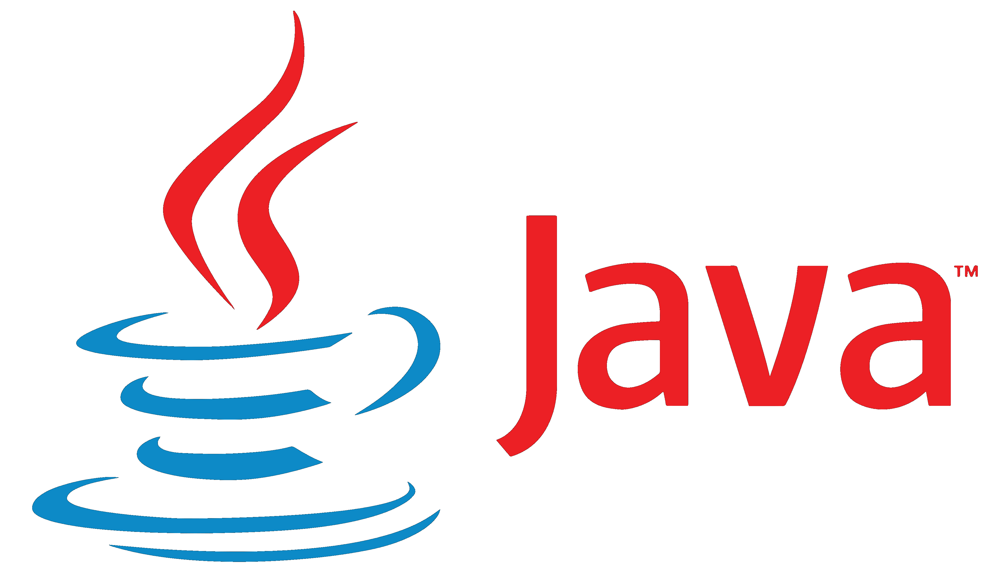
Go vs. Java
Performance – Go wins
(not really in speed but in memory)
3 complex problems:
Mandelbrot equation
N body problem
Fasta
Significant pain is to compile java that is much slower.
Mandelbrot
Mandelbrot
6.96 sec
5.47 sec
76316 units
31004 units
N-Body
N-Body
22.00 sec
21.00 sec
32272 units
1536 units
Fasta
Fasta
2.32 sec
2.07 sec
42212 units
2620 units
https://benchmarksgame-team.pages.debian.net/benchmarksgame/faster/python3-go.html
www.leannet.eu

Slide 12
Go vs. Python
Scalability – Go wins
Taking advantage on multicore processors and concurrency:
Go is very good at:
support concurrency (CSP model)
taking advantage on multicore processors
Java is not that good or at least not that easy
Execution:
Java and Go are both statically typed -> can handle both small and big programs with finesse
Java is dynamically linked -> upgrades without requiring you to ship anything (with bugs)
Go is statically linked -> will run in limited environments with easier distribution
Containerization:
Go -> the necessary parts of the libraries needs to be installed & very easy cross compiling
Two phase build -> Small container size (~5 MB)
Java -> Java can run anywhere, if there is a JVM installed on it.
Large container size (~100 MB)
www.leannet.eu
Notes:
Itt linket esetleg updatelni

Slide 13
Go vs. Java
Readibility – Go wins
Go sacrifices expressiveness for uniformity.
Go leaves very limited space for “creativity”:
e.g. no generics, no lambda expressions, etc.
all that enables a developer to create her own style and abstractions is not there
not at all as elegant and productive at first look as Java (at least for the first look)
but eliminate all initial hurdles that makes hard to work with someone else’s code
far less challenge when a codebase is huge (across timezones, developers and years)
www.leannet.eu
Notes:
Azért egyszerűbb Go-t olvasni, mert nincs mindenféle runtime code injection? Fordítási időben, code review során nehéz megtalálni dolgokat?

Slide 14
Go vs. Python
www.leannet.eu
Notes:
Összehasonlítás más nyelvekkel

Slide 15
Go vs. Python
Performance – Go wins
3 complex problems:
Mandelbrot equation
N body problem
Fasta
Mandelbrot
Mandelbrot
279.68 sec
5.47 sec
49344 units
31280 units
N-Body
N-Body
882 sec
21.00 sec
8212 units
1532 units
Fasta
Fasta
62.88 sec
2.07 sec
680736 units
3168 units
https://benchmarksgame-team.pages.debian.net/benchmarksgame/faster/python3-go.html
www.leannet.eu
Notes:
Összehasonlítás más nyelvekkel – Nem mindenből az optimális, hanem valszeg commodity HW és megvalósítás…

Slide 16
Go vs. Python
Scalability – Go wins
Taking advantage on multicore processors and concurrency:
Go is very good at:
support concurrency (CSP model)
taking advantage on multicore processors
Python is not that good
Execution:
Python is dynamically typed -> kind of limits to build a really big program
Go is statically typed -> can handle both small and big programs with finesse
Python is dynamically linked -> upgrades without requiring you to ship anything (with bugs)
Go is statically linked -> will run in limited environments with easier distribution
Containerization:
Go -> the necessary parts of the libraries needs to be installed & very easy cross compiling
Two phase build -> Small container size (~5 MB)
Python -> Interpreter and necessary libraries need to be installed
One phase build -> Large container size
www.leannet.eu
Notes:
Itt linket esetleg updatelni

Slide 17
Go vs. Python
Readability – no clear winner (maybe Go)
Development is done by a team with ten or even hundreds of other developers.
Python:
has fantastic expressivity
but has probably 10 different ways to say the same thing → can lead to confusion
Go:
comes with strict rules
there is one definite way to perform a task → leads to better understanding of code
syntax is also considerably less friendly to beginners but not as unforgiving as C or C++
www.leannet.eu
Notes:
Code readability is a major factor

Slide 18
Summary
For a pretty big set of problems for today Go does a decent job
This problems weren’t there 20 years ago
Nor they will be there from 20 years now
This are the reasons why Go’s popularity increasing today
www.leannet.eu
Notes:
Ezt rövidíteni!

