Slide 1
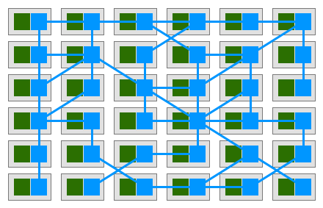
Service Mesh: a New Infrastructure Layer Under Microservices

Slide 2
$> whoami
PhD in Telecommunications @ Budapest University of Technology
Worked with 5G technology
SDN & NFV → Cloud Native Network Functions
Graduated in the EIT Digital Doctoral School
Co-founder & CTO @ LeanNet Ltd.
Consulting, training, implementing
Cloud Native, Microservices, DevOps
megyesi@leannet.eu
twitter.com/M3gy0
linkedin.com/in/M3gy0

Slide 3
Outline
Basics of service mesh
The evolution of cloud computing
Microservices leading to complexity
The necessity of a new architectural component
The sidecar proxy deployment strategy
Data plane vs. control plane in a service mesh
Choices for realizing a service mesh
Linkerd
Linkerd2 (the current version)
Envoy as the universal dataplane for
Istio
AWS App Mesh
Consul
Kuma
3 hour tutorial tomorrow: Linkerd & Istio!

Slide 4
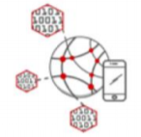
Application Architecture
Development Process
Deployment & Packaging
Application Infrastructure
Monolithic
Waterfall
Psychical Servers
Server Room
SOA
Agile
Virtual Machines
Data Center (IaaS)
Time
DevOps
Cloud Native
Microservices
Containers
Cloud Platform

Slide 5
What are Microservices?
Microservices architecture is software development form that structures an application as a collection of loosely coupled services having bounded context, which implement business capabilities. Microservices enable the continuous delivery/deployment of large, complex applications.
Monolithic software
Vertically scalable
Hard to maintain and evolve
Very long build / test / release cycles
Always fixing bugs
Lack of innovation
Service Oriented Architecture
Microservices
Horizontally scalable
Services are easy to maintain
Very short build / test / release cycles
Easy to innovate
Notes:
The microservice architecture is not a silver bullet. It has several drawbacks. Moreover, when using this architecture there are numerous issues that you must address. The microservice architecture pattern language is a collection of patterns for applying the microservice architecture. It has two goals:
The pattern language enables you to decide whether microservices are a good fit for your application.
The pattern language enables you to use the microservice architecture successfully.

Slide 6
This is not a Microservice Architecture!
Web Server
App Server
DB Server

Slide 7
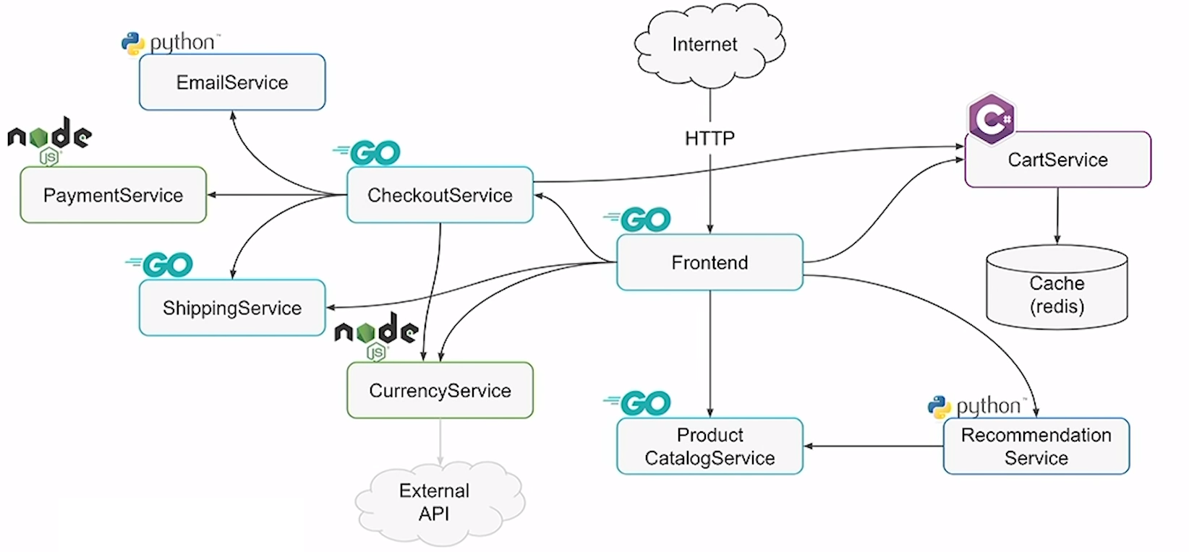
This is Getting There….

Slide 8
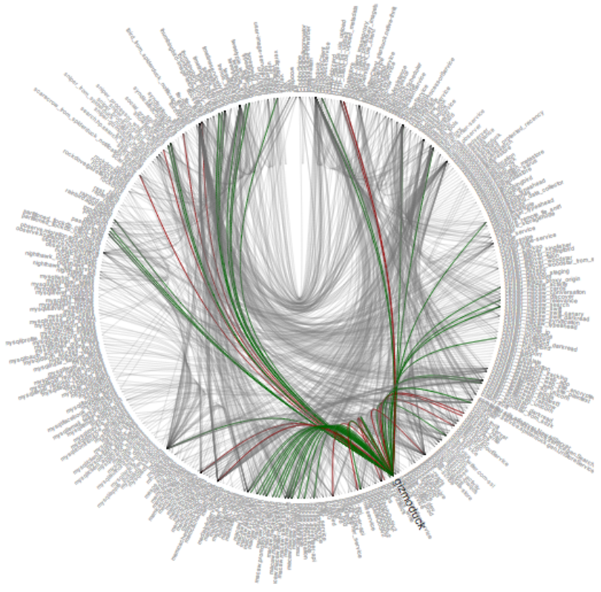
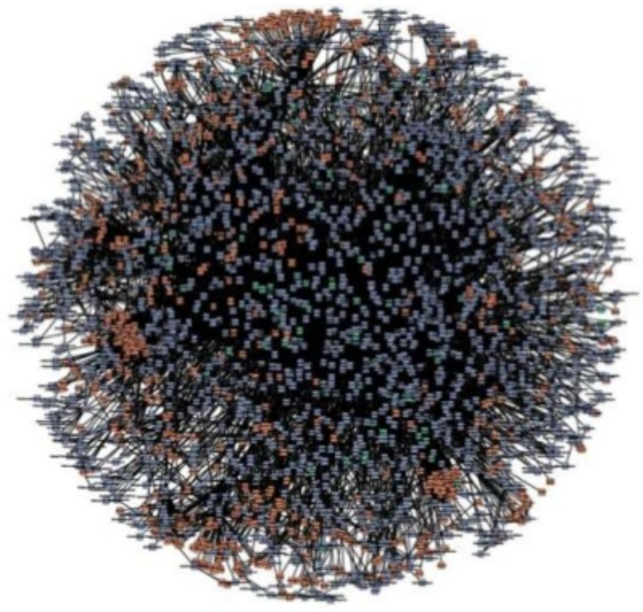
But These are True Microservice Architectures!
Twitter
Amazon Web Service

Slide 9
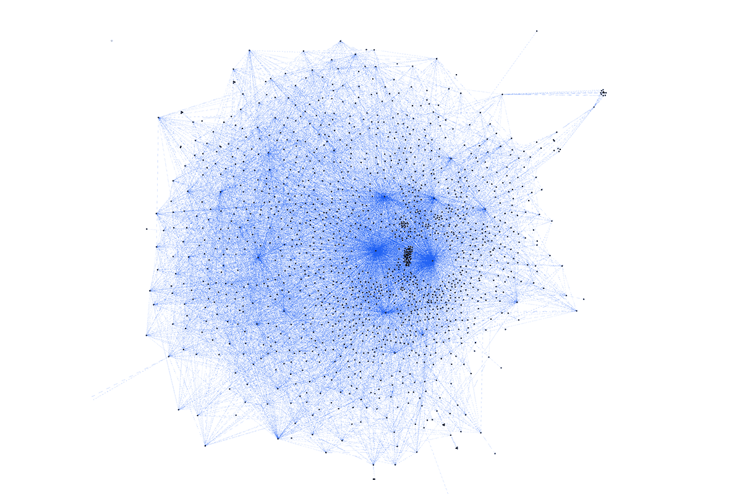
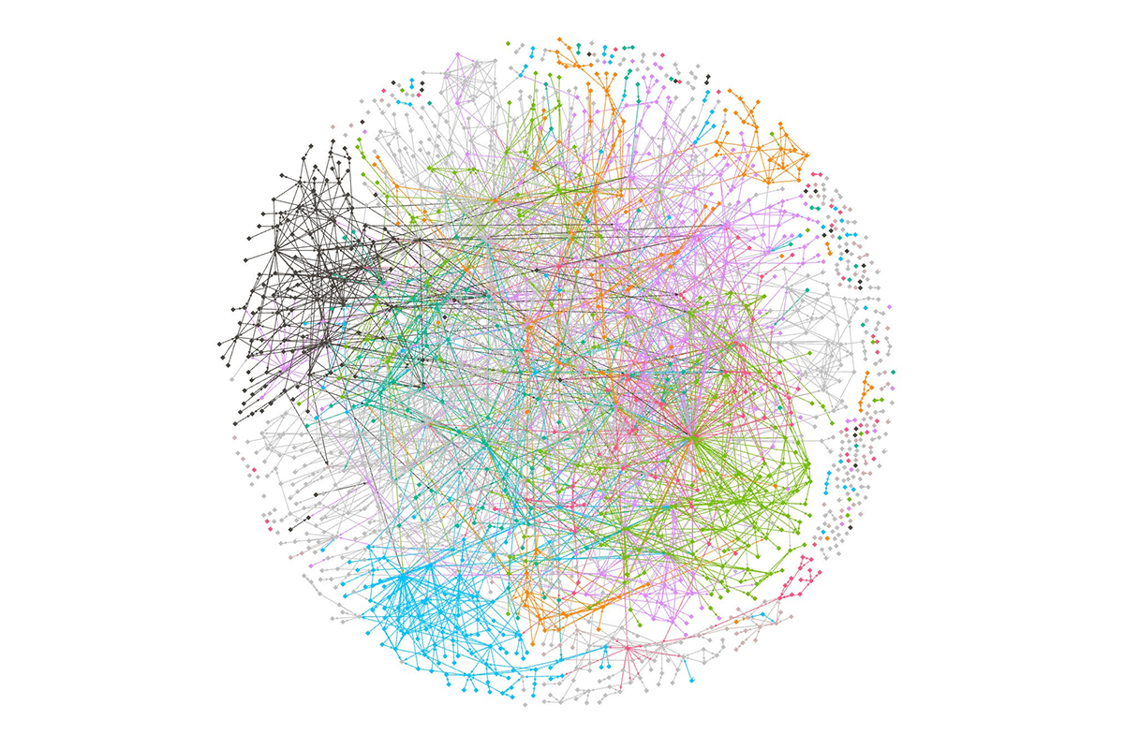
But These are True Microservice Architectures!

Slide 10
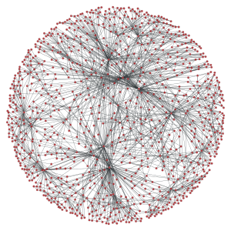
Monolith vs. Microservices?
Complex application
Easy networking
Easy applications (services)
Complex networking
The fallacies of distributed computing:
The network is reliable
Latency is zero
Bandwidth is infinite
The network is secure
Topology doesn't change
There is one administrator
Transport cost is zero
The network is homogeneous
https://en.wikipedia.org/wiki/Fallacies_of_distributed_computing
Notes:
A service mesh is a dedicated infrastructure layer for handling service-to-service communication. It’s responsible for the reliable delivery of requests through the complex topology of services that comprise a modern, cloud native application. In practice, the service mesh is typically implemented as an array of lightweight network proxies that are deployed alongside application code, without the application needing to be aware.

Slide 11
What is a Service Mesh?
Service Mesh is dedicated infrastructure layer in a microservices environment to consistently manage, monitor and control the communication between services across the entire application
Notes:
A service mesh is a dedicated infrastructure layer for handling service-to-service communication. It’s responsible for the reliable delivery of requests through the complex topology of services that comprise a modern, cloud native application. In practice, the service mesh is typically implemented as an array of lightweight network proxies that are deployed alongside application code, without the application needing to be aware.

Slide 12
Evolution: LAMP to Web Scale
PHP
SVC
Apache
PHP
MySQL
Nginx
DB
SVC
Apache
PHP
MySQL
Nginx
DB
SVC
Apache
PHP
MySQL
Nginx
DB
SVC
PHP
SVC

Slide 13
Evolution: Common Features in DevSecOps
Dynamic service discovery
Load balancing
Health checks
Timeouts
Retries
Circuit breakers
Traffic encryption (mTLS)
Fine-grained access control
Access auditing
Rate limiting
Rewrites and redirects
Consistent metrics
Access logs
Distributed tracing
Fault injection
Notes:
circuit-breaking, latency-aware load balancing, eventually consistent (“advisory”) service discovery, retries, and deadlines.

Slide 14
Evolution: Shared Libraries to Service Mesh
Examples for such fat libraries:
Hystrix @ Netflix
Stubby @ Google
Finagle @ Twitter
Disadvantages of shared libraries:
Have to be implemented in multiple languages
If the library changes the entire service has to be redeployed
Too tight involvement of dev teams
SVC
Nginx
DB
SVC
Nginx
DB
SVC
Nginx
DB
SVC
SVC
Library
Notes:
Stubby is the basis of gRPC
Finagle is the basis of Linkerd

Slide 15
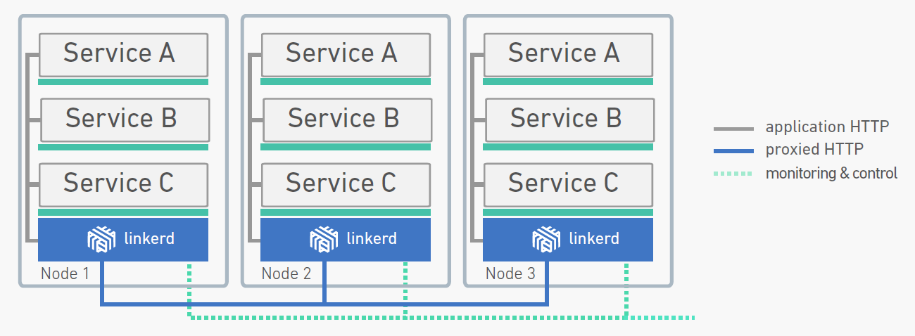
Linkerd
A service mesh that adds reliability, security, and visibility to cloud native applications
Official CNCF Project
Originally created by Buoyant Inc. based on Finagle
Written in JAVA
This is the control plane that programs the individual dataplane proxies
These are the dataplane components (proxies)
namerd
Notes:
Data Plane vs. Control Plane

Slide 16
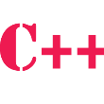
Sidecar Model in Container Environments
Disadvantages of per-node model
Raises security concerns in multi-tenant environments (shared TLS secrets, common authentication, etc.)
Can only be scaled vertically, not horizontally (give it more memory and CPU and it will handle more connection)
Not optimized for container workloads
The sidecar model
Put a proxy next to every container
This is supported by the POD abstraction in Kubernetes
Linkerd is considered to be too heavy for such environment!
Proxy
Proxy
Proxy
Proxy
Proxy
Proxy
Proxy
Proxy
Proxy
Proxy
Proxy
Proxy
Node 1
Node 2
Node 3
Notes:
Data Plane vs. Control Plane

Slide 17
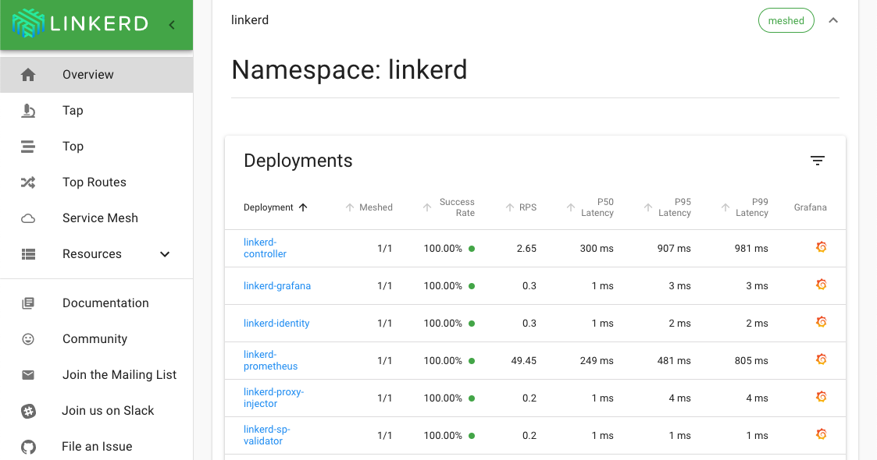
Linkerd2 (previously know as Conduit)
A novel service mesh that was specifically designed to work in Kubernetes
Created by Buoyant, the same team who created Linkerd
Data plane is written in Rust to be very fast and lightweight to sidecar operations (~5MB container size)
Control plane is written in GO to work well in Kubernetes
Can be deployed service-by-service (it’s not an all-or-nothing choice…)
Notes:
Rust is a systems programming language that runs blazingly fast, prevents segfaults, and guarantees thread safety.
Featuring
zero-cost abstractions
move semantics
guaranteed memory safety
threads without data races
trait-based generics
pattern matching
type inference
minimal runtime
efficient C bindings

Slide 18
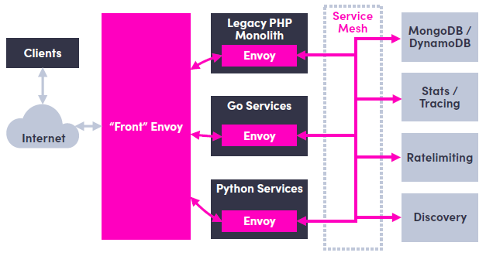
Envoy
Envoy is an open source edge and service proxy, designed for cloud-native applications
Official CNCF Project
Originally created by Lyft
Written in C++
Out of process architecture with advanced threading
Best in class observability
Rich APIs called xDS
Features include
L3/L4 filter and routing architecture
HTTP L7 filter architecture
First class HTTP/2 support
gRPC support
MongoDB and DynamoDB L7 support
Notes:
Originally built at Lyft, Envoy is a high performance C++ distributed proxy designed for single services and applications, as well as a communication bus and “universal data plane” designed for large microservice “service mesh” architectures. Built on the learnings of solutions such as NGINX, HAProxy, hardware load balancers, and cloud load balancers, Envoy runs alongside every application and abstracts the network by providing common features in a platform-agnostic manner. When all service traffic in an infrastructure flows via an Envoy mesh, it becomes easy to visualize problem areas via consistent observability, tune overall performance, and add substrate features in a single place.

Slide 19
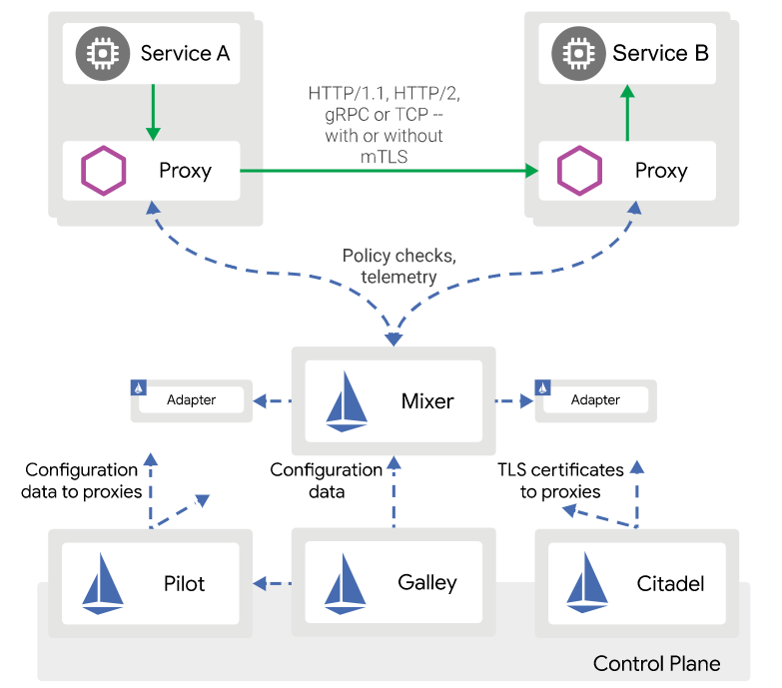
Istio
A service mesh control plane which uses Envoy as data plane
Originally created by Google and IBM
Written in GO
Provides core features for:
Traffic management
Observability
Security
Has four main components
Pilot for managing and configuring the Envoy proxies
Mixer for providing policy controls and telemetry collection
Citadel for service-to-service and end-user authentication
Galley for configuration validation, ingestion, processing and distribution
Notes:
Data Plane vs. Control Plane

Slide 20
Istio vs. Linkerd2
Somewhat easy to install
Hard to operate
Heavy control plane
Advanced data plane (Envoy)
Has a built in ingress (and egress) controller (Envoy)
Doesn’t have a dashboard (but Kiali can be one)
Monitoring:
Service graph
S2S latency
Response codes
Jaeger Tracing
Advanced HTTP routing:
Blue/Green
Canary
Dark launch
Very easy to install
Easy to operate
Light control plane
Very light data plane (in Rust)
No ingress included
Has a dashboard
Monitoring:
Service graph
S2S latency
Response codes
No tracing
Very basic HTTP routing:
No Blue/Green
Canary
No dark launch
Notes:
Data Plane vs. Control Plane

Slide 21
Other Examples
Envoy based
Non-Envoy based
synaps
Notes:
Data Plane vs. Control Plane

Slide 22
Okay, But Should I Use a Service Mesh???
It depends…
Not a good reason:
I’ve heard it’s cool since Google made this!
Want to be cloud native so I must use this new stuff
My boss told me…
But definitely use it if:
You have micro(ish)services environment, written in multiple languages, and you need consistent telemetry
You need mTLS for every service-to-service communication
You have a microservices environment where some service are failing, and you can’t figure out which one of them
You need to apply more advance deployment patterns (e.g. canary, blue/green), since you current one is too slow
Notes:
Data Plane vs. Control Plane

