Slide 1


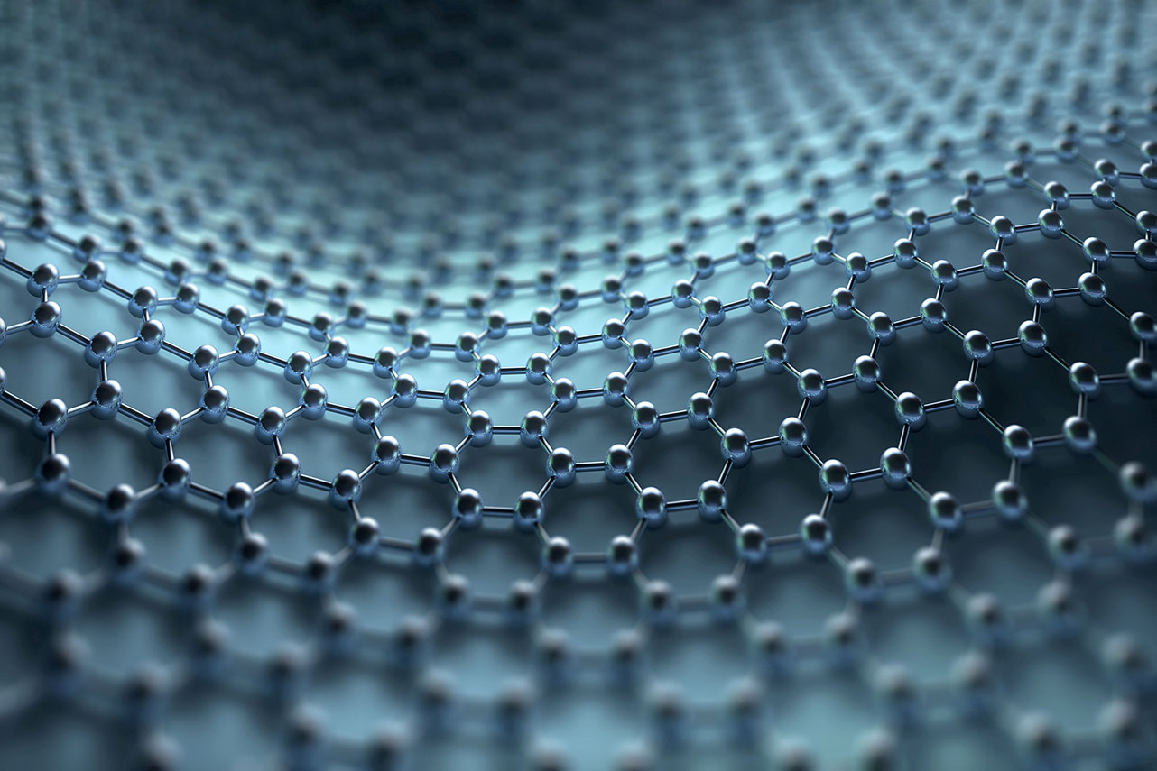
Data Science without Machine Learning
Budaházy Gábor Chief Data Scientist

Slide 2

Natural Language Processing
Text Preprocessing
Techniques
Applications

Slide 3
Quasi ML
Unsupervised Learning
Non-parametric Learning
Recommendation Systems
Market Basket Analysis

Slide 4




Web Scraping
Tools: Rapidminer, Selenium, web browsers, R/Python
Phases:
Crawling
Parsing
Storing
Sources

Slide 5
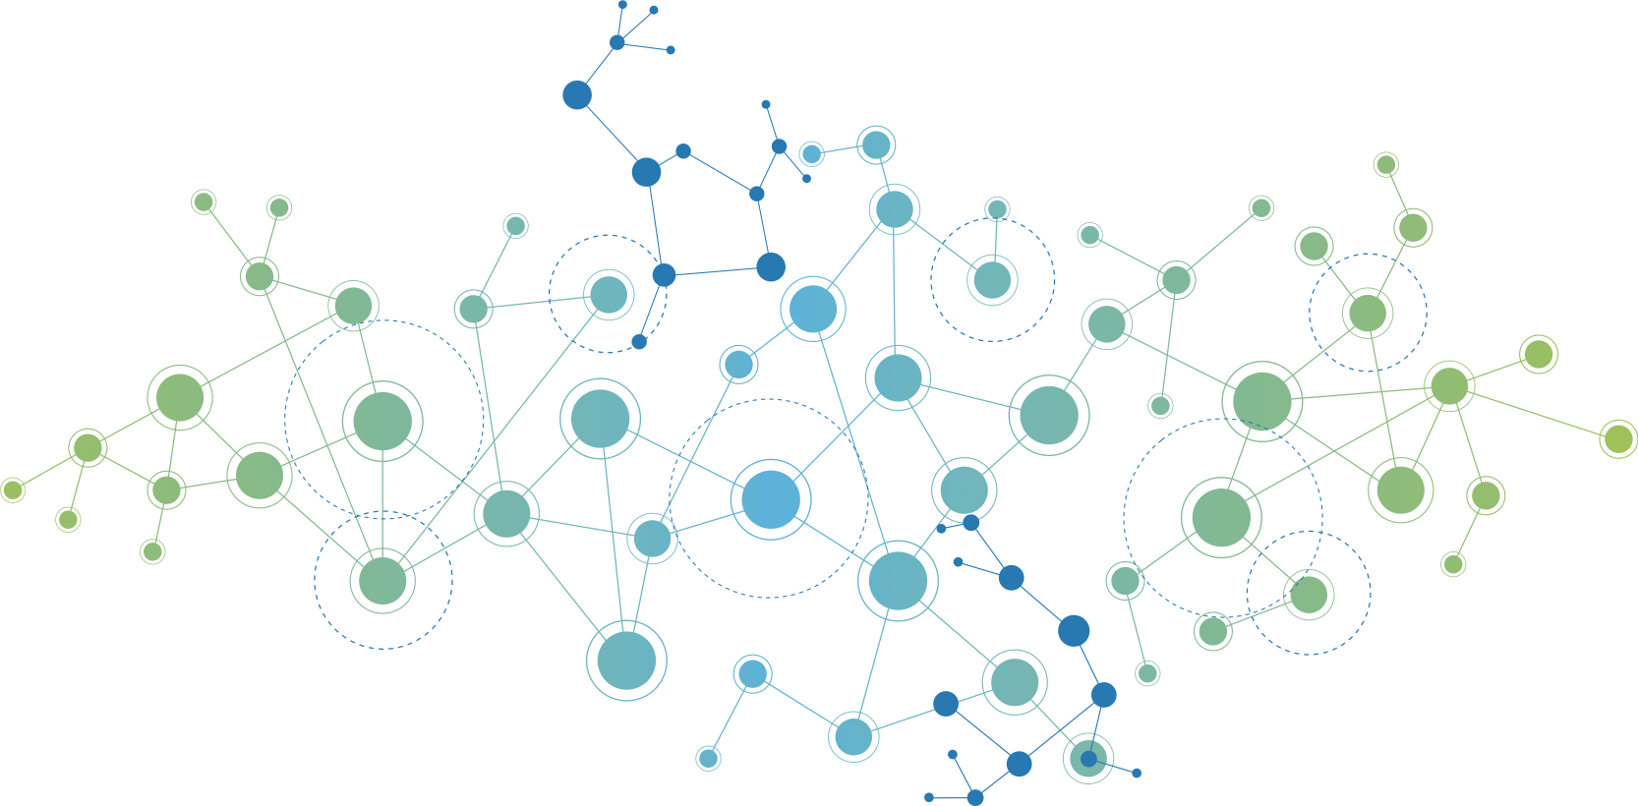
Graph Analysis

Slide 6
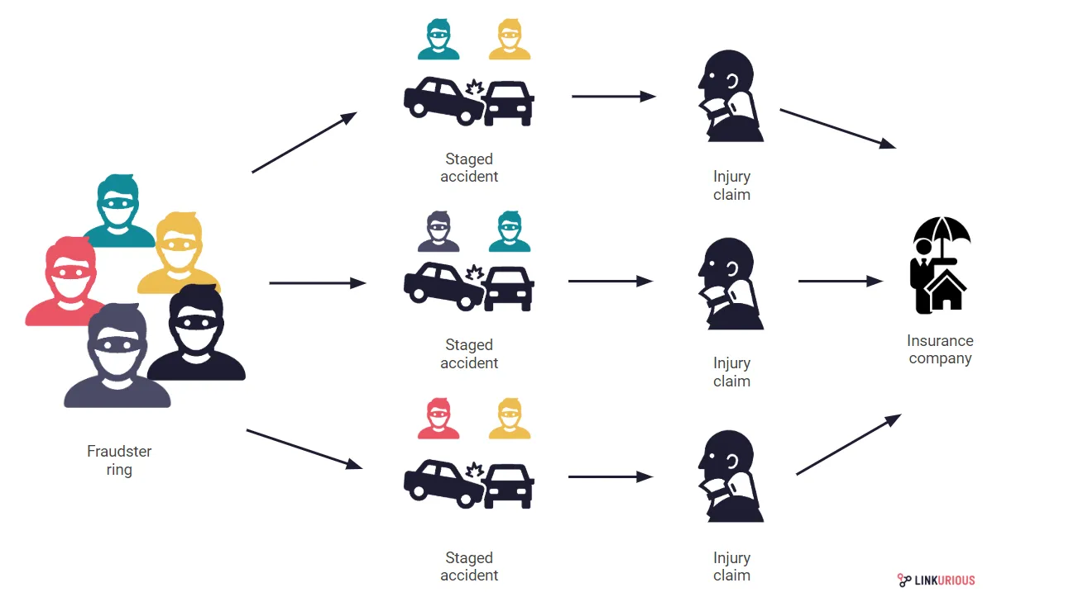

Slide 7
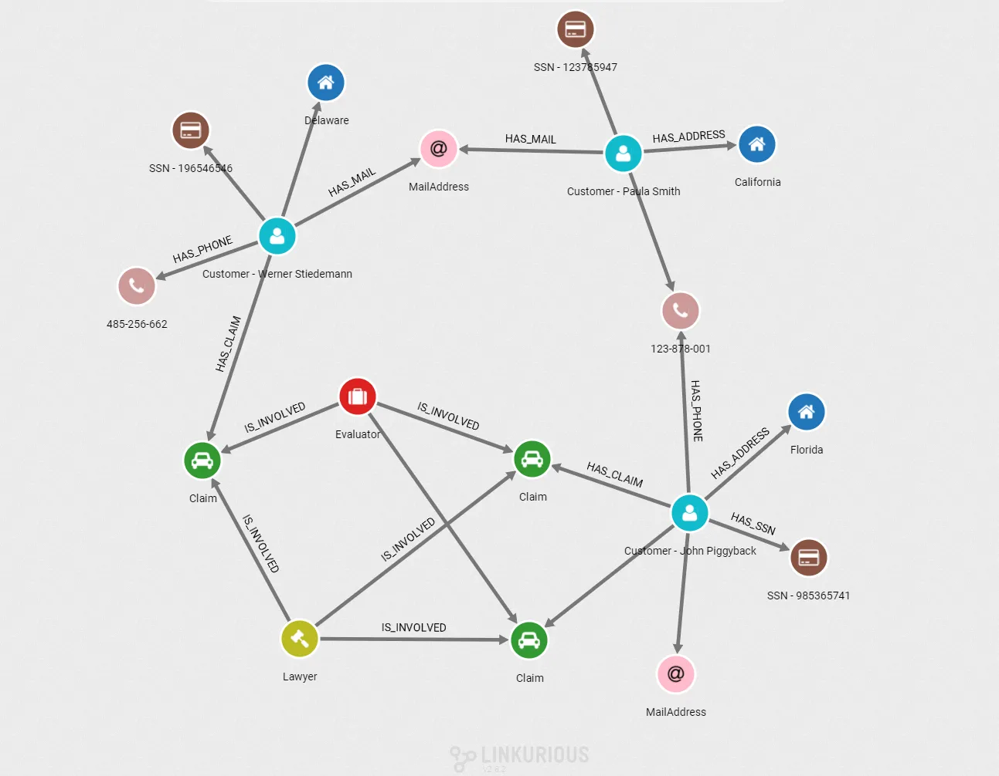

Slide 8
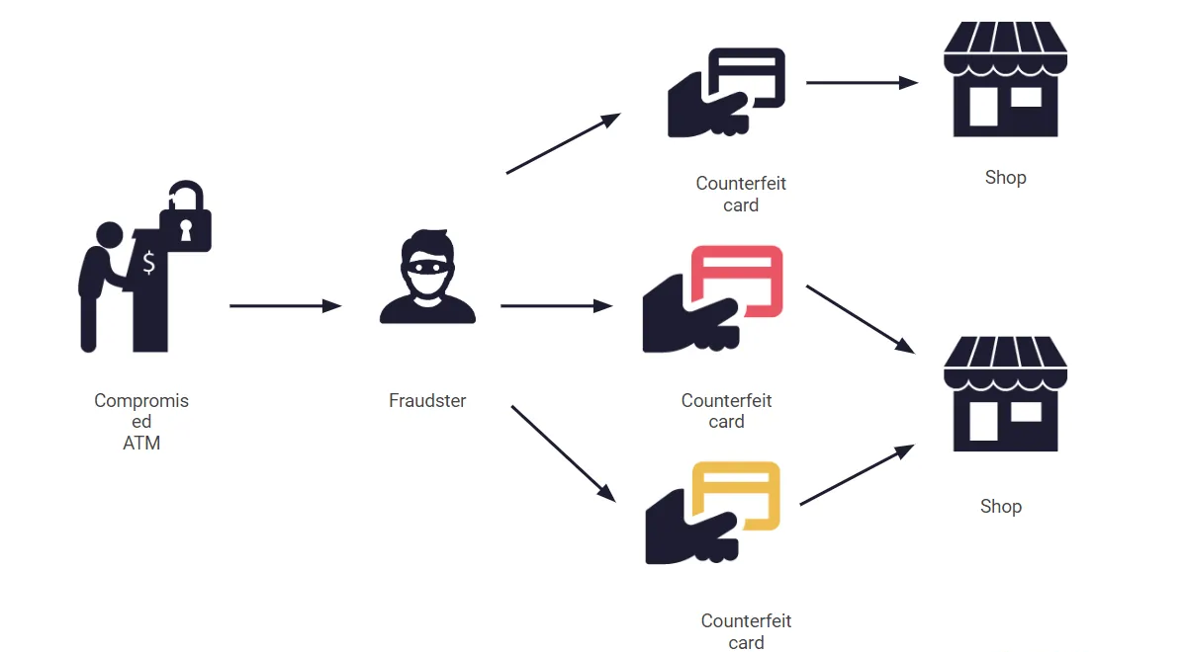

Slide 9
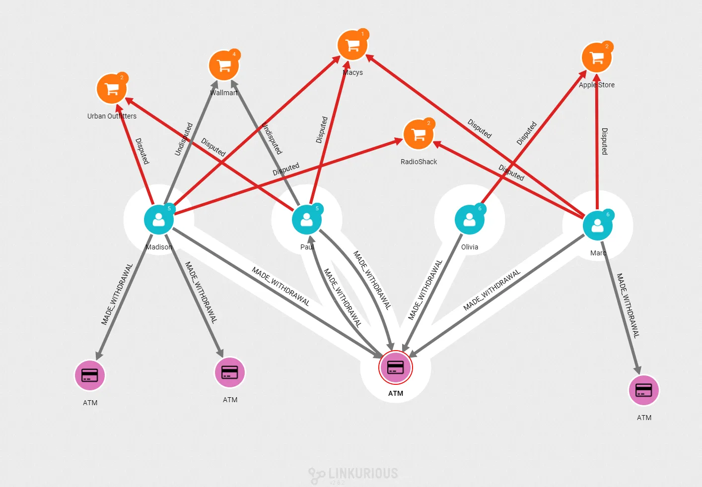

Slide 10
Thank you for your attention!
gabor.budahazy@itware.hu

