Slide 1
EGY AI PROJEKT ANATOMIAJA

Slide 2
ABOUT US
DATA ENGINEERING
DATA ANALYTICS
TRAINING | CONSULTANCY
MANUFACTURING | DIGITAL SERVICES | LHS | TECHNOLOGY

Slide 3
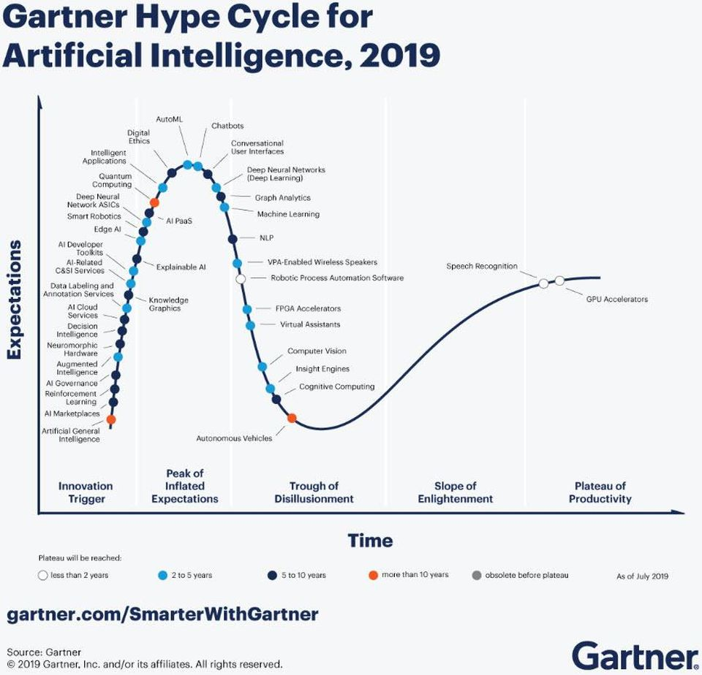
AI HYPE

Slide 4
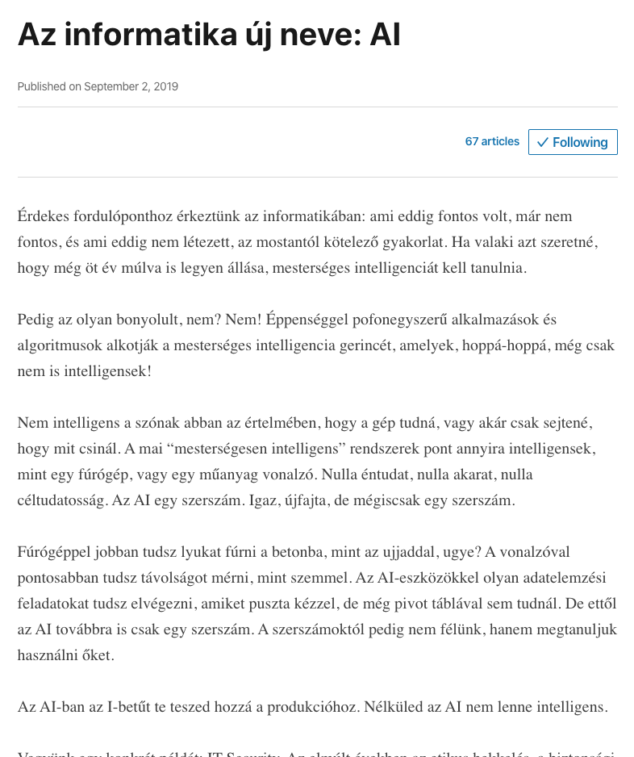
“ Ha valaki azt szeretné, hogy még öt év múlva is legyen állása, mesterséges intelligenciát kell tanulnia. “

Slide 5
AI VAGY ML?

Slide 6
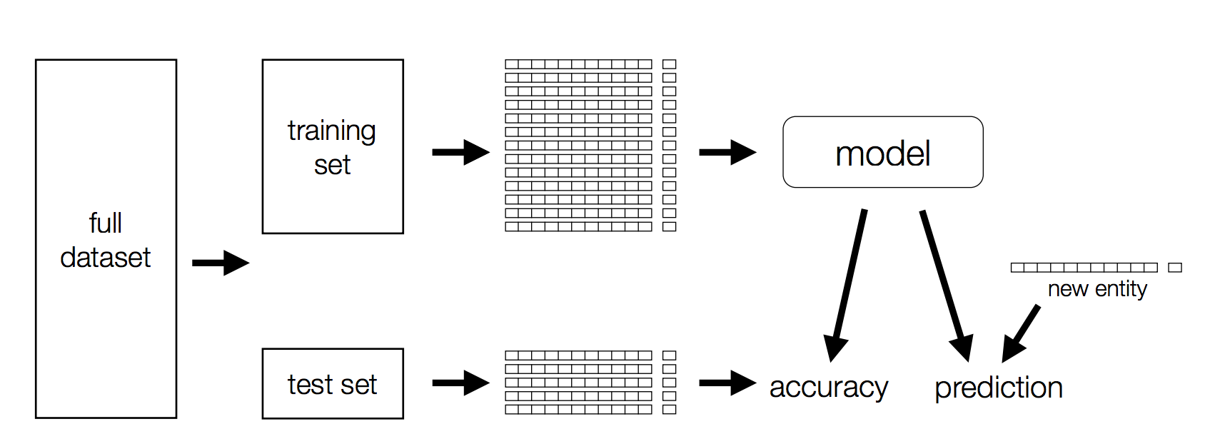

Slide 7
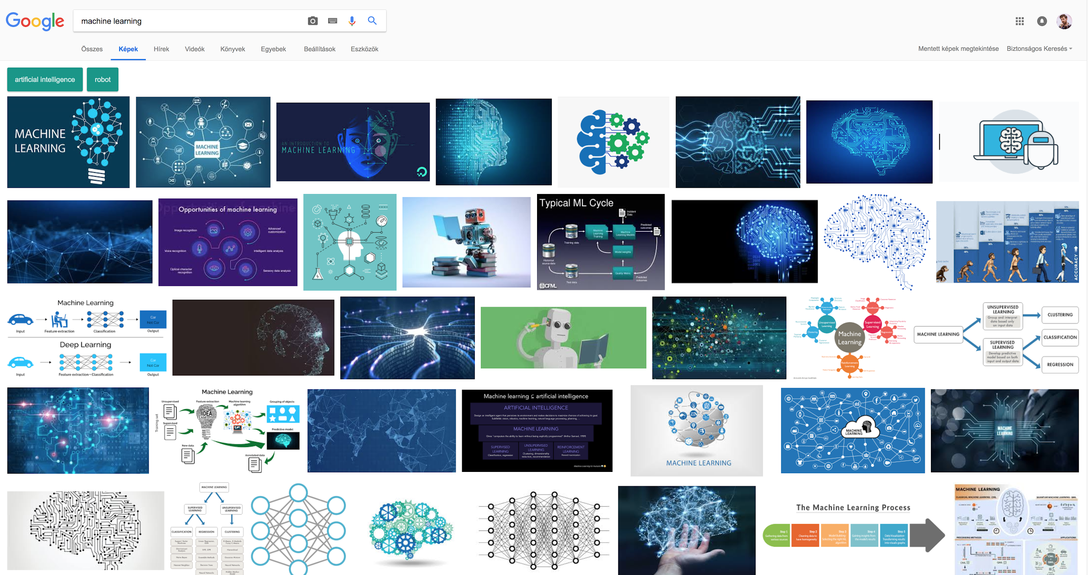
Notes:
Emberi pontossaggal, automatikusan

Slide 8
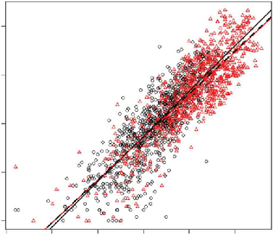
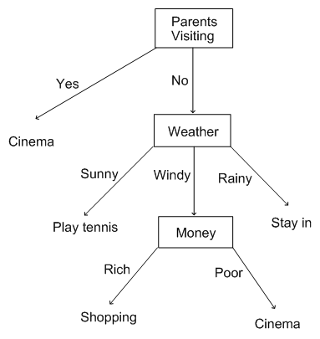
Notes:
Emberi pontossaggal, automatikusan

Slide 9
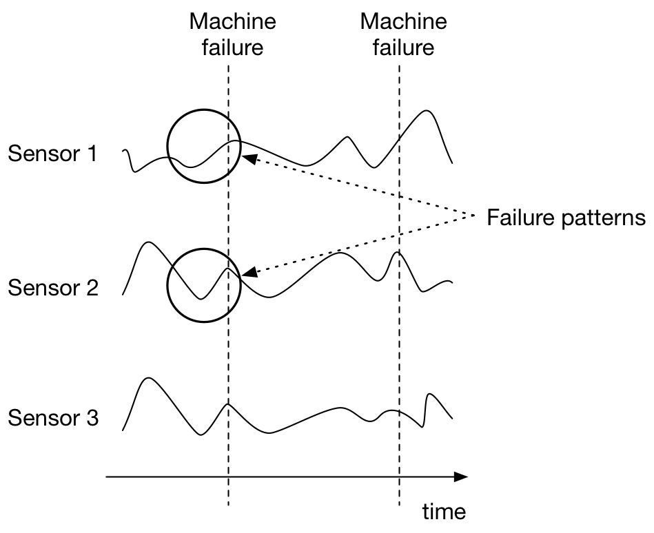
PREDICTIVE MAINTENANCE

Slide 10
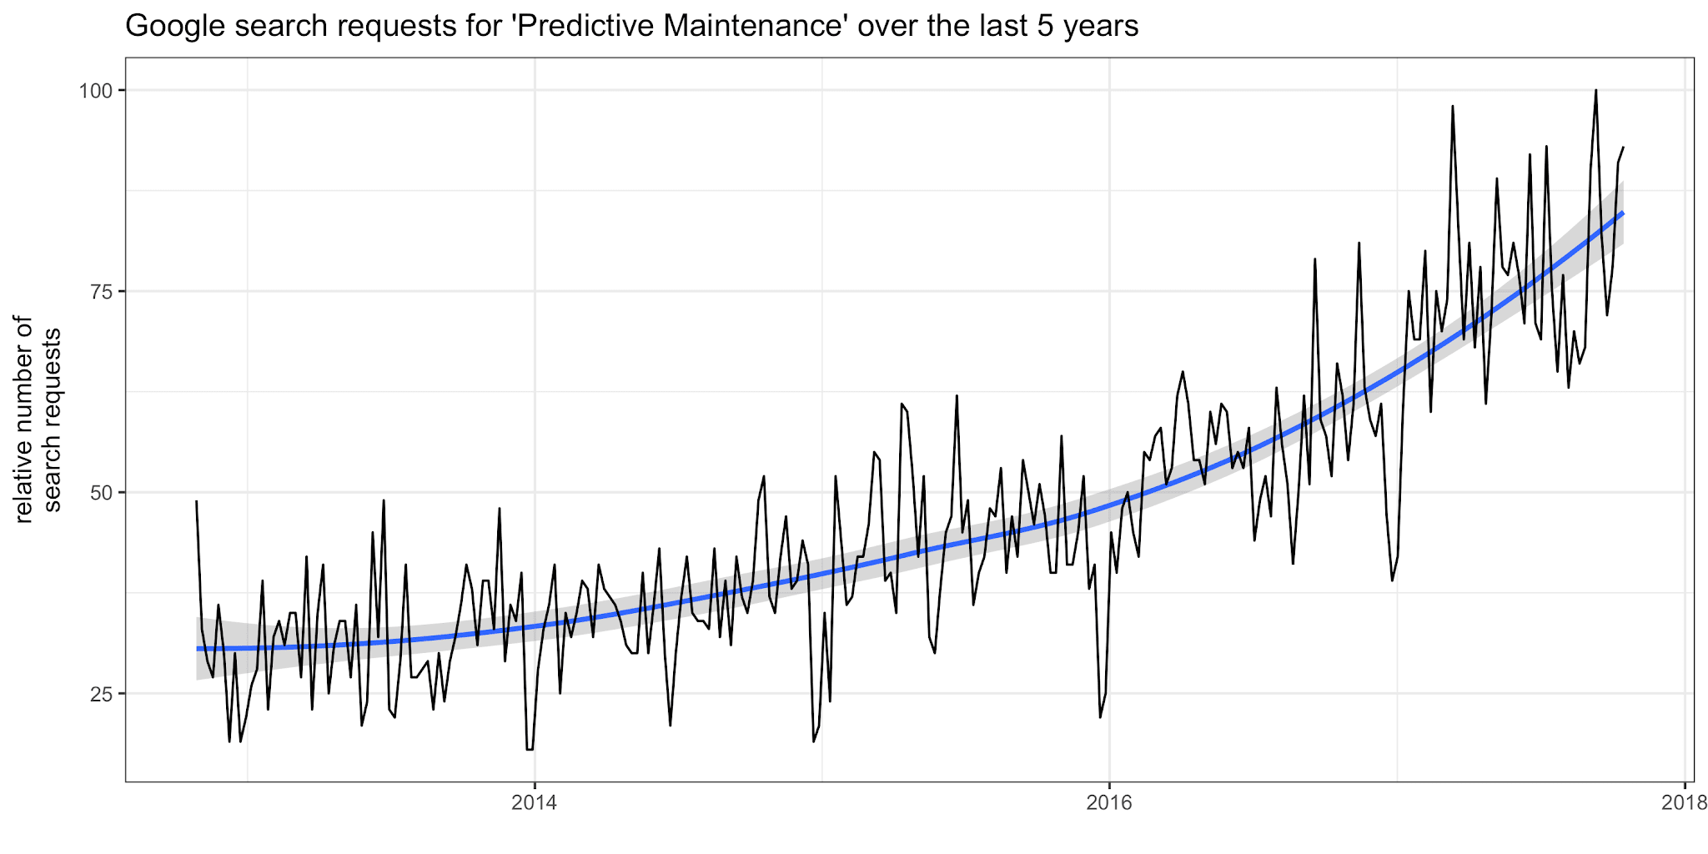

Slide 12
IPAR 4.0

Slide 13
INDUTRY 4.0
CONVERGENCE OF
IT & OT

Slide 14
INDUSTRY 4.0
INFORMATION TECHNOLOGY
OPERATION TECHNOLOGY

Slide 15
INDUSTRY 4.0

Slide 16
EGY ML PROJEKT

Slide 17
DATA INGESTION
DATA PREPARATION
MODELLING
PRODUCTIONISING

Slide 18
DATA INGESTION
DATA PREPARATION
MODELLING
PRODUCTIONISING

Slide 20
DATA INGESTION
DATA PREPARATION
MODELLING
PRODUCTIONISING

Slide 21
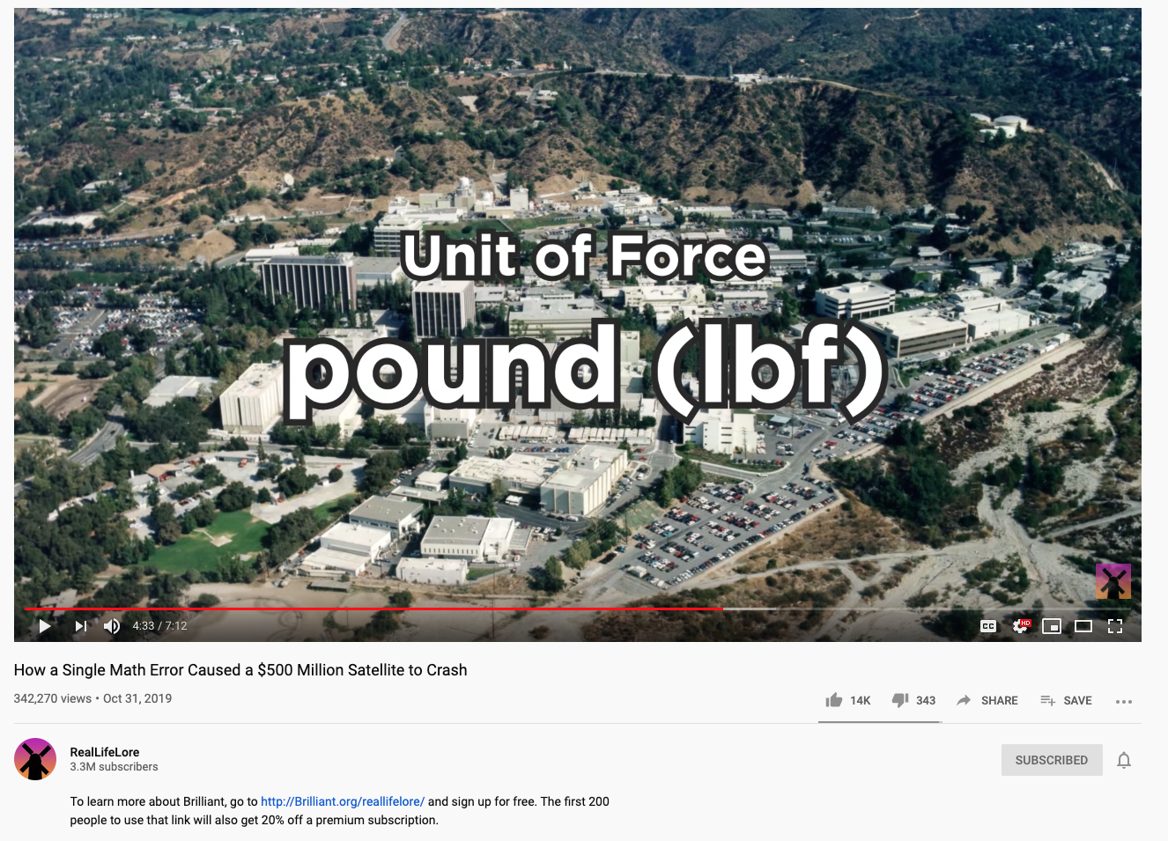

Slide 22
DATA PREPARATION
ADDRESS
BUDAPEST, ATTILA UT 12, 4EM 87
ZIP
1024
CITY
BUDAPEST

Slide 23
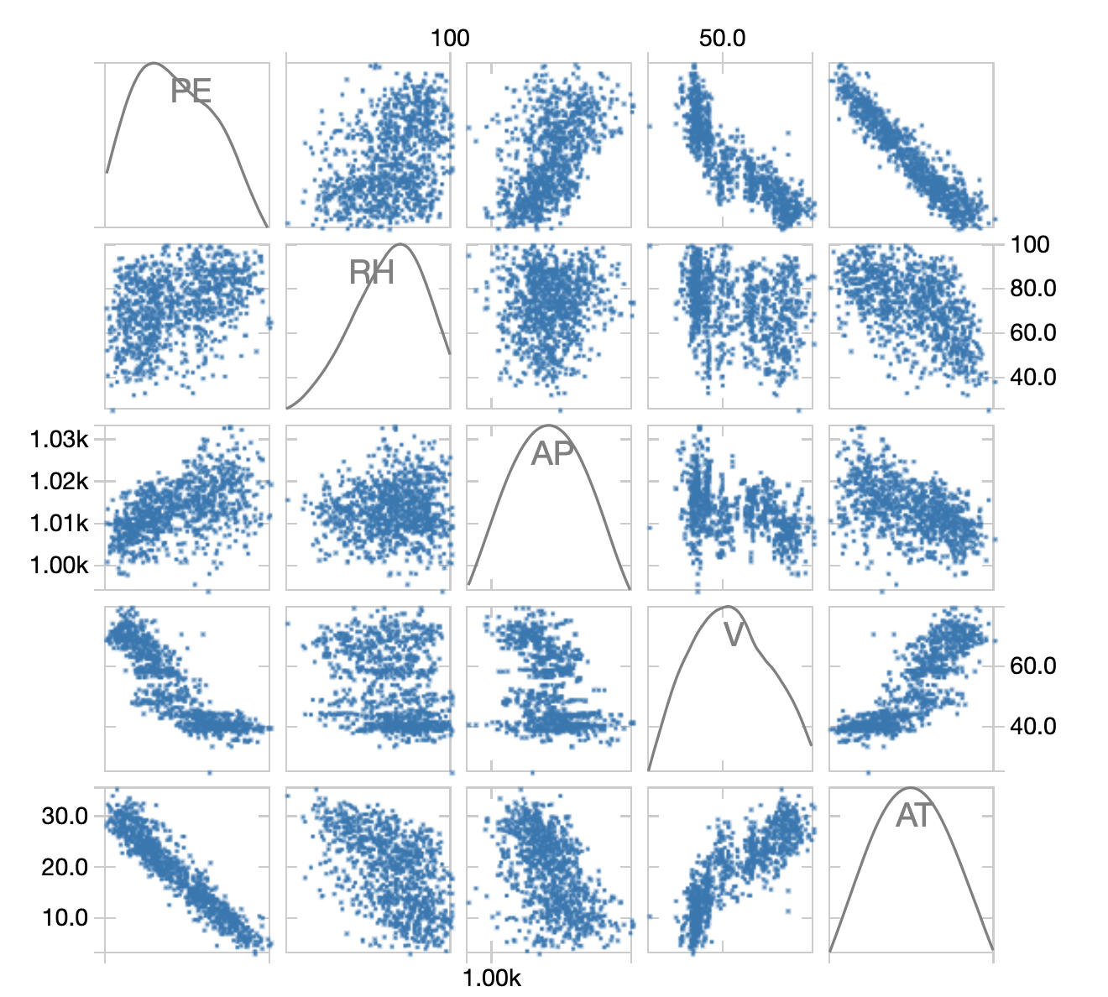
DO I HAVE THE NECESSARY INFORMATION IN THE DATA?

Slide 24
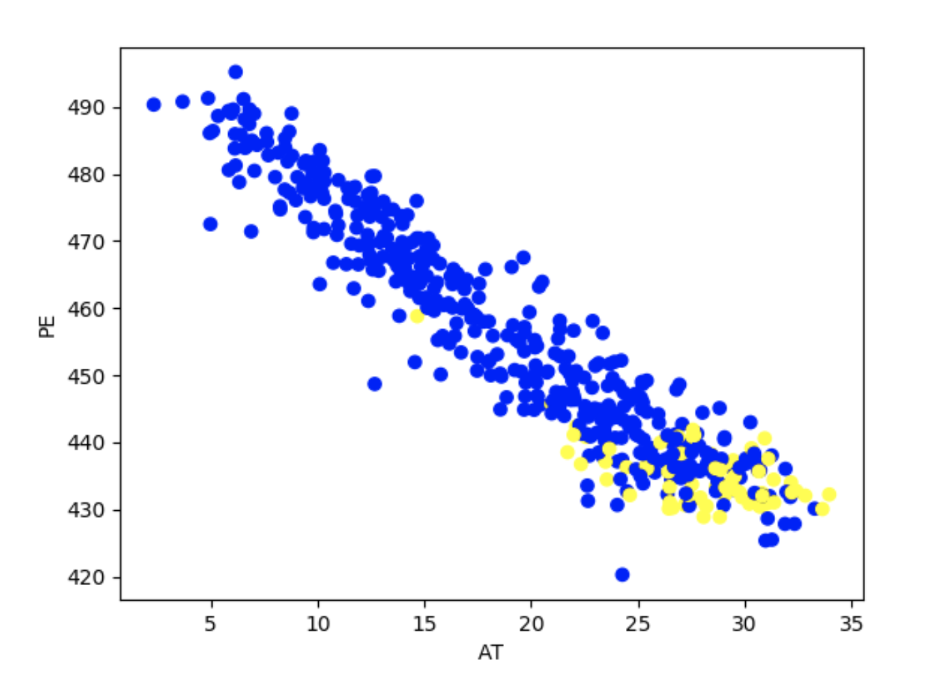
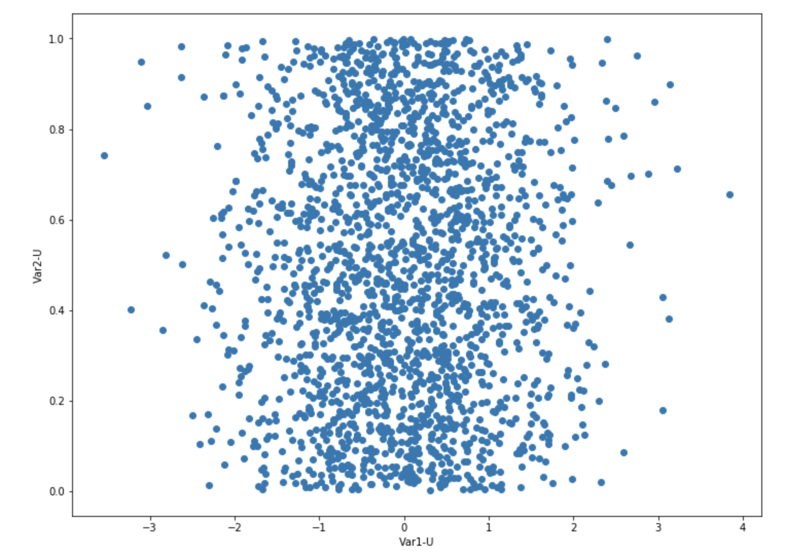

Slide 25
DATA INGESTION
DATA PREPARATION
MODELLING
PRODUCTIONISING

Slide 26
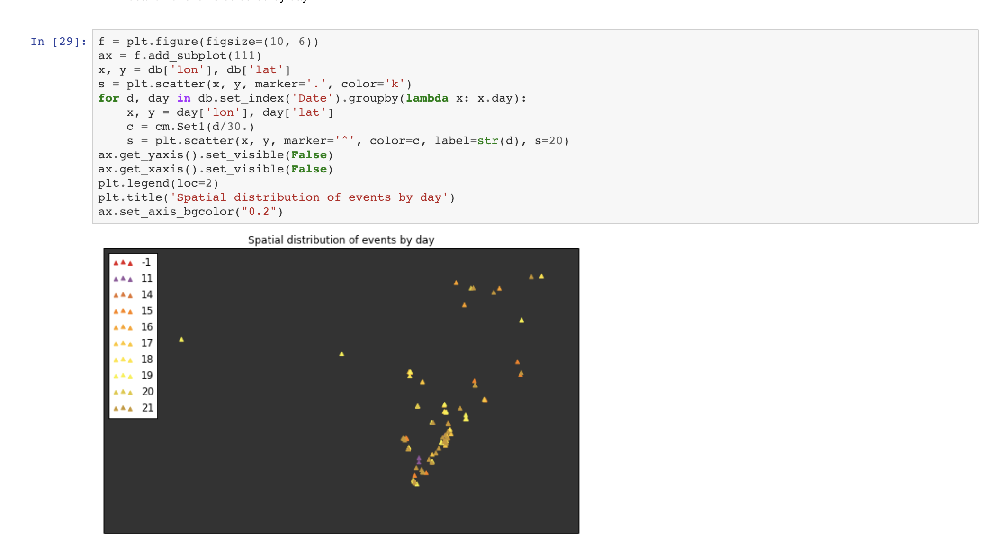

Slide 27
DATA INGESTION
DATA PREPARATION
MODELLING
PRODUCTIONISING

Slide 28
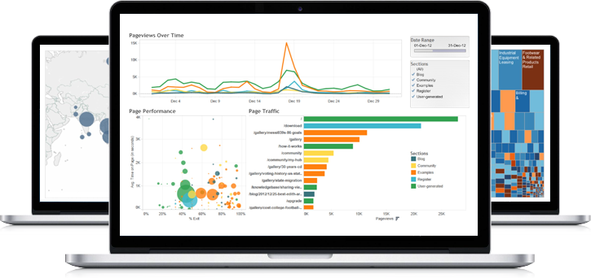
DASHBOARD

Slide 29
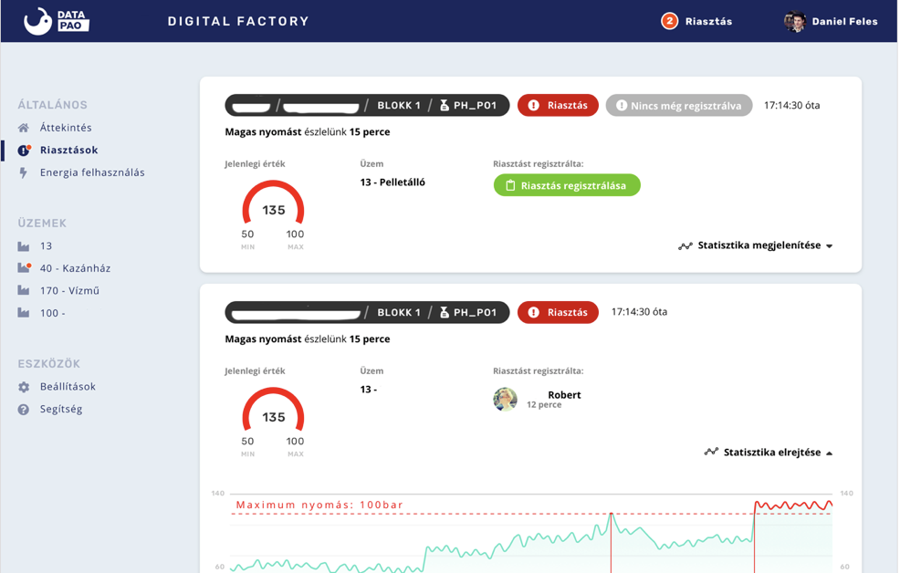

Slide 30
IN THE FUTURE
EVERY COMPANY
WILL BE A DATA COMPANY

Slide 31
DATA ENGINEER | DATA SCIENTIST
WE ARE HIRING!
PING ME!
gulyasm@datapao.com

Slide 32
THANK YOU!
@datapao
datapao.com

