Slide 1
A NYOLCADIK UTAS: A SCRUM MASTER

Slide 2
A STORY

Slide 4
+12%

Slide 5
IS THE SCRUM MASTER WORTH THE EXTRA 12%?

Slide 6
LET ME INTRODUCE MYSELF

Slide 7
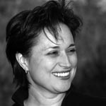
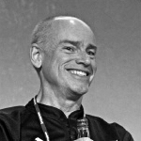
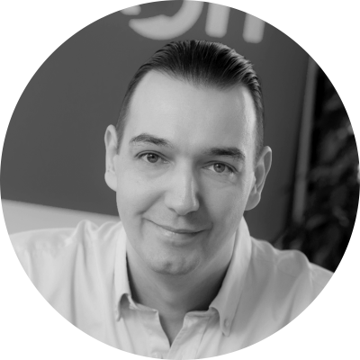

Slide 8
25
YEARS XP
1500+
TRAINED
BME
PRO BONO

Slide 9
WHERE IS THE ROI?

Slide 10
ACCEPT
DONE STATUS
DEFINE & ORDER
BACKLOG
SCRUM
PROCESS
ESTIMATE
BACKLOG ITEMS
HOW TO
TURN BLI INTO INCREMENT

Slide 11
TIME
RESOURCES
TIME
RESOURCES
PRODUCT FEATURES
PRODUCT FEATURES

Slide 13
I.N.V.E.S.T.

Slide 14
D.O.D.

Slide 16
SELF ORGANIZATION
TRANSPARENCY AND EMPIRICISM
COACHING AND MENTORING
REMOVING IMPEDIMENTS
LIVING AGILE VALUES
SERVANT LEADERSHIP

Slide 17
AGILE IS SOMETHING YOU ARE
AGILE IS NOT SOMETHING YOU DO

Slide 18
TRANSFORM

Slide 19
MINDSET TRANSFOR-MATION
BETTER
BOTTOM
LINE
BETTER
EXECUTIVE
DECISIONS
MARKETING
ADVANTAGE
AGILE
COACHING
(SCRUM
MASTER)
PROGRESS
VISIBLE
LESS
WASTE
SHORTER
DELIVERY
+
BETTER QUALITY
TRANS-PARENCY
LEARNING
INCREASED
CUSTOMER
SATISFACTION
CORRECT
APPLICATION
OF AGILE
HR QUALITY
BECOMES VISIBLE
INCREASED
MOTIVATION
BETTER
TALENT
RETENTION
BETTER EMPLOYER
BRAND
Notes:
Challenges.

Slide 20
200%
12%
100%
30%
50%

Slide 21
COMMON MISTAKES

Slide 22
NOT JUNIOR ASSISTANT

Slide 23
NOR A BOSS OR MANAGER

Slide 24
ORGANIZE MEETINGS
ASSIGN TASKS
PROVIDE PERKS
LISTEN TO REPORTS
EVALUATES EMPLOYEES
BULLIES DEVELOPERS

Slide 29
HOW TO RECRUIT?

Slide 30
NO BULLSHIT ADS PLEASE

Slide 31
INTERVIEW FOR THE
MINDSET

Slide 32
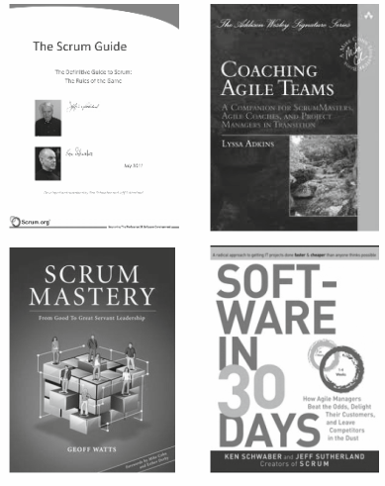
BOOKS

Slide 33
PROVIDE TRAINING
MINDSET

Slide 35
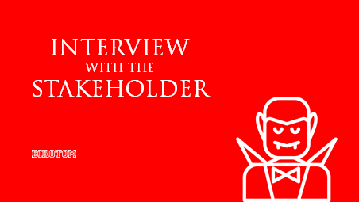

Slide 36
WWW.BIROTOM.COM

