Slide 1


About me
PhD in Telecommunications @ BME
Worked with 5G technology
SDN & NFV → Cloud Native Network Functions
Graduated in the EIT Digital Doctoral School
Co-founder & CTO @ LeanNet Ltd.
Consulting, training, implementing
Cloud Native, Microservices, DevOps
Cloud Native Competence Center Leaders of adesso Hungary
Team building, strategy creation, sales
Freelancer, Consultant
linkedin.com/in/szabvid

Slide 2

The Workhorse of Event-Driven Systems

Slide 3
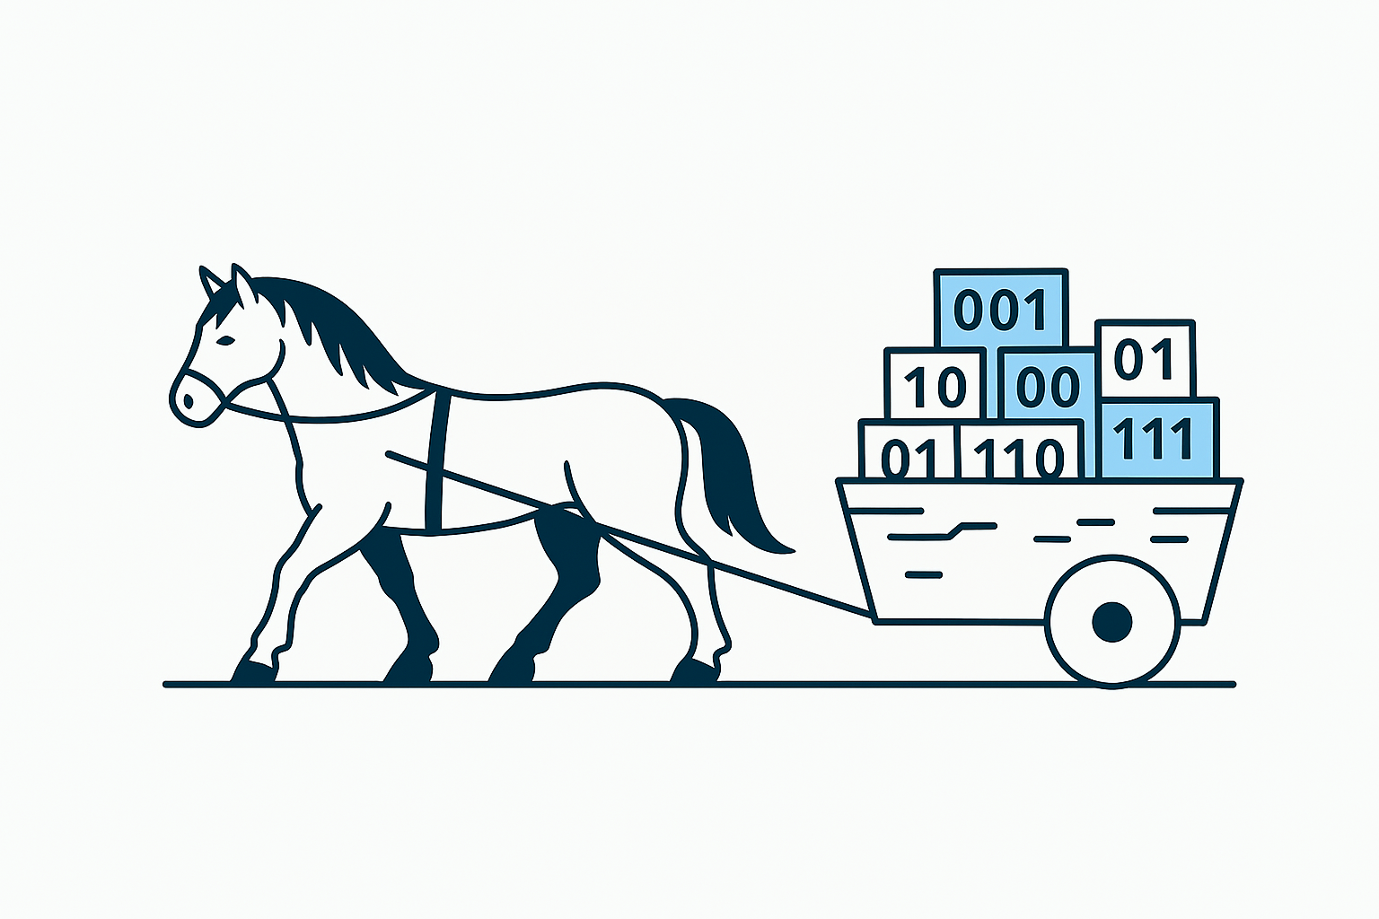
What is Apache Kafka?
An open-source distributed event streaming platform for
  data integration,
  mission-critical applications,
  streaming analytics and
  high-performance data pipelines

Slide 4
What is Event Streaming?
It is the practice of capturing data in
  i) real-time from event sources (e.g. databases, sensors, applications) in the form of streams of events;
  ii) storing these event streams durably for later retrieval;
  iii) manipulating, processing, and reacting to the event streams in real-time as well as retrospectively;
  iv) and routing the event streams to different destination technologies as needed.
Notes:
accounting, billing, CRM, websites

Slide 5
What is Event Streaming?
Source System
Source System
Source System
. . .
data
data
data
Target System
Target System
Target System
. . .
Notes:
accounting, billing, CRM, websites

Slide 6
What is Event Streaming?
A typical challenge is data integration:
  Protocol –
    how the data is transported?
    TCP, HTTP, REST, FTP, JDBC…
  Data format –
    how the data is parsed?
    Binary, CSV, JSON, Avro…
  Data schema & evolution –
    how the data is shaped and may change?
Website Events
Pricing Data
Sensor Data
. . .
data
data
data
Database
Analytics
Audit
. . .
Notes:
accounting, billing, CRM, websites

Slide 7
What is Event Streaming?
A typical challenge is data integration:
  Protocol –
    how the data is transported?
    TCP, HTTP, REST, FTP, JDBC…
  Data format –
    how the data is parsed?
    Binary, CSV, JSON, Avro…
  Data schema & evolution –
    how the data is shaped and may change?
Website Events
Pricing Data
Sensor Data
. . .
Database
Analytics
Audit
. . .
Notes:
accounting, billing, CRM, websites

Slide 8
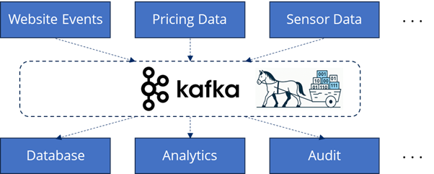
Kafka to the Rescue
Kafka was created at LinkedIn at 2011
Written in Java
Under 2 years became an Apache Foundation project
Nowadays mainly maintained by Confluent, IBM, Yelp, Netflix, ...
Typical use-cases:
  Messaging systems
  Activity Tracking
  Gather metrics from many different locations, for example, IoT devices
  Application logs analysis
  De-coupling of system dependencies
  Integration with Big Data technologies like Spark,
  Flink, Storm, Hadoop.
  Event-sourcing store
Notes:
accounting, billing, CRM, websites

Slide 9
What is an Event-Driven System?
Architectural concept where system components communicate by producing and responding to events.
Key characteristics:
  Loose Coupling: Producers don’t need to know about consumers.
  Asynchronous Communication: Events are sent and received independently.
  Scalability: Services can scale independently with increased event load.
  Real-Time Responsiveness: Enables systems to react instantly to change.
Event Producer
{ event }
Event Broker
{ event }
Event Consumer

Slide 10
What is an Event-Driven System?
Architectural concept where system components communicate by producing and responding to events.
Common use-cases:
  Microservices communication
  User activity tracking
  Financial transactions
  IoT sensor updates
Event Streaming feeds EDS by
delivering events reliably
Event Producer
Website Events
Pricing Data
Sensor Data
. . .
{ event }
{ event }
Event Broker
{ event }
{ event }
Event Consumer
Database
Analytics
Audit
. . .

Slide 11
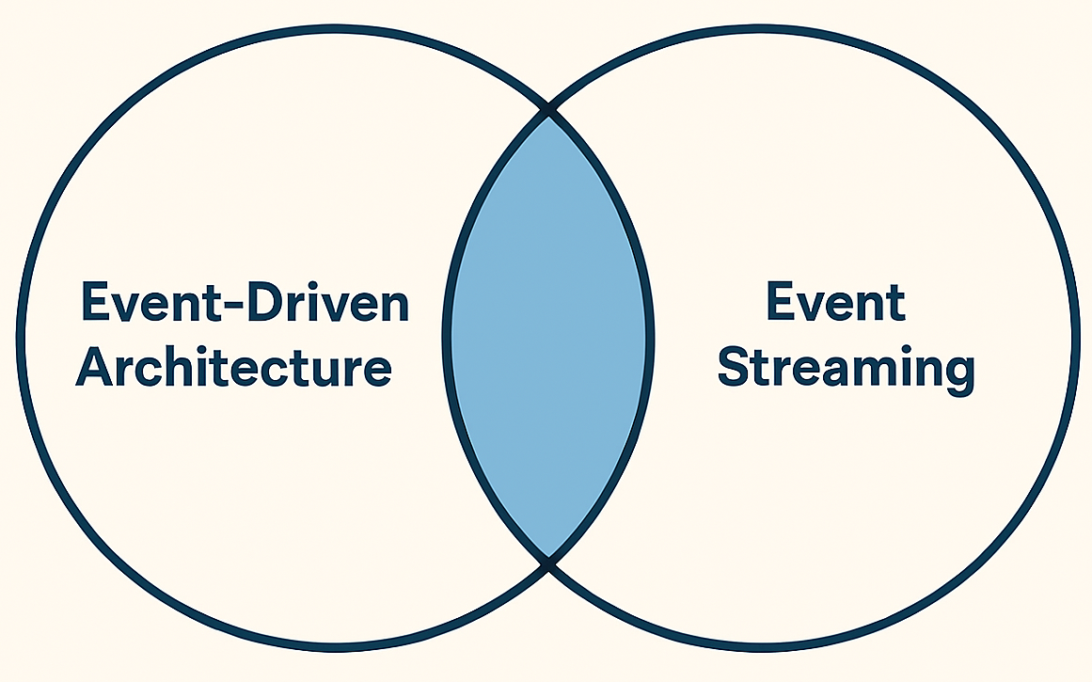
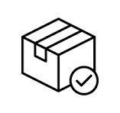


Side Note
Difference in Focus:
  Event-Driven Systems focuses on reacting to events
  —it's about event-triggered behavior and loosely coupled service interactions.
  Event Streaming focuses on capturing and processing a continuous flow of events
  —it's about real-time data movement and processing over time.
EDA but not Event Streaming
Event Steaming but not EDA
A package delivery
service emits “Parcel
Shipped” events via
a message queue,
triggering customer
notifications — no
streaming or historical
playback is needed.
A telemetry pipeline
continuously streams
sensor data from wind
turbines into a data
lake via Kafka for
analytics—no services
react to events
in real time.
Smart traffic
management
system

Slide 12
Kafka Core Concepts – Overview
Topics oragnize related events:
  E.g. logs of a specific application
  Rougly analogous to SQL tables
Producers are applications that send data into topics:
  They are deployed outside Kafka and only interact with it
  At code level they integrate with Kafka client libraries (Java, Python, Go, etc.)
Consumers are applications that pull data from topics:
  They are deployed outside Kafka and only interact with it
  At code level they integrate with Kafka client libraries (Java, Python, Go, etc.)
Client-server architecture:
  Topics are stored on servers, called Kafka brokers
  Producers and consumers are the clients
Can scale to 100s of brokers
Can scale to millions of messages per second
Latency of less than 10 ms ~ real time
Producer
...
broker
broker
.
.
.
.
.
.
topic
topic
topic
topic
Consumer

Slide 13
Comparing Kafka to Other Message Brokers?
Feature / Broker | Apache Kafka | RabbitMQ | Redis Streams | Cloud-Native Brokers (AWS, Azure, GCP)
Message Retention | ✅ Long-term, configurable (disk-based) | ⚠️ Short-term (until consumed) | ⚠️ Short-term (memory-based, optional persistence) | ⚠️ Limited (varies by service; often time-bound)
Throughput | 🔥 Extremely high (millions/sec) | ⚠️ Moderate | ✅ High (in-memory, low latency) | ⚠️ Moderate to high (depends on service tier)
Replay Support | ✅ Native replay from log | ❌ Not supported | ⚠️ Limited (manual tracking needed) | ❌ Typically not supported (some exceptions)
Ordering Guarantees | ✅ Per partition (strong ordering) | ✅ Per queue (FIFO optional) | ✅ Per stream (by ID) | ⚠️ Varies: some offer FIFO queues, others don’t
Use Case Fit | ❌ Not lightweight (requires cluster) | ✅ Lightweight, easy to deploy | ✅ Lightweight, in-memory | ✅ Lightweight, fully managed (cloud-native)
Kafka isn’t just a message broker—it’s a distributed event streaming platform

Slide 14
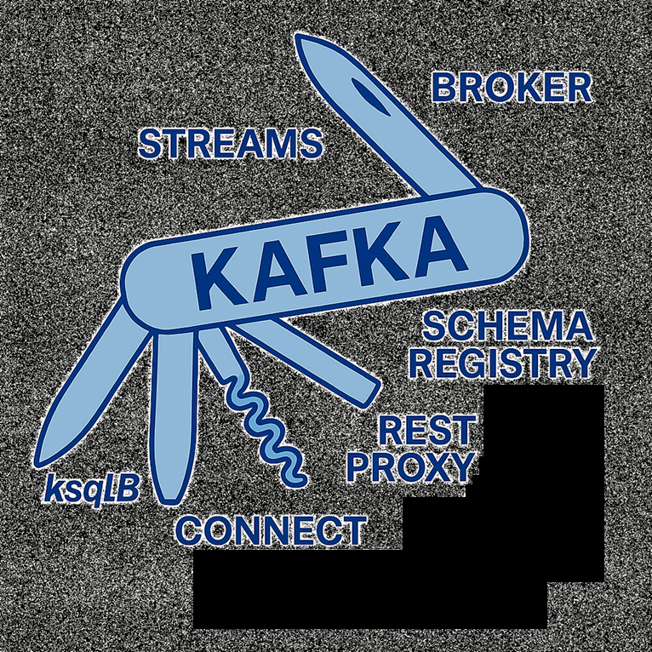
Kafka Core & Ecosystem

Slide 15




Kafka Extended Ecosystem
Kafka Consumers and Producers have existed for a long time and are considered low-level
Kafka & ecosystem has introduced over time some new APIs that are higher level for specific problem sets:
  Kafka Connect: integration toolkit for streaming data between Kafka brokers and other systems using connector plugins
  Kafka Streams: solves transformations in Kafka (used as a Java lib) with exactly once capabilities
  Schema Registry: helps using Schema in Kafka
Kafka Schema Registry
Kafka Streams
Kafka Producer
Kafka Consumer
Source DB
Target DB
Kafka Connect Source
Kafka Connect Sink

Slide 16
Kafka Extended Ecosystem and Integration
Kafka Consumers and Producers have existed for a long time and are considered low-level
Kafka & ecosystem has introduced over time some new APIs that are higher level for specific problem sets:
  Kafka Connect: integration toolkit for streaming data between Kafka brokers and other systems using connector plugins
  Kafka Streams: solves transformations in Kafka (used as a Java lib) with exactly once capabilities
  Schema Registry: helps using Schema in Kafka
  REST Proxy / Kafka Bridge: a HTTP REST API server for clients that cannot speak the native Kafka API
  Mirror Maker: replicates data between two Kafka clusters
  ksqlDB: an SQL-like query engine for Kafka
ksqlDB
Source
Cluster
REST Proxy / Kafka Bridge
Mirror Maker

Slide 17

So We Should Use Kafka for Everything, Everywhere?
Definitely not—actually, it depends:
  Do you need event replay or long-term retention?
  Kafka may be overkill for transient messaging.
  Is your workload high-throughput or real-time?
  For low-volume or infrequent tasks, simpler tools may suffice.
  Are your consumers diverse or asynchronous?
  For snynchronous, rarely changing, simple services Kafka is not ideal.
  Do you have the operational muscle?
  Kafka requires thoughtful setup, monitoring, and tuning—especially if self-managed.
  Is your use case more transactional (ACID) or request/response (synchronous)?
  Kafka is not a replacement for RPC or traditional databases—it complements them.
  Would a managed cloud-native broker be simpler?
  For lightweight, serverless, or tightly integrated cloud apps, services like Pub/Sub, EventBridge, or Service Bus might be a better fit.
  Is stream processing part of your architecture?
  If yes, Kafka’s ecosystem (Streams, ksqlDB) can be a huge advantage. If not, you might not need its full power.

Slide 18
Kafka, Containers, and Kubernetes – A Timeline of Convergence
Containerization:
  Early 2000s: Linux-based isolation (e.g. chroot, cgroups) laid the groundwork
  2013: Docker popularized containers — portable, lightweight, and developer-friendly
Apache Kafka: Born Before Containers
  Created in 2011 at LinkedIn — designed for bare-metal and VM-based infrastructure
  Distributed, scalable, and event-driven by nature
  Though not container-native, Kafka’s architecture fits well into containerized models
Kubernetes:
  Introduced by Google in 2014 to manage containers at scale
  Became the de facto standard for cloud-native infrastructure
Convergence: Kafka + Kubernetes
  Kafka can be containerized → Kubernetes can orchestrate it
  Operators like Strimzi and Confluent Operator simplify Kafka cluster management
  Together, they form a modern, cloud-native data streaming platform

