Slide 1
Frész Ferenc Cyber Services Zrt
Rosszindulatú csomagok és konténerek
1/21

Slide 2
(Partial) History of Software Supply Chain Attacks
1982, Russia – Trans-Siberian Pipeline
2013, South Korea – South Korean government and news websites
2017, Canada – Altair Technologies (a cybersecutity software and services company)
2017, United Kingdom – Ccleaner
2017, Ukraine – ME Doc
2018, „Global” – VestaCP (a control panel interface that system admins use to manage servers)
2018, „Global” – Cryptocurrency users
A compromise of the software update infrastructure of Kiev-based ME Doc, a maker of financial software for businesses, resulted in the NotPetya wiper malwarebeing delivered to more than 12,000 systems in Ukraine and 80 victim organizations in 64 countries.
2018, United States - Copay (now known as BitPay)
2019, United States - Agma cryptocurrency
2019, Taiwan - ASUSTeK (Shadow Hammer)
2/21
Notes:
Source: https://blog.reversinglabs.com/blog/a-partial-history-of-software-supply-chain-attacks

Slide 3
(Partial) History of Software Supply Chain Attacks
2020, United States - U.S. Government program for low-income Americans
2020, „Global” - NetBeans Projects
2020, Mongolia - Able Desktop
2020, „Global” – Aisino (China based tax software)
2020, South Korea - WIZVERA VeraPort
2020, United States – SolarWinds
Attackers believed to be working for the government of Russia compromised the software build system for SolarWinds Orion Network Management System software and distributed malicious code in the form of a SolarWinds Orion software update to around 18,000 customers.
2020, Vietnam - Vietnam VCGA (SignSight)
2020, United States – Twilio
3/21
Notes:
Source: https://blog.reversinglabs.com/blog/a-partial-history-of-software-supply-chain-attacks

Slide 4
(Partial) History of Software Supply Chain Attacks
2021, United Kingdom – Mimecast
2021, „Global” - Stock investment platform
2021, Hong Kong – BigNox
2021, „Global” – Various
“A researcher (Alex Birsan) managed to breach over 35 major companies' internal systems, including Microsoft, Apple, PayPal, Shopify, Netflix, Yelp, Tesla, and Uber, in a novel dependency confusion supply chain attack.”
2021, Mongolia – MonPass
2021, Unired States – Xcode
2021, Australia - Click Studios (Passwordstate)
4/21
Notes:
Source: https://blog.reversinglabs.com/blog/a-partial-history-of-software-supply-chain-attacks

Slide 5
(Partial) History of Software Supply Chain Attacks
2021, United States – CodeCov
2021, „Global” - Ledger (Nano X Wallet)
2021, Myanmar - Myanmar Presidential Website
2021, United States – SYNNEX
2021, „Global” - SushiSwap’s MISO cryptocurrency platform
2021, „Global” - npm 'coa' and 'rc' packages
2022, „Global” - Several well-known OSS projects
SYNNEX, a technology distributor, had its systems and Microsoft accounts attacked, which caused the Republican National Committee (one of its clients) to have a security incident. APT29 (also known as Cozy Bear) are the suspected attackers.
The incident involved an npm account takeover causing the ‘coa’ and ‘rc’ packages to become hijacked in an effort to spread malware. These packages have been used by tech giants like Microsoft and Meta.
5/21
Notes:
Source: https://blog.reversinglabs.com/blog/a-partial-history-of-software-supply-chain-attacks

Slide 6
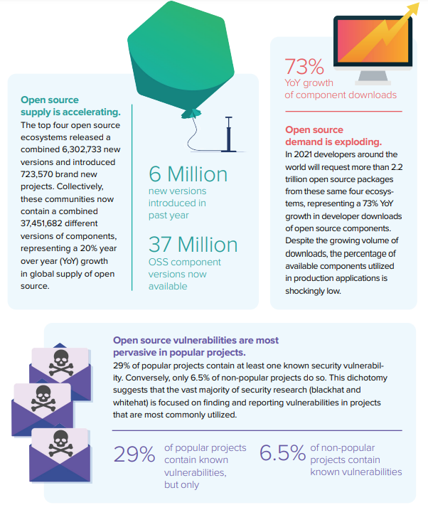
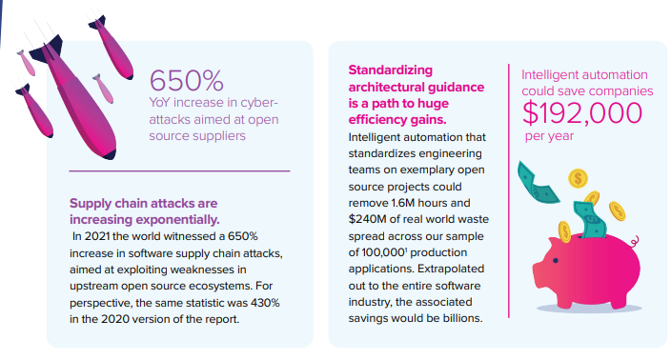
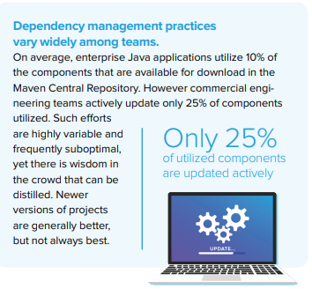
Top Cyber Security Risks In Healthcare
Software Supply Chain - 2021
6/21
Notes:
Source: Sonatype - State of Software Supply Chain 2021
https://www.sonatype.com/hubfs/Q3%202021-State%20of%20the%20Software%20Supply%20Chain-Report/SSSC-Report-2021_0913_PM_2.pdf?hsLang=en-us

Slide 7
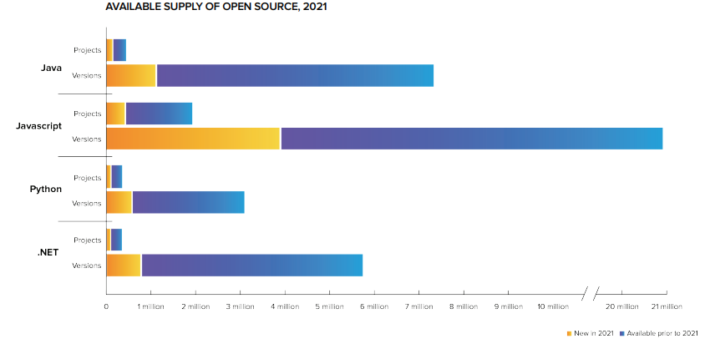
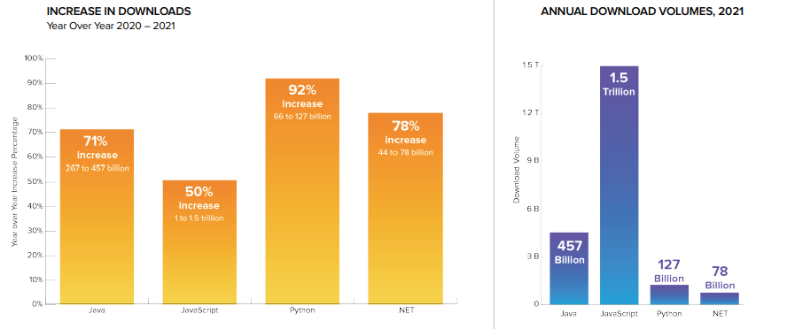
Top Cyber Security Risks In Healthcare
Software Supply Chain - 2021
7/21
Notes:
Source: Sonatype - State of Software Supply Chain 2021
https://www.sonatype.com/hubfs/Q3%202021-State%20of%20the%20Software%20Supply%20Chain-Report/SSSC-Report-2021_0913_PM_2.pdf?hsLang=en-us

Slide 8
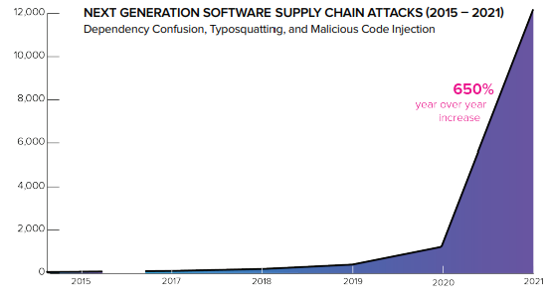
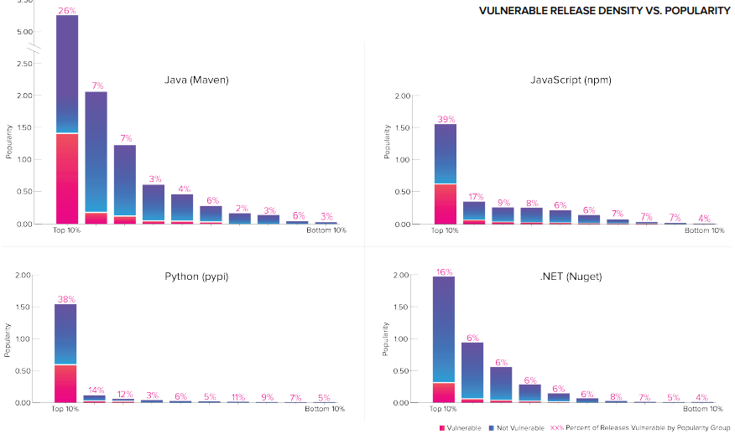
Top Cyber Security Risks In Healthcare
Software Supply Chain - 2021
8/21
Notes:
Source: Sonatype - State of Software Supply Chain 2021
https://www.sonatype.com/hubfs/Q3%202021-State%20of%20the%20Software%20Supply%20Chain-Report/SSSC-Report-2021_0913_PM_2.pdf?hsLang=en-us

Slide 9
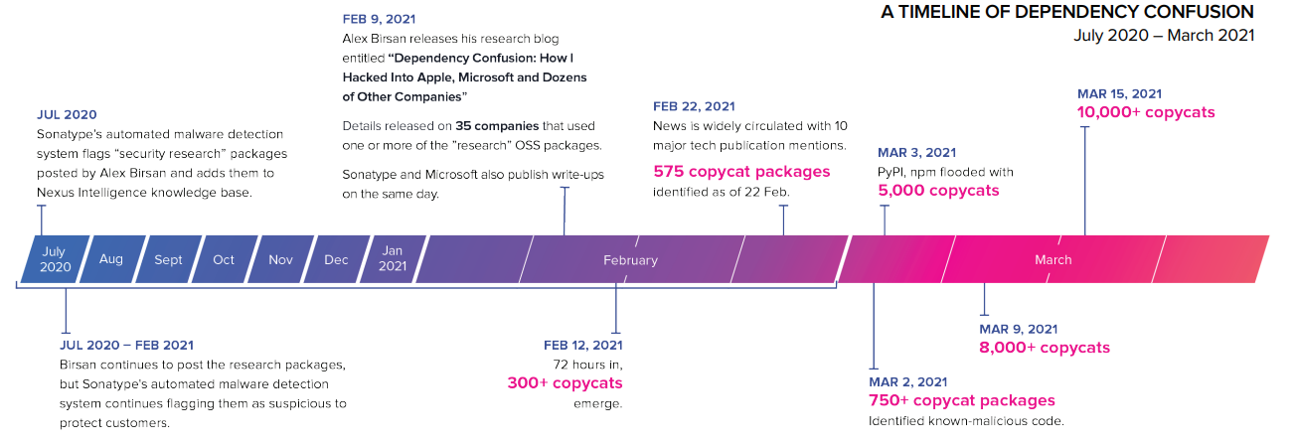
Top Cyber Security Risks In Healthcare
Software Supply Chain - 2021
9/21
Notes:
Source: Sonatype - State of Software Supply Chain 2021
https://www.sonatype.com/hubfs/Q3%202021-State%20of%20the%20Software%20Supply%20Chain-Report/SSSC-Report-2021_0913_PM_2.pdf?hsLang=en-us

Slide 10
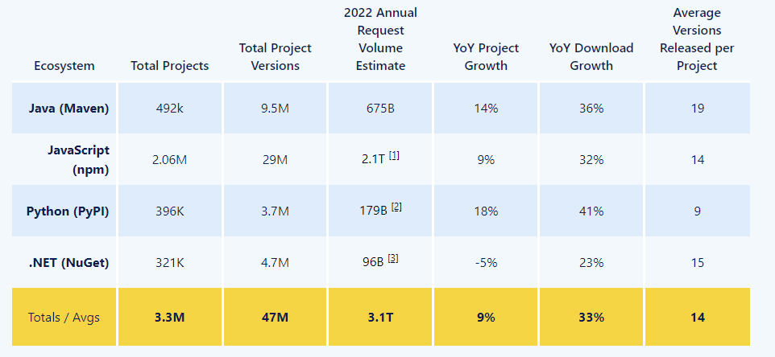
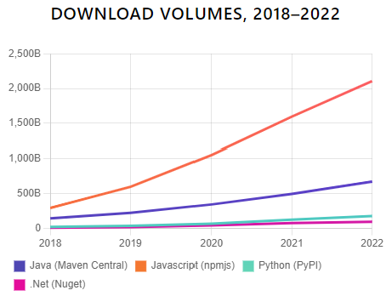
Top Cyber Security Risks In Healthcare
Software Supply Chain - 2022
10/21
Notes:
Source: Sonatype - 8th State of the Software Supply Chain
https://www.sonatype.com/state-of-the-software-supply-chain/open-source-supply-demand-security

Slide 11
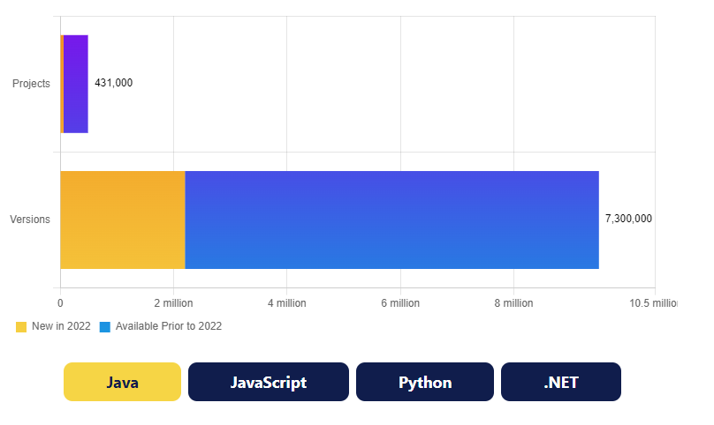
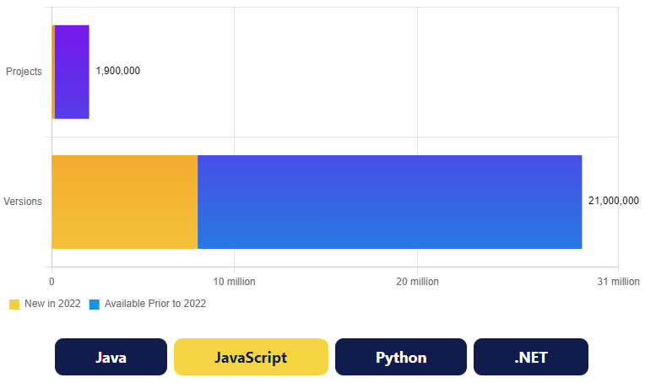
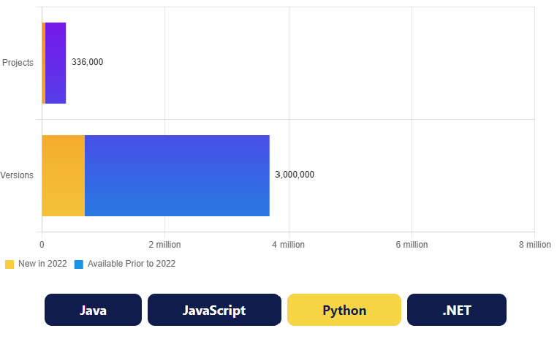
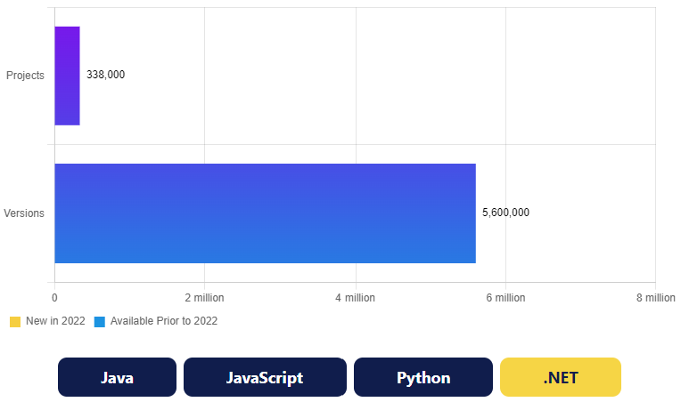
Top Cyber Security Risks In Healthcare
Software Supply Chain - 2022
Open source projects and version growth in 2022
11/21
Notes:
Source: Sonatype - 8th State of the Software Supply Chain
https://www.sonatype.com/state-of-the-software-supply-chain/open-source-supply-demand-security

Slide 12
Software Supply Chain - 2022
Java (Maven) by the numbers
675 billion packages – projected request volume
36% YoY (Year over Year) growth
JavaScript (npmjs) by the numbers
2.1 trillion packages – projected download volume
32% YoY growth
Python (PyPI) by the numbers
176 billion packages – projected download volume
41% YoY growth
.NET (NuGet) by the numbers
96 billion packages – projected download volume
23% YoY growth
12/21
Notes:
Source: Sonatype - 8th State of the Software Supply Chain
https://www.sonatype.com/state-of-the-software-supply-chain/open-source-supply-demand-security
Java (Maven)
Through the first 4.5 months of 2022, 244 billion Java components were downloaded from the Maven Central Repository following 497 billion downloads in 2021 - nearly 9% above original estimates. At this rate, the volume for 2022 is projected to be over 675 billion, a 36% YoY increase. These overshoots can be explained by the relative stability of Maven Central as the focused ecosystem of the Java Virtual Machine (JVM) world, which reflects the organic growth. It also may be tied to the significant consolidation event linked to JCenter, a popular open source registry closing down, and as a result, has led to projects migrating to The Maven Central Repository.
The impact of the activity surrounding Log4shell also cannot be discounted from the final figures, inflating the download statistics in December, which were well above normal.
JavaScript (npmjs)
Npmjs continues to be the largest open source ecosystem measured by download volume. In 2021, JavaScript developers requested 1.5 trillion packages from npmjs - beating estimates by a substantial 40%. Since JavaScript is the most popular programming language, the ecosystem’s distribution is much more networked, with functional packages designed to be distributed with great agility and fit for purpose, compared to the larger collected libraries seen in the other ecosystems.
All told, the total volume for 2022 is estimated to approximate 2.1 trillion, representing 32% annual growth. Significantly, the volumes served by npmjs tally as many packages as all four registries combined in 2021.
Python (PyPI)
Python and its package registry PyPI continues to be the fastest growing software ecosystem for the second year running. In 2021, PyPI served nearly 127 billion packages. In 2022, PyPI download volume is estimated to hit 179 billion packages. YoY growth of PyPI download volume is estimated at 41%.
.NET (NuGet)
NuGet is the chosen ecosystem of the .NET family of languages and continues to serve engineers working with the ever-growing Microsoft technologies. Developers downloaded 78 billion NuGet packages in 2021. In 2022, estimates peg volume at over 96 billion packages, representing 23% YoY growth.

Slide 13
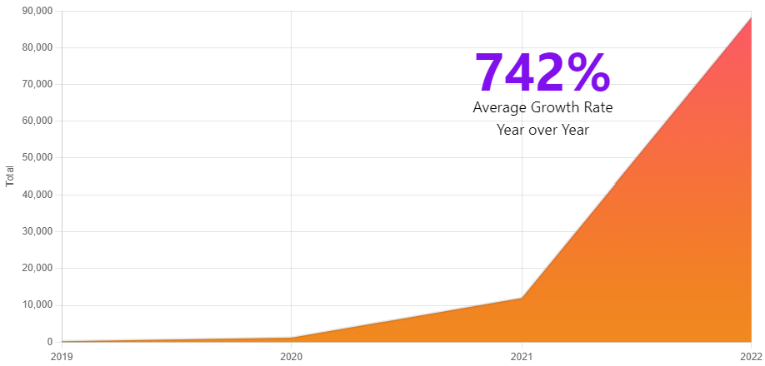
Software Supply Chain Attacks - 2022
97 337 malicious packages
Attack types:
Malicious software supply chain attacks increase another 633% YoY
Dependency Confusion
Typosquatting and its Cousin–Brandjacking
Malicious Code Injections
Protestware
13/21
Notes:
Source: Sonatype - 8th State of the Software Supply Chain
https://www.sonatype.com/state-of-the-software-supply-chain/open-source-supply-demand-security

Slide 14
Software Supply Chain Attacks - 2022
Attacks
A targeted campaign against karapace, a Apache Kafka implementation for Python
A targeted campaign against VMware vSphere - later revealed to be a bug bounty hunter
A user uploading over 1,200 dependency confusion packages that exfiltrated sensitive system information aimed against many organizations including Sagepay, Apple and Google to name a few
Dependency Confusion
A form of attack relying on spoofing internal package names and publishing them to an open source registry with an abnormally high version number.
14/21
Notes:
Source: Sonatype - 8th State of the Software Supply Chain
https://www.sonatype.com/state-of-the-software-supply-chain/open-source-supply-demand-security
Dependency confusion, a form of attack relying on spoofing internal package names and publishing them to an open source registry with an abnormally high version number. This continues to be one of the most numerous types of attacks observed. This intrusion reflects a highly targeted approach and is favored by both security researchers doing legitimate penetration testing, as well as adversaries seeking entry into a given organization.
The type of defense that can be applied against dependency confusion exists in both upstream and downstream scenarios. Ultimately, these attacks rely on the fact that an organization will not register its internal package names in the upstream repositories.
Some registries such as the Maven Central Repository require mandatory organizational verification and a namespaced coordinate system to help avert this type of attack. Other registries take an open door policy to package registrations, requiring measures downstream such as auditing incoming packages against designated package names. The simplest mitigation for these types of attacks is to use namespaced coordinates whenever possible and claim your organization’s namespace upstream early.

Slide 15
Software Supply Chain Attacks - 2022
Typosquatting and its Cousin–Brandjacking
Attacks:
Cryptominers distributed using typosquatting
Requests typosquat installs malware
PyPI packages that stole authentication keys distributed using typosquatting
PyMafka - a typosquatted package that dropped Cobalt Strike as its payload
rustdecimal - a Rust Crate found in crates.io named after the legitimate 'rust_decimal'
Multiple instances of typosquats against the popular "colors" -library on npmjs
15/21
Notes:
Source: Sonatype - 8th State of the Software Supply Chain
https://www.sonatype.com/state-of-the-software-supply-chain/open-source-supply-demand-security
Typosquatting continues to be a popular approach for executing software supply chain attacks and relies on a deceptively simple technique. Pick a popular component, misspell the name slightly, and rely on the assumption that some developers will make a mistake in adding a component. Software development is ultimately a very repetitive form of writing. With millions of pairs of hands typing ‘npm install’, or editing requirements.txt on millions of keyboards, inevitably, mistakes will happen. There is also a variation on this theme or type of attack called “brandjacking”. In this variant, a known name is taken over or spoofed closely to bait developers into accidentally integrating these packages instead of the legitimate component they were expecting.
An example seen in real life is a campaign against the colors library, with adversaries naming their packages “colors-2.0” or “colors-helper” and so on.
These techniques are often combined with a malicious payload that executes immediately using the built-in functionality of the developer's build tool. Most current build utilities such as npm, cargo, pip3, etc. allow the package maintainer to execute some sort of setup script during package installation. There are many legitimate uses for such functionality, such as compiling native libraries for use or preparing a directory structure. Unfortunately, as there is usually no user interaction when executing this step, this same mechanism can be used to fetch malicious payloads from a command and control server, which is then automatically installed and executed without the user’s awareness.
The most common types of payloads include installing malware and exfiltrating system credentials and tokens, as well as other system information.
What is common with these types of packages is that they operate much like phishing scams, duplicating the README sections of their chosen targets closely. Take a closer look at the code that’s published though, and you’ll see that they rarely work like the original, and instead will cause build failures. By the time the developer notices something is amiss, it is already too late — the damage has been done by the malicious payload executed via the build automation. The developer has probably not given much thought to this occurrence and likely believes that they just encountered a harmless typo.
Mitigating these types of attacks unfortunately is not possible without some level of automated verification that looks at the newly acquired dependencies against known malware signatures or other suspicious signs. Due diligence at the keyboard will certainly help alleviate errors, but we all have a tendency to make typos so organizations should be cognizant of this reality in their approach.

Slide 16
Software Supply Chain Attacks - 2022
Malicious Code Injections
Attacks:
3 million dollar crypto heist - leveraging access to a private GitHub repository
Coa - a very popular npm library is hijacked via an npm account takeover to distribute malware
Rc - another popular library is hijacked moments after coa in seemingly the same campaign
Mitigating these types of campaigns requires two things:
Awareness of what software components are integrated into software both directly and transitively (i.e., using an SBOM, or Software Bill of Materials).
The ability to execute changes at a rapid pace as soon as the corrupted release is discovered.
16/21
Notes:
Source: Sonatype - 8th State of the Software Supply Chain
https://www.sonatype.com/state-of-the-software-supply-chain/open-source-supply-demand-security
Malicious Source Code Injections are another type of attack that poses a very real risk to developers of popular libraries but, due to the highly targeted nature of these attacks, are less numerous than the ‘mass attack’ types noted above. This form of attack however is no less destructive, leveraging a popular component as a vector for a malicious payload.
The attack design relies on an adversary gaining access to the source code of a library, either through a compromise (as seen in the codecov and SolarWinds cases), or by pretending initially to be a benevolent open source committer. Once they have access, some of the code is modified, often hidden in what may otherwise appear as harmless code changes. This payload is then distributed to users of the library and continues with its nefarious objective. At its simplest, it may just be another credential exfiltration, but it was also observed in the sophisticated crypto heist that stole cryptocurrency worth over $3 million USD. The attack used compromised access to a private GitHub repository of a crypto auction site’s front-end.
An encouraging aspect of the open source community is that code can be scrutinized, so many of these campaigns are uncovered swiftly.

Slide 17
Software Supply Chain Attacks - 2022
Protestware
Another subvariant of malicious code injections that has been being observed more of in the last 12 months
Attacks:
January 2022: Maintainer of popular 'colors' and 'faker' libraries adds code to cause a Denial of Service in applications in protest of big corporations using open source but not contributing anything back to the community.
March 2022: 'node-ipc' project begins deleting data of users it suspects to be Russian or Belarusian. Any application using the library ends up overwriting Russian users' files with a '❤️' emoji.
March–April 2022: In days following the incident, maintainers behind npm libraries like 'event-source-polyfill', 'es5-ext' and 'styled-components' add peaceful anti-war messages to their packages.
17/21
Notes:
Source: Sonatype - 8th State of the Software Supply Chain
https://www.sonatype.com/state-of-the-software-supply-chain/open-source-supply-demand-security
Another subvariant of malicious code injections that the team has been observing more of in the last 12 months is protestware. In this scenario, an incident occurs when a maintainer deliberately sabotages their own project to cause harm or malfunction in ways that disrupt its adopters’ work.
The emergence of these types of campaigns open the door to an interesting dialogue about what constitutes reckless irresponsibility versus a seemingly harmless functionality change by a developer. While technically it is the maintainer’s right to do whatever they want with their code, as all open source code is delivered as-is. The consequent disruption caused to users, inflicting significant harm and delay, may not necessarily have been the intended outcome. The emergence of these types of self-imploding protest releases has caused healthy debate, as they are often performed in support of causes such as the illegal war in Ukraine, or due to the maintainer feeling that they are not adequately compensated for their efforts. Whether the cause is legitimate or not, it highlights the need for consumers of open source to be ready for this eventuality.
Though these types of events are not currently very numerous, due to their highly unpredictable and disruptive nature, they underscore the need to build in a response procedure inside organizations that adopt open source. Whether it’s Log4Shell or components going rogue or some other malicious attack, dependencies will require replacing at a rapid pace — something that organizations need to prepare for. We explore possible strategies for this later in the Report in the section, Open Source Dependency Management: Trends and Recommendations.

Slide 18
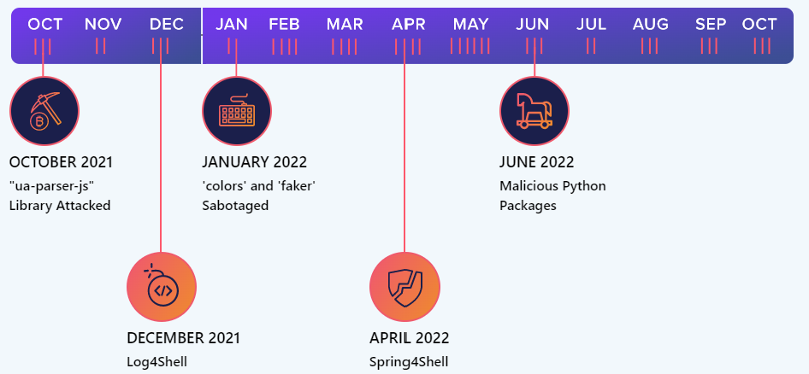
Software Supply Chain Attacks - 2022
Highest profile vulnerabilities and attacks, 2021-22
18/21
Notes:
Source: Sonatype - 8th State of the Software Supply Chain
https://www.sonatype.com/state-of-the-software-supply-chain/open-source-supply-demand-security

Slide 19
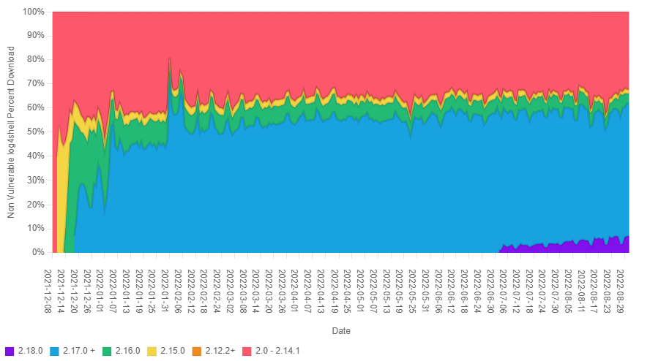
Software Supply Chain Attacks - 2022
Adoption of Log4Shell releases from August 2021 - August 2022
The code that was implicated to cause Log4Shell in JndiManager.class was borrowed by 783 other projects, being seen in over 19,562 individual components.
19/21
Notes:
Source: Sonatype - 8th State of the Software Supply Chain
https://www.sonatype.com/state-of-the-software-supply-chain/open-source-supply-demand-security
The amount of third-party code flowing through software supply chains occurs on a massive scale. Yet published code accrues technical debt over time, creating the potential for compounded security vulnerabilities, if not kept up to date.
In 2021, the State of the Software Supply Chain Report revealed that the top 10% most popular open source projects, as measured by download volume, contain the most security vulnerabilities as currently identified. These vulnerabilities were most present in the Log4j project and Log4j-core package that contained the now-famous Log4Shell security vulnerability. Analyzing this incident provided an unprecedented view into the adoption of new fixes and a glimpse of how the industry tends to utilize fixes. Figure 1.5 illustrates the relative adoption rates of Log4j-core, with subsequent releases addressing issues outside the original issue.
As we can observe in Figure 1.5, the fix-adoption rate stabilizes around 65% and, at the time of writing, hovers between 65-70% with significant differences between different countries. A deeper look at Log4shell is captured in the Open Source Management section, but its occurrence is a significant case study for research and how the industry can identify better practices adopting newer versions–faster.
Unfortunately, Log4Shell taught us another lesson about the security vulnerabilities in dependencies–it’s not only the direct inclusion of the code that matters, but also indirect inclusion of all kinds. Dependencies may be pulled in as a part of a transitive dependency chain for a given program, as well as embedded into other software that might be used. This last characteristic is what makes the event so menacing: it is not enough to know where developers are using Log4j-core, organizations have to know all software that uses Log4j.
Digging further, the Log4Shell vulnerability is introduced by the JndiManager class that exists inside the Log4j-core artifact. Matching versions of this affected class exists inside 783 other projects with a total of 19,562 versions. Tooling that only relies on the vulnerability disclosure and doesn't look deeper will miss these existing use cases, leading to false negatives and a false sense of security.
The networked nature of dependencies highlights the importance of having visibility and awareness about these complex supply chains. These dependencies impact our software so having an understanding of their origins is critical to vulnerability response. Many organizations did not have the needed visibility and continued their incident response procedures for Log4Shell well beyond the summer of 2022 as a result.

Slide 20
Software Supply Chain Attacks - 2022
Examples
Sources:
Sonatype - State of the software supply chain - https://www.sonatype.com/hubfs/Q3%202021-State%20of%20the%20Software%20Supply%20Chain-Report/SSSC-Report-2021_0913_PM_2.pdf?hsLang=en-us
Sonatype - 8th state of the software supply chain - https://www.sonatype.com/state-of-the-software-supply-chain/open-source-supply-demand-security
ReversingLabs - A (Partial) History of Software Supply Chain Attacks - https://blog.reversinglabs.com/blog/a-partial-history-of-software-supply-chain-attacks
20/21

Slide 21
Köszönöm a figyelmet! www.cyber.services
WE ESTABLISH ORDER
21/21

