Slide 1
docker run vs. kubectl apply

Slide 2
Hello!
I am Márk Sági-Kazár
SRE Tech Lead @ Cisco
@sagikazarmark
https://sagikazarmark.hu
hello@sagikazarmark.hu

Slide 3
Agenda
Docker
Kubernetes
Summary

Slide 4
1.
Docker

Slide 5
Docker environments
Docker Engine
Docker Swarm
Docker Desktop

Slide 6
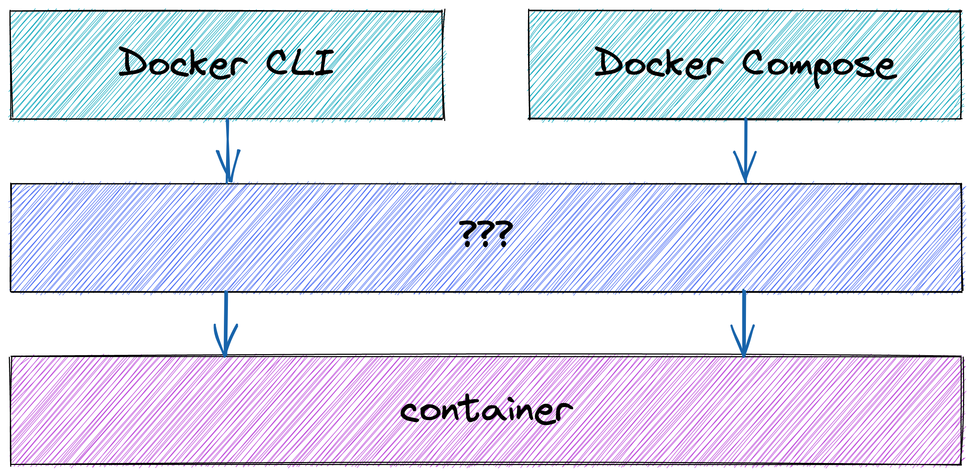

Slide 7
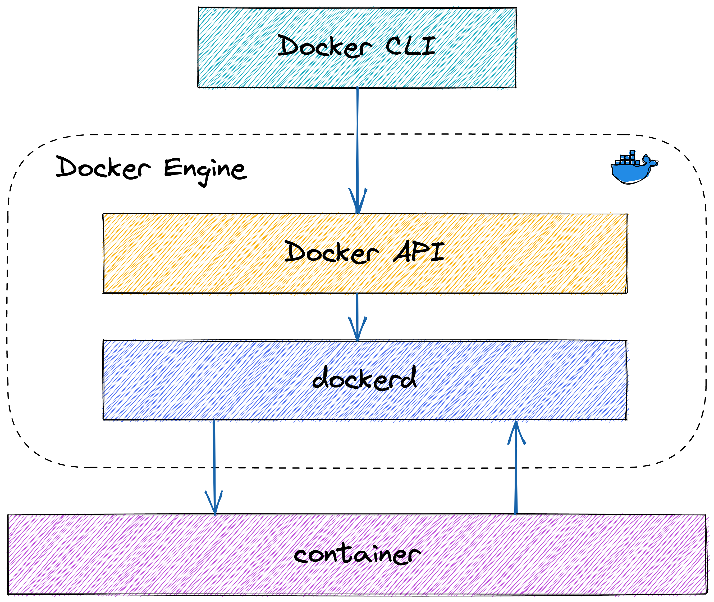

Slide 8
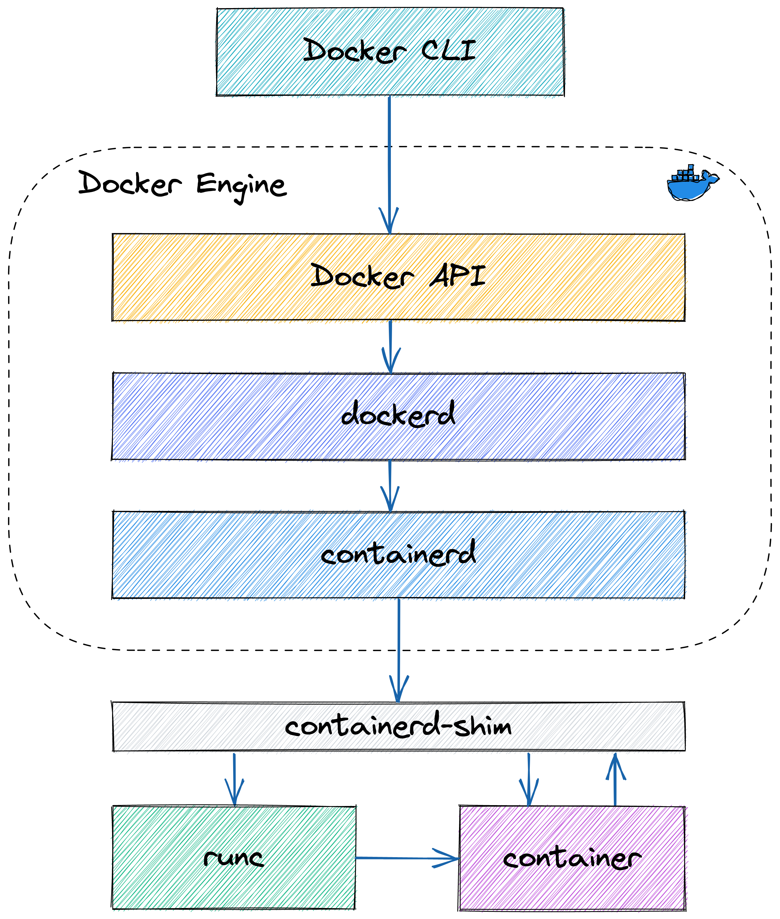

Slide 9
2.
Kubernetes

Slide 10
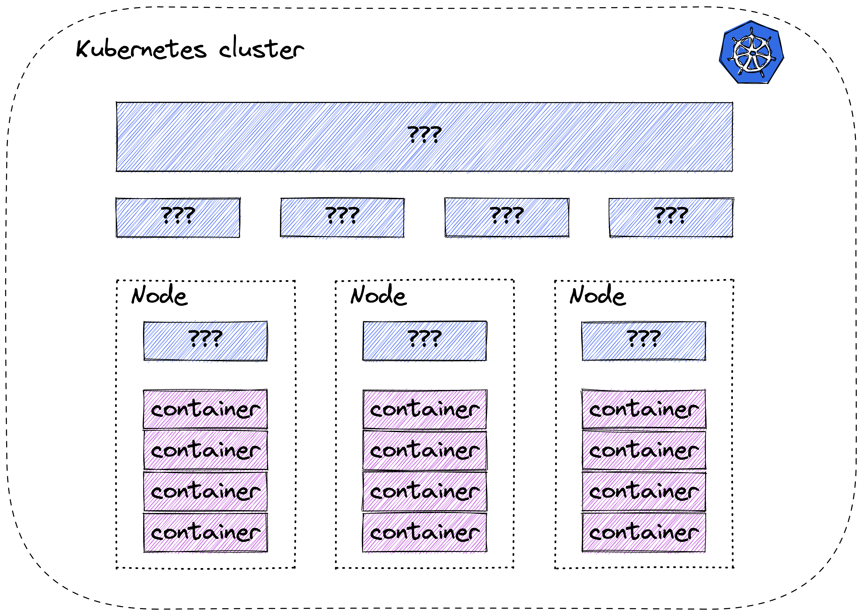

Slide 11
Pods vs containers
Smallest deployable unit
One or more containers
Shared storage and networking
Scaling unit

Slide 12
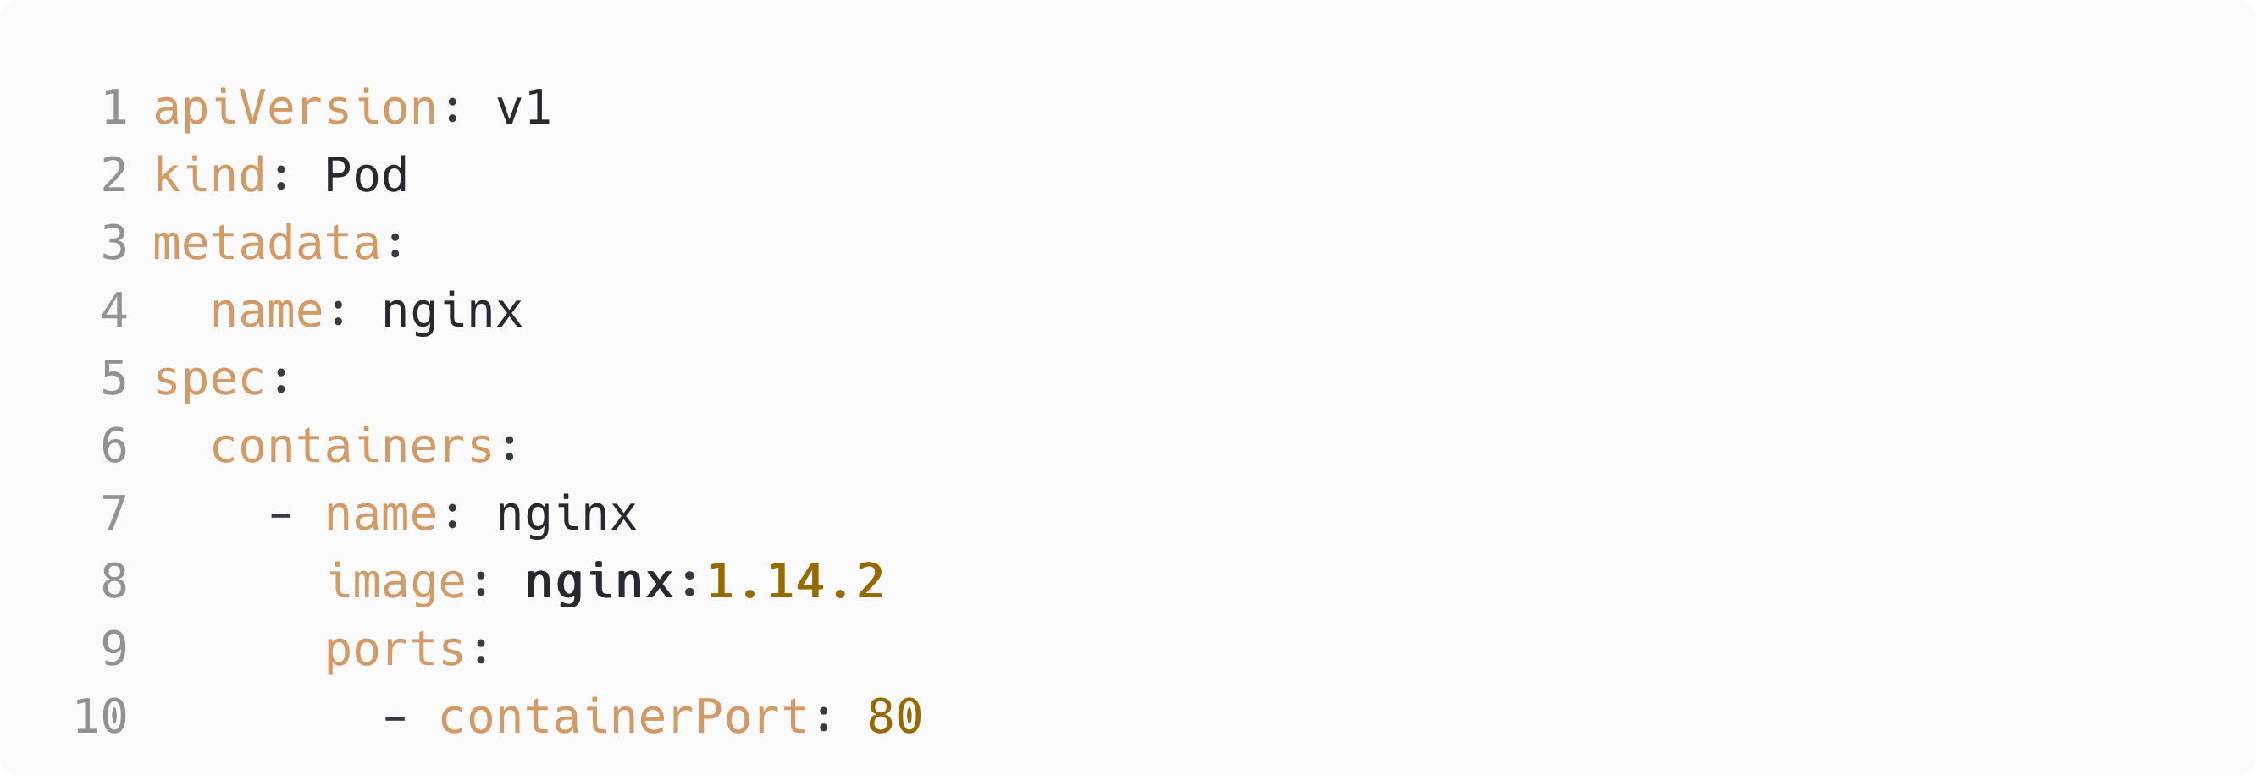

Slide 13
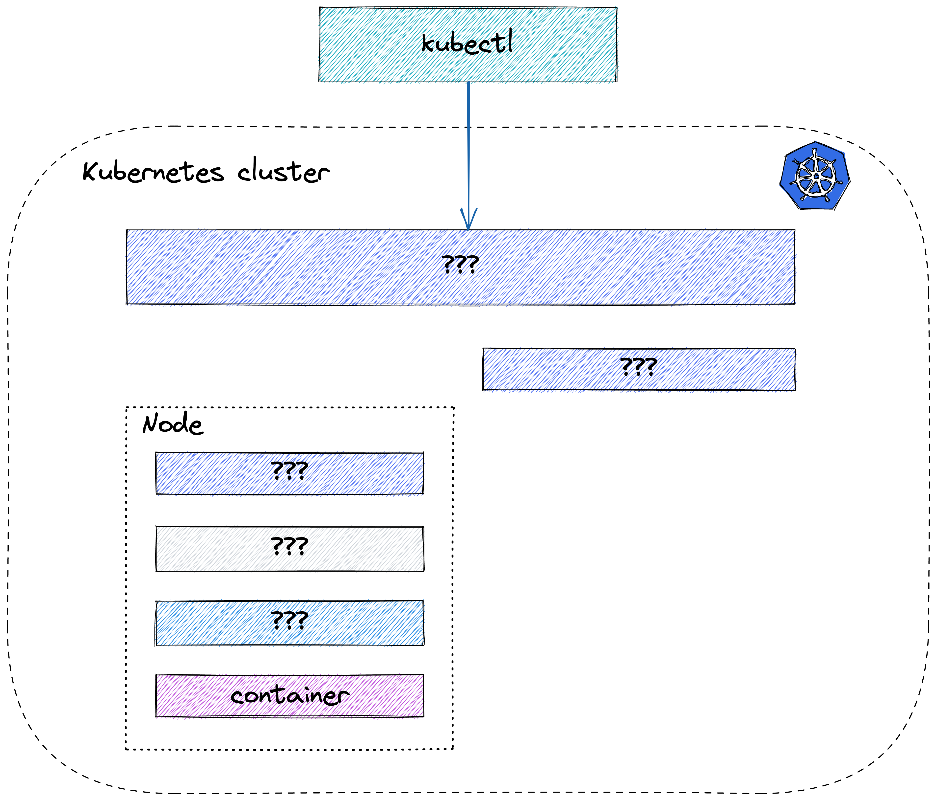

Slide 14
Kubernetes API server
Control plane frontend
Stores desired state
Tracks actual state

Slide 15
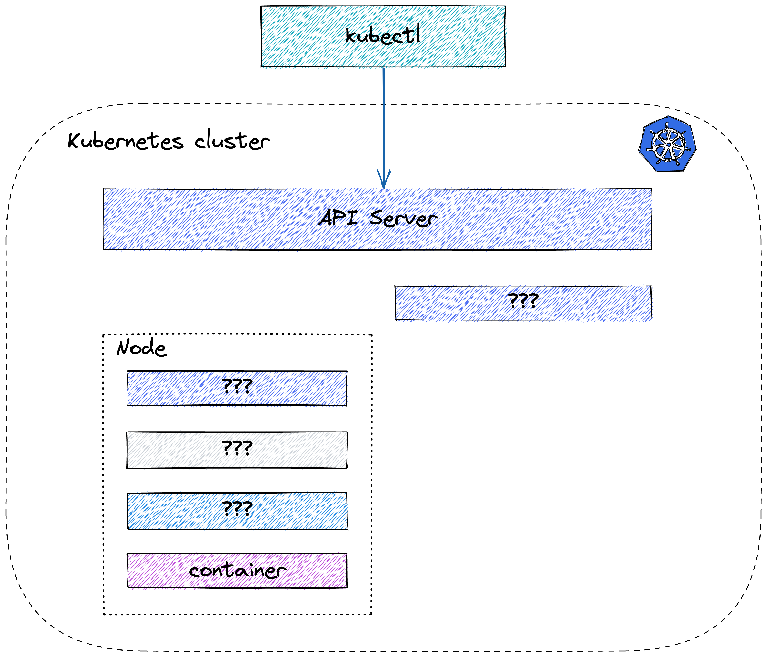

Slide 16
Scheduler
Finds the best Node to run the Pod on
Scheduling operation:
Filtering
Scoring

Slide 18
Kubelet
Node agent
Gets the list of Pods from the API server
Ensures that the containers in Pods are running and healthy

Slide 19
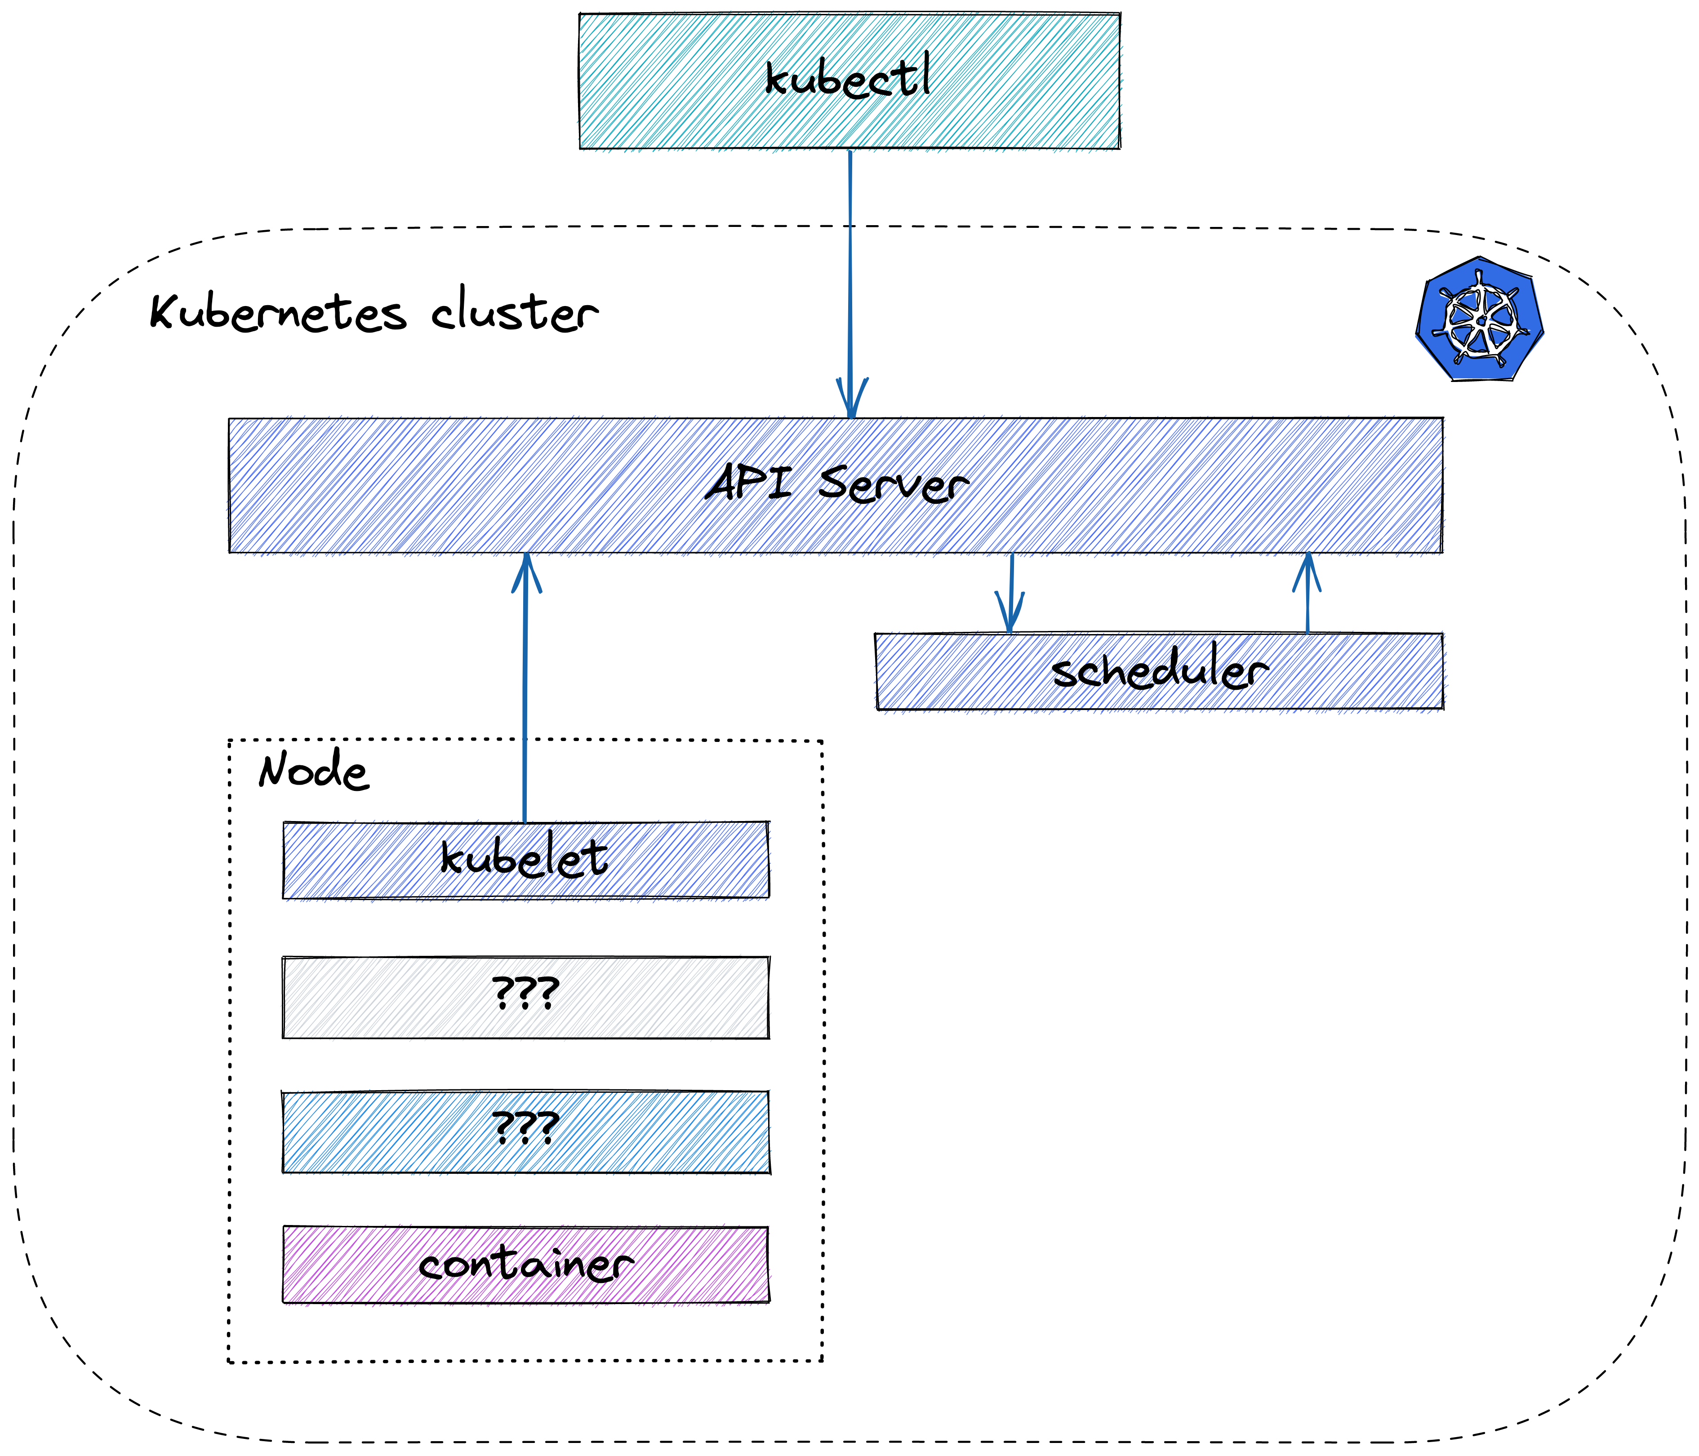

Slide 20
CRI: Container Runtime Interface
gRPC API for managing containers
Runtimes: containerd, cri-o
Remember dockershim?

Slide 22
3.
Summary

Slide 23
Differences
Docker: manage containers directly (well...usually)
Kube: configure desired state, Kubernetes „makes it happen”
Docker: containerd+runc
Kube: CRI

Slide 24
Similarities
Generally both uses OCI
Containerd is the most common runtime

Slide 25
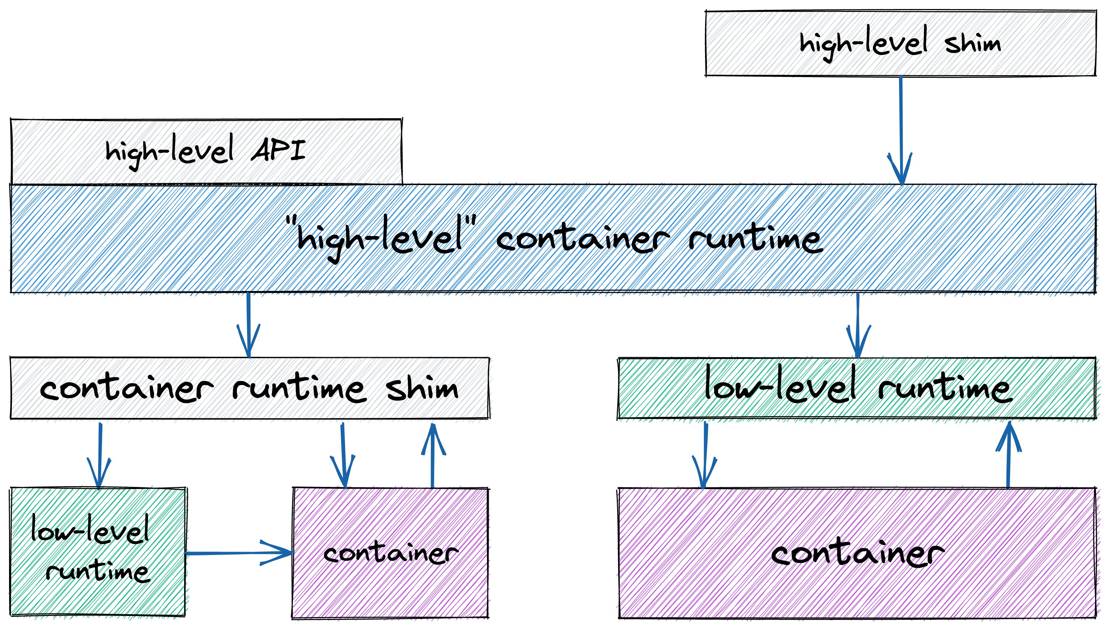

Slide 26
Thanks!
Any questions?
@sagikazarmark
https://sagikazarmark.hu
hello@sagikazarmark.hu

Slide 27
Read more
https://iximiuz.com/en/posts/journey-from-containerization-to-orchestration-and-beyond/
https://mkdev.me/posts/dockerless-part-1-which-tools-to-replace-docker-with-and-why
https://iximiuz.com/en/posts/implementing-container-runtime-shim/
https://twitter.com/iximiuz/status/1433694551940681754
https://kubernetes.io/blog/2016/12/container-runtime-interface-cri-in-kubernetes/
https://unit42.paloaltonetworks.com/making-containers-more-isolated-an-overview-of-sandboxed-container-technologies/

