Slide 1
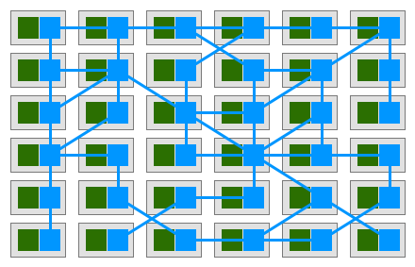
New Directions in the Service Mesh Space

Slide 2
Who am I?
Co-founder & CTO @ LeanNet Ltd.
Consulting, training, implementing
Cloud Native, Kubernetes, Microservices, DevOps
Now part of the
megyesi@leannet.eu
twitter.com/M3gy0
linkedin.com/in/M3gy0

Slide 3
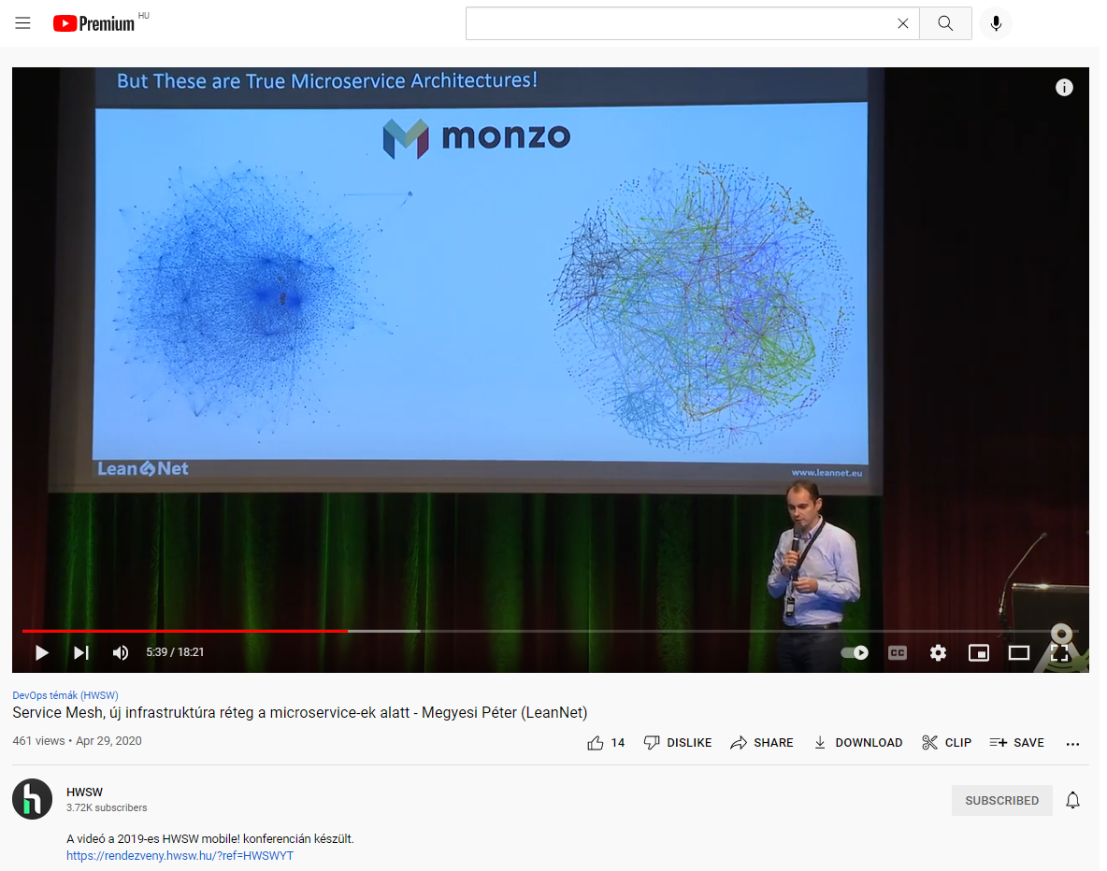
Check Out My Serivce Mesh Basics Video on YouTube

Slide 4
The Basics Very Quickly…
Proxy
Proxy
Proxy
Proxy
Proxy
Proxy
Proxy
Proxy
Proxy
Proxy
Proxy
Proxy
Node 1
Node 2
Node 3
Service Mesh Control Plane
Dynamic service discovery
Load balancing
Health checks
Timeouts
Retries
Circuit breakers
Traffic encryption (mTLS)
Fine-grained access control
Access auditing
Rate limiting
Rewrites and redirects
Consistent metrics
Access logs
Distributed tracing
Fault injection
Lots of resources
Added latency
Operational overhead
HTTP focused
Notes:
Data Plane vs. Control Plane

Slide 5
Sidecar Unjection: Using the Mutating Webhook of the API Server
API
HTTP
handler
Authentication
Authorization
Mutating
admission
Object Schema Validation
Validating
admission
Persisted to etcd
API request
Webhook
Webhook
Webhook
Happens on pod level if annotation is present
Namespace
Pod controller
Deployment, ReplicaSet, DaemonSet, StatefulSet
Pod itself

Slide 6
The Two Big Players
Somewhat easy to install
Hard to operate
Heavy control plane
Advanced data plane (Envoy)
Has a built in ingress (and egress) controller (Envoy)
Kiali as dashboard
Monitoring:
Service graph
S2S latency
Response codes
Jaeger Tracing
Advanced HTTP routing:
Blue/Green
Canary
Dark launch
Very easy to install
Easy to operate
Light control plane
Very light data plane (in Rust)
No ingress included
Has a dashboard
Monitoring:
Service graph
S2S latency
Response codes
No tracing
Very basic HTTP routing:
No Blue/Green
Canary
No dark launch

Slide 7
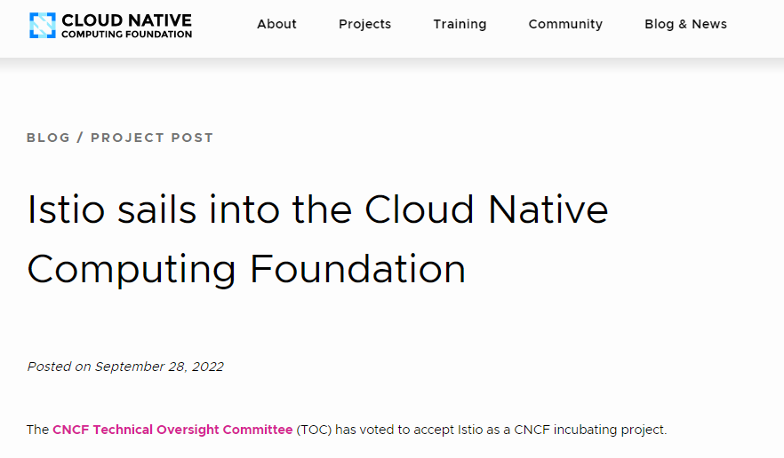
The Buzz Around Istio

Slide 8
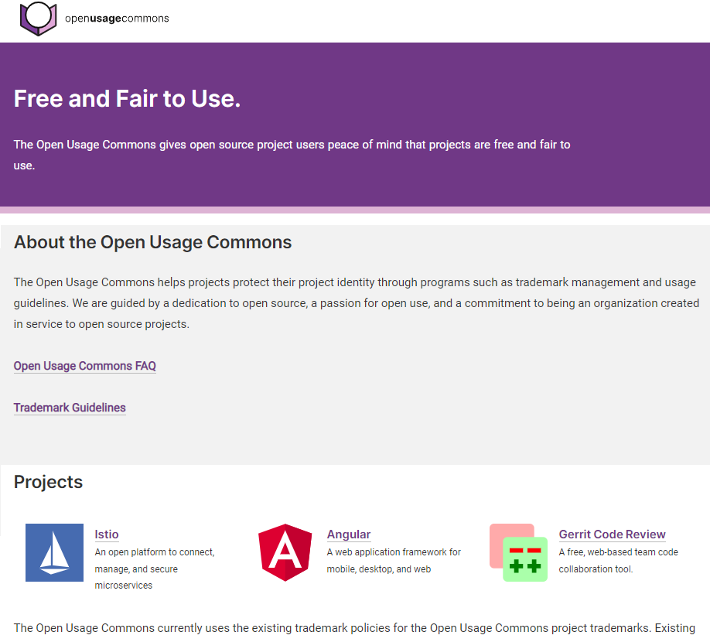
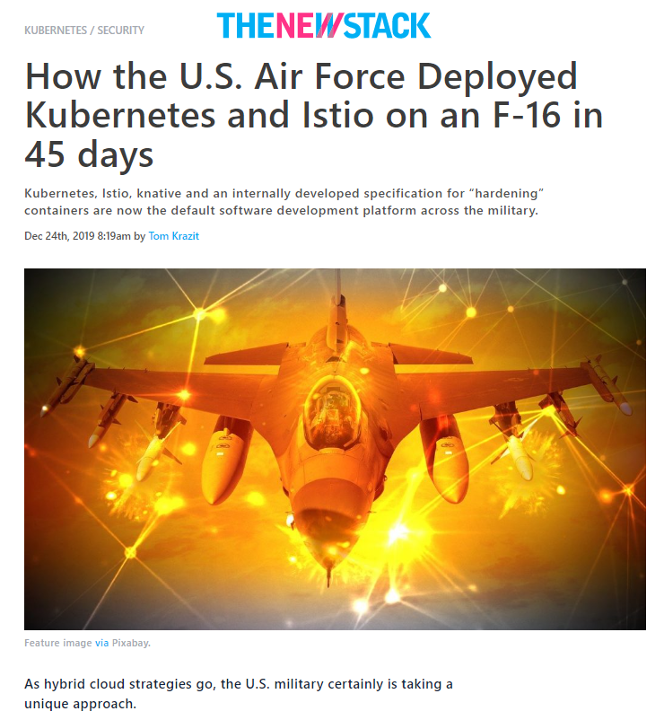
The Buzz Around Istio

Slide 9
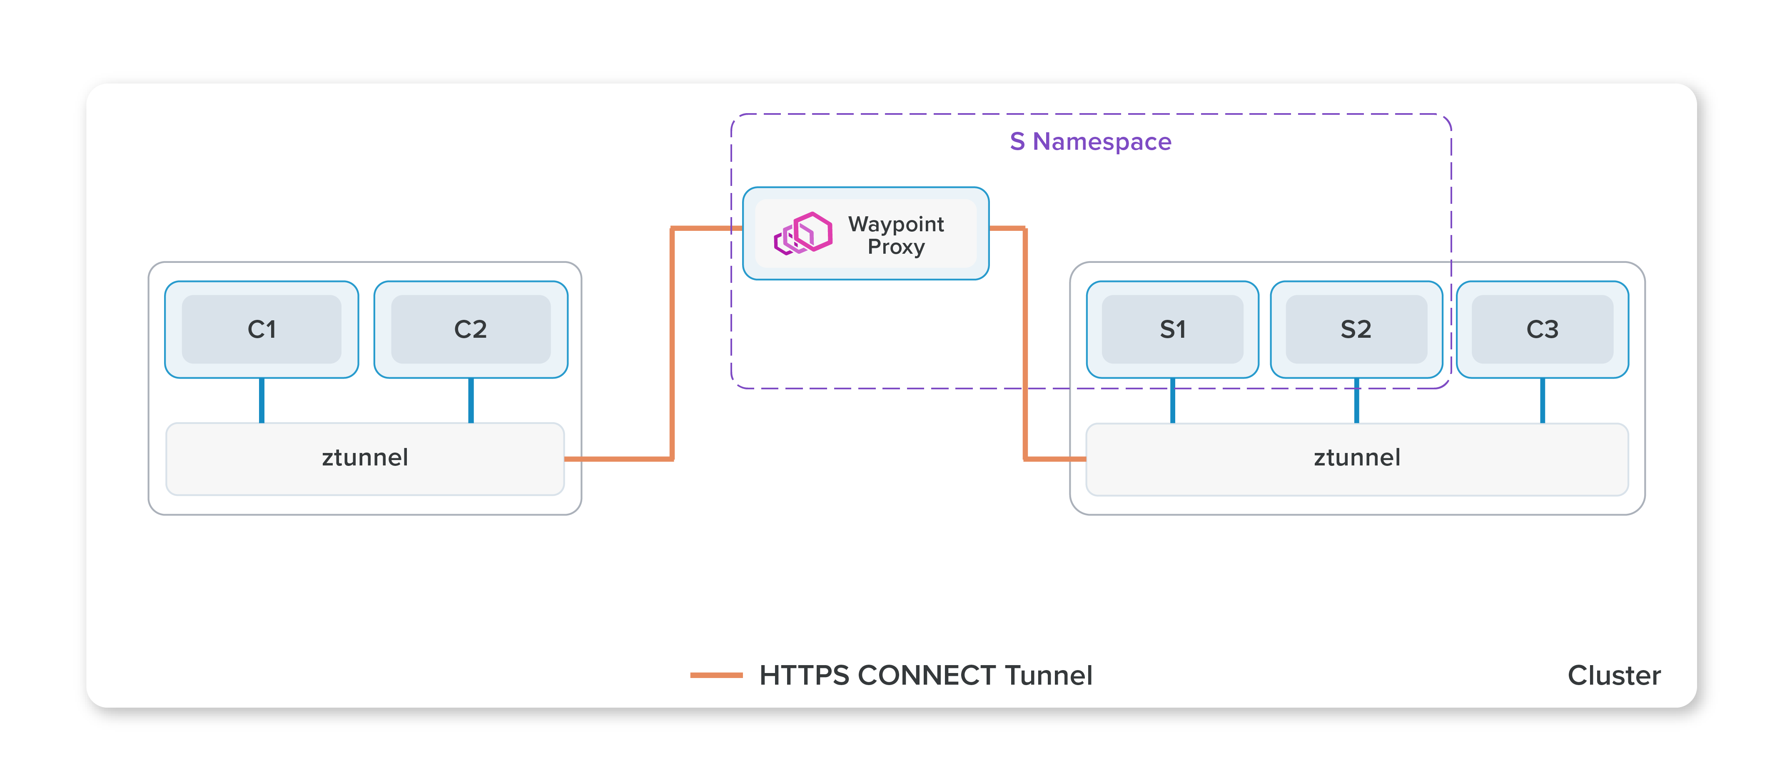
The Buzz Around Istio: Ambient Mesh

Slide 10
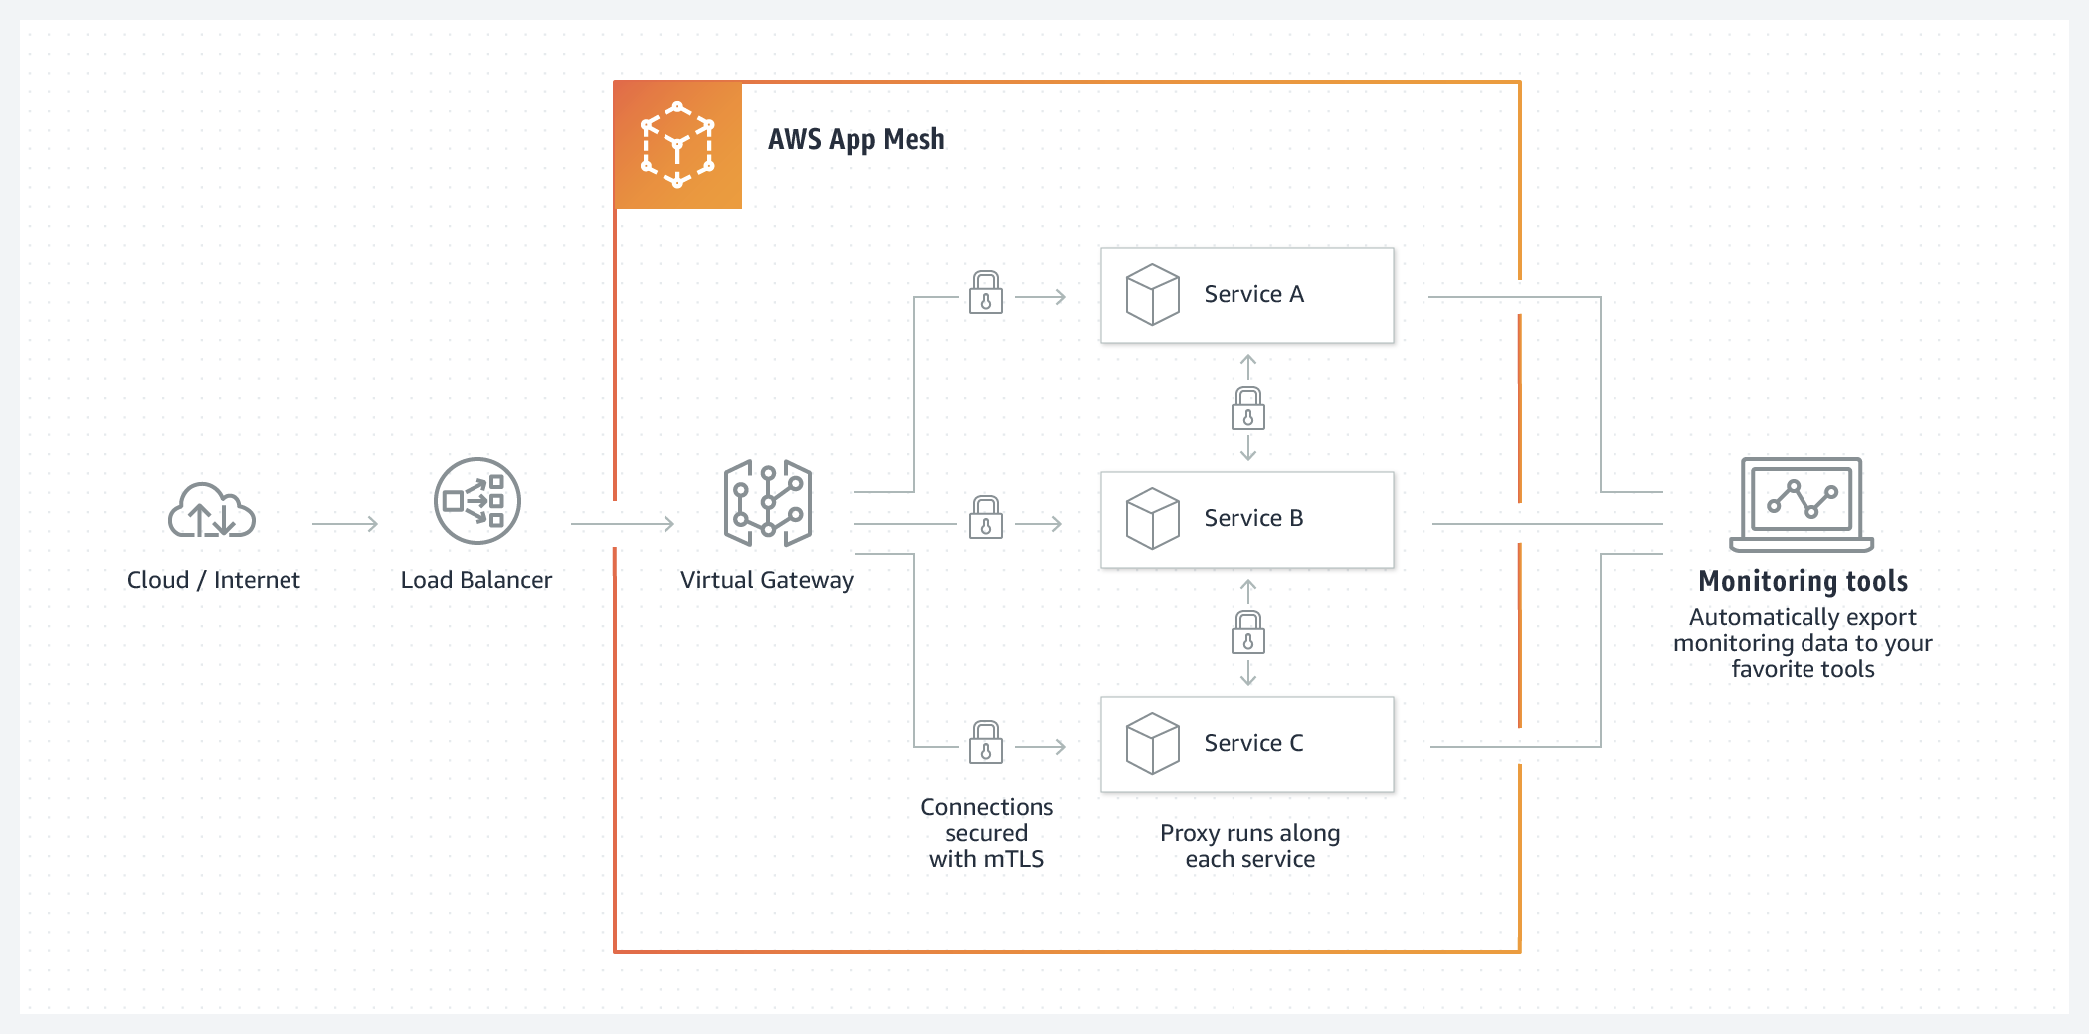
Honorable Mentions 1: AWS App Mesh
AWS specific service mesh that makes it easy to monitor and control services
Works with Amazon EC2, Amazon ECS, Amazon EKS, and AWS Fargate
Envoy as dataplane

Slide 11
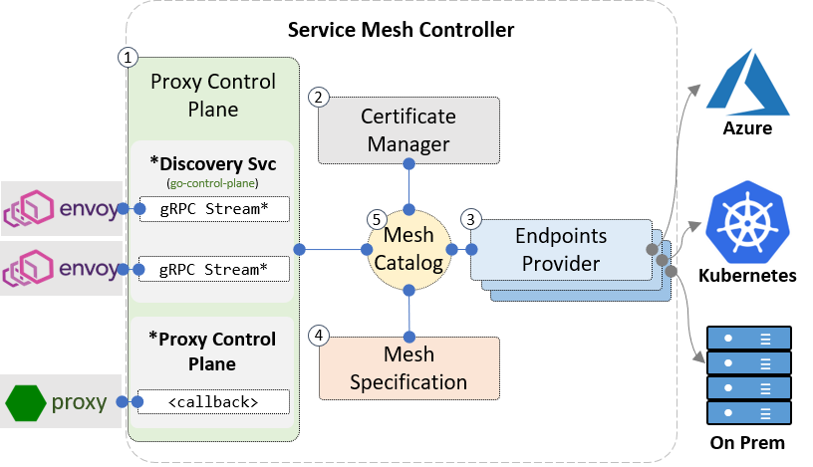
Honorable Mentions 2: Open Service Mesh
OSM is a lightweight and extensible cloud native service mesh
Originally created by Microsoft (supported by AKS)
CNCF sandbox project
Envoy as dataplane, control plane written in Go
Configure via Service Mesh Interface (SMI)
Features include
Easily and transparently configure traffic shifting
Secure end-to-end communication by enabling mTLS
Fine grained access control policies for services
Observability and insights into application metrics for debugging and monitoring services
Integrate with external certificate management services/solutions with a pluggable interface
Onboard applications onto the mesh by enabling automatic sidecar injection of Envoy proxy
Flexible enough to handle both simple and complex scenarios through SMI and Envoy XDS APIs

Slide 12
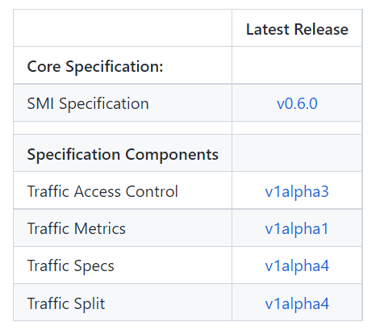
Honorable Mentions 3: Service Mesh Interface
A standard interface for service meshes on Kubernetes
A basic feature set for the most common service mesh use cases
Flexibility to support new service mesh capabilities over time
Space for the ecosystem to innovate with service mesh technology
Ecosystem
Linkerd: ultralight service mesh
Open Service Mesh: lightweight and extensible cloud native service mesh
Traefik Mesh: simpler service mesh
Gloo Mesh: Multi-cluster service mesh management plane
Meshery: the service mesh management plane
Flagger: progressive delivery operator
Argo Rollouts: advanced deployment & progressive delivery controller
Istio*: connect, secure, control, observe
Consul Connect*: service segmentation
* via adaptor

Slide 13
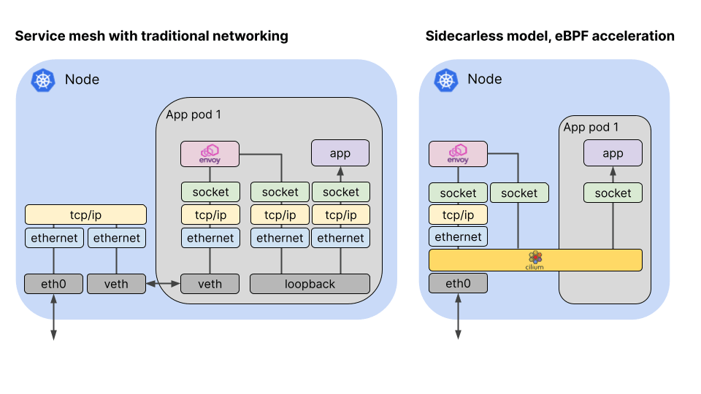
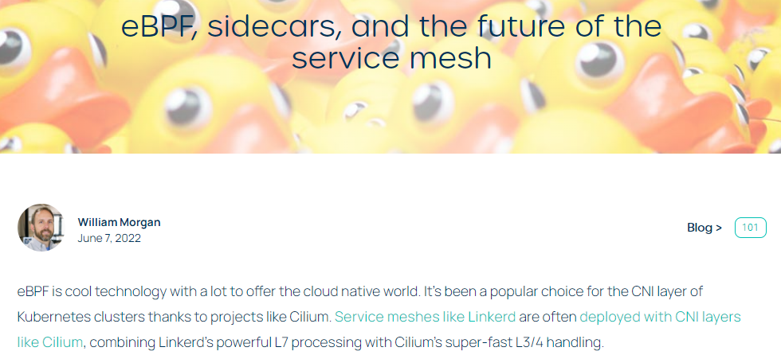
Honorable Mentions 4: Cilium Service Mesh with eBPF

Slide 14
Honorable Mentions 5: Even More Tools ☺

Slide 15
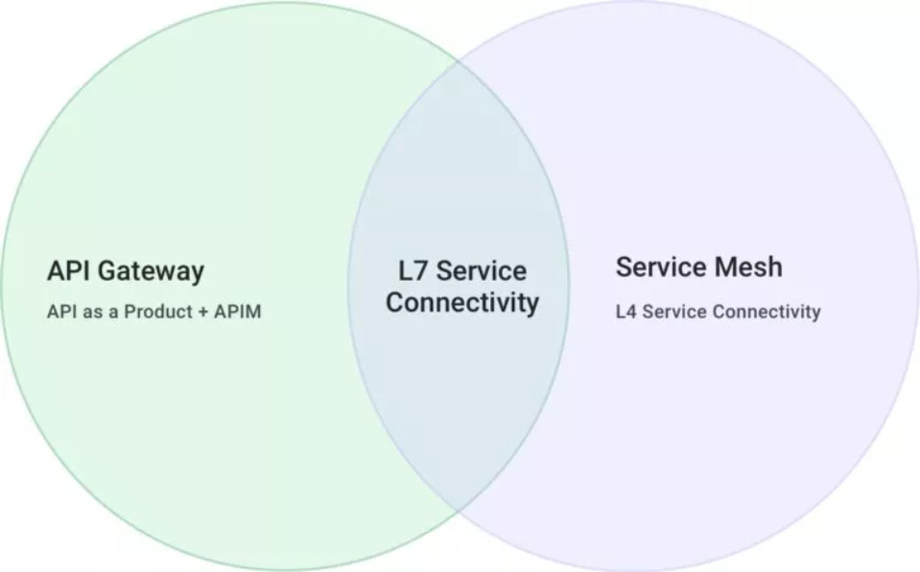
Honorable Mentions 6: Service Mesh vs. API Gateways
Many features of the Service Mesh and API Gateways seems overlapping
Telemetry collection
Distributed tracing
Service discovery
Load balancing
TLS termination/origination
JWT validation
Request routing
Traffic splitting
Canary releasing
Traffic shadowing
Rate limiting
Control the edge
Control the cluster
Good to read: https://blog.christianposta.com/microservices/do-i-need-an-api-gateway-if-i-have-a-service-mesh/
https://konghq.com/blog/the-difference-between-api-gateways-and-service-mesh

Slide 16
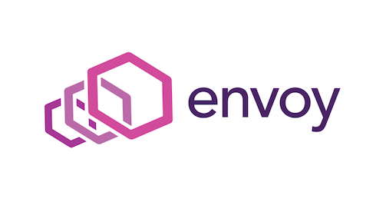
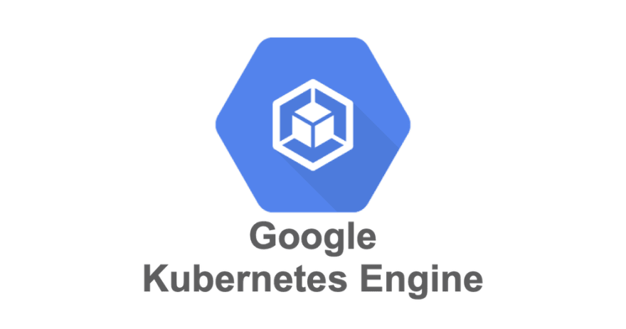
Honorable Mentions 7: Kubernetes Gateway API
The Kubernetes Ingress resource seems to be limited for API Gateway use-cases
Very similar CRDs appeared for ingress controllers (including service mesh ingresses)
Ingress annotations are overloaded, and very vendor specific
Gateway API (currently in v1beta1 status):
Standardize underlying route matching, traffic management, and service exposure
Represent L4/L7 routing and traffic management through common core API resources
Provide extensibility for more complex capabilities in a way that does not sacrifice the user experience of the core API
gateway

Slide 17
Honorable Mentions 8: Service Mesh Managers
Management plane that enables the adoption, operation, and management of service mesh
Typical features:
Lifecycle management (e.g. version upgrades)
Multi-cluster management and hybrid (non-Kubernetes) deployments
Multi-tenancy and self-service
Enhanced security (e.g. access control, cert management)
Created by Solo.io
Supports only Istio
Created by Layer5.io
Many supported service mesh solutions

Slide 18
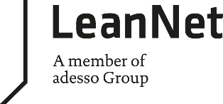
Okay, But Should I Use a Service Mesh???
It depends…
Not a good reason:
I’ve heard it’s cool since Google made this!
Want to be cloud native so I must use this new stuff
My boss told me…
But definitely use it if:
You have micro(ish)services environment, written in multiple languages, and you need consistent telemetry
You need mTLS for every service-to-service communication
You have a microservices environment where some service are failing, and you can’t figure out which one of them
You need to apply more advance deployment patterns (e.g. canary, blue/green), since you current one is too slow
Notes:
Data Plane vs. Control Plane

