Slide 1
Dagger
A portable devkit for CI/CD pipelines

Slide 2
Hello!
Márk Sági-Kazár
Engineering Technical Lead @ Cisco
https://sagikazarmark.hu

Slide 3
Agenda
The problem
Solutions so far
Dagger: new kid on the block
Recap

Slide 4
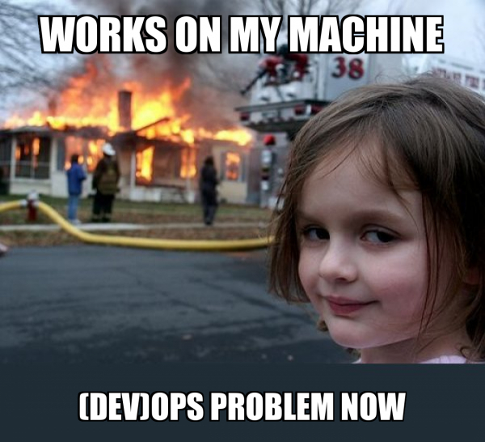
The problem

Slide 5
“Just run this script and it’s going work.”

Slide 6
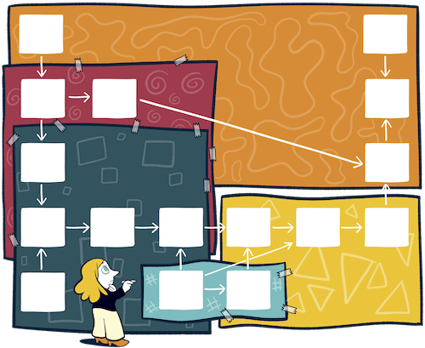
DevOps nightmare

Slide 7
Modern build systems
Portability
Hermetic builds
Build graph
Caching
Remote builds

Slide 8
Dagger
„a portable devkit for CI/CD”
Develop, test and debug pipelines locally
No more YAML hell: write pipelines in Cue
Reduce CI lock-in

Slide 9
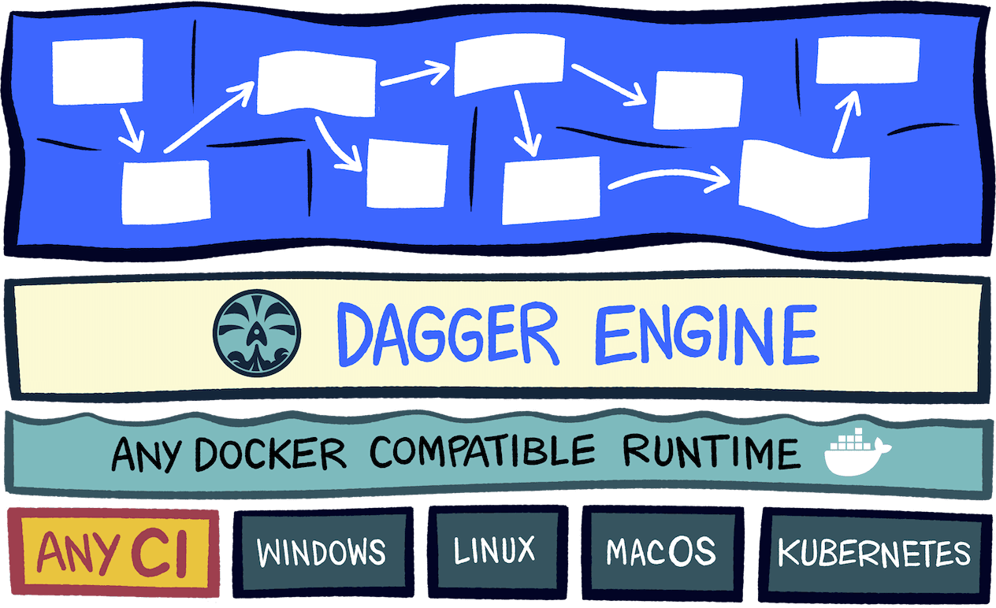

Slide 10
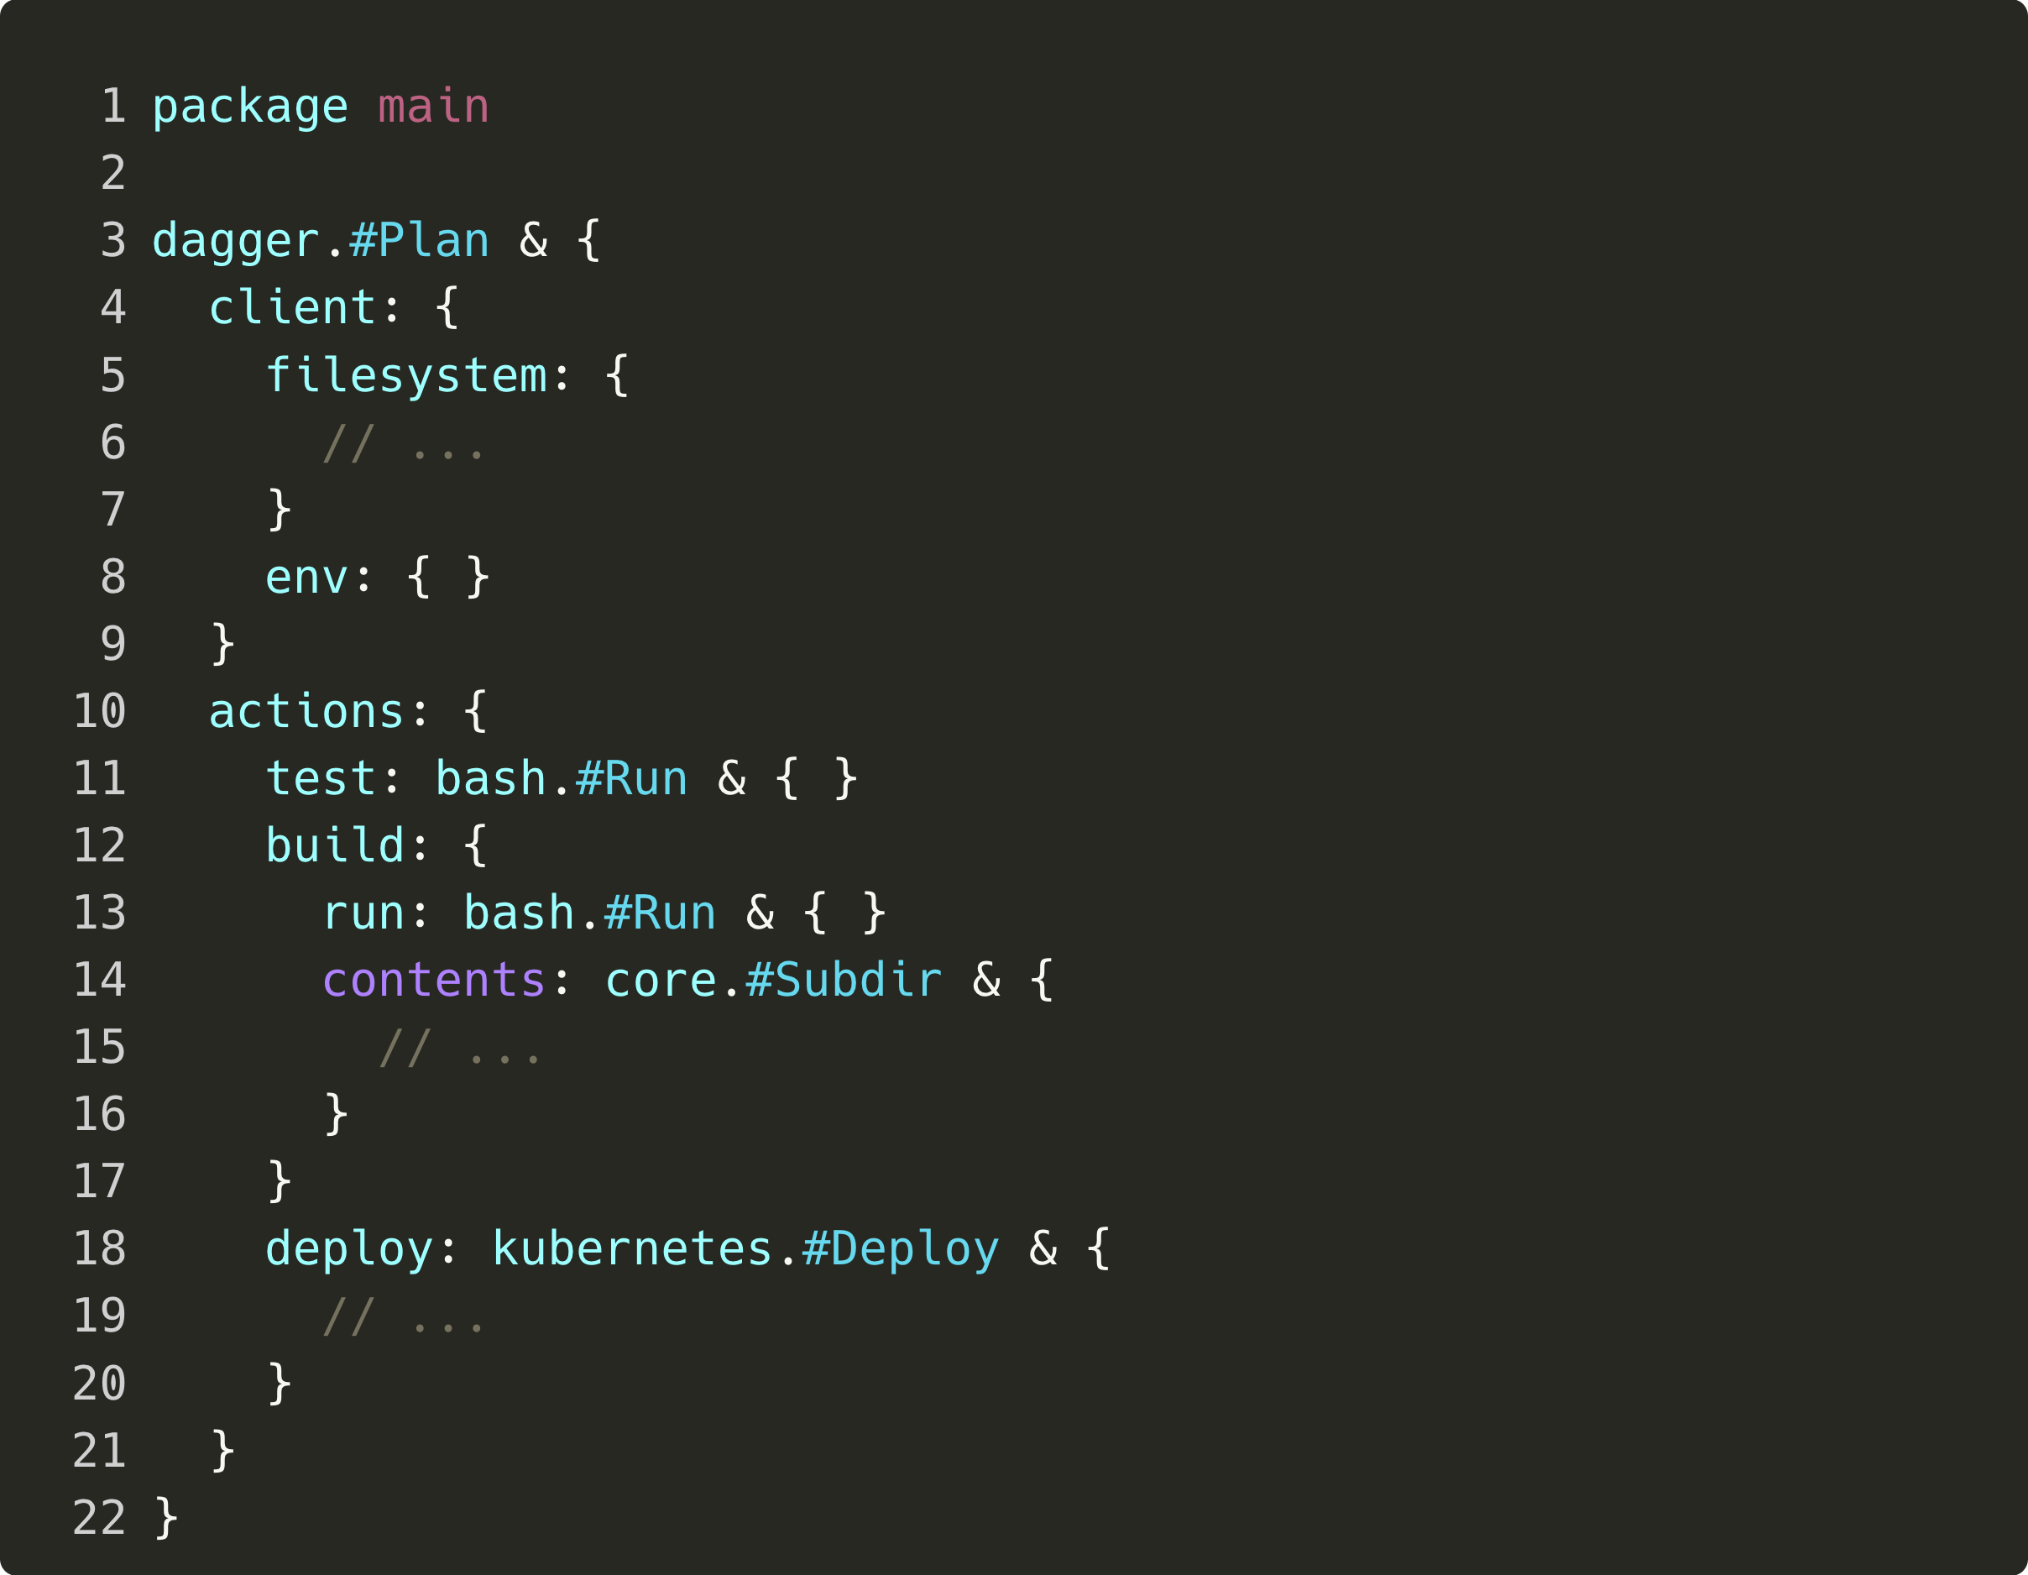
Dagger ”plan”

Slide 11
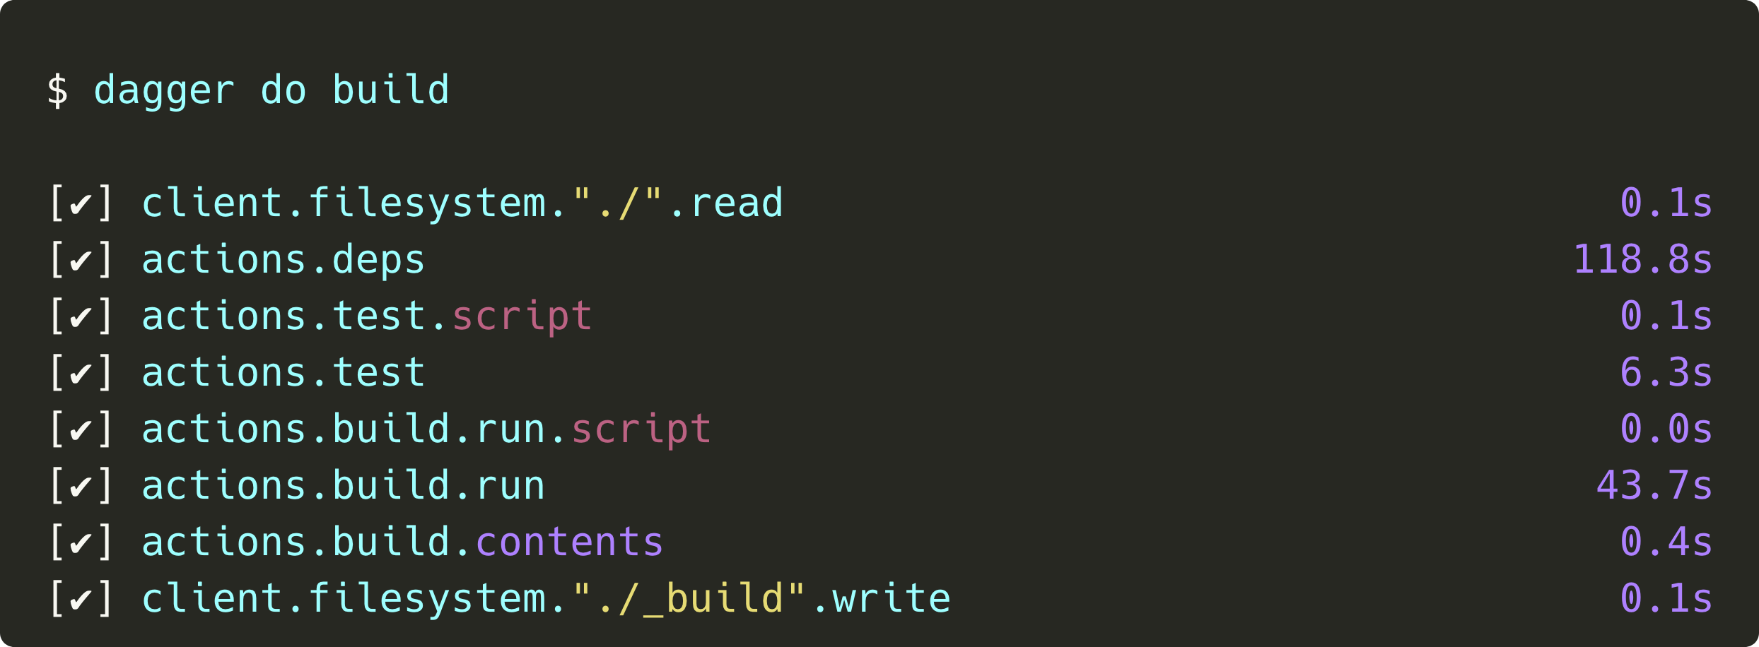
Build!

Slide 12
Other notable features
Secrets
Reusable components

Slide 13
Demo
Check out the demo repository:
https://github.com/sagikazarmark/todobackend-go-kit

Slide 14
Recap
Portability ✅
Hermetic builds ✅
Build graph ✅
Caching ✅
Remote builds ✅

Slide 15
Thanks!
Any questions?
You can find me at online:
@sagikazarmark
hello@sagikazarmark.hu
https://sagikazarmark.hu

