Slide 1
Continuous Delivery
How to build better software faster

Slide 2
Who am I?
Co-founder & CTO @ LeanNet Ltd.
Consulting, training, implementing
Cloud Native, Kubernetes, Microservices, DevOps
Now part of the
megyesi@leannet.eu
twitter.com/M3gy0
linkedin.com/in/M3gy0

Slide 3
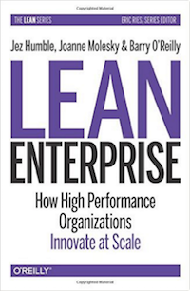
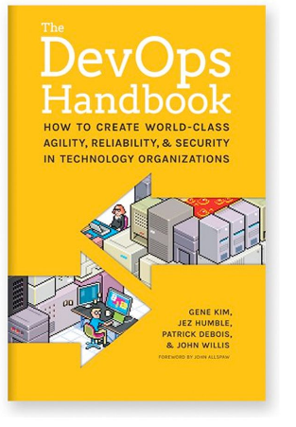
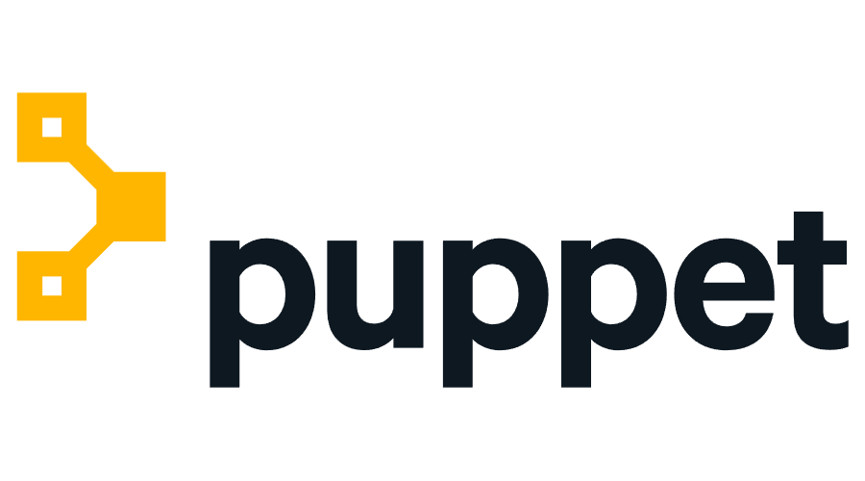
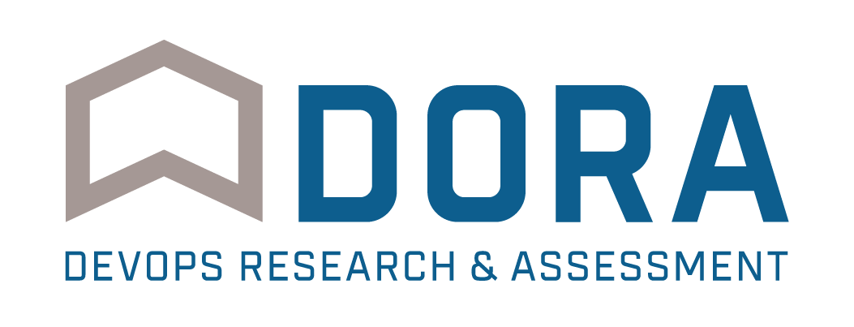
References Used for This Talk
State of DevOps Report 2014-2019

Slide 4
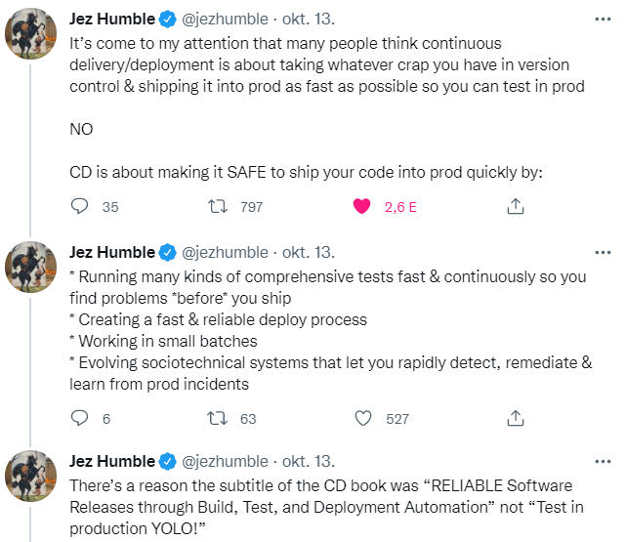
What CD isn’t….

Slide 5
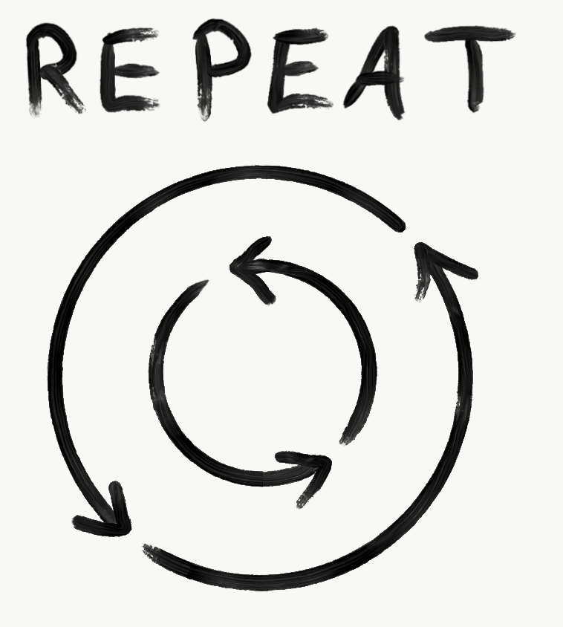
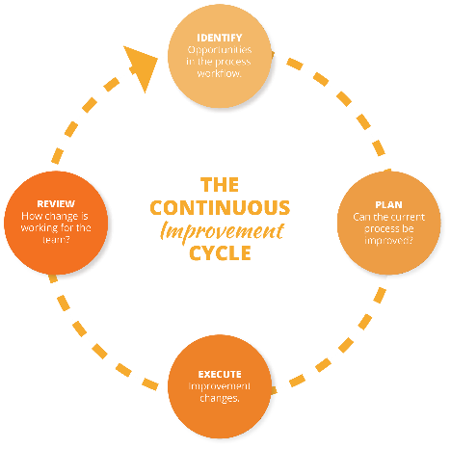
The 5 Most Important Principles of Continuous Delivery
Build quality in
Work in small batches
Computers perform repetitive tasks, people solve problems
Relentlessly pursue continuous improvement
Everyone is responsible

Slide 6
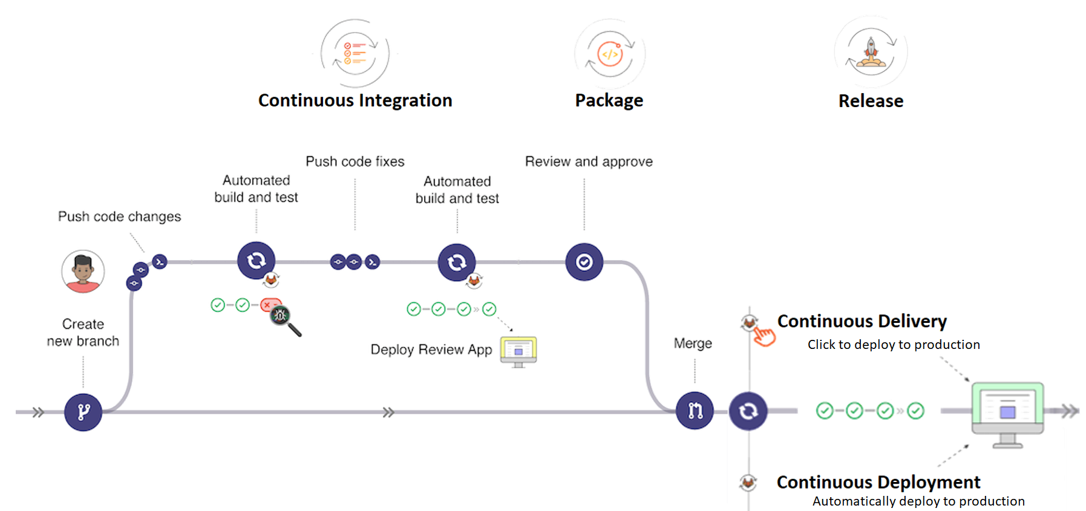
Foundation 1: Continuous Integration
3 important questions:
Are all the engineers pushing their code into trunk / master (not feature branches) on a daily basis?
Does every commit trigger a run of the unit tests?
When the build is broken, is it typically fixed within 10 minutes?

Slide 7
Foundation 2: Configuration Management
Goals: Reproducibility & Traceability
Main benefits:
Disaster recovery
Auditability
Higher quality
Capacity management
Response to defects
Notes:
We have two overriding goals:
Reproducibility: We should be able to provision any environment in a fully automated fashion, and know that any new environment reproduced from the same configuration is identical.
Traceability: We should be able to pick any environment and be able to determine quickly and precisely the versions of every dependency used to create that environment. We also want to to be able to compare previous versions of an environment and see what has changed between them.
These capabilities give us several very important benefits:
Disaster recovery: When something goes wrong with one of our environments, for example a hardware failure or a security breach, we need to be able to reproduce that environment in a deterministic amount of time in order to be able to restore service.
Auditability: In order to demonstrate the integrity of the delivery process, we need to be able to show the path backwards from every deployment to the elements it came from, including their version. Comprehensive configuration management, combined with deployment pipelines, enable this.
Higher quality: The software delivery process is often subject to long delays waiting for development, testing and production environments to be prepared. When this can be done automatically from version control, we can get feedback on the impact of our changes much more rapidly, enabling us to build quality in to our software.
Capacity management: When we want to add more capacity to our environments, the ability to create new reproductions of existing servers is essential. This capability enables the horizontal scaling of modern cloud-based distributed systems.
Response to defects: When we discover a critical defect, or a vulnerability in some component of our system, we want to get a new version of our software released as quickly as possible. Many organizations have an emergency process for this type of change which goes faster by bypassing some of the testing and auditing. This presents an especially serious dilemma in safety-critical systems. Our goal should be to be able to use our normal release process for emergency fixes—which is precisely what continuous delivery enables, on the basis of comprehensive configuration management.

Slide 8
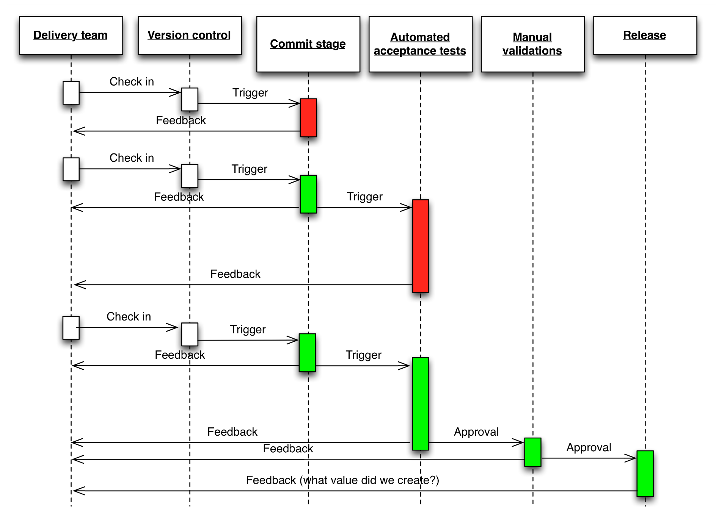
Foundation 3: Continuous Testing
Notes:
The key to building quality into our software is making sure we can get fast feedback on the impact of changes. Traditionally, extensive use was made of manual inspection of code changes and manual testing (testers following documentation describing the steps required to test the various functions of the system) in order to demonstrate the correctness of the system. This type of testing was normally done in a phase following “dev complete”. However this strategy have several drawbacks:
Manual regression testing takes a long time and is relatively expensive to perform, creating a bottleneck that prevents us releasing software more frequently, and getting feedback to developers weeks (and sometimes months) after they wrote the code being tested.
Manual tests and inspections are not very reliable, since people are notoriously poor at performing repetitive tasks such as regression testing manually, and it is extremely hard to predict the impact of a set of changes on a complex software system through inspection.
When systems are evolving over time, as is the case in modern software products and services, we have to spend considerable effort updating test documentation to keep it up-to-date.
In order to build quality in to software, we need to adopt a different approach. Our goal is to run many different types of tests—both manual and automated—continually throughout the delivery process.

Slide 9
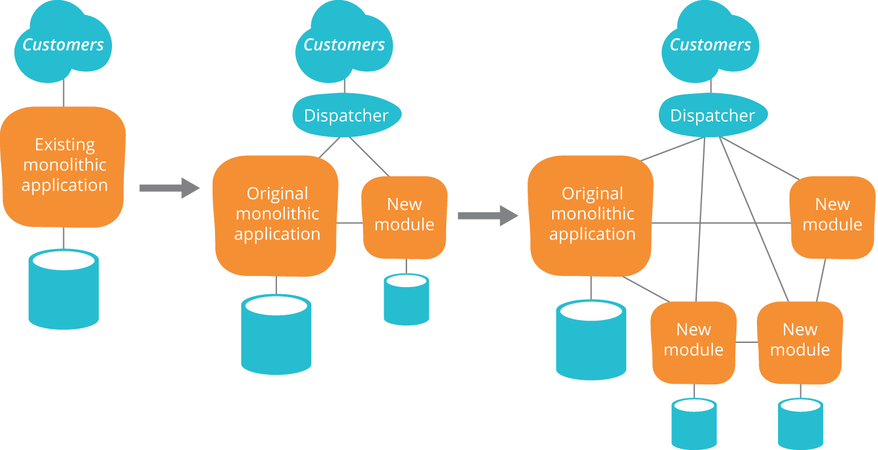
Architectural Patterns
Goals: Testable & Deployable
Notes:
In the context of enterprise architecture there are typically multiple attributes we are concerned about, for example availability, security, performance, usability and so forth. In continuous delivery, we introduce two new architectural attributes: testability and deployability.
In a testable architecture, we design our software such that most defects can (in principle, at least) be discovered by developers by running automated tests on their workstations. We shouldn’t need to depend on complex, integrated environments in order to do the majority of our acceptance and regression testing.
In a deployable architecture, deployments of a particular product or service can be performed independently and in a fully automated fashion, without the need for significant levels of orchestration. Deployable systems can typically be upgraded or reconfigured with zero or minimal downtime.
Where testability and deployability are not prioritized, we find that much testing requires the use of complex, integrated environments, and deployments are “big bang” events that require that many services are released at the same time due to complex interdependencies. These “big bang” deployments require many teams to work together in a carefully orchestrated fashion with many hand-offs, and dependencies between hundreds or thousands of tasks. Such deployments typically take many hours or even days, and require scheduling significant downtime.
Designing for testability and deployability starts with ensuring our products and services are composed of loosely-coupled, well-encapsulated components or modules (in the context of object-oriented programming, such systems follow the principles of SOLID design).
We can define a well-designed modular architecture as one in which it is possible to test or deploy a single component or service on its own, with any dependencies replaced by a suitable test double, which could be in the form of a virtual machine, a stub, or a mock. Each component or service should be deployable in a fully automated fashion on developer workstations, test environments, or in production. In a well-designed architecture, it is possible to get a high level of confidence the component is operating properly when deployed in this fashion.
In order to aid the independent deployment of components, we will also invest in creating versioned APIs which have backwards compatibility. Ensuring backwards compatibility for APIs adds complexity to our systems, but the flexibility we gain in terms of ease of deployment will pay this off many times over.
Any true service-oriented architecture should have these properties—but unfortunately many do not. However, the microservices movement has explicitly prioritized these architectural properties.
Evolutionary architecture
Of course, many organizations are living in a world where services are distinctly hard to test and deploy. Rather than re-architecting everything, we recommend an iterative approach to improving the design of enterprise system, sometimes known as evolutionary architecture. In the evolutionary architecture paradigm, we accept that successful products and services will require re-architecting during their lifecycle due to the changing requirements placed on them.
One pattern that is particularly valuable in this context is the strangler application. In this pattern, we iteratively replace a monolithic architecture with a more componentized one by ensuring that new work is done following the principles of a service-oriented architecture, while accepting that the new architecture may well delegate to the system it is replacing. Over time, more and more functionality will be performed in the new architecture, and the old system being replaced is “strangled”.

Slide 10
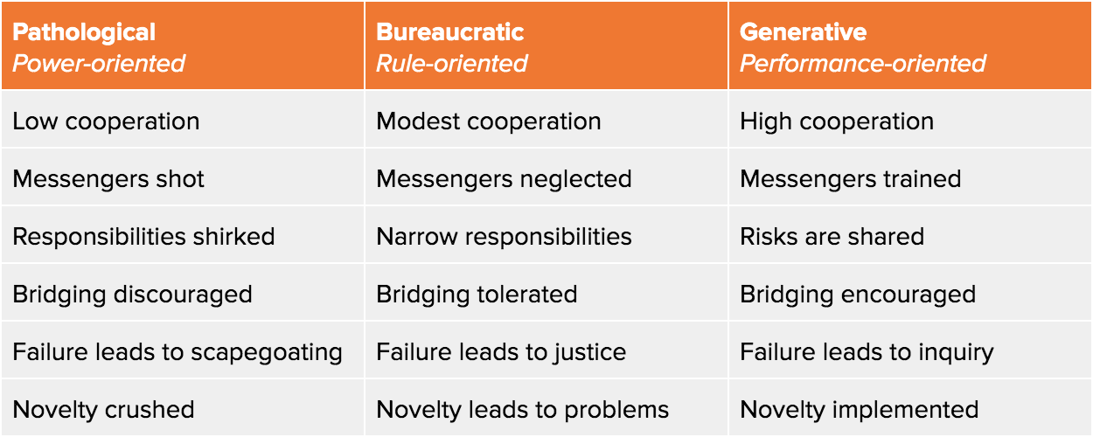
Cultural Patterns
Westrum organizational culture:
A generative, high-trust culture drives better organizational and software delivery performance
Notes:
In the context of enterprise architecture there are typically multiple attributes we are concerned about, for example availability, security, performance, usability and so forth. In continuous delivery, we introduce two new architectural attributes: testability and deployability.
In a testable architecture, we design our software such that most defects can (in principle, at least) be discovered by developers by running automated tests on their workstations. We shouldn’t need to depend on complex, integrated environments in order to do the majority of our acceptance and regression testing.
In a deployable architecture, deployments of a particular product or service can be performed independently and in a fully automated fashion, without the need for significant levels of orchestration. Deployable systems can typically be upgraded or reconfigured with zero or minimal downtime.
Where testability and deployability are not prioritized, we find that much testing requires the use of complex, integrated environments, and deployments are “big bang” events that require that many services are released at the same time due to complex interdependencies. These “big bang” deployments require many teams to work together in a carefully orchestrated fashion with many hand-offs, and dependencies between hundreds or thousands of tasks. Such deployments typically take many hours or even days, and require scheduling significant downtime.
Designing for testability and deployability starts with ensuring our products and services are composed of loosely-coupled, well-encapsulated components or modules (in the context of object-oriented programming, such systems follow the principles of SOLID design).
We can define a well-designed modular architecture as one in which it is possible to test or deploy a single component or service on its own, with any dependencies replaced by a suitable test double, which could be in the form of a virtual machine, a stub, or a mock. Each component or service should be deployable in a fully automated fashion on developer workstations, test environments, or in production. In a well-designed architecture, it is possible to get a high level of confidence the component is operating properly when deployed in this fashion.
In order to aid the independent deployment of components, we will also invest in creating versioned APIs which have backwards compatibility. Ensuring backwards compatibility for APIs adds complexity to our systems, but the flexibility we gain in terms of ease of deployment will pay this off many times over.
Any true service-oriented architecture should have these properties—but unfortunately many do not. However, the microservices movement has explicitly prioritized these architectural properties.
Evolutionary architecture
Of course, many organizations are living in a world where services are distinctly hard to test and deploy. Rather than re-architecting everything, we recommend an iterative approach to improving the design of enterprise system, sometimes known as evolutionary architecture. In the evolutionary architecture paradigm, we accept that successful products and services will require re-architecting during their lifecycle due to the changing requirements placed on them.
One pattern that is particularly valuable in this context is the strangler application. In this pattern, we iteratively replace a monolithic architecture with a more componentized one by ensuring that new work is done following the principles of a service-oriented architecture, while accepting that the new architecture may well delegate to the system it is replacing. Over time, more and more functionality will be performed in the new architecture, and the old system being replaced is “strangled”.

Slide 11
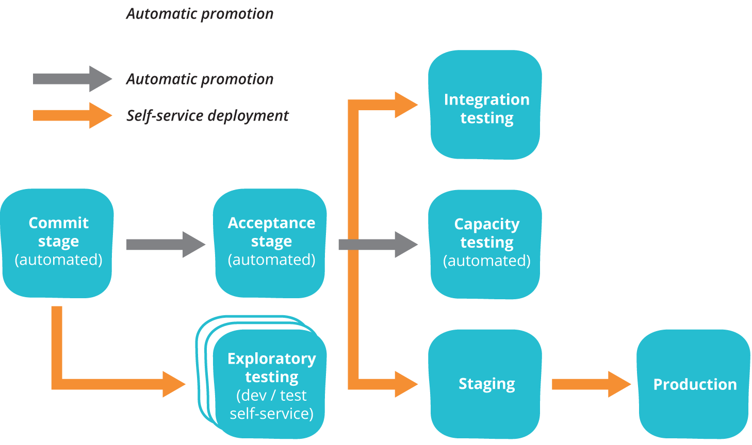
The Deployment Pipeline
Remember!
Low-risk Releases are Incremental
Focus on Reducing Batch Size
Decouple Deployment and Release
Optimize for MTTR
Key practices:
Only build packages once
Keep your environments similar
Deploy the same way to every environment
Smoke test your deployments
Notes:
The key pattern introduced in continuous delivery is the deployment pipeline. This pattern emerged from several ThoughtWorks projects where we were struggling with complex, fragile, painful manual processes for preparing testing and production environments and deploying builds to them. We’d already worked to automate a significant amount of the regression and acceptance testing, but it was taking weeks to get builds to integrated environments for full regression testing, and our first deployment to production took an entire weekend.
We wanted to industrialize the process of taking changes from version control to production. Our goal was to make deployment to any environment a fully automated, scripted process that could be performed on demand in minutes (on the original project we got it down to less than an hour, which was a big deal for an enterprise system in 2005). We wanted to be able to configure testing and production environments purely from configuration files stored in version control. The apparatus we used to perform these tasks (usually in the form of a bunch of scripts in bash or ruby) became known as deployment pipelines, which Dan North, Chris Read and I wrote up in a paper presented at the Agile 2006 conference.
In the deployment pipeline pattern, every change in version control triggers a process (usually in a CI server) which creates deployable packages and runs automated unit tests and other validations such as static code analysis. This first step is optimized so that it takes only a few minutes to run. If this initial commit stage fails, the problem must be fixed immediately—nobody should check in more work on a broken commit stage. Every passing commit stage triggers the next step in the pipeline, which might consist of a more comprehensive set of automated tests. Versions of the software that pass all the automated tests can then be deployed on demand to further stages such as exploratory testing, performance testing, staging, and production, as shown below.
Deployment pipelines tie together configuration management, continuous integration and test and deployment automation in a holistic, powerful way that works to improve software quality, increase stability, and reduce the time and cost required to make incremental changes to software, whatever domain you’re operating in. When building a deployment pipeline, we’ve found the following practices valuable:
Only build packages once. We want to be sure the thing we’re deploying is the same thing we’ve tested throughout the deployment pipeline, so if a deployment fails we can eliminate the packages as the source of the failure.
Deploy the same way to every environment—including development. This way, we test the deployment process many, many times before it gets to production, and again, we can eliminate it as the source of any problems.
Smoke test your deployments. Have a script that validates all your application’s dependencies are available, at the location you have configured your application. Make sure your application is running and available as part of the deployment process.
Keep your environments similar. Although they may differ in hardware configuration, they should have the same version of the operating system and middleware packages, and they should be configured in the same way. This has become much easier to achieve with modern virtualization and container technology.
With the advent of infrastructure as code, it has became possible to use deployment pipelines to create a fully automated process for taking all kinds of changes—including database and infrastructure changes—from version control into production in a controlled, repeatable and auditable way. This pattern has also been successfully applied in the context of user-installed software (including apps), firmware, and mainframes. In The Practice of Cloud System Administration the resulting system is known as a software delivery platform.
Deployment pipelines are described at length in Chapter 5 of the Continuous Delivery book, which is available for free. I introduce them on this site in the context of continuous testing.
Patterns for Low-Risk Releases
In the context of web-based systems there are a number of patterns that can be applied to further reduce the risk of deployments. Michael Nygard also describes a number of important software design patterns which are instrumental in creating resilient large-scale systems in his book Release It!
The four key principles that enable low-risk releases (along with many of the following patterns) are described in my article Four Principles of Low-Risk Software Releases. These principles are:
Low-risk Releases are Incremental. Our goal is to architect our systems such that we can release individual changes (including database changes) independently, rather than having to orchestrate big-bang releases due to tight coupling between multiple different systems. This typically requires building versioned APIs and implementing patterns such as circuit breaker.
Decouple Deployment and Release. Releasing new versions of your system shouldn’t require downtime. In the 2005 project that began my continuous delivery journey, we used a pattern called blue-green deployment to enable sub-second downtime and rollback, even though it took tens of minutes to perform the deployment. Our ultimate goal is to separate the technical decision to deploy from the business decision to launch a feature, so we can deploy continuously but release new features on demand. Two commonly-used patterns that enable this goal are dark launching and feature toggles.
Focus on Reducing Batch Size. Counterintuitively, deploying to production more frequently actually reduces the risk of release when done properly, simply because the amount of change in each deployment is smaller. When each deployment consists of tens of lines of code or a few configuration settings, it becomes much easier to perform root cause analysis and restore service in the case of an incident. Furthermore, because we practice the deployment process so frequently, we’re forced to simplify and automate it which further reduces risk.
Optimize for Resilience. Once we accept that failures are inevitable, we should start to move away from the idea of investing all our effort in preventing problems, and think instead about how to restore service as rapidly as possible when something goes wrong. Furthermore, when an accident occurs, we should treat it as a learning opportunity. The patterns described on this page are known to work at scale in all kinds of environments, and demonstrably increase throughput while at the same time increasing stability in production. However resilience isn’t just a feature of our systems, it’s a characteristic of our culture. High performance organizations are constantly working to improve the resilience of their systems by trying to break them and implementing the lessons learned in the course of doing so.

Slide 12
Summary – Key Benefits of CD
Continuous delivery (CD) is a software engineering approach in which
Teams produce software in short cycles
Ensures that the software can be reliably released at any time
Can release the software without manual intervention
Key benefits
Faster time to market
Low risk releases
Higher quality
Lower costs
Better products
Happier teams

