Slide 1
Where is The Money?
Making costs visible in the AWS Cloud
Balazs Vegvari
26/Apr/2022

Slide 2
Cloud Value Proposition - Recap
Increased speed and agility
Go global in minutes
No upfront investment
Benefit from economies of scale
Pay for only what you use

Slide 3
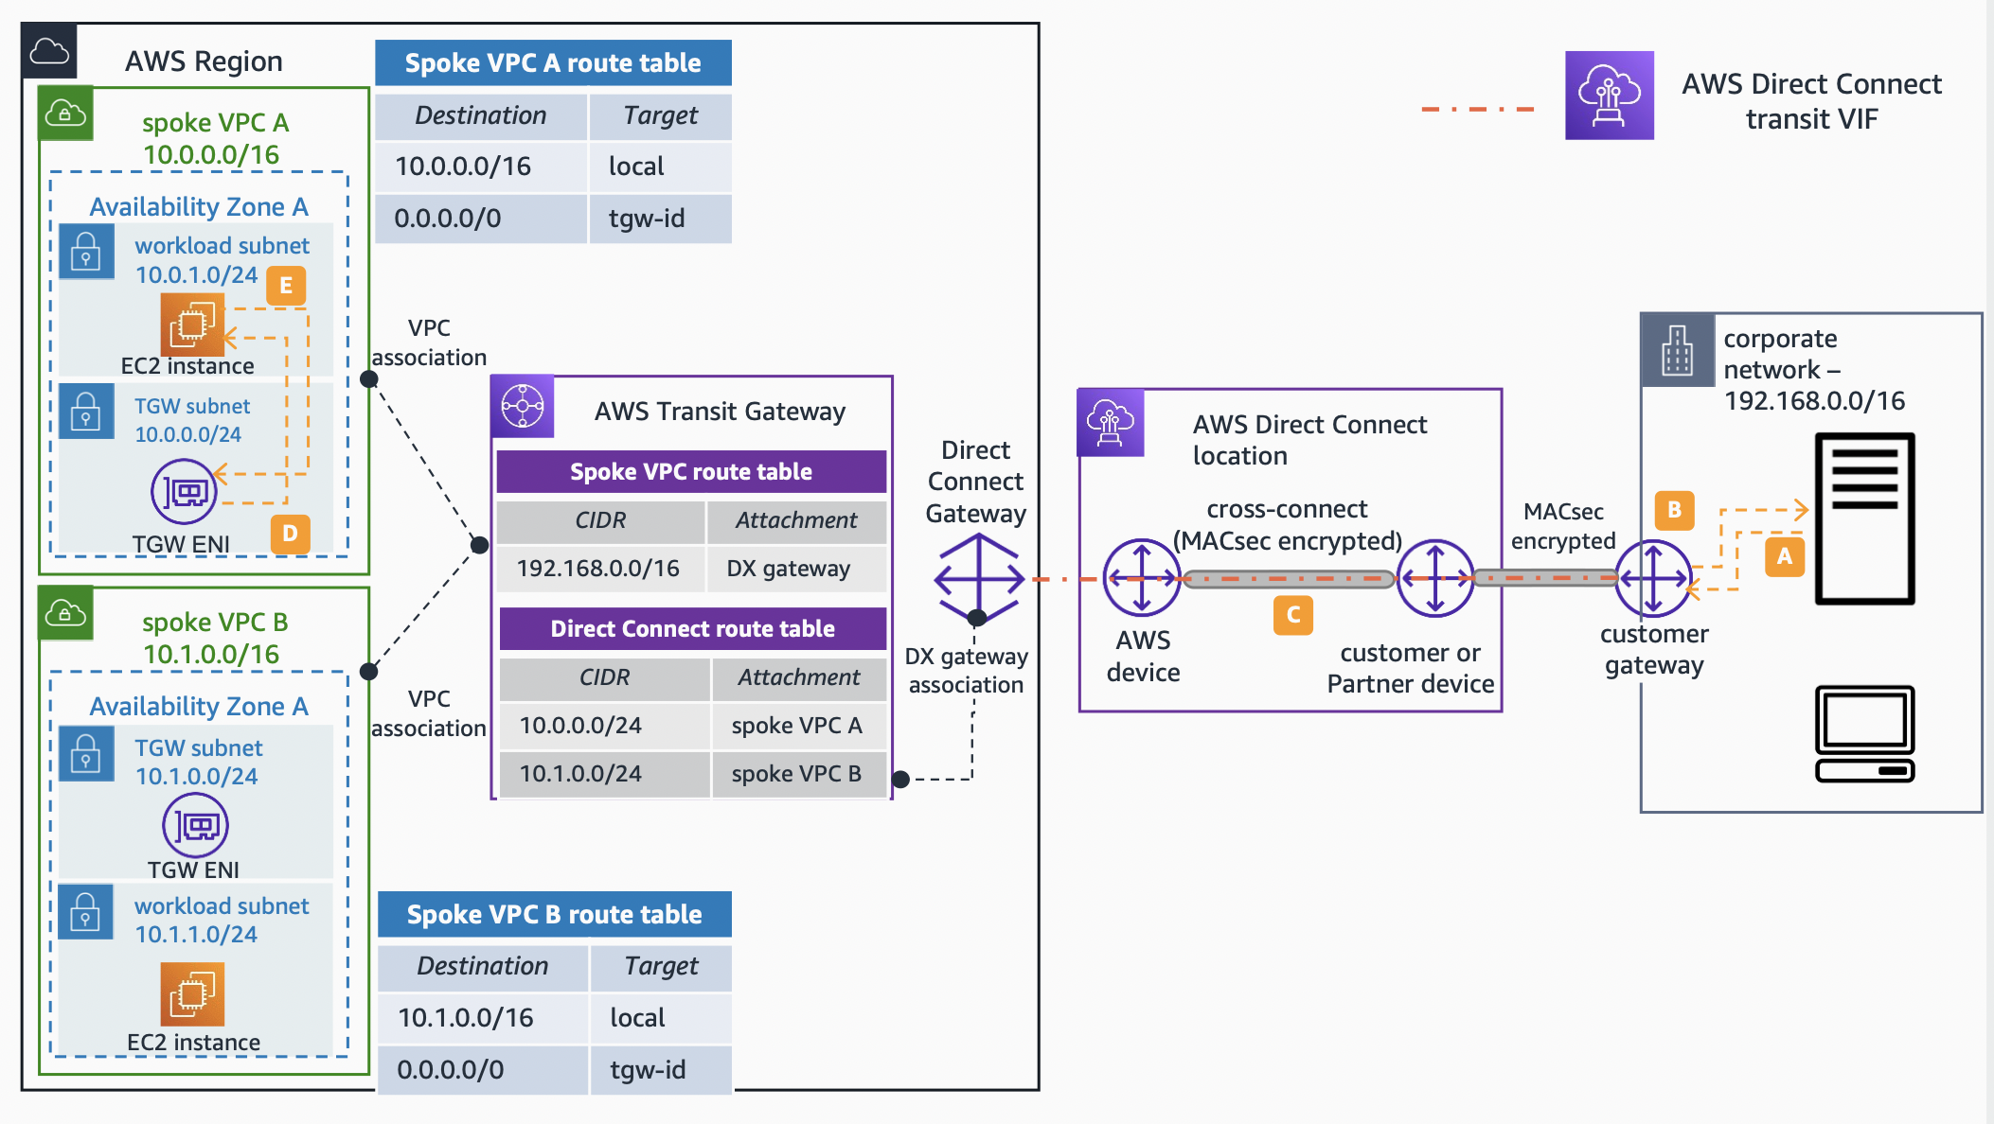
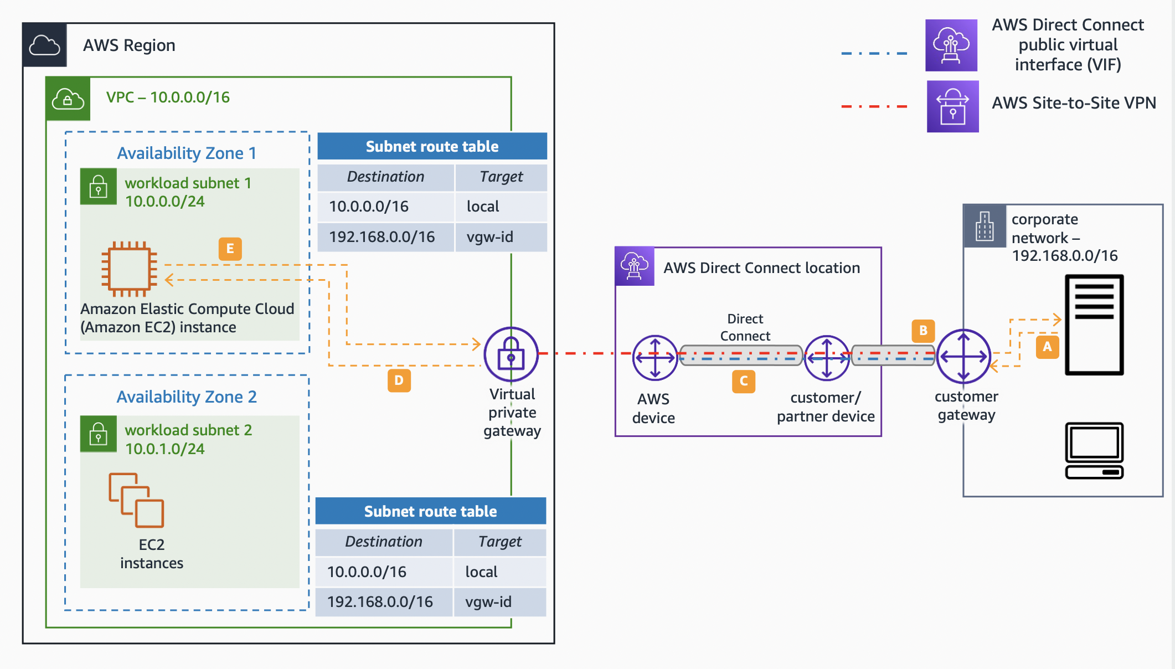
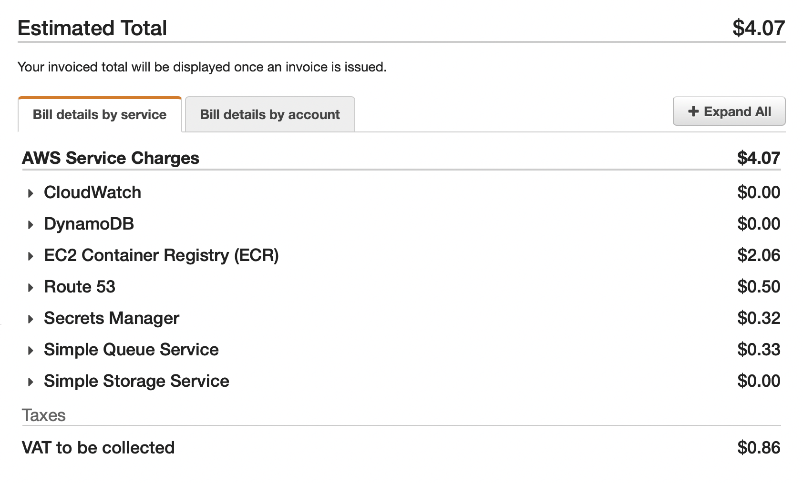
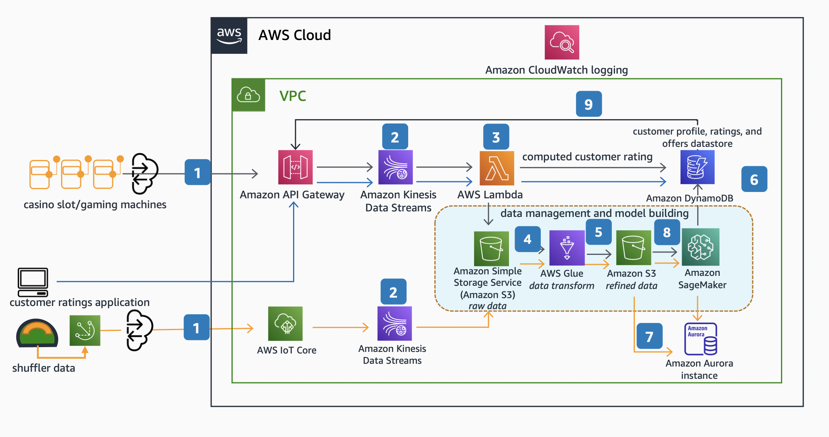
A Few Weeks Later…
Image credits: https://aws.amazon.com/architecture

Slide 4

First Step in FinOps: Understand Your Costs
Cost Allocation Tags
Cost Categories
Consolidated Billing

Slide 5
Cost Allocation Tags

Slide 6
Invoice Details
Only basic cost categorization
(per service and per account)
We need better than this

Slide 7
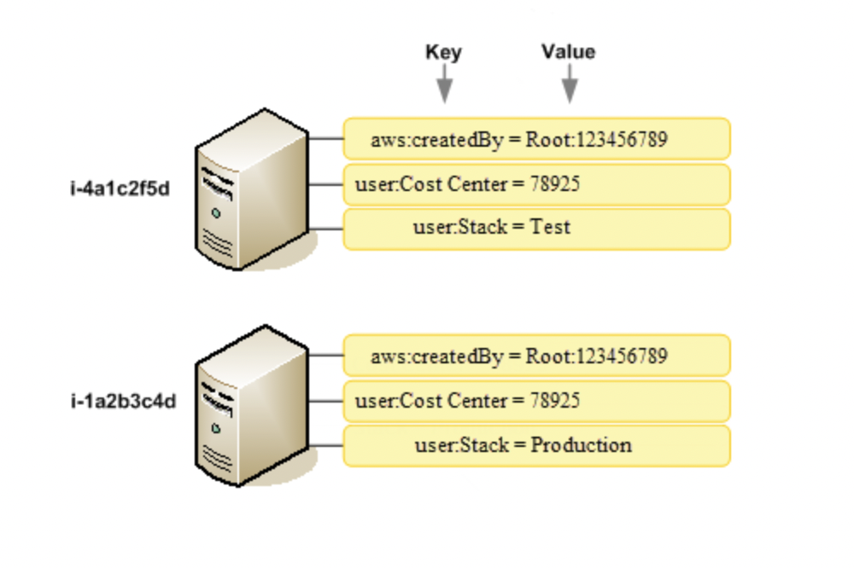
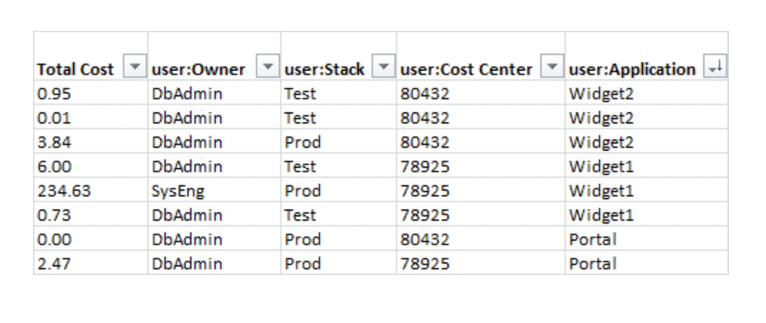
Cost Allocation Tags
What is a Tag?
A Label that AWS or You attach to resources
It has many use cases (security, cost management, etc)
You can designate some of your tags as Cost Allocation Tags
Two flavours: AWS Defined, User Defined
You can assign many tags to a resource
Cost-management tags must be activated in the Billing Console
Once activated, they appear in the Cost Allocation Report:
Image credits: https://docs.aws.amazon.com/awsaccountbilling

Slide 8
Cost Categories

Slide 9
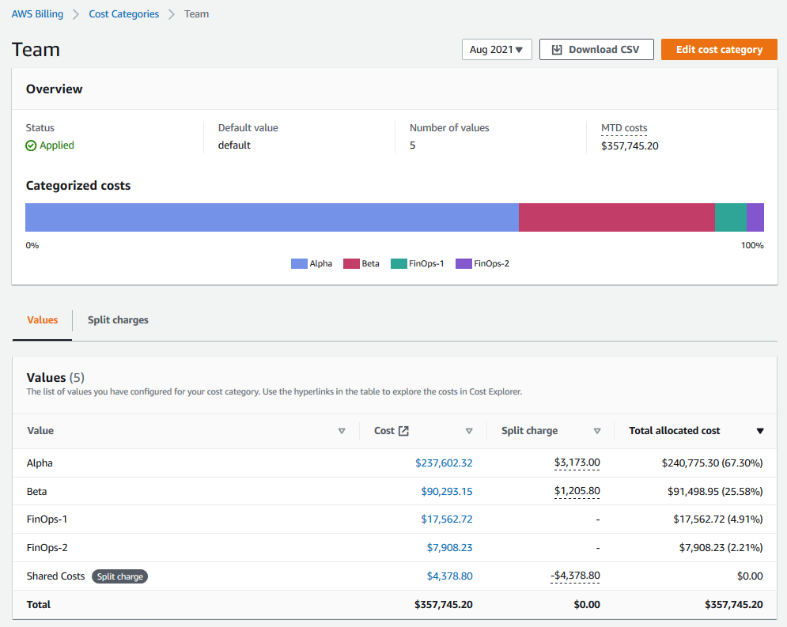
Cost Category Overview
Organize costs into Categories by defining rules
Use Cost Categories in multiple products to slice & dice your costs:
Cost Explorer
AWS Budgets
AWS Cost and Usage Reports, and
Cost Anomaly Detection

Slide 10
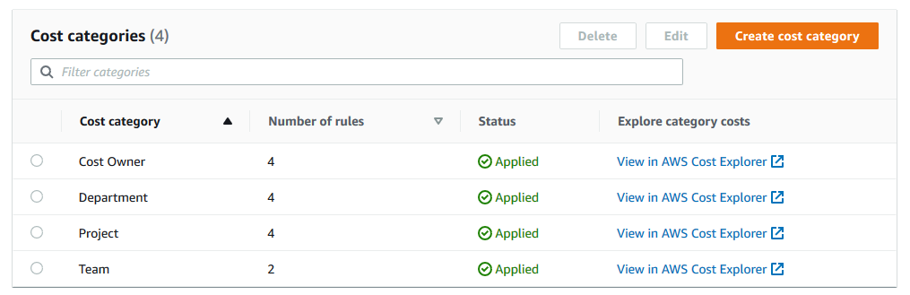
Define Cost Categories

Slide 11
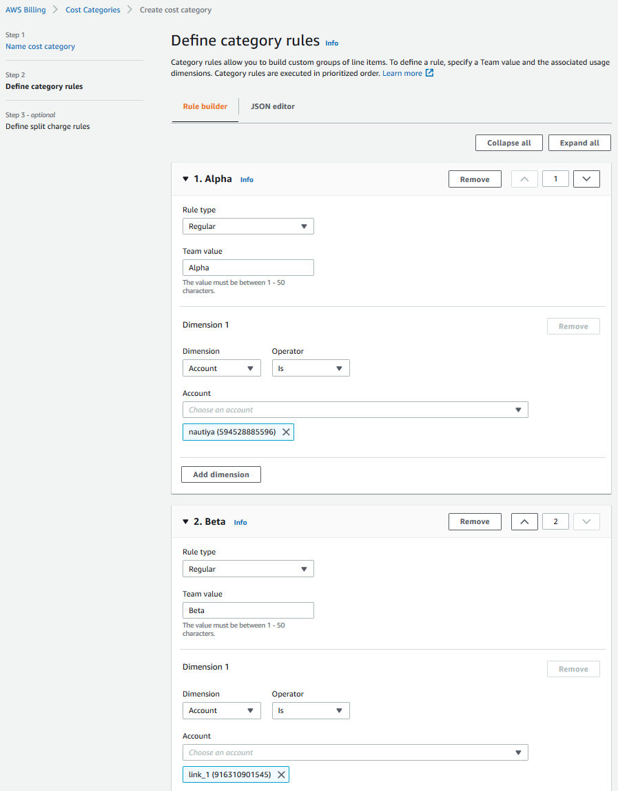
Create Category Rules
Every rule can combine multiple dimensions to match.
Dimensions can be Account, Cost Allocation Tag, Charge Type, Service or Cost Category.
The Operator depends on the Dimension.

Slide 12
View Costs by Categories

Slide 13
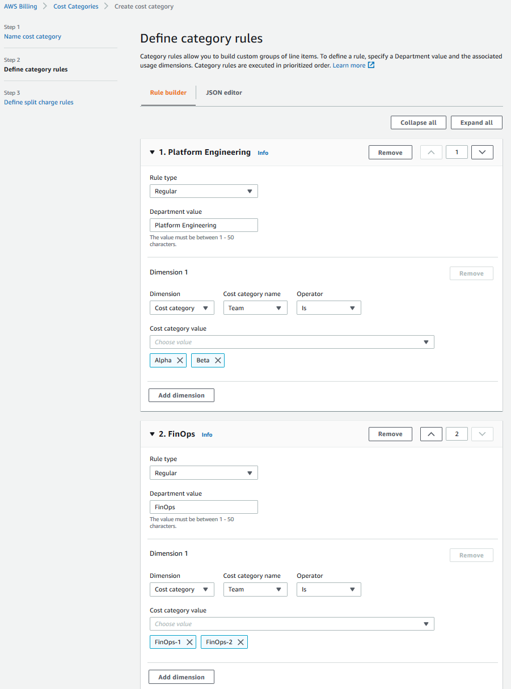
Create Hierarchical Rules

Slide 14
Cost Allocation Tags vs Cost Categories
Tags
Can be attached to specific resources only (for example an S3 bucket)
Can not be organized to Hierarchies
Can not be attached to Accounts
Categories
Can be attached to ‘services’, for example measeure S3 usage in general
Can categorize non resource-related costs (enterprise support cost, data transfer costs, etc)
Can organize/group accounts to track them together

Slide 15
Consolidated Billing

Slide 16
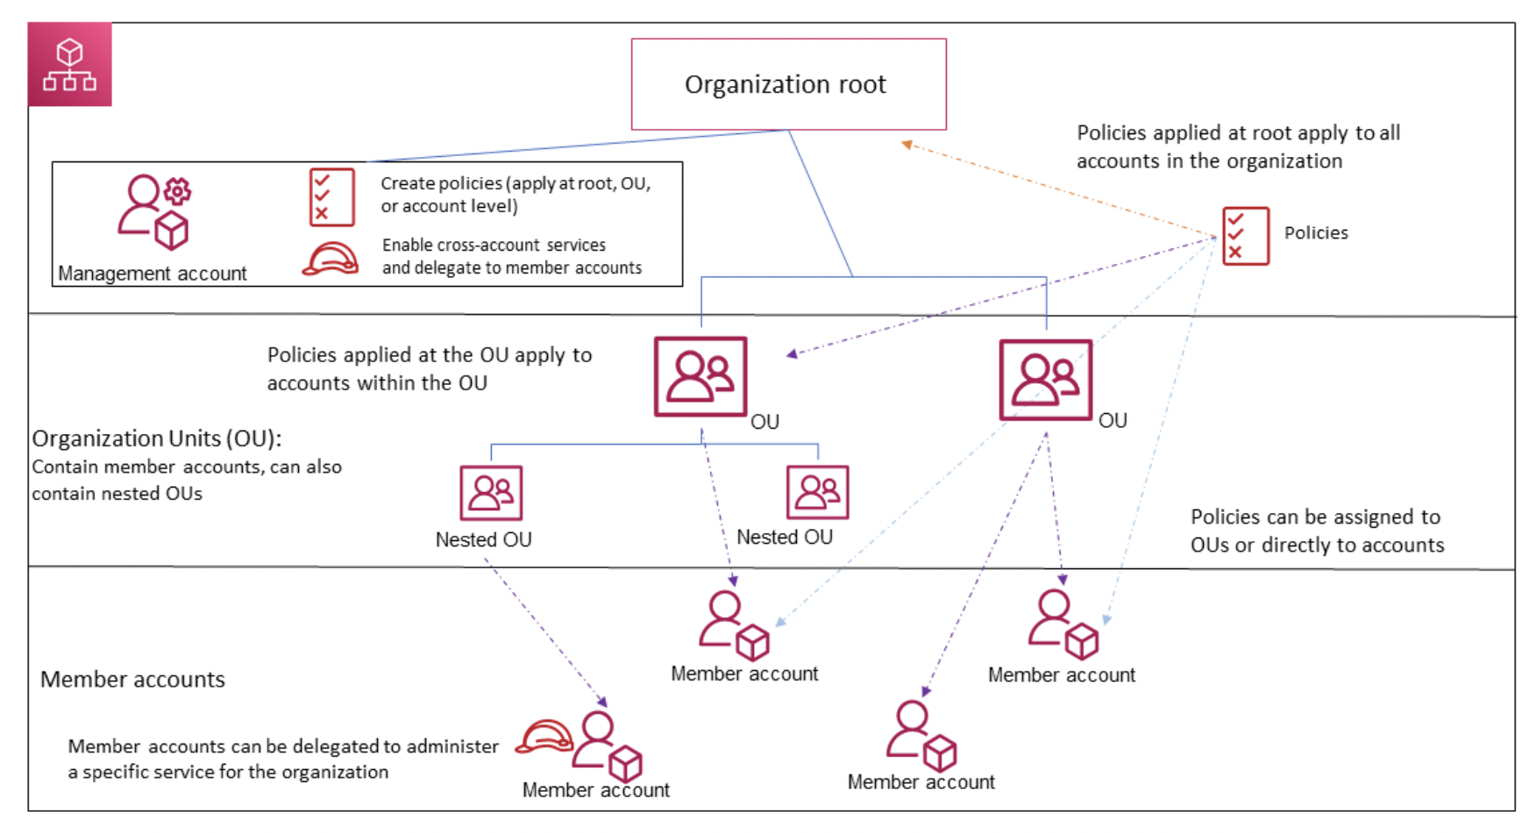
AWS Organizations
Image credits: https://docs.aws.amazon.com/organizations

Slide 17
Billing in Organizations
Single bill (Management Account)
strucured according to the organization hierarchy
Individual accounts see billing items only for their account
All usage is combined
affects tiered pricing (free & non-free)

