Slide 1
FinOps for Beginners
Why FinOps if getting popular nowadays?

Slide 2
Lufthansa Systems Goes Cloud
350+ customer airlines
100+ products
Since 2017 in the Cloud

Slide 3
The Rise of Cloud
Enterprise IT spending on public cloud computing will overtake spending on traditional IT in 2025 (Gartner)

Slide 4
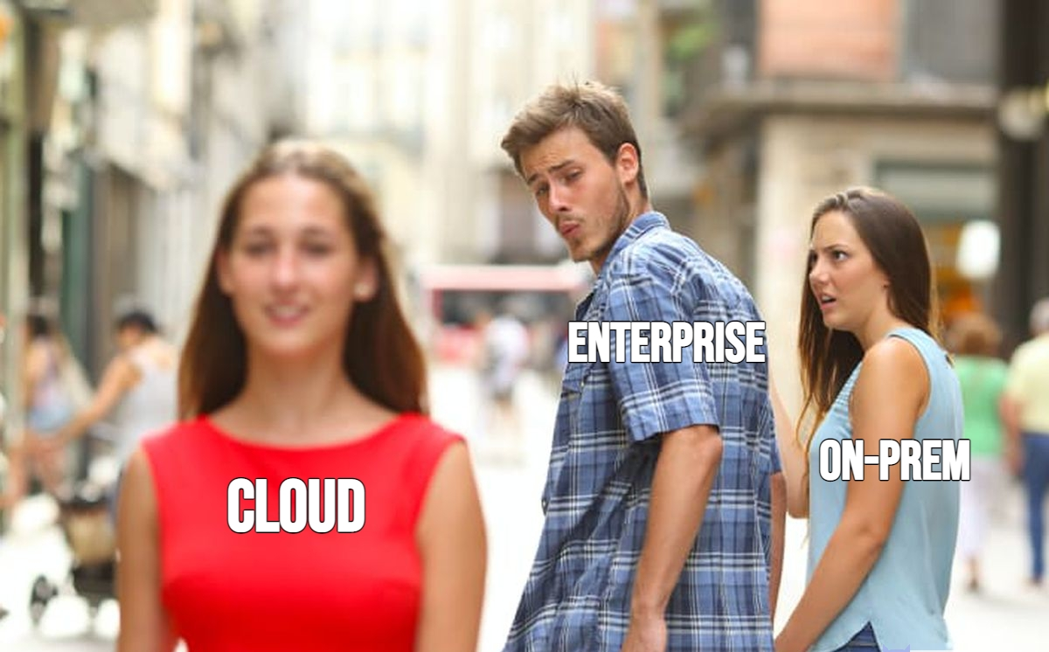
Why Cloud?

Slide 5
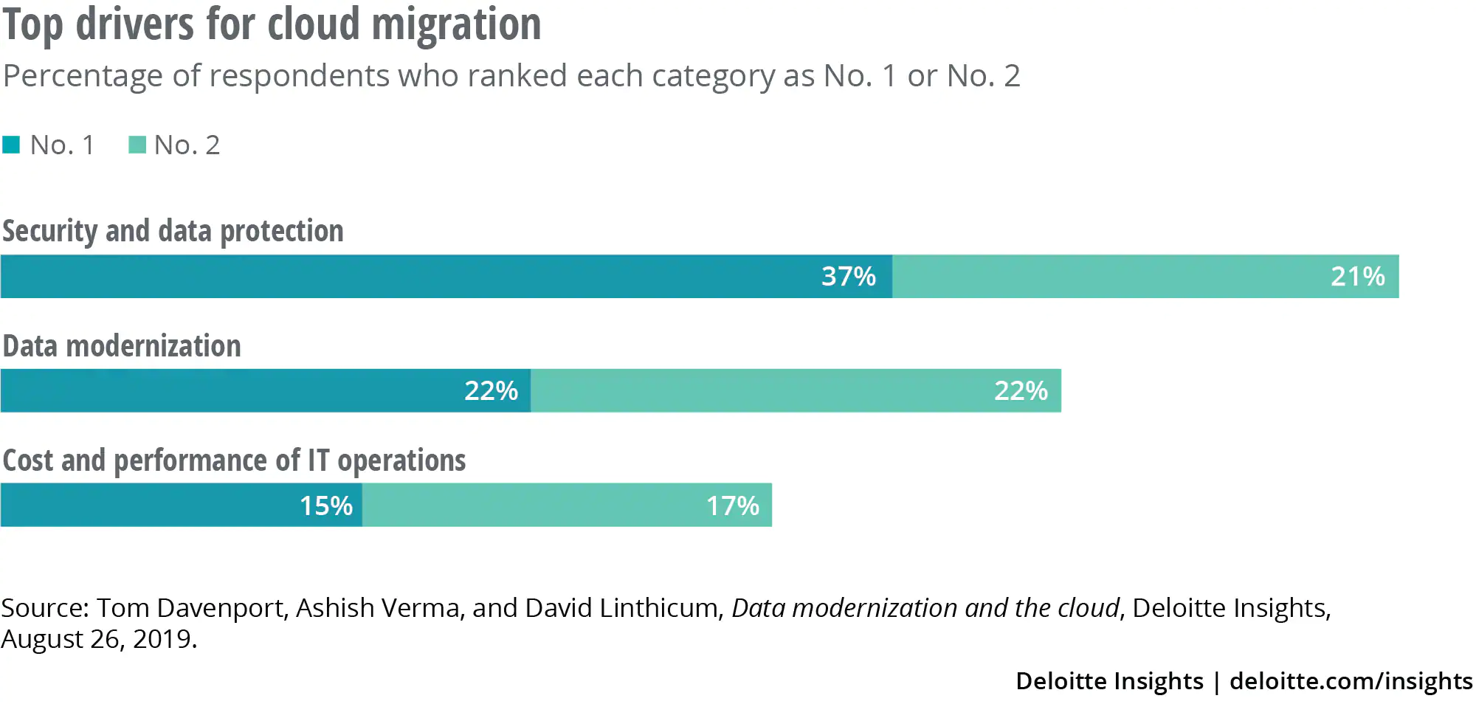
Why Cloud?
Business Agility/Flexibility (→ DevOps!)
New Technologies
Accessibility
Security
Costs!

Slide 6
Cloud is cheaper, really?
Cost
Time

Slide 7
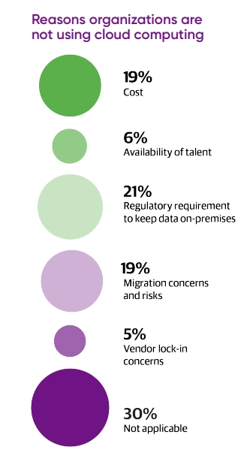
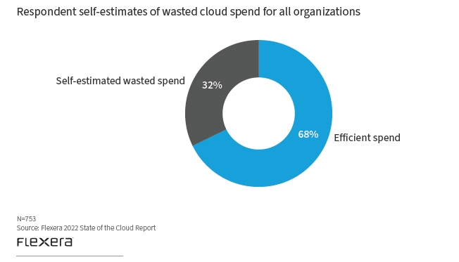
Cloud Challenges

Slide 8
Cloud Challenges

Slide 9
Cloud – DevOps on Steroids
xOps
Basic Cloud Capabilities
FinOps
DevOps
SecOps

Slide 10
FinOps and the Organization
Business
FinOps
IT
Finance

Slide 11
The Iron Triangle
FAST
CHEAP
GOOD

Slide 12
FinOps Principles
Business value 01
Business value of Cloud drives decisions
Transparency 04
FinOps reports should be accessible and timely
Collaboration 02
Teams need to collaborate
Variable cost model 05
Take advantage of the variable cost model of the Cloud
Ownership 03
Everyone takes ownership for their clous usage
Centralized FinOps 06
A centralized team drives FinOps

Slide 13
FinOps brings financial accountability to variable cloud spend with:
➔ A prescriptive model of actions, best practices and culture
➔ That enables distributed product, business and finance team
➔ To make decision that increase the business value

Slide 14
FinOps Lifecycle Action Loop
Inform – report KPIs, allocate costs, forecast etc.
Optimize
Inform
FinOps Culture
Optimize – rightsizing, elasticity, discounts, VM generations etc.
Operate
Operate – automation, unit economics, communication etc.

Slide 15
FinOps Lifecycle vs. “blind run”
Speeend
Freeeze
Budget
Invoice
Buy all the things
Inform
Inform
Inform
…
Inform
Operate
Operate
Operate
Operate
Optimize
Optimize
Optimize
Optimize

Slide 16
FinOps – the Past and the Future
FinOps Foundation
established in 2019 by Linux Foundation
“opensource” community
2500 members
www.FinOps.org - blueprints, trainings, useful resources

