Slide 1
Jetpack Compose The Future of the Android UI in a Nutshell
István Juhos

Slide 2
What is Jetpack Compose?
Declarative
Like React (Native), Flutter, and SwiftUI
Component-based
Unbundled
The UI is a function of the UI state
Notes:
Stable since 2021. July

Slide 3
What is Jetpack Compose?
Declarative
Like React (Native), Flutter, and SwiftUI
Component-based
Unbundled
The UI is a function of the UI state
f(state)
=
UI
Notes:
Quick iteration, fast previews
Aims for being multiplatform too

Slide 4
What is Jetpack Compose?
Uses Composable functions to describe UI components
Kotlin for writing UI
Two-way interoperability
Works with existing View-based UI
Notes:
​Comes as a set of libraries Not tied to OS versions

Slide 5
How we write UI now
View objects inflated from XML layout files
Themes and value resources in XML
View Binding / Data Binding
Code generation and a pinch of pixie dust… ✨
@BindingAdapters all over the place 🕵️
A huge effort, error-prone

Slide 6
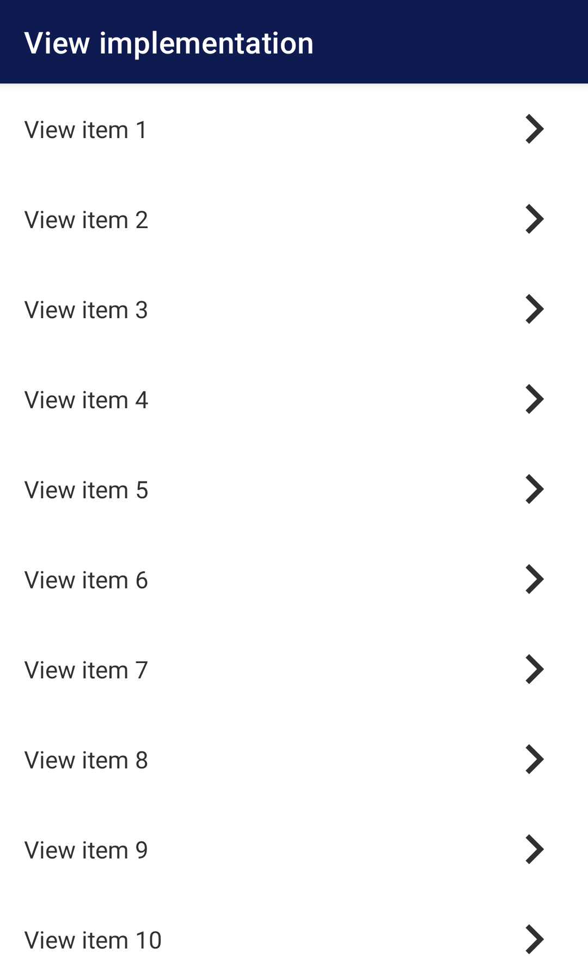
A simple list – Android View

Slide 7
A simple list – Android View
ConstraintLayout

Slide 8
A simple list – Android View
MaterialToolbar
ConstraintLayout
RecyclerView

Slide 9
A simple list – Android View
MaterialToolbar
List item view…
List item view…
ConstraintLayout
RecyclerView

Slide 10
A simple list – Android View
List item view
- layout_item.xml
<?xml version="1.0" encoding="utf-8"?> <androidx.constraintlayout.widget.ConstraintLayout
xmlns:android="http://schemas.android.com/apk/res/android" xmlns:app="http://schemas.android.com/apk/res-auto" xmlns:tools="http://schemas.android.com/tools" android:layout_width="match_parent" android:layout_height="60dp" android:paddingVertical="8dp" android:paddingHorizontal="16dp“> <TextView android:id="@+id/itemText" android:layout_width="0dp" android:layout_height="wrap_content" android:layout_marginEnd="16dp" android:textSize="16sp" android:textColor="@color/grey" app:layout_constraintBottom_toBottomOf="parent" app:layout_constraintEnd_toStartOf="@id/itemForwardArrow" app:layout_constraintStart_toStartOf="parent" app:layout_constraintTop_toTopOf="parent" tools:text="Test view item“/> <ImageView android:id="@+id/itemForwardArrow" android:layout_width="40dp" android:layout_height="40dp" app:layout_constraintBottom_toBottomOf="parent" app:layout_constraintEnd_toEndOf="parent" app:layout_constraintTop_toTopOf="parent" tools:ignore="ContentDescription" android:src="@drawable/ic_chevron_right" app:tint="@color/grey“/>
</androidx.constraintlayout.widget.ConstraintLayout>

Slide 11
A simple list – Android View
Layout of a Fragment
- fragment_view.xml
<?xml version="1.0" encoding="utf-8"?> <androidx.constraintlayout.widget.ConstraintLayout
xmlns:android="http://schemas.android.com/apk/res/android" xmlns:app="http://schemas.android.com/apk/res-auto" android:layout_width="match_parent" android:layout_height="match_parent"> <com.google.android.material.appbar.MaterialToolbar android:id="@+id/toolbar" android:layout_width="0dp" android:layout_height="wrap_content" app:layout_constraintEnd_toEndOf="parent" app:layout_constraintStart_toStartOf="parent" app:layout_constraintTop_toTopOf="parent" app:title="View implementation" style="@style/Theme.ComposeDemo.AppBarOverlay"/> <androidx.recyclerview.widget.RecyclerView android:id="@+id/list" android:layout_width="0dp" android:layout_height="0dp" app:layout_constraintBottom_toBottomOf="parent" app:layout_constraintEnd_toEndOf="parent" app:layout_constraintStart_toStartOf="parent" app:layout_constraintTop_toBottomOf="@id/toolbar" app:layoutManager="androidx.recyclerview.widget.LinearLayoutManager"/>
</androidx.constraintlayout.widget.ConstraintLayout>

Slide 12
A simple list – Android View
Fragment
- ViewFragment.kt
class ViewFragment : Fragment() { lateinit var adapter: ViewItemAdapter override fun onCreateView( inflater: LayoutInflater, container: ViewGroup?, savedInstanceState: Bundle?, ): View = inflater.inflate(R.layout.fragment_view, container, false) override fun onViewCreated(view: View, savedInstanceState: Bundle?) { super.onViewCreated(view, savedInstanceState) adapter = ViewItemAdapter() val list = view.findViewById<RecyclerView>(R.id.list) list.adapter = adapter adapter.submitList( mutableListOf<Item>().apply { (1..30).forEach { add(Item("View item $it")) } } ) } }

Slide 13
A simple list – Android View
Adapter
- ViewItemAdapter.kt
class ViewItemAdapter : ListAdapter<Item, ItemViewHolder>(ItemDiffUtil()) { override fun onCreateViewHolder(parent: ViewGroup, viewType: Int): ItemViewHolder = ItemViewHolder( LayoutInflater.from(parent.context) .inflate(R.layout.layout_item, parent, false) ) override fun onBindViewHolder(holder: ItemViewHolder, position: Int) { holder.bind(getItem(position)) } inner class ItemViewHolder(itemView: View) : ViewHolder(itemView) { private val itemText: TextView = itemView.findViewById(R.id.itemText) fun bind(item: Item) { itemText.text = item.text } } } class ItemDiffUtil : DiffUtil.ItemCallback<Item>() { override fun areItemsTheSame(oldItem: Item, newItem: Item): Boolean { return oldItem == newItem } override fun areContentsTheSame(oldItem: Item, newItem: Item): Boolean { return oldItem == newItem } }

Slide 14
How we’ll write UI with Compose
Layouts in Kotlin – as Composable functions
Themes in Kotlin – as Composable functions
Value resources in Kotlin
Drawables, translations, dimensions etc. can still come from the usual sources
The UI is composed based on the current state

Slide 15
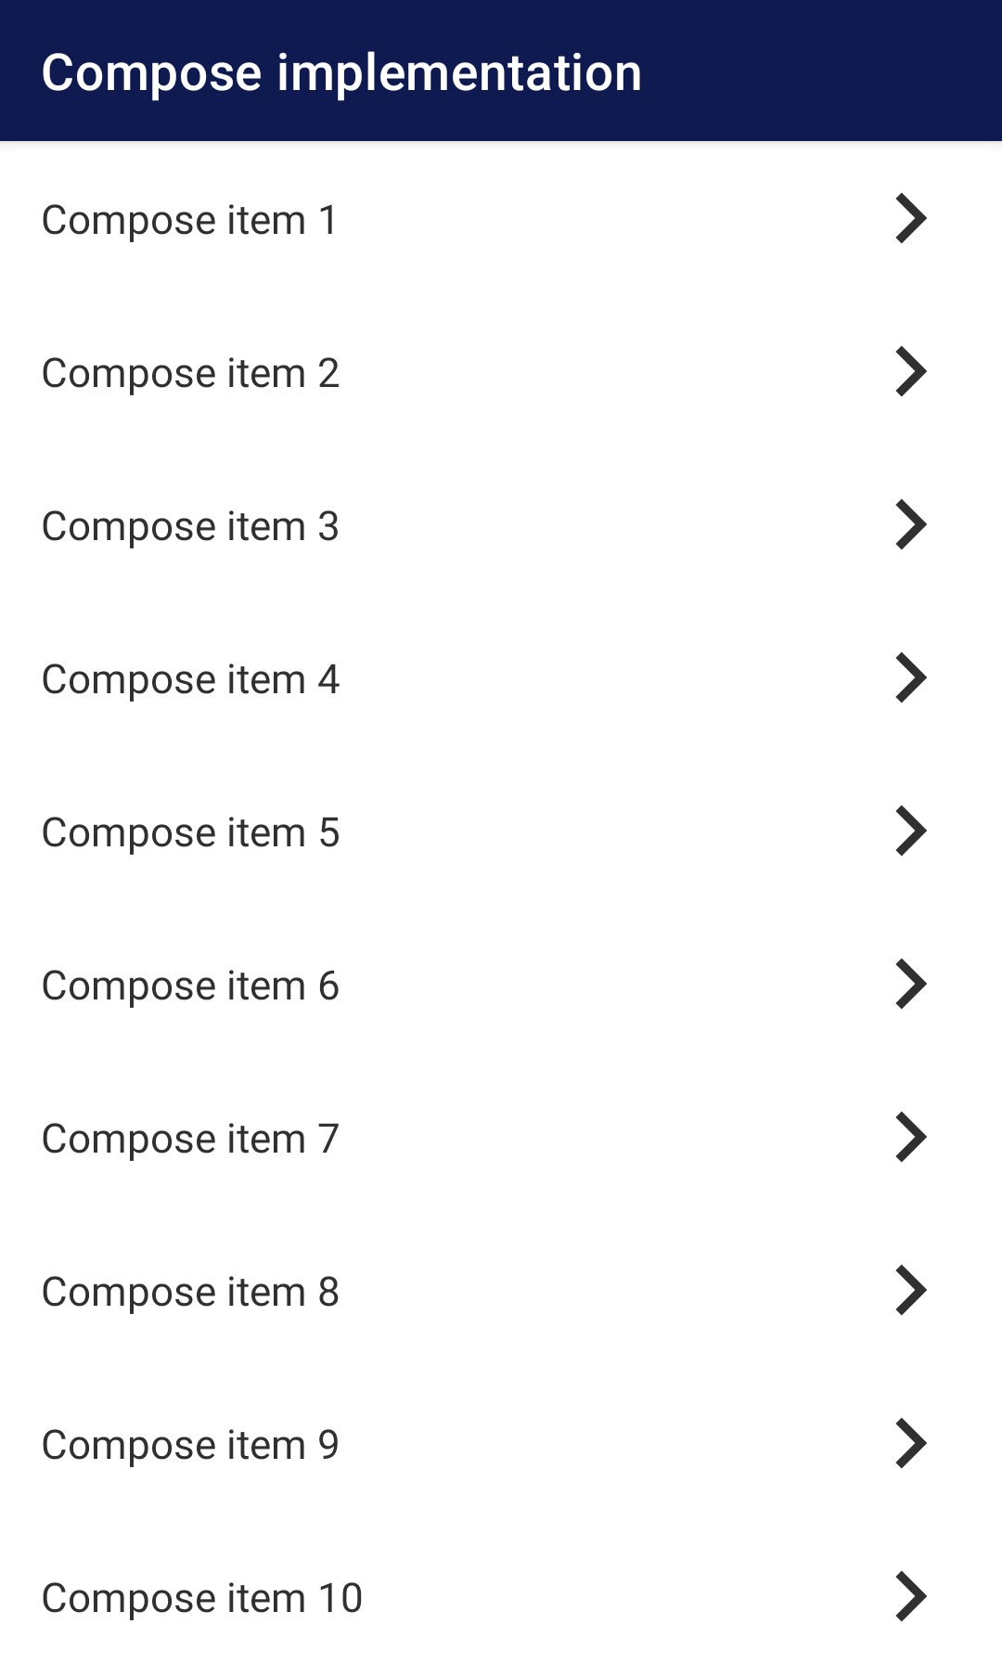
A simple list – Jetpack Compose

Slide 16
A simple list – Jetpack Compose

Slide 17
A simple list – Jetpack Compose
ComposeView (interoperability)

Slide 18
A simple list – Jetpack Compose
Composable
ComposeView (interoperability)
Composable
Composable

Slide 19
A simple list – Jetpack Compose
Interoperability
- fragment_compose.xml
<?xml version="1.0" encoding="utf-8"?> <FrameLayout
xmlns:android="http://schemas.android.com/apk/res/android" xmlns:tools="http://schemas.android.com/tools" android:layout_width="match_parent" android:layout_height="match_parent" tools:context=".ui.compose.ComposeFragment"> <androidx.compose.ui.platform.ComposeView android:id="@+id/composeView" android:layout_width="match_parent" android:layout_height="match_parent"/> </FrameLayout>

Slide 20
A simple list – Jetpack Compose
Interoperability
- fragment_compose.xml
<androidx.compose.ui.platform.ComposeView android:id="@+id/composeView" android:layout_width="match_parent" android:layout_height="match_parent"/>
<?xml version="1.0" encoding="utf-8"?> <FrameLayout
xmlns:android="http://schemas.android.com/apk/res/android" xmlns:tools="http://schemas.android.com/tools" android:layout_width="match_parent" android:layout_height="match_parent" tools:context=".ui.compose.ComposeFragment"> <androidx.compose.ui.platform.ComposeView android:id="@+id/composeView" android:layout_width="match_parent" android:layout_height="match_parent"/> </FrameLayout>
Interoperability with Views

Slide 21
A simple list – Jetpack Compose
List item composable
- ListItem.kt
@Composable fun ListItem( item: Item, ) { /​/ .​.​.
}

Slide 22
A simple list – Jetpack Compose
List item composable
- ListItem.kt
@Composable fun ListItem( item: Item, ) { /​/ .​.​.
@Composable fun ListItem( )
}
f()

Slide 23
A simple list – Jetpack Compose
List item composable
- ListItem.kt
@Composable fun ListItem( item: Item, ) { /​/ .​.​.
@Composable fun ListItem( item: Item, ) { /​/ .​.​. }
}
f(state)

Slide 24
A simple list – Jetpack Compose
List item composable
- ListItem.kt
@Composable fun ListItem( item: Item, ) { /​/ .​.​.
@Composable fun ListItem( item: Item, ) { /​​/ .​​.​​. }
}
f(state)
=
UI

Slide 25
A simple list – Jetpack Compose
List item composable
- ListItem.kt
@Composable fun ListItem( item: Item, ) { /​/ .​.​.
}

Slide 26
A simple list – Jetpack Compose
List item composable
- ListItem.kt
@Composable fun ListItem( item: Item, ) { ConstraintLayout( modifier = Modifier .background(MaterialTheme.colors.background) .height(60.dp) .fillMaxWidth() .padding(horizontal = 16.dp, vertical = 8.dp), ) {
/​/ .​.​.
}

Slide 27
A simple list – Jetpack Compose
List item composable
- ListItem.kt
@Composable fun ListItem( item: Item, ) { ConstraintLayout( modifier = Modifier .background(MaterialTheme.colors.background) .height(60.dp) .fillMaxWidth() .padding(horizontal = 16.dp, vertical = 8.dp), ) {
val (text, chevron) = createRefs() Text( text = item.text, color = Grey, fontSize = 16.sp, modifier = Modifier .constrainAs(text) { top.linkTo(parent.top) start.linkTo(parent.start) end.linkTo(chevron.start) bottom.linkTo(parent.bottom) width = Dimension.fillToConstraints }, ) Icon( painterResource(id = drawable.ic_chevron_right), tint = Grey, contentDescription = "Item arrow forward", modifier = Modifier .constrainAs(chevron) { top.linkTo(parent.top) start.linkTo(text.end, margin = 16.dp) end.linkTo(parent.end) bottom.linkTo(parent.bottom) width = Dimension.value(40.dp) height = Dimension.value(40.dp) }, )
}

Slide 28
A simple list – Jetpack Compose
List item composable
- ListItem.kt
@Composable fun ListItem( item: Item, ) { ConstraintLayout( modifier = Modifier .background(MaterialTheme.colors.background) .height(60.dp) .fillMaxWidth() .padding(horizontal = 16.dp, vertical = 8.dp), ) {
val (text, chevron) = createRefs() Text( text = item.text, color = Grey, fontSize = 16.sp, modifier = Modifier .constrainAs(text) { top.linkTo(parent.top) start.linkTo(parent.start) end.linkTo(chevron.start) bottom.linkTo(parent.bottom) width = Dimension.fillToConstraints }, ) Icon( painterResource(id = R.drawable.ic_chevron_right), tint = Grey, contentDescription = "Item arrow forward", modifier = Modifier .constrainAs(chevron) { top.linkTo(parent.top) start.linkTo(text.end, margin = 16.dp) end.linkTo(parent.end) bottom.linkTo(parent.bottom) width = Dimension.value(40.dp) height = Dimension.value(40.dp) }, )
}

Slide 29
A simple list – Jetpack Compose
Content composable
- ComposeContent.kt
@Composable fun ComposeContent() { ComposeDemoTheme { Scaffold( topBar = { TopAppBar( title = { Text("Compose implementation") }, ) }, content = { LazyColumn { items((1.​.30).toList()) { ListItem(Item("Compose item $it")) } } }, ) } }

Slide 30
A simple list – Jetpack Compose
Content composable
- ComposeContent.kt
LazyColumn { items((1.​.30).toList()) { ListItem(Item("Compose item $it")) } }
@Composable fun ComposeContent() { ComposeDemoTheme { Scaffold( topBar = { TopAppBar( title = { Text("Compose implementation") }, ) }, content = { LazyColumn { items((1.​.30).toList()) { ListItem(Item("Compose item $it")) } } }, ) } }
The equivalent of a “RecyclerView”

Slide 31
A simple list – Jetpack Compose
Content composable
- ComposeContent.kt
@Composable fun ComposeContent() { ComposeDemoTheme { Scaffold( topBar = { TopAppBar( title = { Text("Compose implementation") }, ) }, content = { LazyColumn { items((1.​.30).toList()) { ListItem(Item("Compose item $it")) } } }, ) } }

Slide 32
A simple list – Jetpack Compose
Fragment
- ComposeFragment.kt
class ComposeFragment : Fragment() { override fun onCreateView( inflater: LayoutInflater, container: ViewGroup?, savedInstanceState: Bundle?, ): View = inflater.inflate(R.layout.fragment_compose, container, false) override fun onViewCreated(view: View, savedInstanceState: Bundle?) { super.onViewCreated(view, savedInstanceState) view.findViewById<ComposeView>(R.id.composeView) .apply { setViewCompositionStrategy(DisposeOnViewTreeLifecycleDestroyed) setContent { ComposeContent() } } } }

Slide 33
A simple list – Jetpack Compose
Fragment
- ComposeFragment.kt
view.findViewById<ComposeView>(R.id.composeView) .apply { setViewCompositionStrategy(DisposeOnViewTreeLifecycleDestroyed) setContent { ComposeContent() } }
class ComposeFragment : Fragment() { override fun onCreateView( inflater: LayoutInflater, container: ViewGroup?, savedInstanceState: Bundle?, ): View = inflater.inflate(R.layout.fragment_compose, container, false) override fun onViewCreated(view: View, savedInstanceState: Bundle?) { super.onViewCreated(view, savedInstanceState) view.findViewById<ComposeView>(R.id.composeView) .apply { setViewCompositionStrategy(DisposeOnViewTreeLifecycleDestroyed) setContent { ComposeContent() } } } }
Interoperability with Views

Slide 34
A simple list – View vs. Compose
View
Imperative
2 layout XMLs
Binding code in a Fragment
RecyclerView adapter
Compose
Declarative
2 composable functions in Kotlin
1 layout in XML (interop)
Interop code in a Fragment

Slide 35
A simple list – View vs. Compose
Check out the demo project seen here:
https://github.com/stewemetal/hwsw_meetup_compose_demo

Slide 36
There’s so much more to talk about!
Compose lifecycle and how composition works
State handling
Side effects
Theming
Navigation
UI testing
Accessibility
.​.​.

Slide 37
Resources
The official docs
https://developer.android.com/jetpack/compose
Jetpack Compose basics codelab
https://developer.android.com/codelabs/jetpack-compose-basics
Compose sample projects
https://github.com/android/compose-samples
Jetpack Compose internals – Jorge Castillo
https://jorgecastillo.dev/book/

Slide 38
Jetpack Compose The Future of the Android UI in a Nutshell
István Juhos
The future is declarative
Less code = less chance for errors
Quick iteration
Photo by Xavi Cabrera

