Slide 1
A tesztelési piramis csúcsán
BDD implementáció Pythonban

Slide 2
PROPER POSITION OF THE BDD
E2E
System test
SubSystem test
Component test
Unit test
Notes:
Melyik tesztelési szintekről lesz szó.

Slide 3
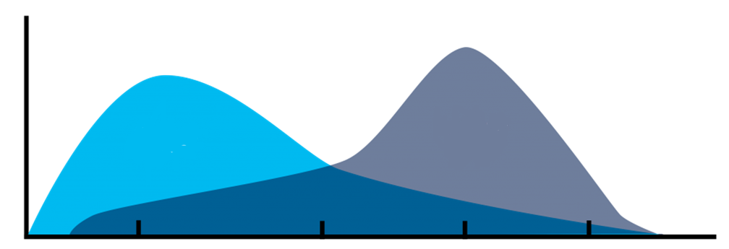
HOW CAN IT BE INTRODUCED
STAGE4
STAGE3
STAGE2
STAGE1
Manual testing and automated testing? In-tribe and cross-tribe solution:
Stage1: A team member asks an automated tester to execute and analyze the test executions
Stage2: A team member is able to execute and analyse test test executions
Stage3: Test development happens in Jira and GitLab via feature files
Stage4: The base classes of glue-code are written by manual testers

Slide 4
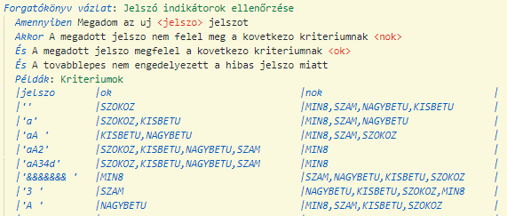
AN EXAMPLE FOR BDD

Slide 5
BEHIND THE SCENES

Slide 6
WHY PYTHON
Short learning curve
Modules for BDD are ready
Cross-platform
Easy to practise the SOLID principles

Slide 7
GITLAB PIPELINE
Every system has its own pipeline and GitLab repository
~15 system is tested by 6 test automation engineer

