Slide 1
CI/CD
or how to achieve 10+ deploys a day?

Slide 2
Who am I?
Co-founder & CTO @ LeanNet Ltd.
Consulting, training, implementing
Cloud Native, Kubernetes, Microservices, DevOps
Now part of the
megyesi@leannet.eu
twitter.com/M3gy0
linkedin.com/in/M3gy0

Slide 3
10+ Deploys Per Day Was Possible in 2009…
John Allspaw and Paul Hammond:
10+ Deploys Per Day: Dev and Ops Cooperation at Flickr
O’Reilly Velocity, 2009

Slide 4
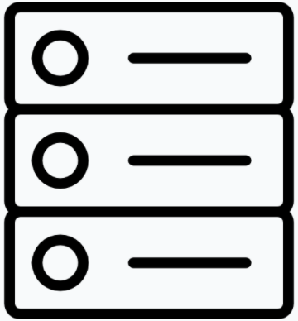
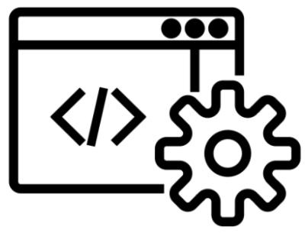
Traditional SW Development Workflow
Dev teams:
create code for specific SW modules
check them into specific repo branches
(this is a bit different in case of Microservices but the general problem is the same)
Integration team:
merges new branches into the mainline source control bucket in iterations
build the code on their own PC
pass the release and installation instructions
Operations team:
deploys on different environments
Dev: module 1
Integration
Operations
Staging
Dev: module 2
Dev: module 3
Production

Slide 5
Traditional SW Development Workflow
Areas to improve:
Integration takes a lots of effort and error prone:
Usually takes 1+ day(s)
Multiple teams involved:
Integration team
Lead developers of dev teams
Defects are only found late:
Bug fix is slow because the feedback cycle is long
Similar to waterfall methodology
Reproducing release is hard:
Build environments (OS, libs, config, etc.) is hard to sync
Hard to reproduce the integration bugs
Dev: module 1
Integration
Operations
Staging
Dev: module 2
Dev: module 3
Production

Slide 6
The Concept of Continuous Integration
“CI is the practice of frequently integrating one's new or changed code with the existing code repository”
“CI is a development practice that requires developers to integrate code into a shared repository several times a day”

Slide 7
Traditional SW Development Workflow
Developers need to change how they work:
They should use a central repository
This requires them to integrate code themselves:
Actually the developers knows his code best.
To check the code works and fits together with rest need to be built regularly
Compilation has to happen on a dedicated built environment:
Makes build config the same and keeps it more controllable
This way the process is transparent for every developers
Tests should be included and well:
Unit, UI, Security, Code Quality, etc.
Dev: module 1
Unit tests
Dev: module 2
Code Quality
Dev: module 3
Security

Slide 8
The Concept of Continuous Integration
“CI is the practice of frequently integrating one's new or changed code with the existing code repository”
“CI is a development practice that requires developers to integrate code into a shared repository several times a day”
Important Notice:
There is nothing here about automation, containerization, ci tools…
Automation isn't the goal it's the technique to achieve the goal.
Tooling is also part of the technique: Docker, Jenkins, GitHub Actions, …
(While might adapting to the spirit of novel trends: DevOps, Microservices, 12 Factor App Design…)

Slide 9
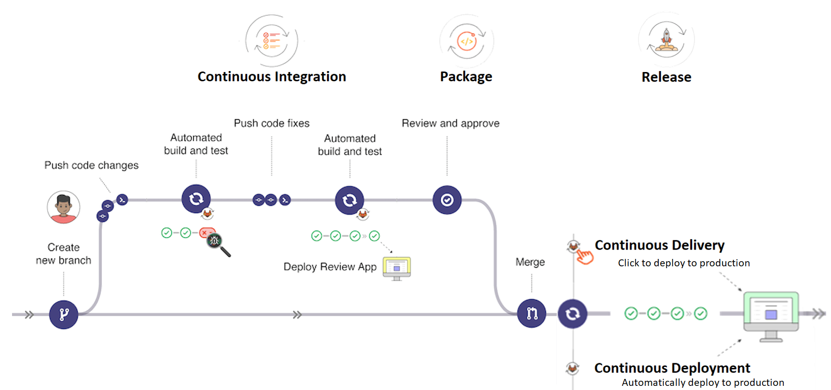
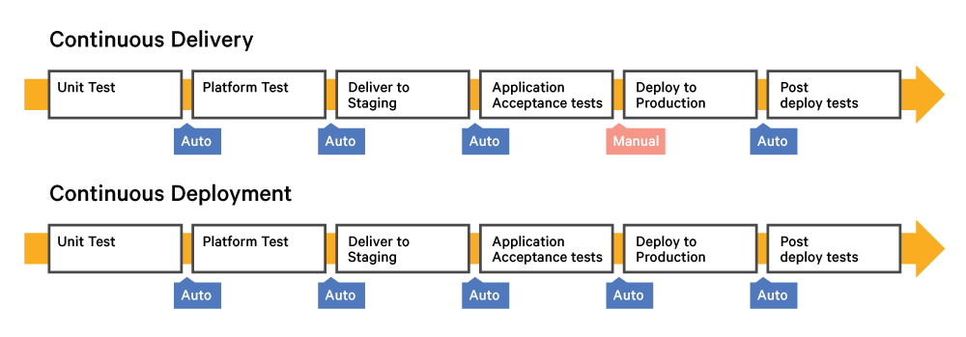
The Big Picture of CI/CD/CD
Continuous Integration
Continuous Delivery:
automated release creation
manually triggered deployments
Continuous Deployment:
automated deployments as well
Notes:
Package és delivery határa elmosódhat.
Config részt esetleg félig behúzni

Slide 10
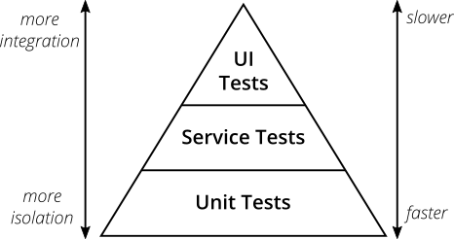
The Test Pyramid
source: https://martinfowler.com/articles/practical-test-pyramid.html
Notes:
Package és delivery határa elmosódhat.
Config részt esetleg félig behúzni

Slide 11
Cloud and Immutable Infrastructure
Cloud made it incredibly easy to rebuild infrastructure elements
Instead of updating, you can replace it with a new using automation
Can be applied to servers (VMs and especially containers), or any other element in the app stack
Very resilient and secure
The Netflix model
Always build a new AMI image, never patch
Agents running on VMs to kill it after SSH login
Instance A
Instance A
Instance A
Instance B
Destroy
X
App v1.0
Reboot
App v1.1
App v1.0
App v1.1
OS v1.0
App v1.0
OS v1.0
Provision
OS v1.0
OS v1.0
Mutable infrastructure
Immutable infrastructure

Slide 12
Advanced Deploy/Release Management Techniques
Rolling Update
LB
V1
V1
V1
V1
V1
Notes:
Package és delivery határa elmosódhat.
Config részt esetleg félig behúzni

Slide 13
Advanced Deploy/Release Management Techniques
Rolling Update
Blue Green
LB
LB
V2
V2
V1
V2
V1
V2
V1
V2
V2
V1
V1
V2
V1
V1
Notes:
Package és delivery határa elmosódhat.
Config részt esetleg félig behúzni

Slide 14
Advanced Deploy/Release Management Techniques
Rolling Update
Blue Green
LB
LB
V2
V2
V1
V2
V1
V2
V1
V2
V2
V1
V1
V2
V1
V1
Notes:
Package és delivery határa elmosódhat.
Config részt esetleg félig behúzni

Slide 15
Advanced Deploy/Release Management Techniques
Canary
LB
99%
1%
V1
V1
V2
V2
Notes:
Package és delivery határa elmosódhat.
Config részt esetleg félig behúzni

Slide 16
Advanced Deploy/Release Management Techniques
Canary
LB
95%
5%
V1
V1
V2
V2
Notes:
Package és delivery határa elmosódhat.
Config részt esetleg félig behúzni

Slide 17
Advanced Deploy/Release Management Techniques
Canary
Dark Launch
LB
LB
90%
10%
Mirror Traffic
V1
V1
V2
V2
V1
V1
V2
V2
DB
Notes:
Package és delivery határa elmosódhat.
Config részt esetleg félig behúzni

Slide 18
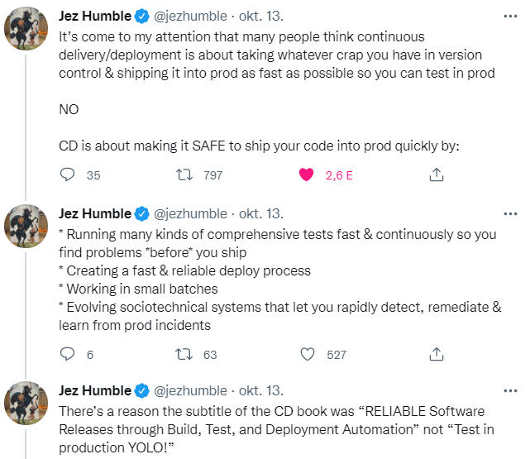
Finally, Please Keep This in Mind…

