Slide 1
Amit az <img> tag nem tud, de én már igen
Notes:
Intro
OSN project
Research
Open before start:
https://www.google.com/?hl=ar
https://www.google.com/

Slide 2
Too high resolution images
Notes:
Way of thinking.
Books

Slide 3
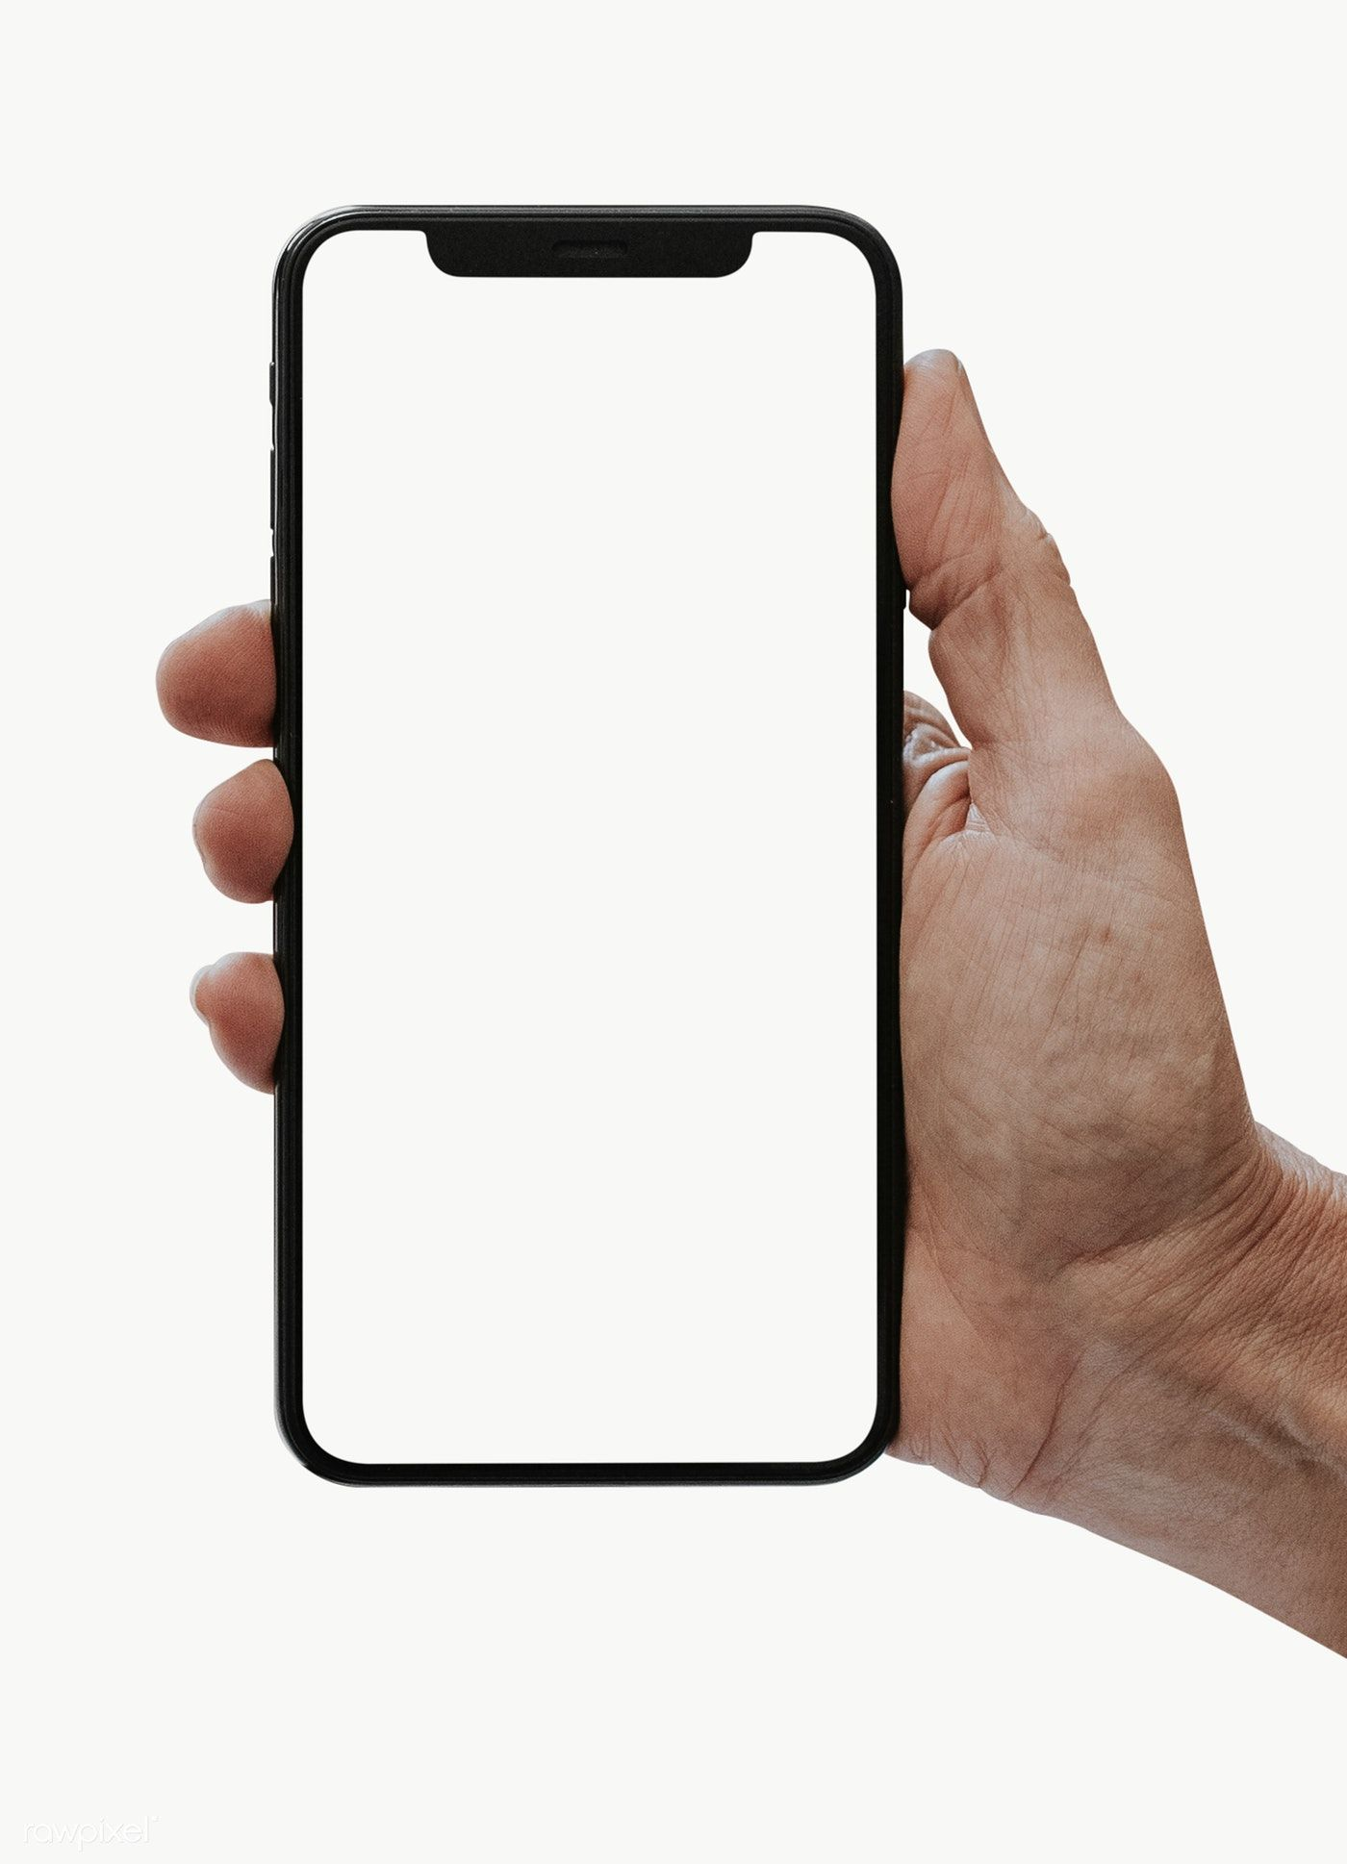
Too low resolution images
Notes:
Way of thinking.
Books

Slide 4
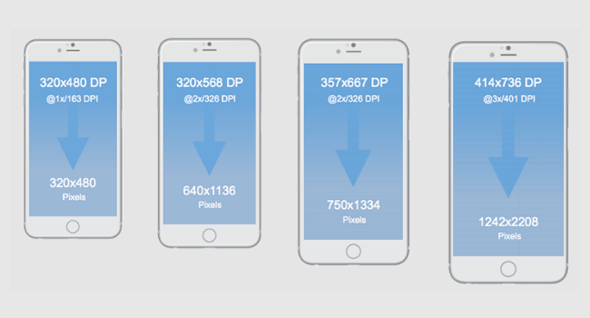
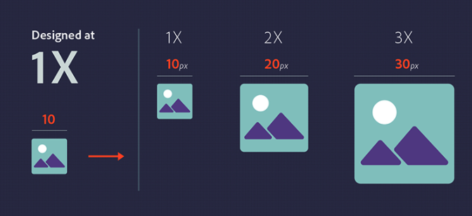
Display quality
Notes:
Way of thinking.
Books

Slide 5
Resolution switching
54.8% mobile traffic (https://www.statista.com/ - 2021 Q1)
Responsiveness
Different sizes
unnecessary large images
small raster images are grainy
Different resolution
Retina display
Pixel density
Notes:
Overline
Phone numbers
Days of week - same first letter

Slide 6
Art direction
Different images on different screen sizes
Portrait vs. Landscape
Notes:
Overline
Phone numbers
Days of week - same first letter

Slide 7
Screen sizes and pixel density
Display resolution
Pixel density (PPI)
DPI

Slide 8
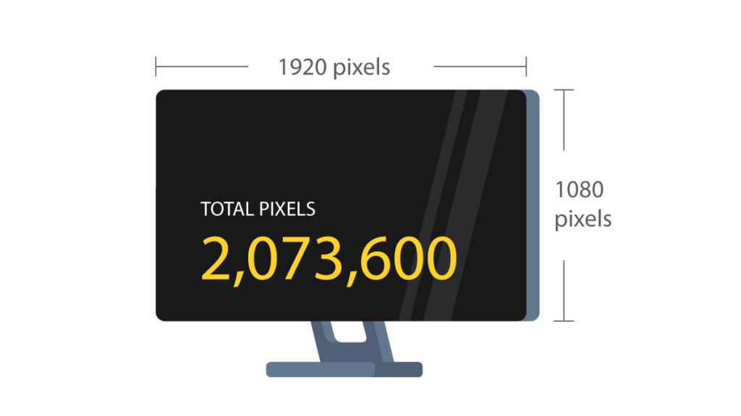
Resolution
Notes:
Talk with the customer or stakeholders.

Slide 9
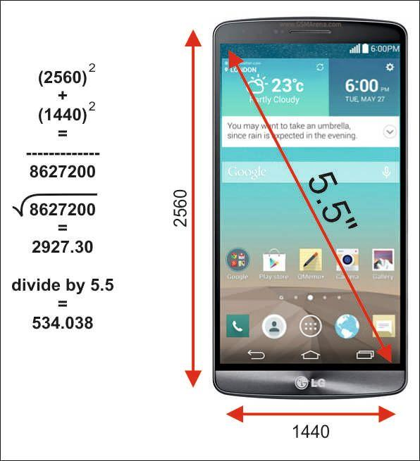
Calculate pixel density
Notes:
Talk with the customer or stakeholders.

Slide 10
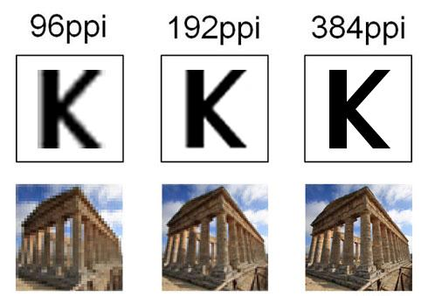
Pixel density
DPI (dots per inch) indicates the number of dots found within a one-inch line of a scan or print
PPI (Pixels Per Inch) refers display resolution, or, how many individual pixels are displayed in one inch of a digital image
Notes:
Rule of thumb: general fonts +3px

Slide 11
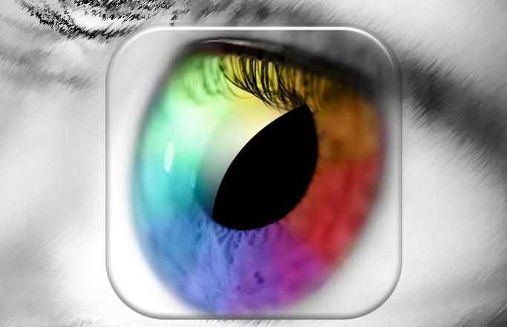
Retina display
Retina Display is a brand name used by Apple
One logical pixel = four physical pixels
CPU “sees” a small portion of the data
GPU renders these elements with high quality
Make the text and images being displayed extremely crisp
Notes:
Rule of thumb: general fonts +3px

Slide 12
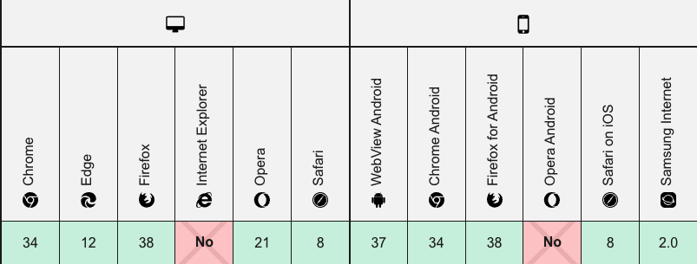
03
What is srcset?

Slide 13
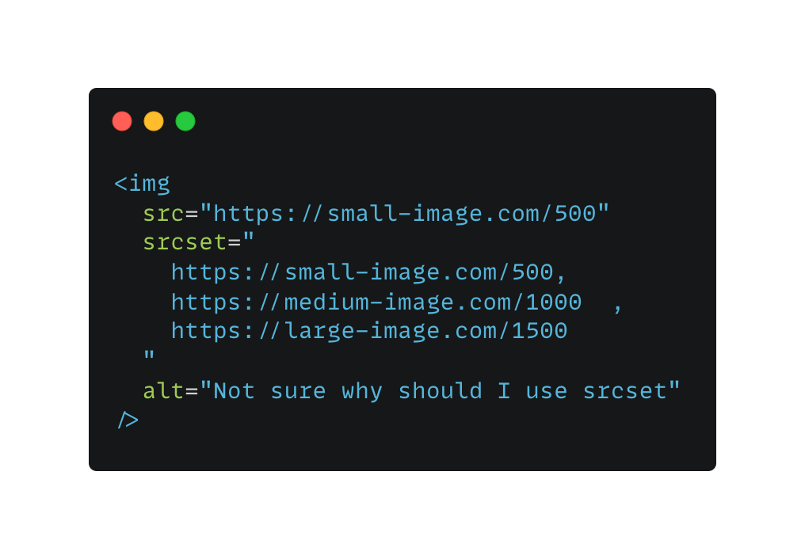
Step 1
?
?

Slide 14
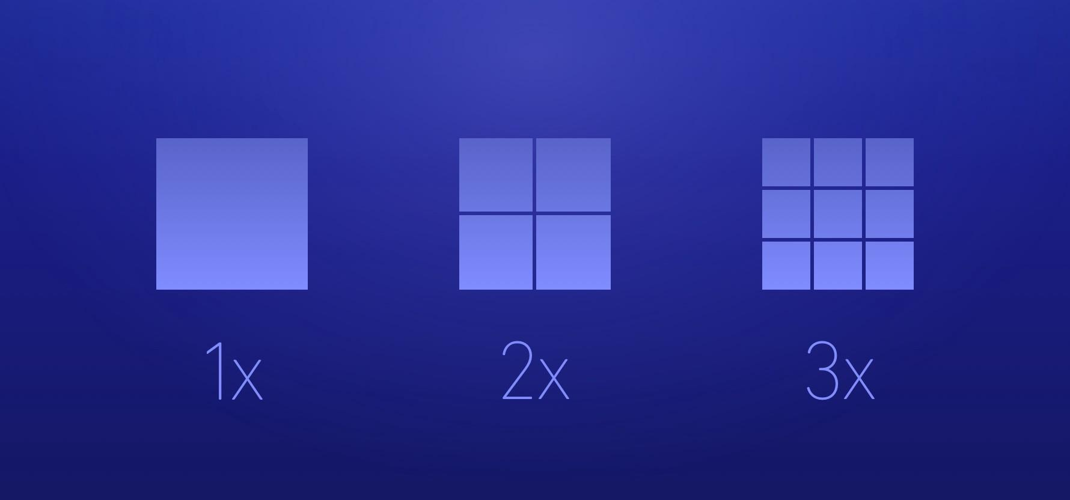

Slide 15
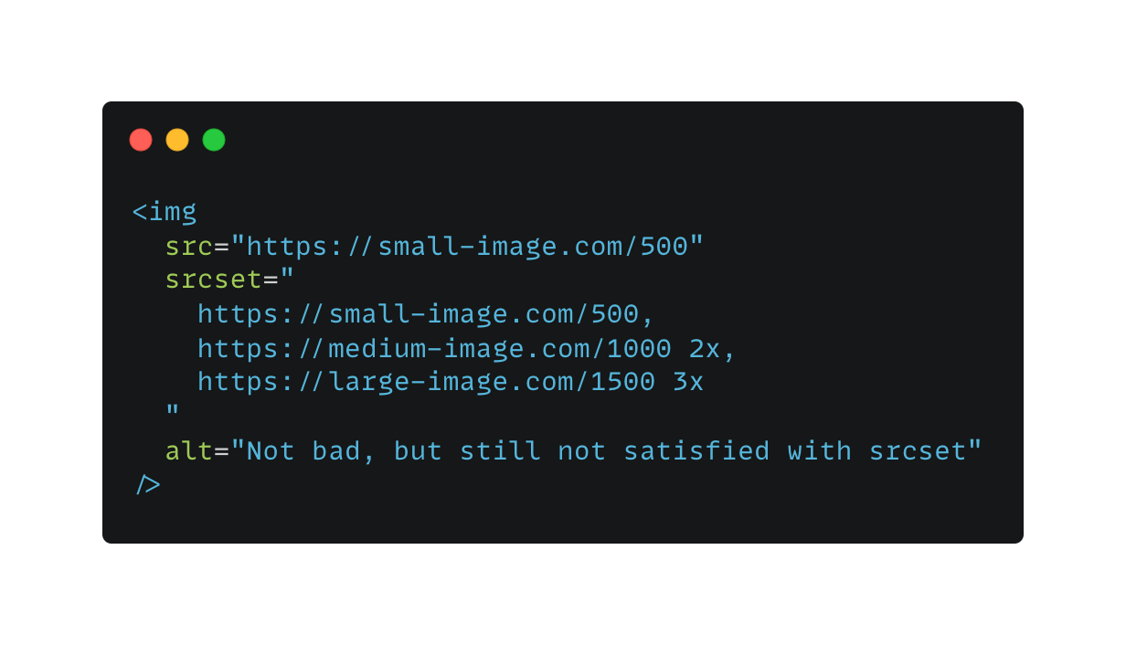
Step 2

Slide 16
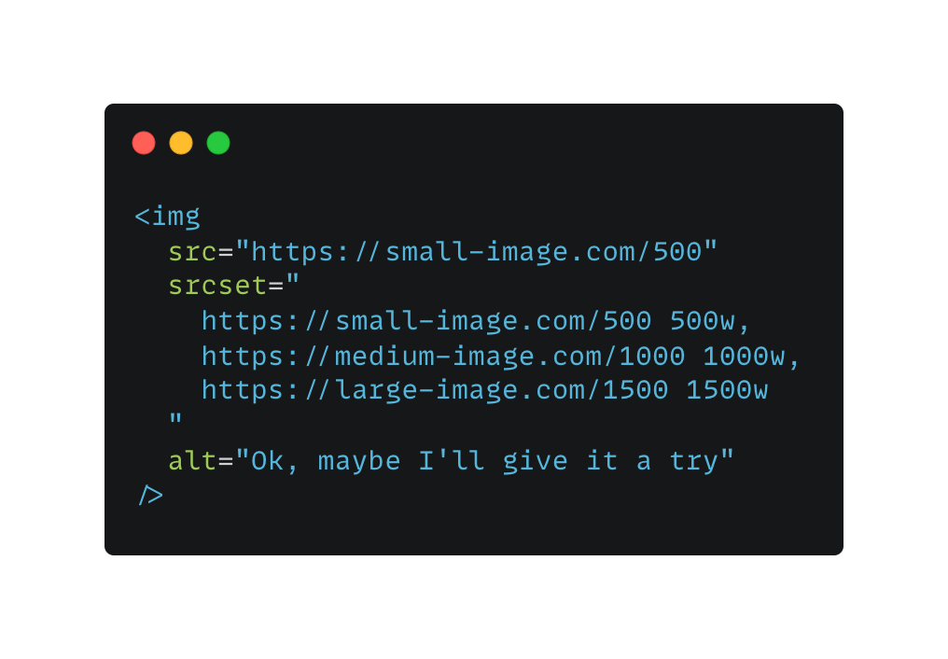
Step 3

Slide 17
Which picture will be rendered if the user open our website with an Iphone X device? (width: 375px, Device pixel ratio: 3x) ?

Slide 18
Solution
Image width / Screen width > DPR
500 / 375 = 1.33
1000 / 375 = 2.67
1500 / 375 = 4 WINNER!!!
Notes:
Rule of thumb: general fonts +3px

Slide 19
Why use srcset?
Avoid low quality images
Avoid unnecessary use of high quality image
Save bandwidth
Render image based on pixel density
Render image based on viewport

Slide 20
Resolution switching: Different sizes 😎
Resolution switching: Same size, different resolutions 😎
Art direction 🥲

Slide 21
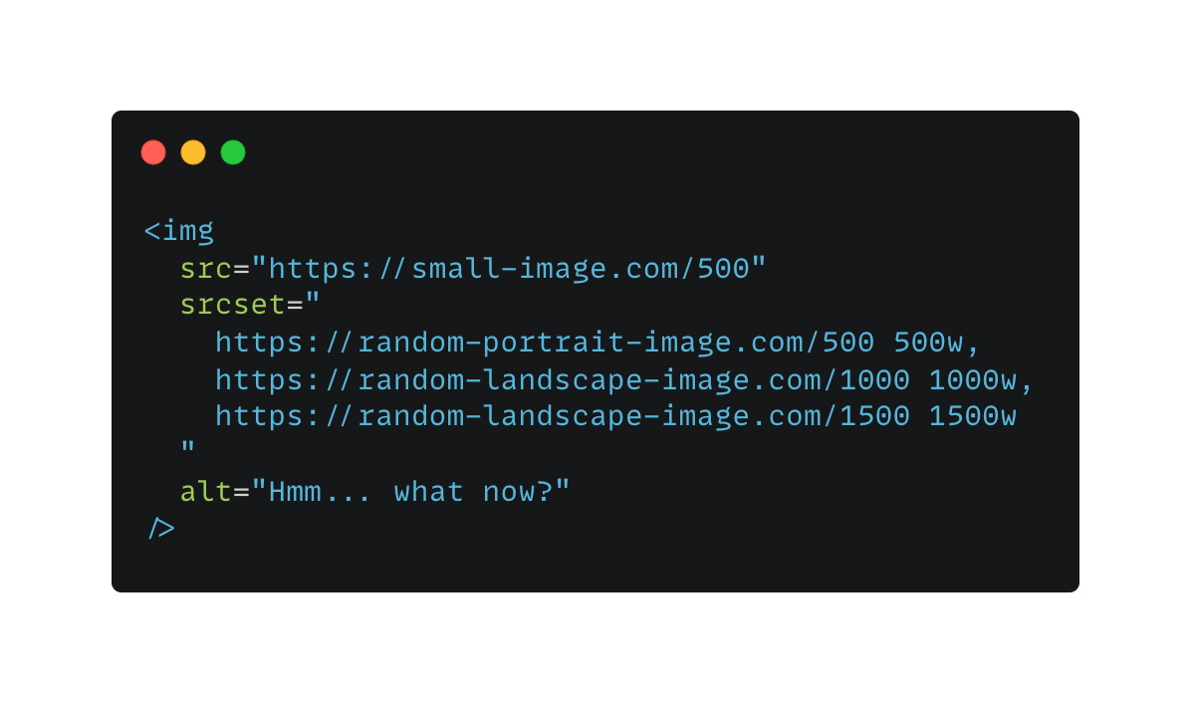
Step 4

Slide 22
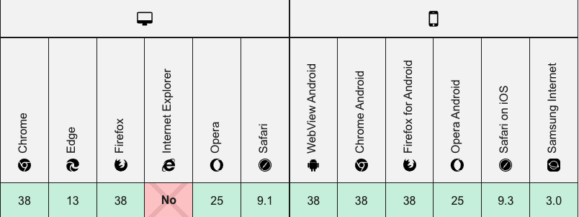
<picture>

Slide 23
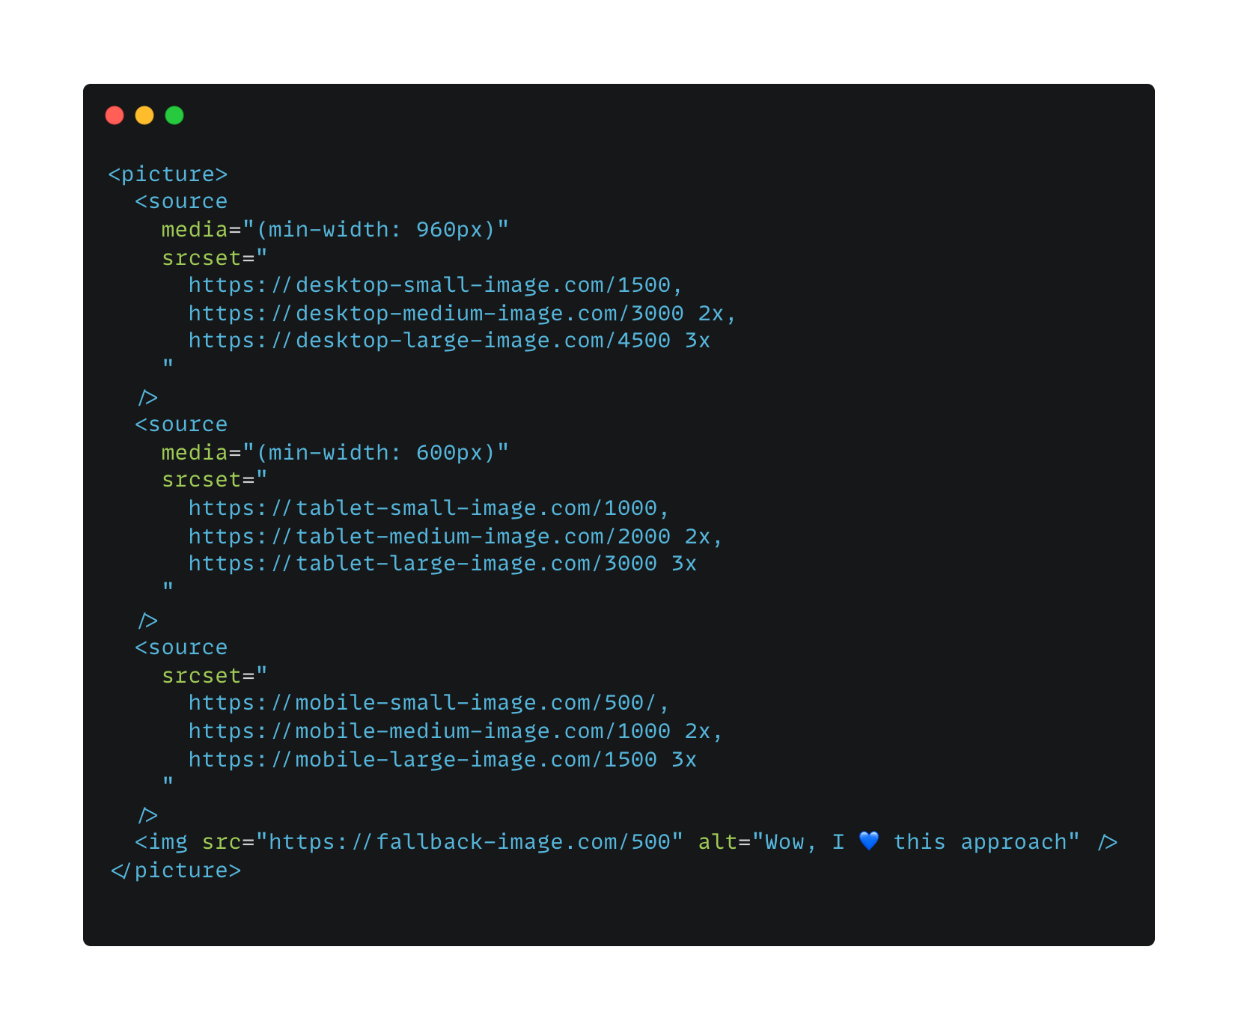
Notes:
Rule of thumb: general fonts +3px

Slide 24
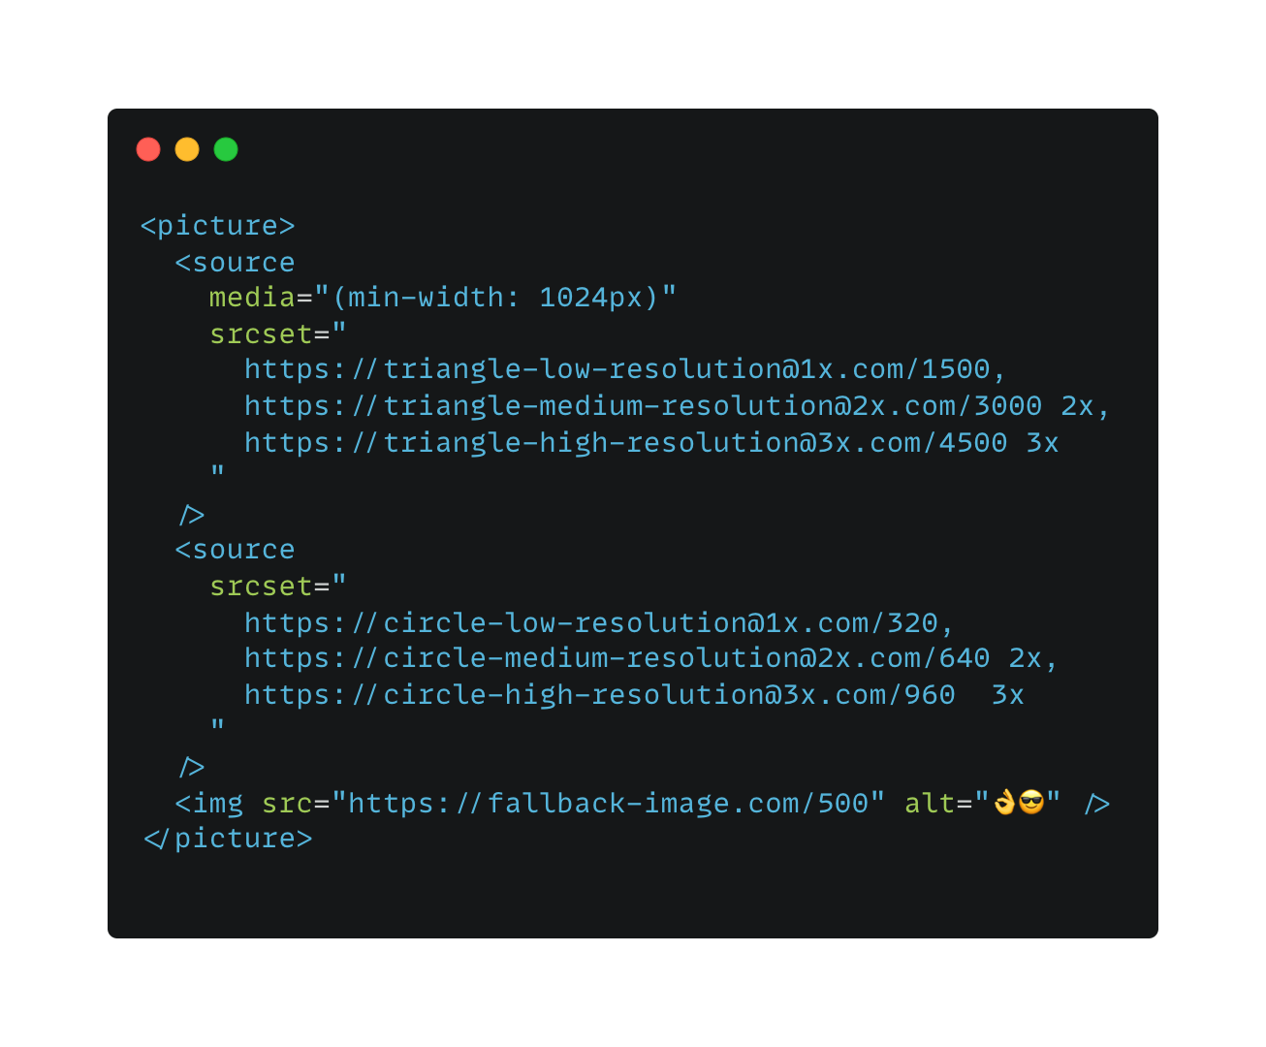
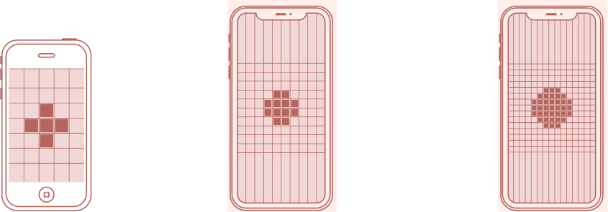
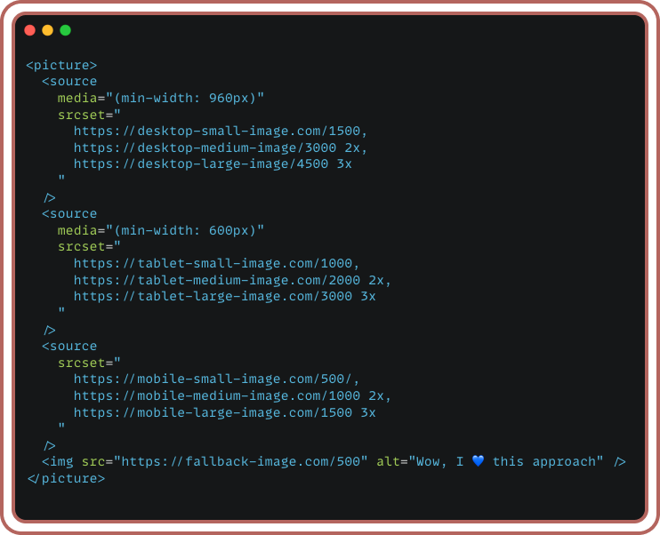
1x
2x
3x
iPhone
1st gen
iPhone 11
iPhone X
Normal monitors
MacBook Pro
retina display
Notes:
Rule of thumb: general fonts +3px

Slide 25
thank
you
for your
attention
Tamás
Szám
Javascript developer
tamas.szam@supercharge.io

