Slide 1
Modern application
operations on AWS
Károly Sepsy – CTO @ TC2
07.10.2021.

Slide 2
Operating functions
Cloud project lifecycle
Cloud projekt életciklus
Cloudwatch metrics
Error-success rate
Throttles
Invocations
Cloudwatch logs
Function outputs, errors logged
Monitor log patterns
Dead letter queue
Business Idea
Cloud native design
Proof of Concept
Productionize
Cloud Operating Model
Governance
^{Serverless}

Slide 3
Automation
Operation
Security

Slide 4
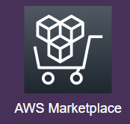
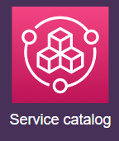
Automation
Operation
Infrastructure as code Event driven
Security

Slide 5
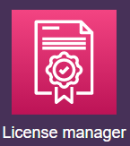
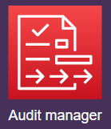
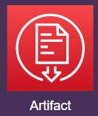
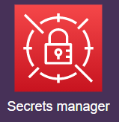
Automation
Operation
Infrastructure as code Event driven
Encryption at rest&in transit
Identity and access mgmt
Compliance
Security

Slide 6
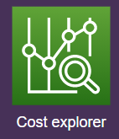
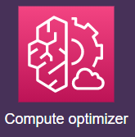
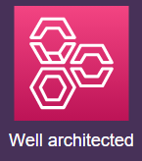
Automation
Operation
Infrastructure as code Event driven
Monitoring
Logging
Error handling
Patching
Optimising
Encryption at rest&in transit
Identity and access mgmt
Compliance
Security

Slide 7
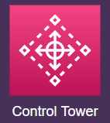
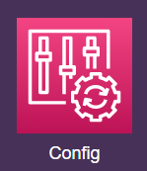
Automation
Operation
Infrastructure as code Event driven
Monitoring
Logging
Error handling
Patching
Optimising
Blueprints
Auto remediation
Encryption at rest&in transit
Identity and access mgmt
Compliance
Security

Slide 8
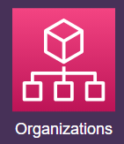
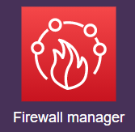
Automation
Operation
Infrastructure as code Event driven
Monitoring
Logging
Error handling
Patching
Optimising
Multi account governance
Behaviour analysis
Threat detection
Blueprints
Auto remediation
Encryption at rest&in transit
Identity and access mgmt
Compliance
Security

Slide 9
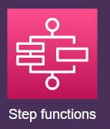
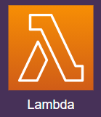
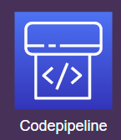
Automation
Operation
Automated
change management Remote host management
Infrastructure as code Event driven
Monitoring
Logging
Error handling
Patching
Optimising
Multi account governance
Behaviour analysis
Threat detection
Blueprints
Auto remediation
Encryption at rest&in transit
Identity and access mgmt
Compliance
Security

Slide 10
Automation
Operation
Automated
change management Remote host management
Infrastructure as code Event driven
Monitoring
Logging
Error handling
Patching
Optimising
DevSecOps
People
Process
Technology
Multi account governance
Behaviour analysis
Threat detection
Blueprints
Auto remediation
Encryption at rest&in transit
Identity and access mgmt
Compliance
Security

Slide 11
Wrap up
Make use of Cloud native operations portfolio
Break down silos in IT teams
Integrate Cloud best practices into everyday processes

Slide 12
KÁROLY SEPSY
Chief Technology Officer
karoly.sepsy@tc2.hu
+36 20 370 0708
THANK YOU FOR
YOUR ATTENTION!

