Slide 1
Cutting through Amazon Serverless technologies in AWS Cloud
Adrián Mezei
Cloud Architect at SnapSoft Ltd.

Slide 2
Topics
Serverless services
Compute
Data Store
Application Integration
Example architecture

Slide 3
Serverless services

Slide 4
What is serverless?
Managed services are used
Avoid manual capacity provisioning
Avoid manual patching
Usually with stateless containers, cold/warm start
Very fast go-live, minimal configuration
Pay-as-you-go
Scale dynamically with the load
You still have servers behind the scenes

Slide 5
AWS Serverless Services
Compute
AWS Lambda
Amazon Fargate
Data Store
Amazon S3
Amazon DynamoDB
Amazon Aurora Serverless
Amazon RDS Proxy
Application Integration
Amazon API Gateway
AWS Step Functions
Amazon SNS
Amazon SQS
Amazon EventBridge
AWS AppSync

Slide 6
Compute solutions
Virtual machine
Amazon Elastic Compute Cloud (EC2)
Auto scaling
On-demand, reserved, spot instances
Container
Elastic Container Service (ECS), ECR, EKS
AWS Fargate
Function
AWS Lambda

Slide 7
What is serverless?
On-Premise | IaaS Infrastructure-as-a-service | CaaS Container-as-a-service | FaaS Function-as-a-service
functions | functions | functions | functions
application | application | application | application
runtime | runtime | runtime | runtime
container | container | container | container
operating system | operating system | operating system | operating system
hardware | hardware | hardware | hardware
own datacenter | EC2 | ECS / AWS Fargate | AWS Lambda

Slide 8
CaaS or FaaS
Portability
E.g. on-premise execution
E.g. vendor lock
Custom environment configuration
E.g. special database driver is required
Event driven functionality
E.g. S3, SQS, DynamoDB events
Some AWS Lambda limitations
Memory (max: 10 204 MB)
Execution time (15 minutes)
Invocation payload (6 MB async. / 256 KB sync.)
Deployment package (250 MB)
Runtimes: Node.js, Python, Ruby, Java, Go, .NET, custom runtime

Slide 9
AWS Serverless Services
Compute
AWS Lambda
Amazon Fargate
Data Store
Amazon S3
Amazon DynamoDB
Amazon Aurora Serverless
Amazon RDS Proxy
Application Integration
Amazon API Gateway
AWS Step Functions
Amazon SNS
Amazon SQS
Amazon EventBridge
AWS AppSync
Notes:
RDS Proxy:
- Database proxy
- Improve application performance
- Maintains a connection pool
- Improves application scaling
- Increase availability
- Preserves application connection when a DB instance fails and automatically connects to a new DB instance
- Failover times are reduced by 66% (for Aurora and RDS)
- Security management
- Credential management with Secrets Manager
- Access management with IAM

Slide 10
Data store solutions
Amazon S3 – object storage
Simple website hosting
Storage classes
Versioning
Events and triggers
Lifecycle policies
Amazon DynamoDB – key-value
Single digit ms performance at scale
Built in point-in-time-recovery
Amazon Aurora Serverless - RDS
Aurora capacity units (ACU)
No instance provisioning
Auto-scaling
Can scale to zero
Pay per capacity
Available for PostgreSQL and MySQL
Notes:
1 ACU ~ 2GB memory
Scale-blocking operations (timeout 5mins.):
- Long-running queries
- In-progress transactions
- Temporary tables or table locks

Slide 11
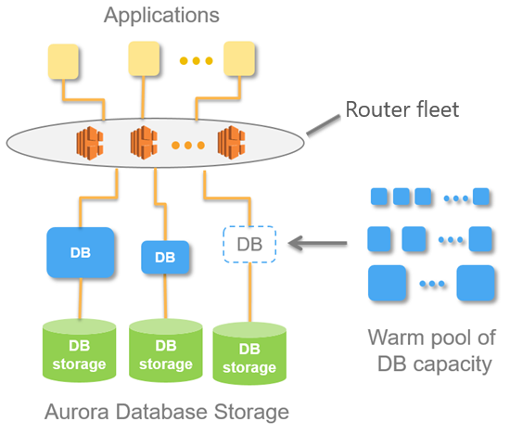
Amazon Aurora Serverless v1 architecture

Slide 12
AWS Serverless Services
Compute
AWS Lambda
Amazon Fargate
Data Store
Amazon S3
Amazon DynamoDB
Amazon Aurora Serverless
Amazon RDS Proxy
Application Integration
Amazon API Gateway
AWS Step Functions
Amazon SNS
Amazon SQS
Amazon EventBridge
AWS AppSync

Slide 13
Amazon API Gateway
HTTP API
Lambda and routable HTTP backend
OpenID Connect, OAuth 2.0
Custom authorizer Lambda
CORS support
Stages
Throttling
Monitor
Logging (CloudWatch)
Import/export OpenAPI 3
REST API
Can target more than 100 AWS services
API keys
Usage plans for API keys
API caching
Request/response validation
AWS X-Ray
WebSocket
Real time bidirectional
HTTP backend
Lambda backend

Slide 14
Application integration
Step Functions
Visual workflows
Checkpoints, retries, order
Branching, parallel execution, timeouts
SQS
Managed message queue service
Decoupling
Eliminates administrative overhead
Scales elastically
Types: Standard and FIFO
SNS
A2A, A2P message service
Push based pub/sub many-to-many
Between microservices
SNS topics, subscriber management
SMS, email, mobile push, SQS, Lambda, HTTP webhooks
Types
Standard
FIFO
Notes:
A2A: app-to-app
A2P: app-to-person
SNS topic types:
standard: at-least once delivery, best effort ordering
FIFO: ordered, no duplicates

Slide 15
Example architecture

Slide 16
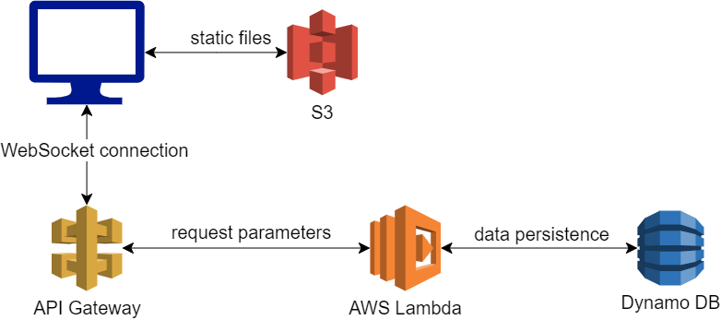
Chat application architecture overview

Slide 17
Awesome chat CloudFormation

Slide 18
Thank you for your attention!

Slide 19
References
https://aws.amazon.com/serverless/
https://www.twilio.com/docs/glossary/what-is-serverless-architecture
https://serverless-stack.com/chapters/what-is-aws-lambda.html
https://www.cloudflare.com/learning/serverless/what-is-serverless/
https://aws.amazon.com/products/compute/
https://docs.aws.amazon.com/lambda/latest/dg/gettingstarted-limits.html
https://medium.com/greenm/aws-lambda-or-aws-fargate-the-step-by-step-guide-to-choosing-the-right-technology-925ebcf89b7c
https://docs.aws.amazon.com/AmazonRDS/latest/AuroraUserGuide/aurora-serverless.how-it-works.html
https://aws.amazon.com/dynamodb/
https://aws.amazon.com/s3/
https://aws.amazon.com/rds/aurora/serverless/
https://docs.aws.amazon.com/AmazonRDS/latest/AuroraUserGuide/aurora-serverless.html
https://aws.amazon.com/rds/proxy/
https://aws.amazon.com/api-gateway/
https://docs.aws.amazon.com/apigateway/latest/developerguide/http-api-vs-rest.html
https://docs.aws.amazon.com/apigateway/latest/developerguide/apigateway-websocket-api.html
https://github.com/aws-samples/simple-websockets-chat-app
https://aws.amazon.com/sqs/

