Slide 1
Microservices: is monolith a thing of the past?

Slide 2
Who am I?
Co-founder @ LeanNet Ltd.
Consulting, training, implementing
Cloud Native, Kubernetes, Microservices, DevOps
Now part of the
szabo@leannet.eu
linkedin.com/in/szabvid
twitter.com/szabvid

Slide 3
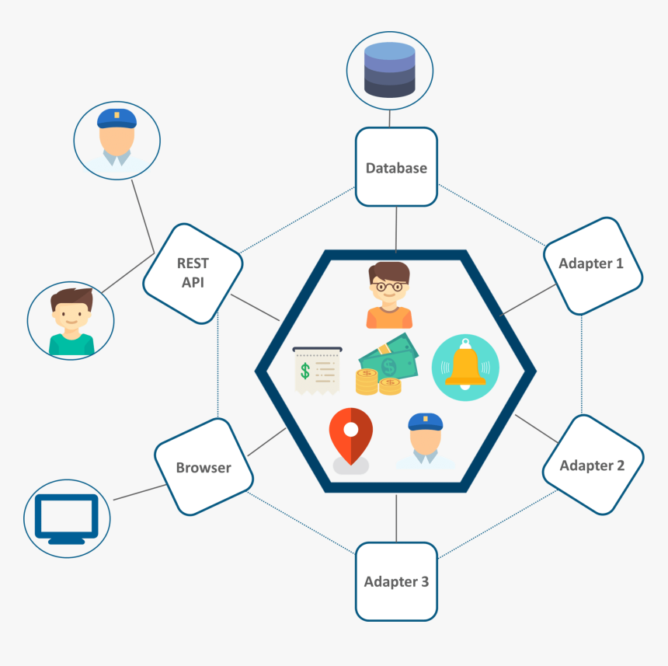
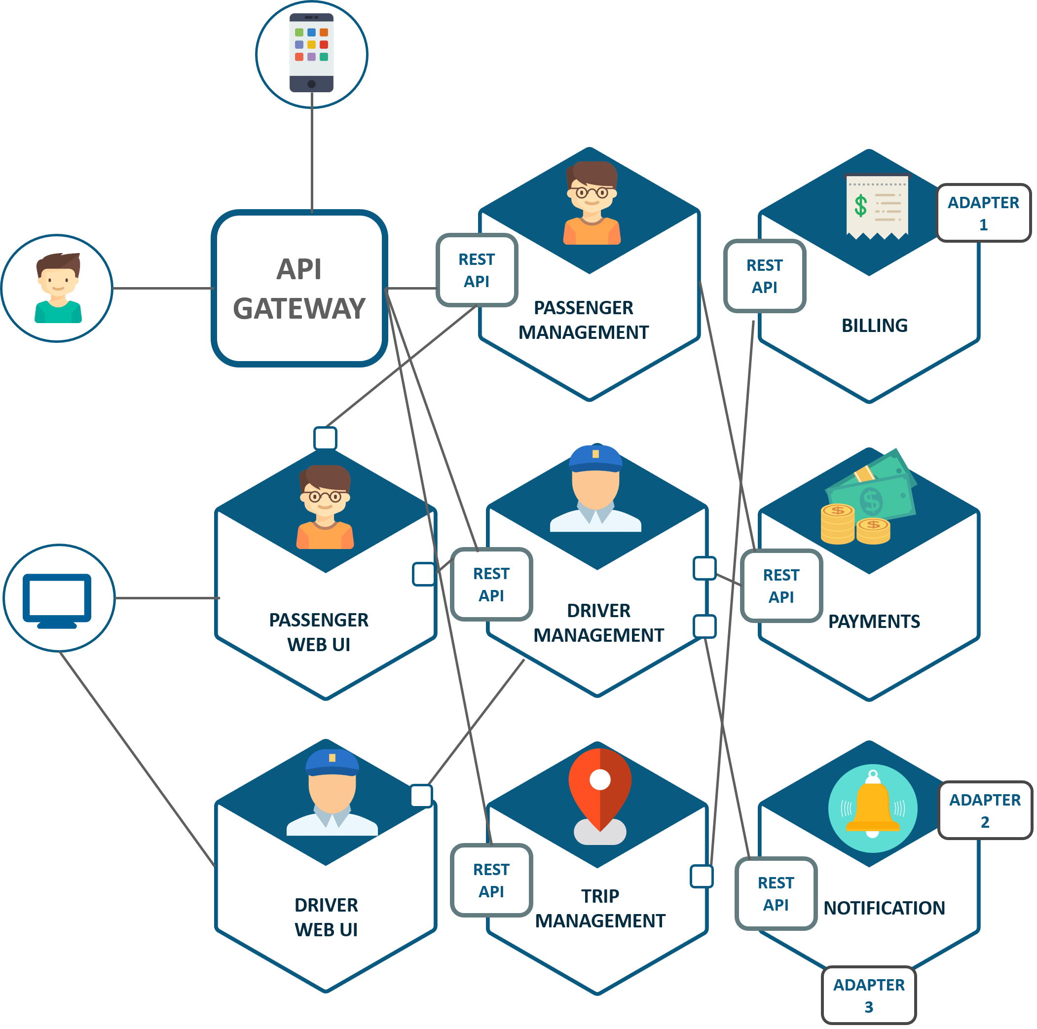
Quick Example: UBER’s Transition to Microservices
Monolithic architecture
Microservices architecture
Notes:
Minden egy kupacban – Egy kupac minden.

Slide 4
What is a Monolith?
Single codebase/repository
Single process
Single host
Single database
One language

Slide 5
Advantages of a Monolith
Simple to develop
Easy to make radical changes to the application
Straightforward to test
Straightforward to deploy
Easy to scale
Notes:
Simple to develop
IDEs and other developer tools are focused on building a single application.
Easy to make radical changes to the application
You can change the code and the database schema, build, and deploy.
Straightforward to test
Straightforward to deploy
All a developer had to do was copy the WAR file to a server that had Tomcat installed.
Easy to scale (up to a point)

Slide 6
Why this can go wrong?
Because of success!
Since it is a success:
New features were constantly added
Dev team steadily grows
Growth rate of code base and management
overhead increased

Slide 7
Living in monolithic hell
Difficult to digest (nobody understands)
Development is slow (builds and startups)
Difficult to scale (mostly vertically)
Difficult to deploy (infrequent and large changes)
Testing is hard (lacks of fault isolation)
Locked into technology stack
Notes:
Complexity intimidates developers:
Too large for anybody to fully understand it
Bug fixes and new features implementation is
Error prone
Time consuming
It’s a downward spiral
Development is slow:
builds and start ups take much longer
path from commit to deployment is long and arduous

Slide 8
What are Microservices?
It is an architectural style where
autonomous, independently deployable services
collaborate together
to form an application/service
Helps an individual to fully understand what she works on
API is an impermeable boundary (internals are hidden)
Each service has its own Database (if needed)
Can be deployed and scaled independently
micro is misleading…
What matters: loosely coupled & bounded context

Slide 9
Advantages of Microservices?
Independent deployability (with Zero downtime)
Services are small and easily maintained
Services are independently scalable
The Microservices architecture enables teams to be autonomous
It allows easy experimenting and adoption of new technologies
It has better fault isolation
Offers a lot of choices and agility.
… if done well!
… which is hard!
Notes:
If done well: nagyon sok helyen el lehet rontani. Sok mindent említhetnék (és majd fogok is), de talán a legfontosabb, hogy
Elosztott rendszer
Cég hierarchia

Slide 10
Distributed System
Microservices have all the associated complexities of distributed systems
The Monolith
The fallacies of distributed computing:
The network is reliable
Latency is zero
Bandwidth is infinite
The network is secure
Topology doesn't change
There is one administrator
Transport cost is zero
The network is homogeneous

Slide 11
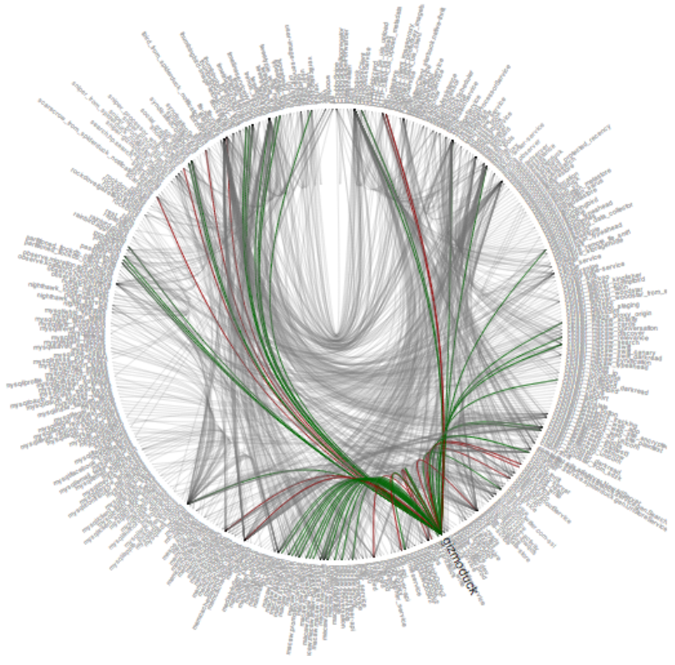
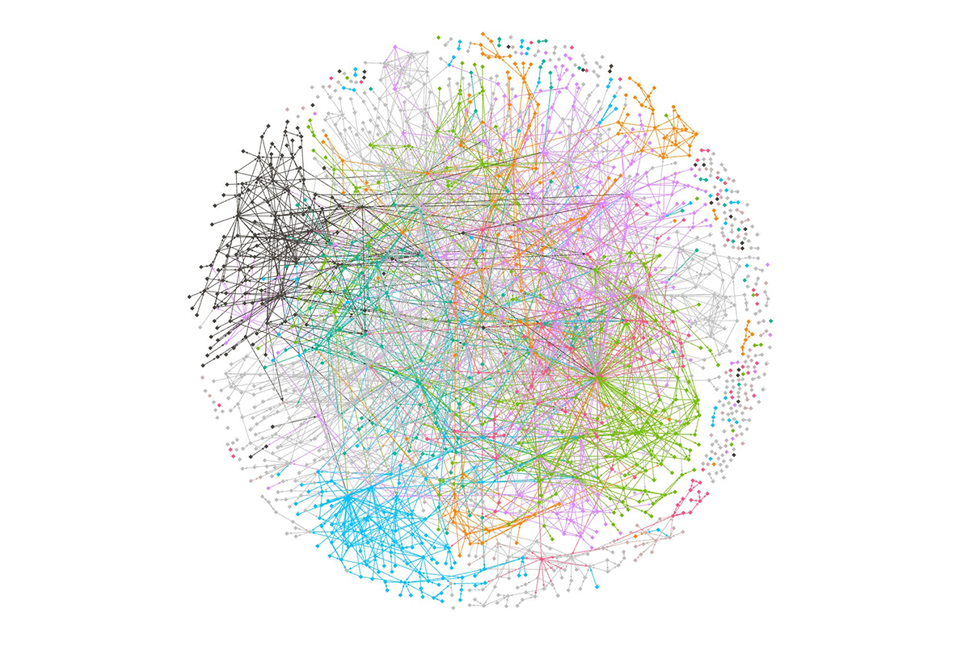
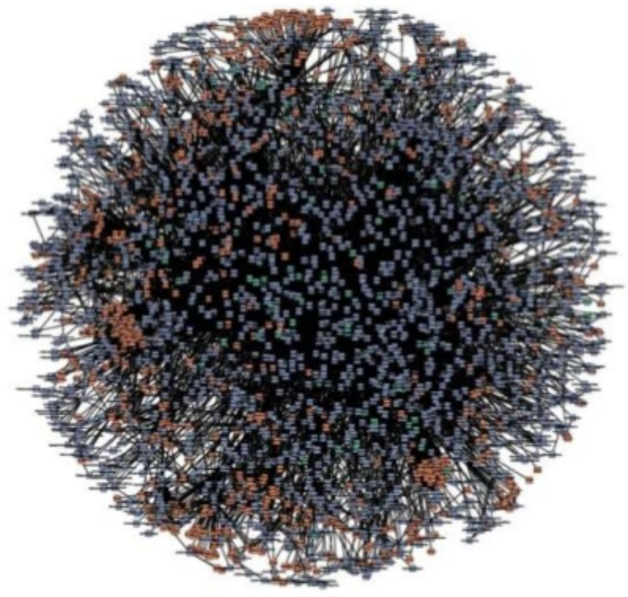
Distributed System
But these are true Microservices!

Slide 12
Oranizational Structure
Conway’s Law:
“Any organization that designs a system
will inevitably produce a design whose structure is a copy of the organization’s communication structure.”

Slide 13
Many other considerations:
Finding the right services is challenging:
Can end up with a distributed monolith
Deploying features spanning multiple services needs careful coordination
Tooling:
CI/CD
Monitoring
Not hurt:
to have Cloud Native Thinking (e.g. 12 factor app design)
to have DevOps-ish mindset
Deciding when to adopt is difficult:
Initially you don’t have the problems that this architecture solves --> slows down the development
A startup should almost certainly begin with a monolithic app
Strangler Pattern
Monolith not always needs to be disappear

Slide 14
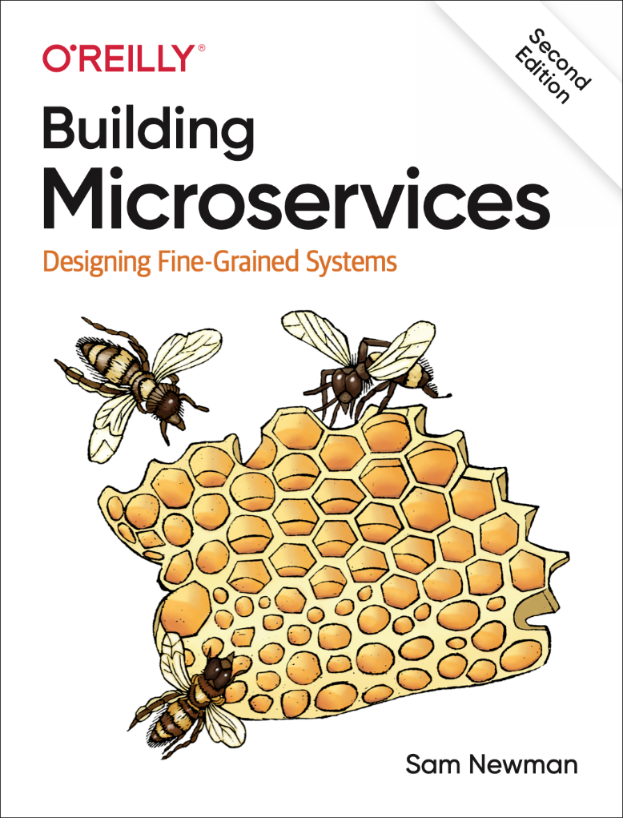
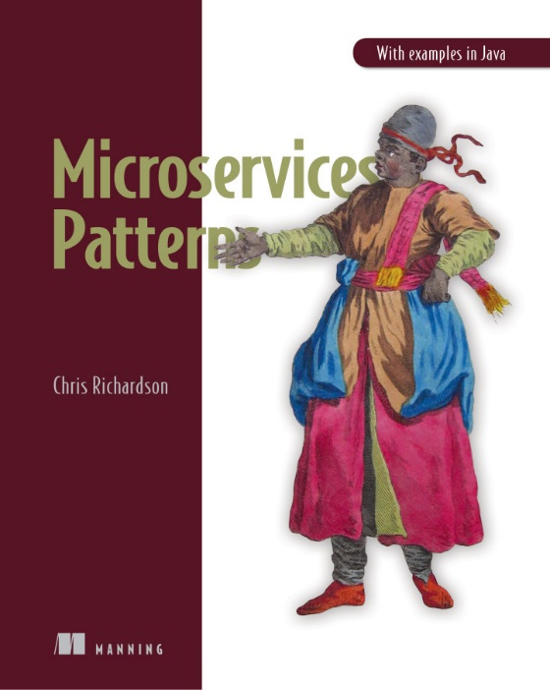
Materials

