Slide 1
DEBUGGING MICROSERVICES

Slide 2
Unimportant slide
Work: Cisco ET&I SRE Engineering Technical Lead
Small teams running lots of different applications
OSS fan (see you at Hacktoberfest)
GitHub/Twitter: sagikazarmark
https://sagikazarmark.hu

Slide 3
The whole story
🔥
Prevent
Detect
Fix
Prevent incidents before they start.
Detect incidents as quickly as possible, notify the responsible parties.
Find and fix problems to resolve the incident ASAP.

Slide 4
Agenda
Challenges
Observability
How it all works
Incident debugging

Slide 5
Challenges
Deployment history
Request context
Network
Skills
Dynamic infrastructure (Kubernetes)

Slide 6
OBSERVABILITY
Data, data, data

Slide 7
Infrastructure / platform
Monitoring
Logging
(Distributed) Tracing
(Continuous) Profiling

Slide 8
Application
Instrumentation
Context propagation (request context)
Correlation
Annotations

Slide 9
Prevent incidents
Deployment strategies
Rolling release
Blue/green deployment
Automatic rollback
Canary releases
Alerting + automations

Slide 10
Detect early
SLI / SLO
Paging: SLO violations
Mission-critical, user-facing services first
Alerting != paging (alert fatigue)
Iterate!

Slide 11
Everything is on fire 🔥
Find what caused the problem
Revert it (if possible)
Investigate the problem
Fix and deploy

Slide 12
Incident debugging: Monitoring
Dashboards
Use different aggregations (median, XY percentile)
Correlate information
Can’t correlate individual requests (eg. latency vs payload size)

Slide 13
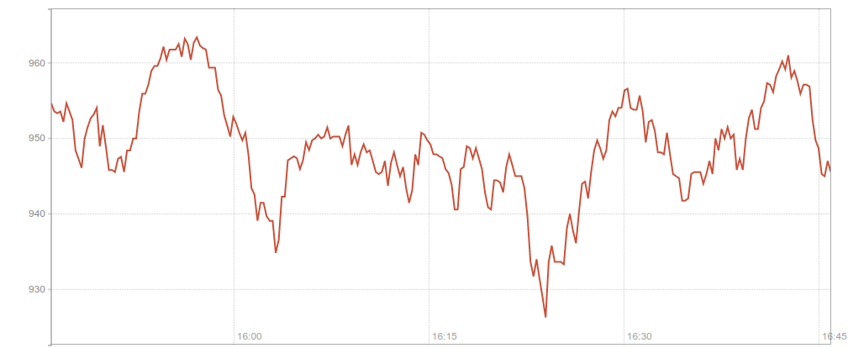
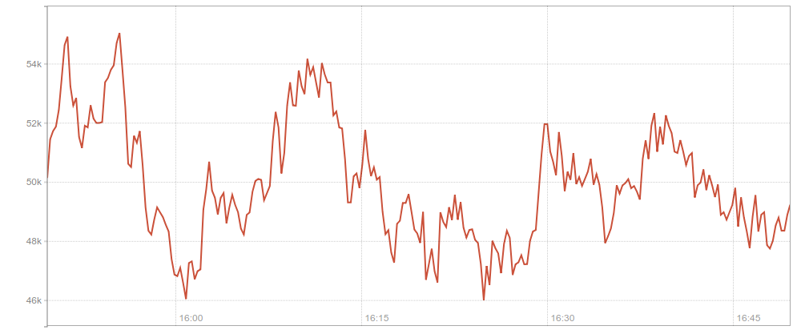

Slide 14
Incident debugging: Tracing
Individual requests
Visualize latency between components
Correlate timing and events
Sampling strategy (rate, error, latency)

Slide 15
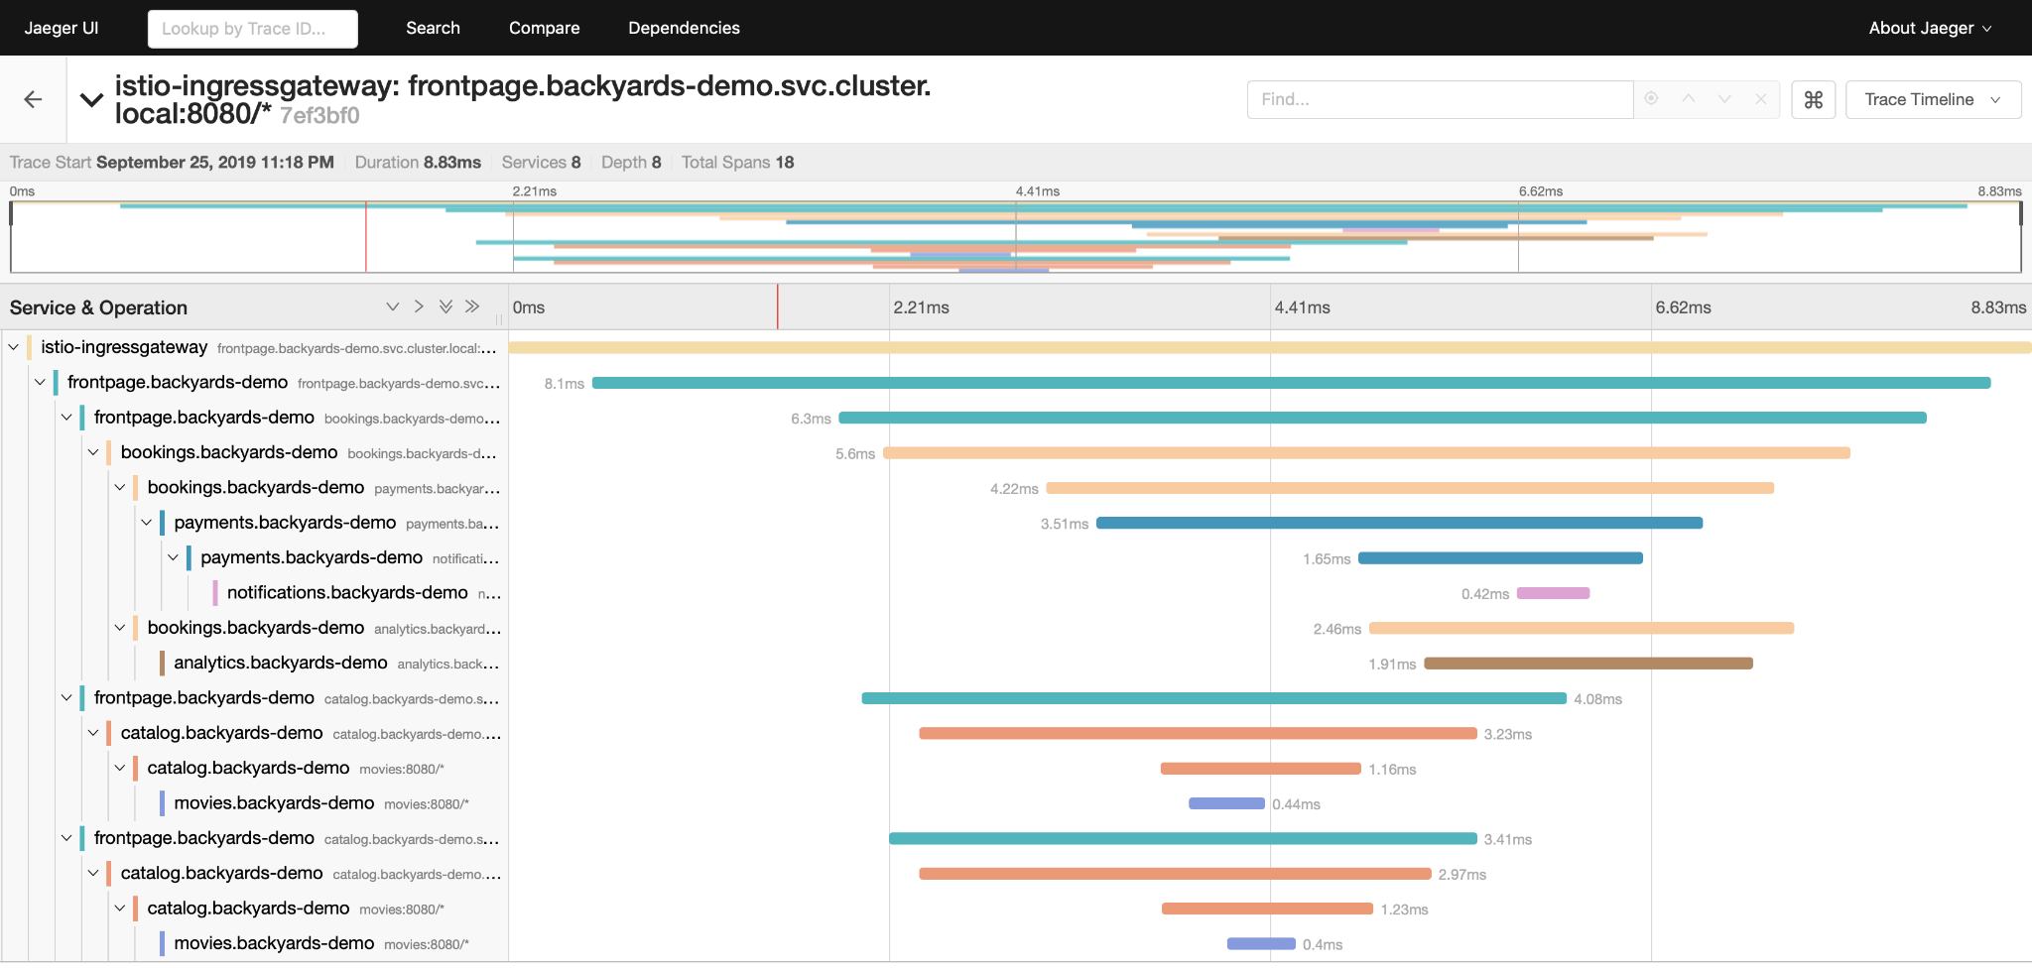

Slide 16
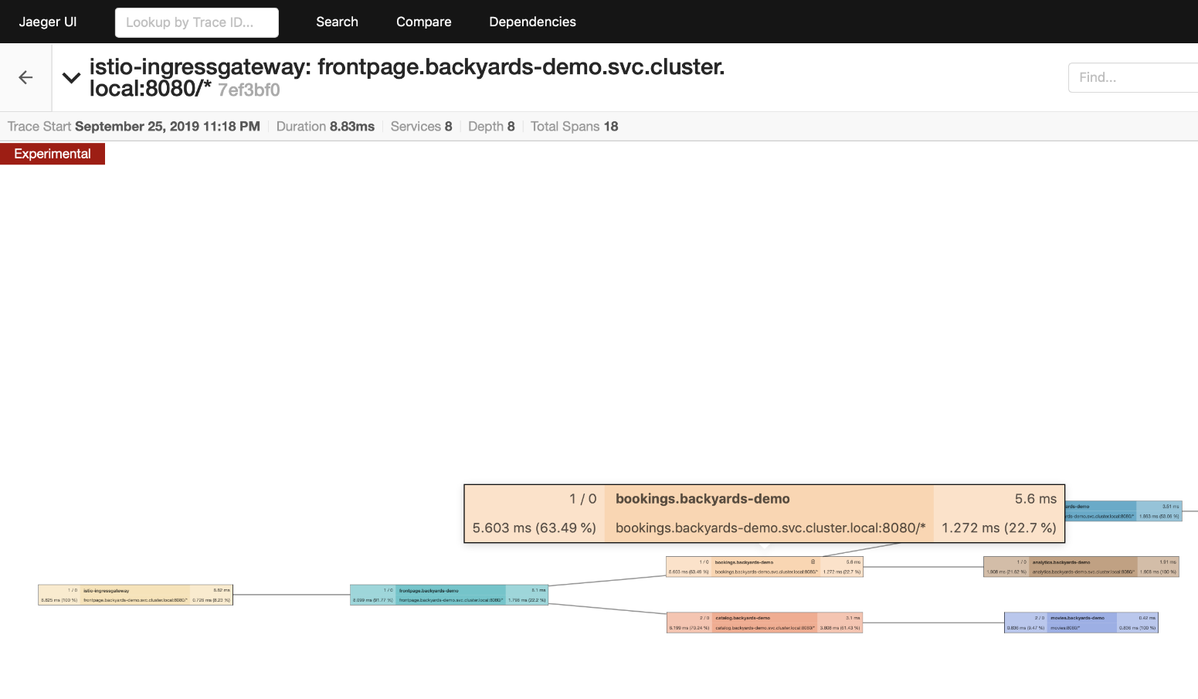

Slide 17
Bonus: postmortems
Best way to learn from our mistakes
Focus on learning (not blaming)
Blameless Postmortem
Atlassian handbook

Slide 18
Recap
🔥
Prevent
Detect
Fix
Prevent incidents before they start.
Detect incidents as quickly as possible, notify the responsible parties.
Find and fix problems to resolve the incident ASAP.

Slide 19
Thanks!
Any questions?
@sagikazarmark
https://sagikazarmark.hu

