Slide 1
Service Architecture at SoundCloud
BFFs and beyond
Notes:
Only one journey out of many

Slide 2
+400 Microservices
Public API
Mothership
Notes:
Mothership - Monolithic application
Hard to change a bigger system -> extract microservices

Slide 3
Core - Stack
Non-blocking networking library - Twitter Finagle (Scala)
Service Discovery - Glimpse (Hashicorp Consul) - DNS
Client-side load-balancing
Circuit-breakers
Out-of-the-box tuning
CI/CD (Go CI)
Canary deployments
K8S (previously Bazooka, inspired by Heroku)
Auto-scaling
Liveness / Readiness probes
Apache Kafka for events

Slide 4
Core - Observability
Metrics
Exposed telemetry:
Alerting:
Dashboards:
Distributed Tracing
Log and Error Aggregation

Slide 5
BFF - motivation
Mothership
Public API
Notes:
Individual requests were too granular, several hundreds of requests even
Different clients need data in different shape

Slide 6
BFF
API Mobile
Mothership
API Web
Public API
Notes:
Backends for frontends for individual client types
GraphQL would be another solution
The hundreds of requests still happen but within the datacenter

Slide 7
VAS
Value Added Service
The same “refactoring” one level down
Encapsulating recurring calls and logic

Slide 8
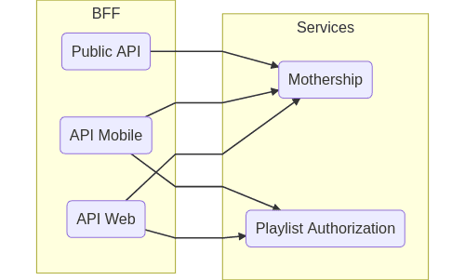
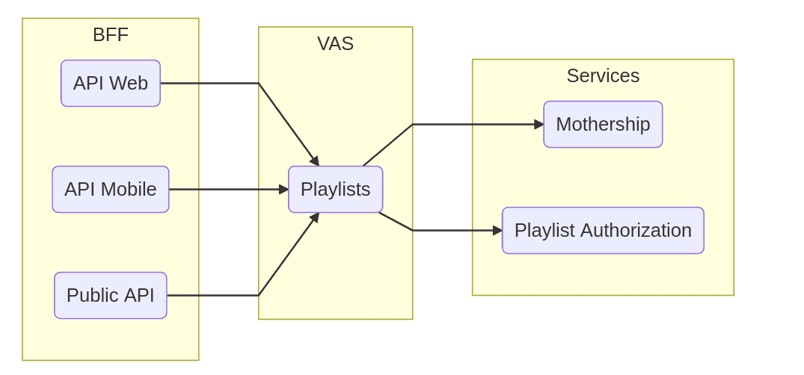
VAS “Playlists” example

Slide 9
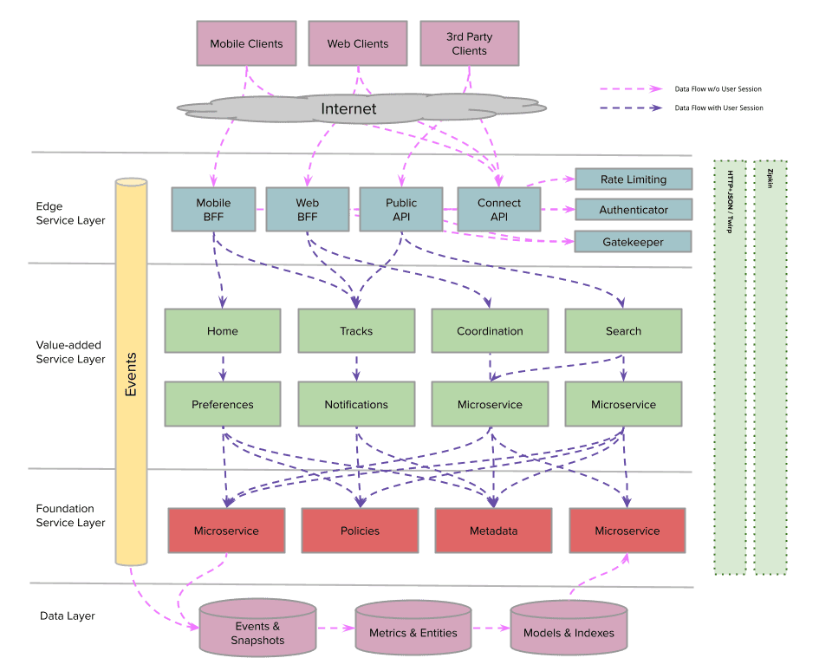
Big Picture

Slide 10
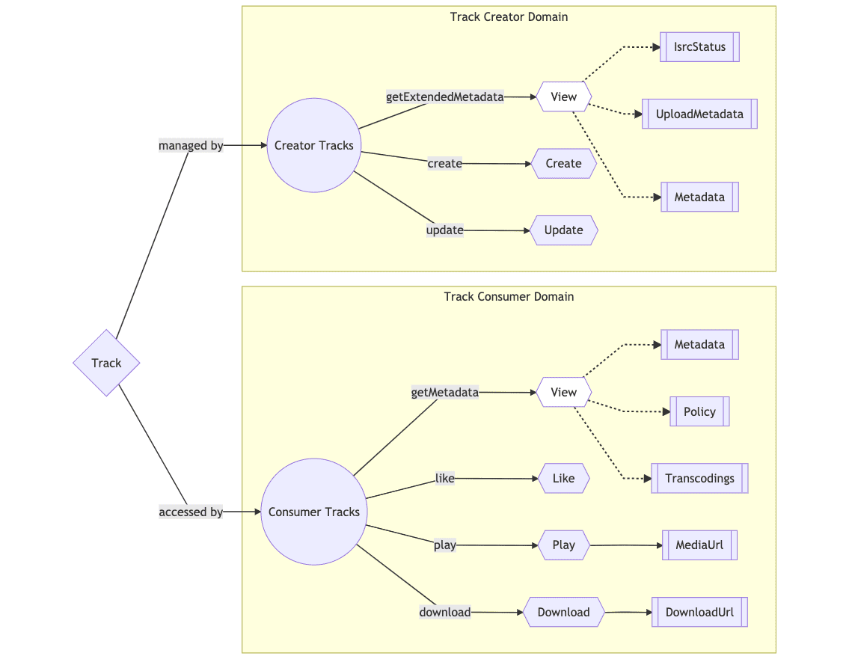
Domain Gateways
Notes:
What if a VAS becomes too big?
Different domains, owned by different teams.

Slide 11
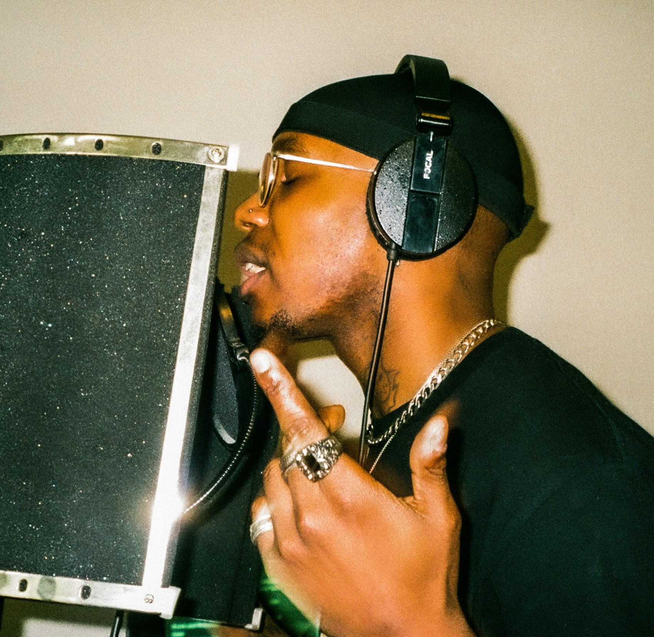
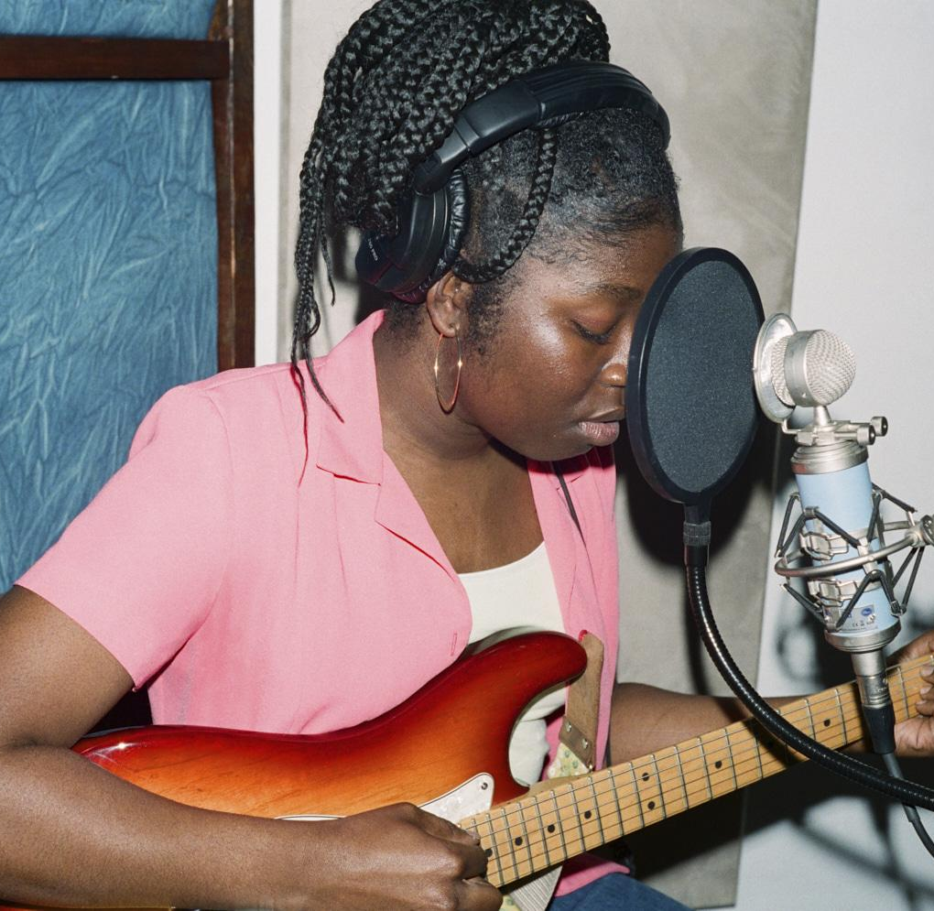
More information
Backstage Blog
Part 1: Backends for Frontends
Part 2: Value-Added Services
Part 3: Domain Gateways
Many thanks to:
The authors:
Jorge Creixell
Bejal Lewis
Marc Tuduri
Kim Covaci
Bernd Louis
And all the colleagues working on this.

Slide 12
Thank You
Köszönöm

