Slide 1

Android mobile device management with Microsoft Intune
Mészáros Etele
MCP, MCSA, MCSE, MCT
TriSys IT Solutions Kft.

Slide 2
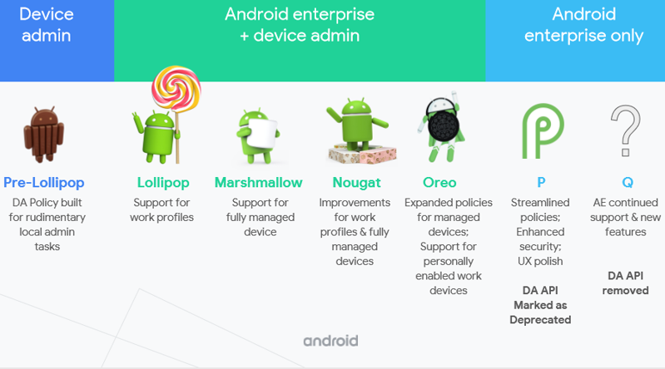
Android Management: DA / AE
Android Enterprise is a Google-led initiative to enable the use of Android devices and apps in the workplace. The program offers APIs and other tools for developers to integrate support for Android into their enterprise mobility management (EMM) solutions.

Slide 3
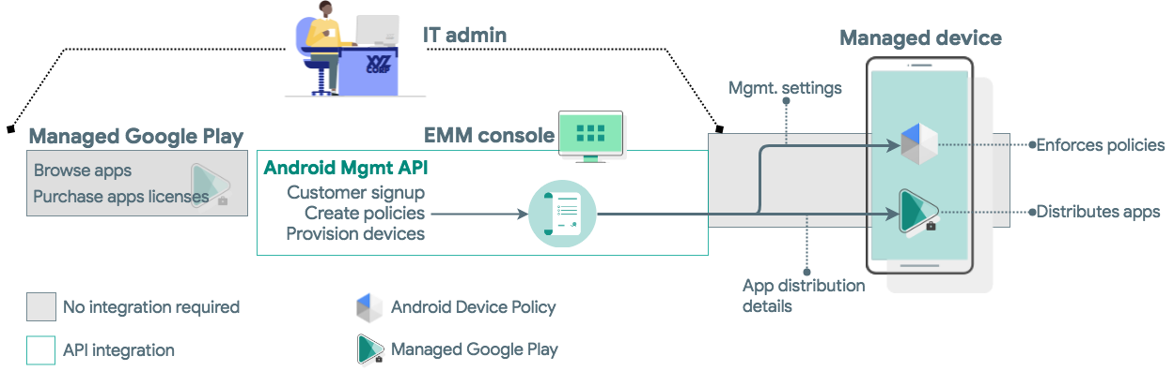
Android Management API Overview
The Android Management API supports mobile device management (MDM) and mobile application management (MAM). The API's partner app, Android Device Policy, receives management policy settings from the API and enforces them on devices.

Slide 4
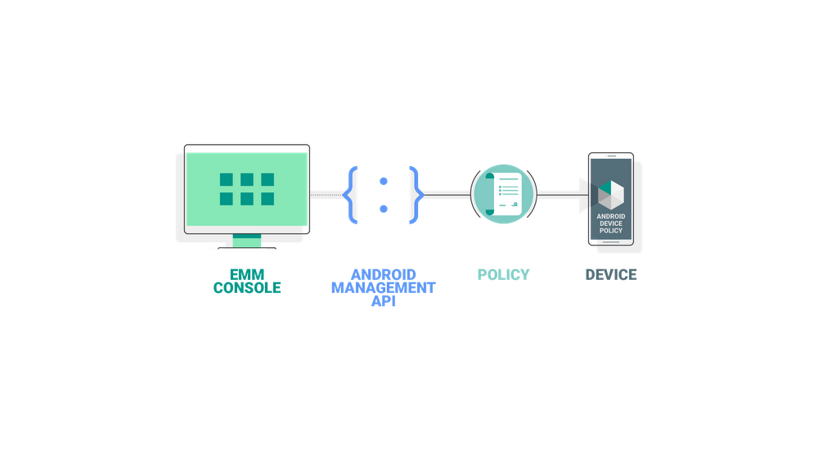
Android Management API with EMM

Slide 5
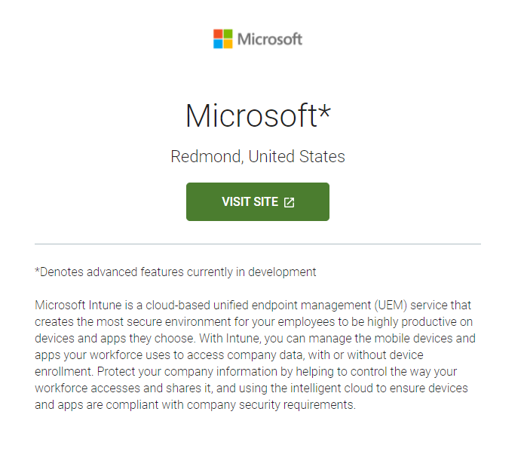
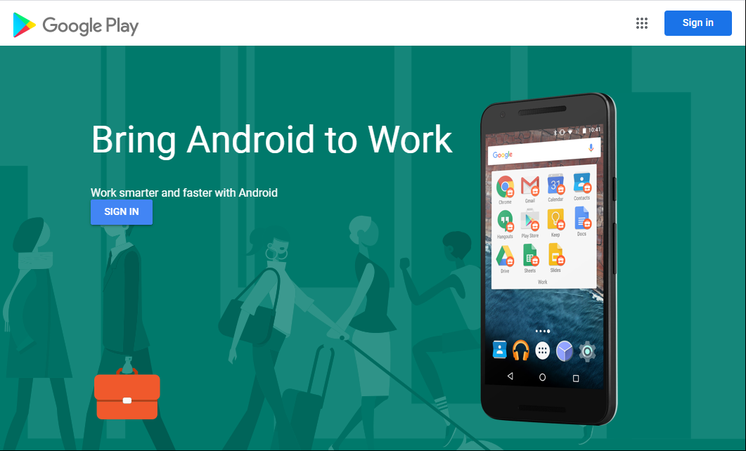
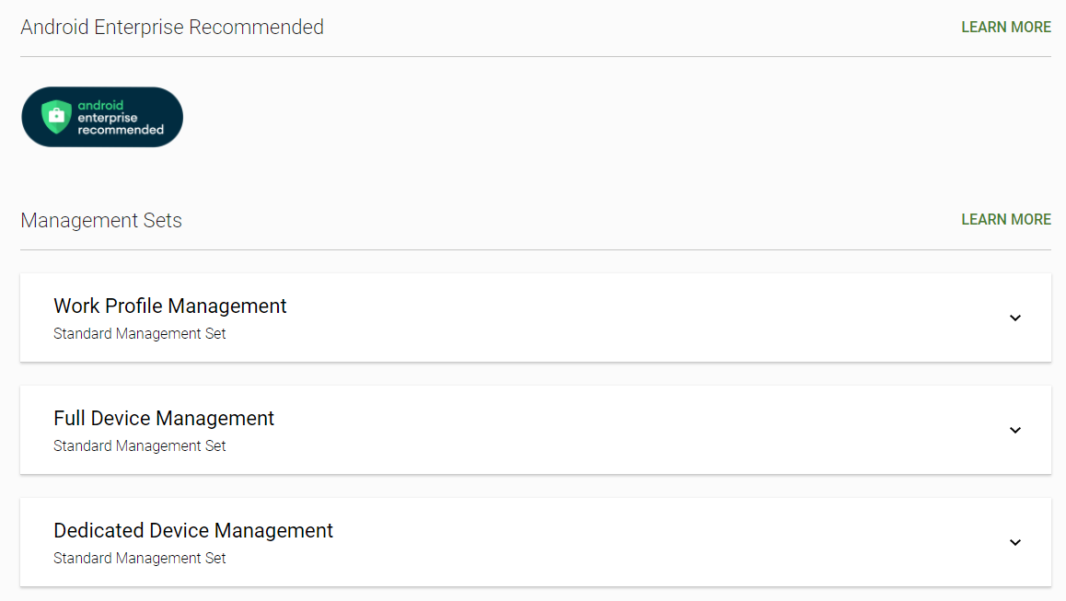
Microsoft EMM: Microsoft Intune

Slide 6
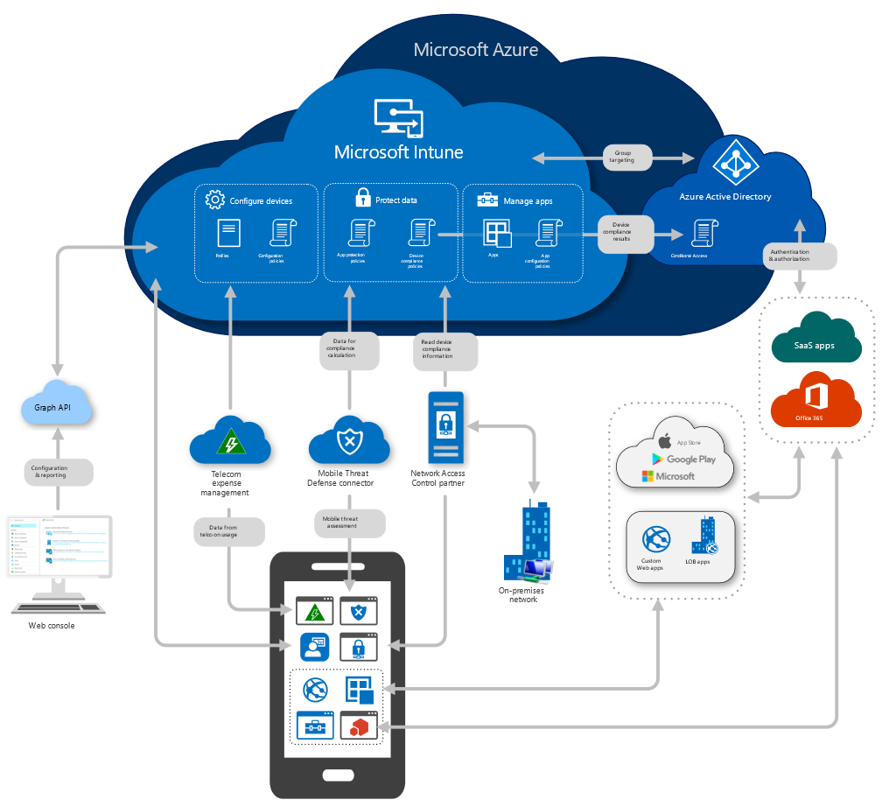
High-level architecture for Microsoft Intune

Slide 7
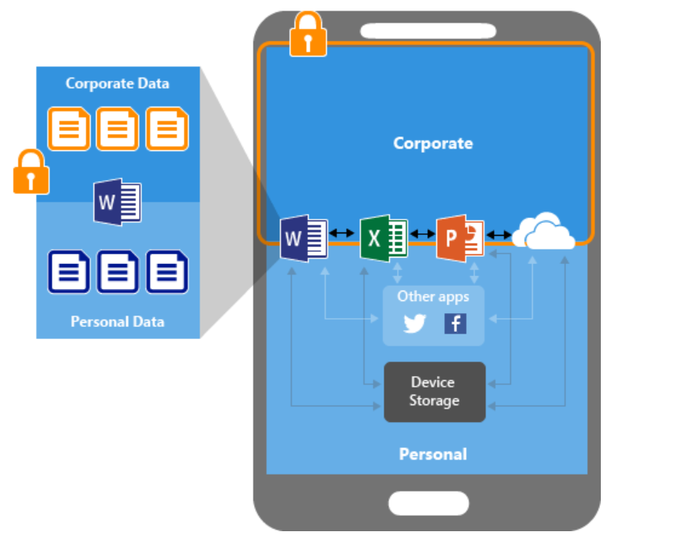
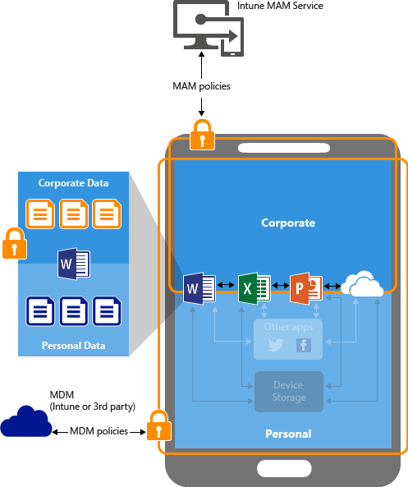



Managing mobile devices: MAM
Mobile Application Management (MAM)
Commonly used for personal devices or Bring Your Own Device scenario
No Device Enrollment required
Company manages the security of only those applications that are enrolled
Key capabilities
Secure corporate data within apps
Report app
inventory & usage
Remove corporate data
Administration
App protection policies
App selective wipe
App configuration policies
Notes:
There are a couple of ways to approach device management.
Mobile application management (MAM).
Typically for personally owned devices, so that the company only has control over only the applications used for business purposes.
Users can use their personal devices to access organizational resources.
When opening an app, such as email or SharePoint, users are prompted for additional authentication. If a device is ever lost or stolen, you can remove all organization data from the device.
Mobile device management (MDM).
Typically used for company owned devices
Users "enroll" their devices, and use certificates to communicate with Intune.
As an IT administrator, you push apps on devices, restrict devices to a specific operating system, block personal devices, and more. If a device is ever lost or stolen, you can also remove all data from the device.
You can also use a combination of MDM and MAM together.
Recap of difference between MDM and MAM
MAM: Company manages the security of only those applications that are enrolled
MDM: Company manages the security of the entire device
MAM: Individual applications are enrolled
MDM: Entire device is enrolled
We will focus on MAM, as it is more common for SMBs who support a BYOD (bring your own device) policy.
Bonus material (optional):
Using Intune to manage apps with MAM without managing the device is useful when:
You want to allow users to use their own device (BYOD).
You want to provide a one-time pop-up message to let users know that MAM protections are in place, rather than continual device-level notification.
You want to comply with policies that require less management capability on personal devices. For instance, you want to manage the corporate data for the apps, rather than manage the corporate data for the entire device.
Using Intune to manage the device with MDM is useful when:
Users need a Wi-Fi or a VPN corporate connectivity profile to be productive – you can \pPreconfigure Wifi profiles for your corp location
Users need a set of apps to be pushed to their device.
Your organization needs to comply with regulatory or other policies that call out specific MDM controls, such as security or encryption.
See https://docs.microsoft.com/en-us/intune/device-management-capabilities

Slide 8









Manage Apps: Commonly used scenarios
Intune
MAM
Intune MAM does two things without requiring Device Enrollment
Separates company managed apps from personal apps, and set policies on how data is accessed from managed apps
Ensures corporate data can’t be copied and pasted to personal apps within the device
Ring fencing Apps
Corp
@contsoso.com
Personal
@hotmail.com
Email Attachment
Copy
Paste
Save
Can’t Paste to Personal Apps
Can’t Save to Personal Storage
Notes:
Intune App Protection policies (APP) protect corporate data even if device itself is not managed
Enables bring-you-own (BYO) and personal devices at work where users may be reluctant to “enroll” their device
Ensures corporate data cannot be copied and pasted to personal apps within the device
May be applied if device is unmanaged, managed by Intune, or by another vendor
Users can access thousands of SaaS apps easily, but often return to the most familiar tools, like the Office 365 suite. Intune is purpose-built to integrate with Office 365 allowing employees to use apps that everyone knows without putting the enterprise at risk. They can begin a document on one device and switch to a different device later without losing anything in transition. Office 365 applications are context aware making them easy to use no matter the size of the screen or device. Employees can work, collaborate and create from wherever on whatever device without worrying about hardware or log ins, leading to greater productivity.

Slide 9
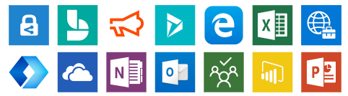


Intune-enlightened apps provide the best control
Check back frequently…

Slide 10
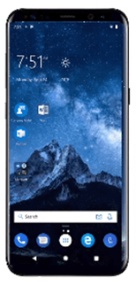
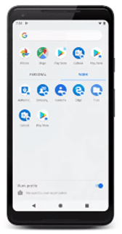
Personally owned devices: Management scenarios
Personally owned devices without enrollment
(MAM-WE)
Personally owned devices with a work profile
(BYOD)

Slide 11
Personally owned devices: Enrollment methods
Personal | Enrollment Methods | Reset Required | User Affinity | Locked
Android Enterprise personally-owned with Work Profile | User initiated via Company Portal | No | Yes | No

Slide 12
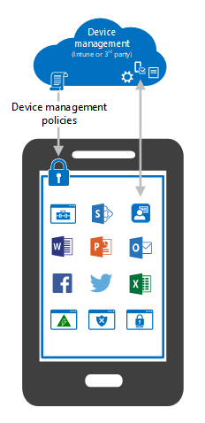



Managing mobile devices: MDM
Mobile Device Management (MDM)
Commonly used for total management of company-owned devices
Device Enrollment Required
Company manages the security of the entire device
Key capabilities
Provision settings, certs, profiles
Advanced policy controls
Report & measure device compliance
Administration
Enroll devices
Configuration profiles
Compliance policies
Notes:
There are a couple of ways to approach device management.
Mobile application management (MAM).
Typically for personally owned devices, so that the company only has control over only the applications used for business purposes.
Users can use their personal devices to access organizational resources.
When opening an app, such as email or SharePoint, users are prompted for additional authentication. If a device is ever lost or stolen, you can remove all organization data from the device.
Mobile device management (MDM).
Typically used for company owned devices
Users "enroll" their devices, and use certificates to communicate with Intune.
As an IT administrator, you push apps on devices, restrict devices to a specific operating system, block personal devices, and more. If a device is ever lost or stolen, you can also remove all data from the device.
You can also use a combination of MDM and MAM together.
Recap of difference between MDM and MAM
MAM: Company manages the security of only those applications that are enrolled
MDM: Company manages the security of the entire device
MAM: Individual applications are enrolled
MDM: Entire device is enrolled
We will focus on MAM, as it is more common for SMBs who support a BYOD (bring your own device) policy.
Bonus material (optional):
Using Intune to manage apps with MAM without managing the device is useful when:
You want to allow users to use their own device (BYOD).
You want to provide a one-time pop-up message to let users know that MAM protections are in place, rather than continual device-level notification.
You want to comply with policies that require less management capability on personal devices. For instance, you want to manage the corporate data for the apps, rather than manage the corporate data for the entire device.
Using Intune to manage the device with MDM is useful when:
Users need a Wi-Fi or a VPN corporate connectivity profile to be productive – you can \pPreconfigure Wifi profiles for your corp location
Users need a set of apps to be pushed to their device.
Your organization needs to comply with regulatory or other policies that call out specific MDM controls, such as security or encryption.
See https://docs.microsoft.com/en-us/intune/device-management-capabilities

Slide 13
Manage devices: Commonly used scenarios
View device inventory
Remote lock
Retire
Wipe
Bulk device actions
Notes:
As an IT admin, you must ensure that managed devices are providing the resources that your users need to do their work, while protecting that data from risk.
The Devices workload gives you insights into the devices you manage, and lets you activate remote tasks on those devices.
https://docs.microsoft.com/en-us/mem/intune/remote-actions/device-management

Slide 14
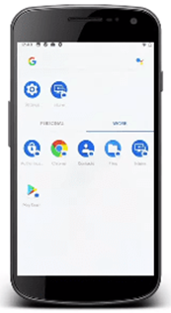

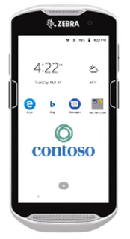
Company owned devices: Management scenarios
Corporate owned work profile
(COPE)
Corporate owned fully managed
(COBO)
Corporate owned dedicated devices
(COSU)

Slide 15
Company owned devices: Enrollment methods
Corporate | Enrollment Methods | Reset Required | User Affinity | Locked
Android Enterprise Dedicated | NFC, Token, QR code, Zero Touch | Yes | No | Configurable via policy
Android Enterprise Fully Managed | NFC, Token, QR code, Zero Touch | Yes | Yes | Configurable via policy
Android Enterprise corporate-owned with Work Profile | NFC, Token, QR code, Zero Touch | Yes | Yes | Configurable via policy

Slide 16
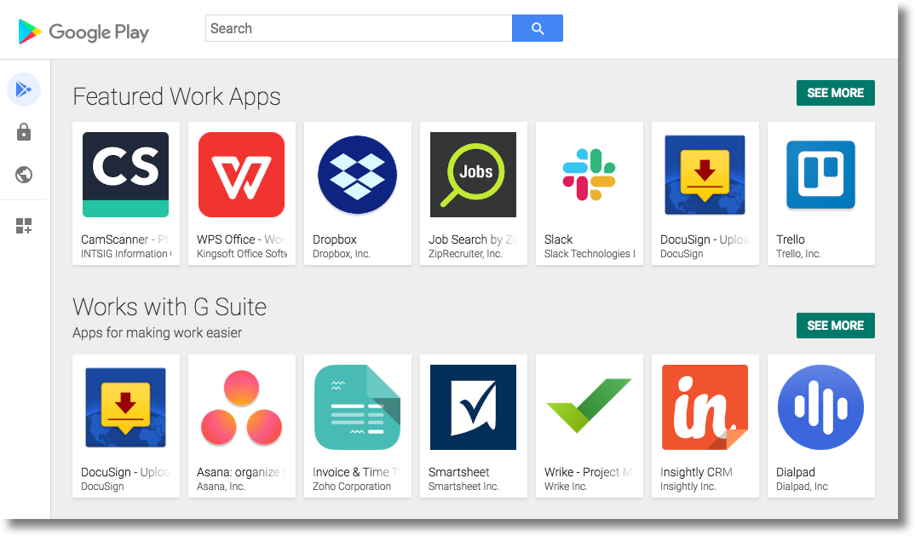
Managed Google Play
Key features:
- Public app search
- Private app publishing
- Web app publishing
- App organization

Slide 17

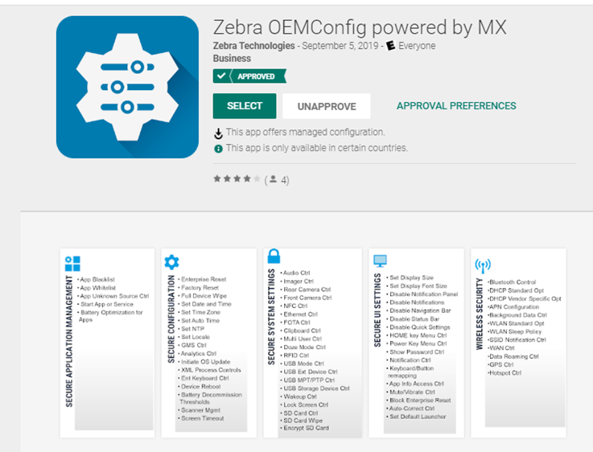
Additional API: OEMConfig
OEMConfig, a means for OEMs to provide additional APIs over and above Android Enterprise easily managed directly through an EMM.
https://docs.microsoft.com/en-us/mem/intune/configuration/android-oem-configuration-overview

