Slide 1
K8S Resource Management Deep dive
From Physical to container and linux kernel level
Notes:
Resource managment deepdive in 15m

Slide 2
whoami
Cloud Engineering Chapter Lead @MT
Hegedűs Dániel
Notes:
multiple hats

Slide 3
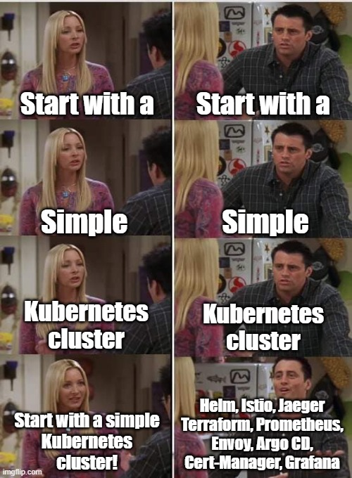
Why do even care?
Following is not needed at start!
Things to consider:
Containers want to acces to all resources (by def.)
Multi tenant cluster → Shared resources
Large number of containers are in production
(try to) Avoid Resource contention Designing for peak workload is not Cost Effective
+1: OPS point of view: Starting Apps can be a noisy and could cause troubles → Restrictions are useful
Notes:
In an ideal world there is no need to consider the followings (endless money, immortality, free beer.)
Env like in MT Efficient resource management needed:
If not restricted Containers want to access all resources if possible.
Multiple internal users
NS gives isolation but its expensive to play it safe, higher density than pure VMs.
No variable resource allocation for container startup
If you want to start up fast just give it more resource and call it a day but it will significantly more expensive

Slide 4
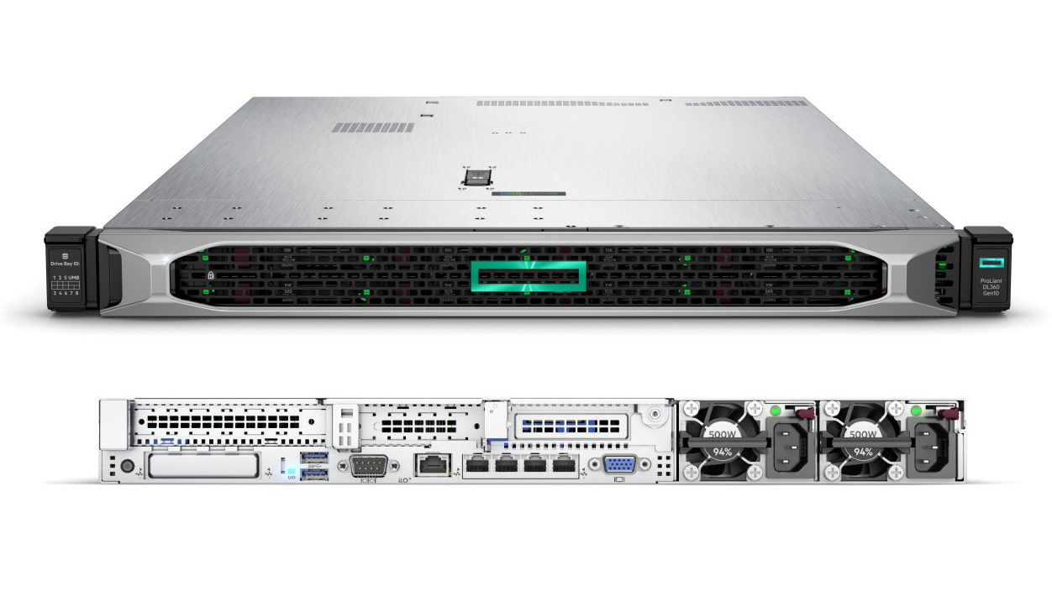
Setting the Scene
Dozens of HPE rackmount servers
Hundreds of VMs
Thousands of Running Pods (high density)
Notes:
Cloud not means there are as many of resources as many clouds thre are, there can be anywhere as clouds.
This presentation is covering the same env as Sz.P W.M M.B.

Slide 5
What can we manage
Server
1 vCPU/Core for cloud providers 1 hyperthread on bare-metal Intel processors
Objects like:
Pod count
CMs
secrets… etc
measured in bytes. Suffixes allowed (like Ei, Pi, Ti, Gi, Mi, Ki.)
Notes:
Physical Resources like Cpu,ram,disk,network &GPU TPU

Slide 6
Node level
Node Capacity
Kube-reserved
is meant to capture resource reservation for kubernetes system daemons like the kubelet, container runtime, node problem detector, etc
System-reserved
is meant to capture resource reservation for OS system daemons like sshd, udev, etc.
Eviction-threshold
Evictions are supported for memory and ephemeral-storage only. The kubelet attempts to evict pods whenever memory (or storage) availability on the node drops below the reserved value.
Allocatable (Available for pods)
P4
P3
On a Kubernetes node is defined as the amount of compute resources that are available for pods. The scheduler does not over-subscribe Allocatable. CPU, memory and ephemeral-storage are supported as of now.
P2
P1
Notes:
Each node has a maximum capacity for each of the resource types

Slide 7
Container Request and limit
Container specs | Meaning | Effect
requests.cpu | == of the --cpu-shares flag in the docker run command. Soft limit (relative weighting) | „dibs” Important for the kube-scheduler
limits.cpu | „converted to its millicore value and multiplied by 100.” →Time! not number of CPU Managed by cgroups & CFS, Default cycle=100ms | „Flexible” limit, Overcommitable but Throttling will kick in
limits.memory | converted to an integer, and used as the value of the --memory flag in the docker run command. | Hard limit → OOM
Pod
Limit
Limit
Request
Request
Notes:
When you specify a Pod, you can optionally specify how much of each resource a Container needs. The most common resources to specify are CPU and memory (RAM); there are others.
If there is no contention pod can be use as many CPU as many it’s needed
CPU under the hood:
Request can be fractional for example 0.2 , and multiplied by 1024. The greater of this number or 2 is used as the value of the --cpu-shares flag in the docker run command. Soft limit. CFS: cpu shares
Alapegység a 100ms amit használsz arra van osztás, utána várni kell., ha valakinek fontos a latency CFS quota-nál lehet beletúrni
The spec.containers[].resources.limits.cpu is converted to its millicore value and multiplied by 100. The resulting value is the total amount of CPU time that a container can use every 100ms. A container cannot use more than its share of CPU time during this interval.
Note: The default quota period is 100ms. The minimum resolution of CPU quota is 1ms.
The spec.containers[].resources.limits.memory is converted to an integer, and used as the value of the --memory flag in the docker run command.

Slide 8
Let’s see it in action
?
Notes:
Am I telling the truth?
Starting a new cointainer w 1CPU &200m RAM and perform a top command from it
From the container you will see the host data

Slide 9
Limits by level
API Server
Kubelet (each node)
CRI runtime (each node)
OCI Runtime (each node)
Detects a pod that needs to be assigned to a Node
Convert CPU cores to CFS period/quota ms
Pass limits & create containers
Set OCI spec
cgroups
Call groups
Notes:
Podspecs -> scheduler assign a node to the pod,
Ask nodespecs from etcd
Kubelet converts CFS period & Quota periods &
Not visible beacause of me, but calls CFS on linux host

Slide 10
QOS
QoS Class | Condition | Priority (Lower is better)
Guaranteed | Limit= Request (and !=0) for all containers | 1
Burstable | some containers have limits > requests | 2
BestEffort | no request/limit for containers | 3
Notes:
When you specify a Pod, you can optionally specify how much of each resource a Container needs. The most common resources to specify are CPU and memory (RAM); there are others.
The spec.containers[].resources.requests.cpu is converted to its core value, which is potentially fractional, and multiplied by 1024. The greater of this number or 2 is used as the value of the --cpu-shares flag in the docker run command.
The spec.containers[].resources.limits.cpu is converted to its millicore value and multiplied by 100. The resulting value is the total amount of CPU time that a container can use every 100ms. A container cannot use more than its share of CPU time during this interval.
Note: The default quota period is 100ms. The minimum resolution of CPU quota is 1ms.
The spec.containers[].resources.limits.memory is converted to an integer, and used as the value of the --memory flag in the docker run command.

Slide 11
Cgroup,CFS and threads in a nutshell
Cgroup (Control group)
- Linux kernel feature:
- Limits, isolates and prioritaziation of resources (CPU,RAM,I/O,NW, etc) for processes
CFS (Completely Fair Scheduler)
- Linux kernel feature: - Models an “ideal, precise multi-tasking CPU” on real hardware.
- All task can access all the Physical power but in an order
- Virtual runtime for timeslices
Threads
The smallest sequence of programmed instructions that can be managed independently by a scheduler
Multiple threads can exist within one process

Slide 12
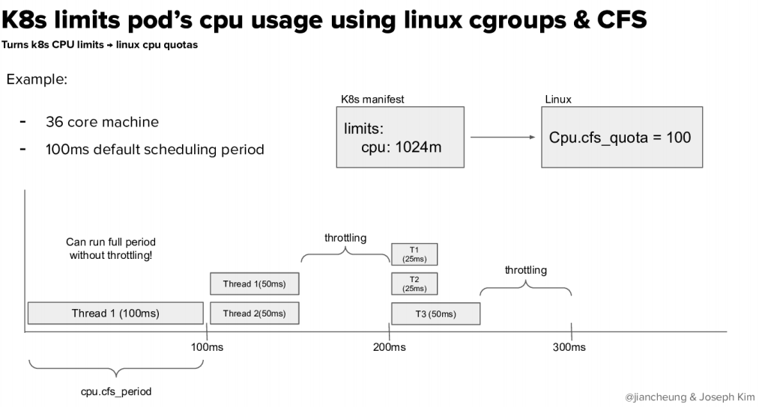
Cgroup,CFS and threads
https://kccncna20.sched.com/event/ek9r/10-more-wierd-ways-to-blow-your-kubernetes-jian-cheung-joseph-kim-airbnb
Notes:
When you specify a Pod, you can optionally specify how much of each resource a Container needs. The most common resources to specify are CPU and memory (RAM); there are others.
If there is no contention pod can be use as many CPU as many it’s needed
CPU under the hood:
Request can be fractional for example 0.2 , and multiplied by 1024. The greater of this number or 2 is used as the value of the --cpu-shares flag in the docker run command. Soft limit.
Alapegység a 100ms amit használsz arra van osztás, utána várni kell., ha valakinek fontos a latency CFS quota-nál lehet beletúrni
The spec.containers[].resources.limits.cpu is converted to its millicore value and multiplied by 100. The resulting value is the total amount of CPU time that a container can use every 100ms. A container cannot use more than its share of CPU time during this interval.
Note: The default quota period is 100ms. The minimum resolution of CPU quota is 1ms.
The spec.containers[].resources.limits.memory is converted to an integer, and used as the value of the --memory flag in the docker run command.

Slide 13
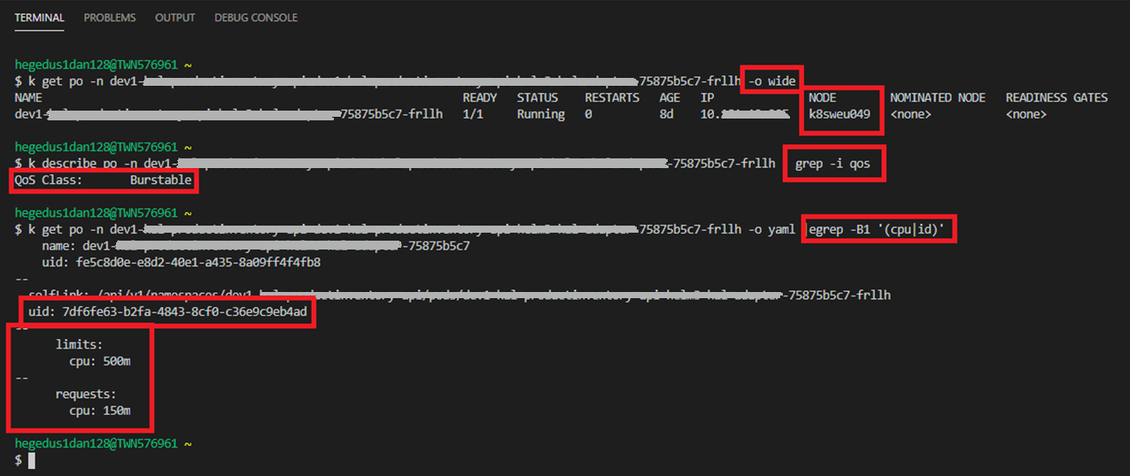
Cgroup,CFS and threads
Notes:
When you specify a Pod, you can optionally specify how much of each resource a Container needs. The most common resources to specify are CPU and memory (RAM); there are others.
If there is no contention pod can be use as many CPU as many it’s needed
CPU under the hood:
Request can be fractional for example 0.2 , and multiplied by 1024. The greater of this number or 2 is used as the value of the --cpu-shares flag in the docker run command. Soft limit.
Alapegység a 100ms amit használsz arra van osztás, utána várni kell., ha valakinek fontos a latency CFS quota-nál lehet beletúrni
The spec.containers[].resources.limits.cpu is converted to its millicore value and multiplied by 100. The resulting value is the total amount of CPU time that a container can use every 100ms. A container cannot use more than its share of CPU time during this interval.
Note: The default quota period is 100ms. The minimum resolution of CPU quota is 1ms.
The spec.containers[].resources.limits.memory is converted to an integer, and used as the value of the --memory flag in the docker run command.

Slide 14
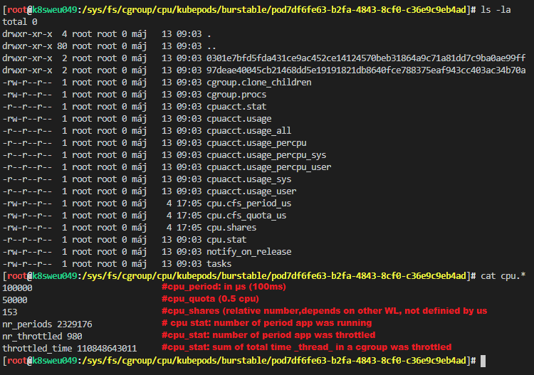
Cgroup,CFS and threads
Notes:
When you specify a Pod, you can optionally specify how much of each resource a Container needs. The most common resources to specify are CPU and memory (RAM); there are others.
If there is no contention pod can be use as many CPU as many it’s needed
CPU under the hood:
Request can be fractional for example 0.2 , and multiplied by 1024. The greater of this number or 2 is used as the value of the --cpu-shares flag in the docker run command. Soft limit.
Alapegység a 100ms amit használsz arra van osztás, utána várni kell., ha valakinek fontos a latency CFS quota-nál lehet beletúrni
The spec.containers[].resources.limits.cpu is converted to its millicore value and multiplied by 100. The resulting value is the total amount of CPU time that a container can use every 100ms. A container cannot use more than its share of CPU time during this interval.
Note: The default quota period is 100ms. The minimum resolution of CPU quota is 1ms.
The spec.containers[].resources.limits.memory is converted to an integer, and used as the value of the --memory flag in the docker run command.

Slide 15
Summary
Cpu time NOT number of cores
Compressible vs real hard limit (Throttling vs OOM)
Container vs Linux Kernel level (CFS Quota)
Percentage of throttling, rather than absoulte value of periods (Threads)
Mitigating OPS risk and saving CX on unnecessary infra expenses

Slide 16
Thank you!

