Slide 1
AppSec trends of 2021
Prekler Róbert
sales engineer
robert.prekler@microfocus.com

Slide 2
DevOps Success
208x More frequent code deployments
106x Faster lead time from commit to deploy
2604x Faster time to recovery from incidents

Slide 3
But security was left out
Why?
Security is a specialist discipline
Security is driven by compliance, which is not the focus of DevOps
Developers deliver functional code fast
Anything else is friction
Security creates too much noise

Slide 4
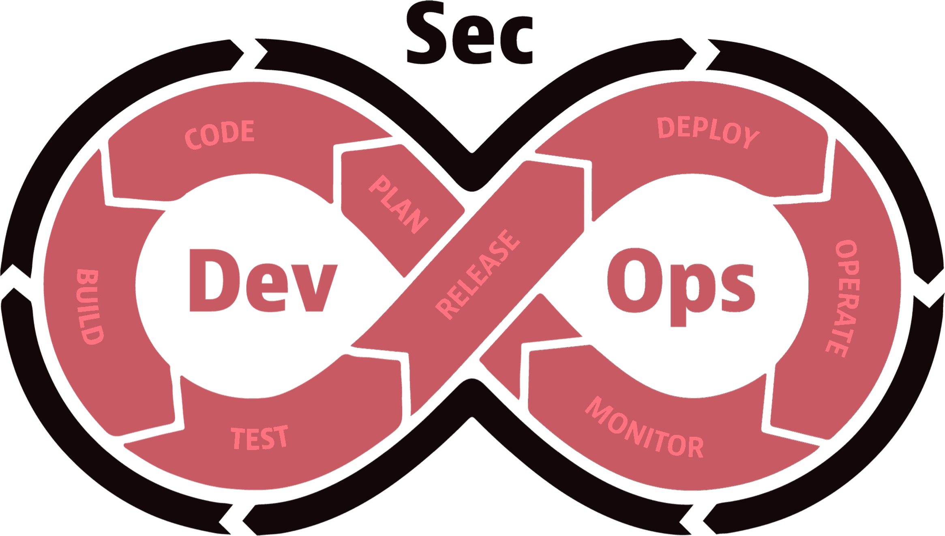
Time to put the Sec into DevOps → DevSecOps
AppSec tooling becomes embedded in the DevOps toolchain
Speed > Accuracy
Ease of use > Depth
Cloud platforms on the rise
Developer driven

Slide 5
SAST and DAST become truly integrated
SAST
DAST

Slide 6
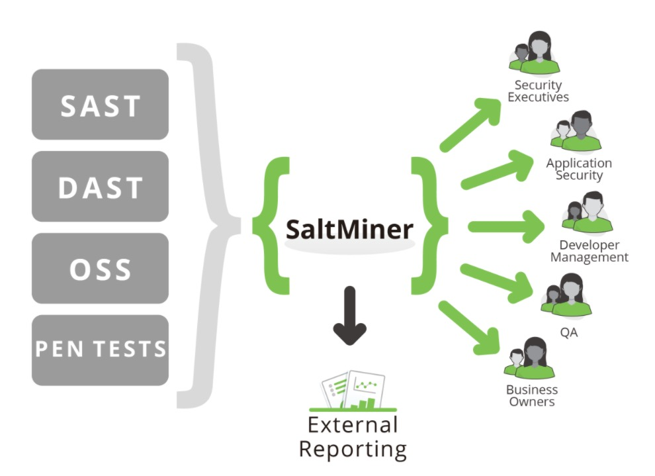
Vulnerability Management takes a step forward
Tools that aggregate information from multiple sources and present that risk in a rollup view

Slide 7
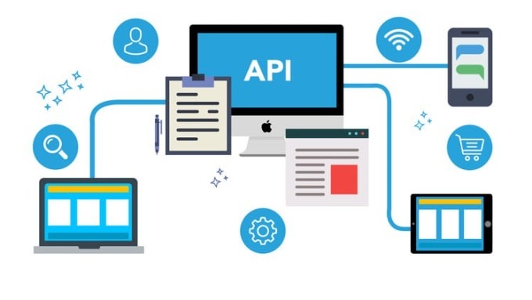
APIs enable rapid innovation, but have unique security challenges
APIs (Application Programming Interfaces):
critical part of modern mobile, SaaS and web applications
found in customer-facing, partner facing and internal applications
APIs expose application logic and sensitive data such as PII and because of this have increasingly become a target for attackers

Slide 8
Container Security
92%
84%
2019
2020
Organizations using containers in production*
*2020 report from Cloud Native Computing Foundation

Slide 9
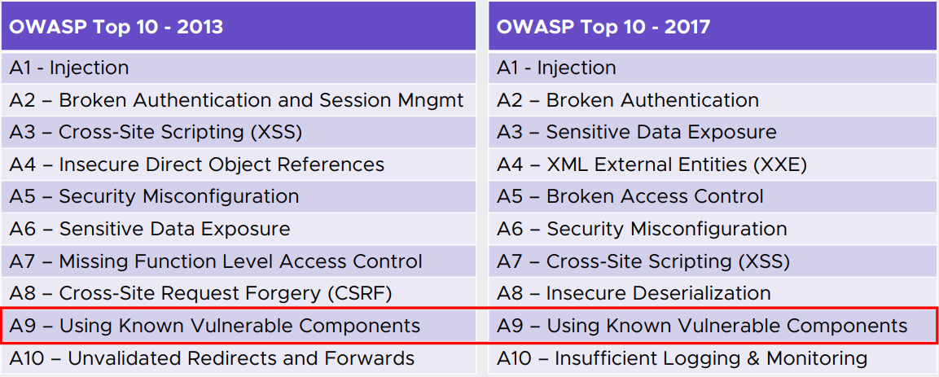
Open Source Prioritization Open source vulnerabilities are an ongoing issue
SAST
DAST

Slide 10
Open Source Prioritization
99% of codebases audited in 2019 contained open source components
82% of codebases had components that were more than four years out of date
37% of firms surveyed still plan on doing software composition analysis (SCA) only during the testing phase, where remediation is much harder
95% of 1,000 enterprise IT leaders thought open-source is "strategically important to their organization's overall enterprise infrastructure software strategy.”

Slide 11
Open Source Prioritization Auditing open source issues is a long, manual process…
20 Minutes spent
38 Open source issues
100 Applications+
On average to manually research an open source finding
The average application SCA scan identifies
Each enterprise organization has on average
Source: 2020 State of the Software Supply Chain

Slide 12
1266+ hours that could be spent investigating issues with no security impact

Slide 13
Susceptibility Analysis focuses on exploitable open source vulnerabilities
Reduce known vulnerability false positives
Prevent spending months of effort upgrading a library that has almost zero security benefit
Save time on investigation of known issues in open source
Better data / Better decisions

Slide 14
Application Security with Micro Focus Fortify
Deep dive webinar on BrightTalk on 2nd of June about the „How”
You can register on the following link:
https://www.brighttalk.com/webcast/17092/481503
Or search for the „Alkalmazás biztonság. A Fortify termékcsalád bemutatása” on BrightTalk

Slide 15
Q&A

Slide 16
Thank You.

