Slide 1
Device Identification by Hardware Security Modules
HWSW Meetup
19th May 2021
Zoltán Hornák

Slide 2
Levels of application security
Web services
SQL Injection, Cross Site Scripting (XSS), Cross-Site Request Forgery (CSRF), Clickjacking, DDoS, …
Programming languages
Input Validation Errors, Buffer Overflow, Integer Overflow, Serialization, Error Handling, TOCTOU, …
Cryptographic Libraries
OpenSSL, JCA/JCE, .NET Crypto, Asymmetric/Symmetric Encryption, Hashing, MAC, Signatures, …
Hardware Security Modules
Trusted Platform Module, Trusted Execution Environment, Device Identification, Secure Boot Loader, …
Chipset Security
Side Channel Attacks, Glitching, Focused Ion Beam Attacks, Differential Power Analysis, …

Slide 3
Some words about me
SCADEMY Ltd
Established (April, 2014)
Portfolio completed (C/C++ JAVA, C#, Python)
Train-the-trainer (training material for trainers)
Industry specific courses (Fintech, automotive, healthcare, telecom)
Budapest University
SEARCH-LAB Ltd
Virsec, VirusBuster
COMP Gmk
15 years university background
40+ Research Projects 400+ Security Evaluations (since 1999)
Laszlo Lovassy Secondary Grammar School
Compfair Prize
Disassembly and analysis plenty of computer viruses (since 1989)

Slide 4
Introduction - Trusted Platform Module -

Slide 5
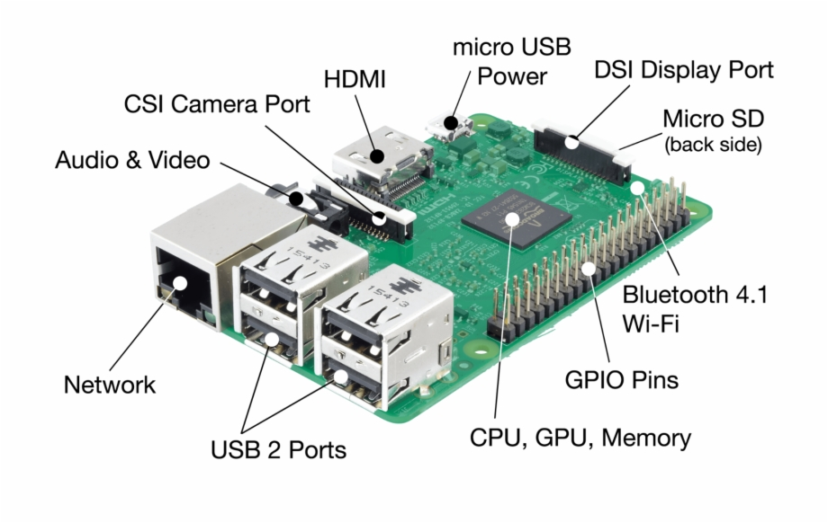
Raspberry PI 3 Model B

Slide 6
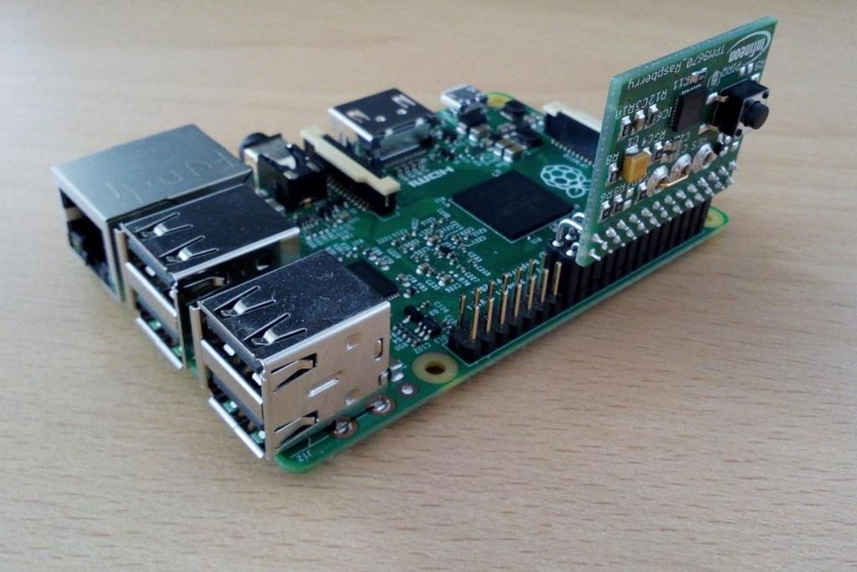
Infineon TPM with RPI 3B
Infineon Optiga TPM SLB 9670 extension card
Raspberry PI 3 model B

Slide 7
TPM 2.0 Features
Discrete TPM
Built into the system
Resist against hardware attacks
Integrated TPM
The TPM is integrated to the SoC
Firmware TPM
The TPM is implemented in protected software (SEE, TEE, TrustZone)
Basics
High quality random numbers
Key generation and storage
Hash functions
Bulk symmetric encryption
Asymmetric methods

Slide 8
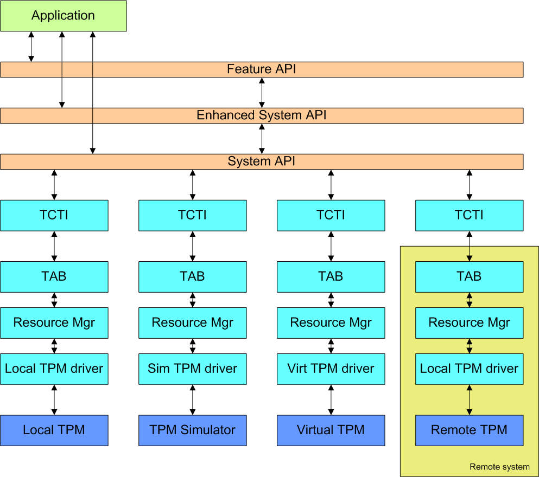
Trusted Software Stack layers
FAPI: Feature API ESAPI: Enhanced System API
SAPI: System API
TCTI: TPM Command Transmission Interface
TAB: TPM Access Broker

Slide 9
TPM Services
Integrity solutions
Root of Trust for Measurement
Reliable Device Identification
Secure Boot Loader
Measurement with Hashes
Digital signature verification
Secure Firmware Update Mechanism
Remote Attestation
Secure key storage
Platform Configuration Register (PCR)
NV Indexes (Non-volatile memory)
NV Counters (Non-volatile secure counters)
Secure sessions

Slide 10
PCR Values
The PCR can cryptographically measure the software state
All PCR values are initialized to contain zeroes
If a value is written to the PCR, it extends the PCR value
PCR_{new value} = Hash( PCR_{old value} || data to extend )
The hash operation is SHA-1 by default, but can be changed to SHA-256
Since PCR value can only be extend, there is no way to undo a measurement
PCR can only store the measures, but cannot verify it
PCR values can be used in authorization policy
So, the secrets in the TPM can be accessed only with proper PCR values
Signed PCR values can be requested, which is called attestation

Slide 11
Example for PCR Hash Calculations
user@training:~/ex/tpm-exercises$ ./reset.sh
Killing simulator and TPM2 access broker
Starting simulator
Starting TPM2 access broker
Unsetting NV memory @ 0x1000001
Calculating flash signing public key's SHA256 hash
Defining NV memory @ 0x1000001
nv-index: 0x1000001
Writing SHA256 hash into NV
Unsetting NV memory @ 0x1000002
Getting CA certificate size
Defining NV memory @ 0x1000002
nv-index: 0x1000002
Writing CA certificate into NV
user@training:~/ex/tpm-exercises$ tpm2 startup –c
Start the TPM

Slide 12
Example for PCR Hash Calculations
user@training:~/ex/tpm-exercises$ tpm2 pcrread
sha1:
0 : 0x0000000000000000000000000000000000000000
1 : 0x0000000000000000000000000000000000000000
2 : 0x0000000000000000000000000000000000000000
3 : 0x0000000000000000000000000000000000000000
4 : 0x0000000000000000000000000000000000000000
5 : 0x0000000000000000000000000000000000000000
6 : 0x0000000000000000000000000000000000000000
7 : 0x0000000000000000000000000000000000000000
8 : 0x0000000000000000000000000000000000000000
9 : 0x0000000000000000000000000000000000000000
10: 0x0000000000000000000000000000000000000000
11: 0x0000000000000000000000000000000000000000
12: 0x0000000000000000000000000000000000000000
13: 0x0000000000000000000000000000000000000000
14: 0x0000000000000000000000000000000000000000
15: 0x0000000000000000000000000000000000000000
16: 0x0000000000000000000000000000000000000000
17: 0xFFFFFFFFFFFFFFFFFFFFFFFFFFFFFFFFFFFFFFFF
18: 0xFFFFFFFFFFFFFFFFFFFFFFFFFFFFFFFFFFFFFFFF
19: 0xFFFFFFFFFFFFFFFFFFFFFFFFFFFFFFFFFFFFFFFF
20: 0xFFFFFFFFFFFFFFFFFFFFFFFFFFFFFFFFFFFFFFFF
21: 0xFFFFFFFFFFFFFFFFFFFFFFFFFFFFFFFFFFFFFFFF
22: 0xFFFFFFFFFFFFFFFFFFFFFFFFFFFFFFFFFFFFFFFF
23: 0x0000000000000000000000000000000000000000
PRCREAD
SHA1

Slide 13
Example for PCR Hash Calculations
user@training:~/ex/tpm-exercises$ tpm2 pcrread
sha256:
0 : 0x0000000000000000000000000000000000000000000000000000000000000000
1 : 0x0000000000000000000000000000000000000000000000000000000000000000
2 : 0x0000000000000000000000000000000000000000000000000000000000000000
3 : 0x0000000000000000000000000000000000000000000000000000000000000000
4 : 0x0000000000000000000000000000000000000000000000000000000000000000
5 : 0x0000000000000000000000000000000000000000000000000000000000000000
6 : 0x0000000000000000000000000000000000000000000000000000000000000000
7 : 0x0000000000000000000000000000000000000000000000000000000000000000
8 : 0x0000000000000000000000000000000000000000000000000000000000000000
9 : 0x0000000000000000000000000000000000000000000000000000000000000000
10: 0x0000000000000000000000000000000000000000000000000000000000000000
11: 0x0000000000000000000000000000000000000000000000000000000000000000
12: 0x0000000000000000000000000000000000000000000000000000000000000000
13: 0x0000000000000000000000000000000000000000000000000000000000000000
14: 0x0000000000000000000000000000000000000000000000000000000000000000
15: 0x0000000000000000000000000000000000000000000000000000000000000000
16: 0x0000000000000000000000000000000000000000000000000000000000000000
17: 0xFFFFFFFFFFFFFFFFFFFFFFFFFFFFFFFFFFFFFFFFFFFFFFFFFFFFFFFFFFFFFFFF
18: 0xFFFFFFFFFFFFFFFFFFFFFFFFFFFFFFFFFFFFFFFFFFFFFFFFFFFFFFFFFFFFFFFF
19: 0xFFFFFFFFFFFFFFFFFFFFFFFFFFFFFFFFFFFFFFFFFFFFFFFFFFFFFFFFFFFFFFFF
20: 0xFFFFFFFFFFFFFFFFFFFFFFFFFFFFFFFFFFFFFFFFFFFFFFFFFFFFFFFFFFFFFFFF
21: 0xFFFFFFFFFFFFFFFFFFFFFFFFFFFFFFFFFFFFFFFFFFFFFFFFFFFFFFFFFFFFFFFF
22: 0xFFFFFFFFFFFFFFFFFFFFFFFFFFFFFFFFFFFFFFFFFFFFFFFFFFFFFFFFFFFFFFFF
23: 0x0000000000000000000000000000000000000000000000000000000000000000
PRCREAD
SHA1
SHA256

Slide 14
Example for PCR Hash Calculations
user@training:~/ex/tpm-exercises$ tpm2 pcrread
sha384:
0 : 0x000000000000000000000000000000000000000000000000000000000000000000000000000000000000000000000000
1 : 0x000000000000000000000000000000000000000000000000000000000000000000000000000000000000000000000000
2 : 0x000000000000000000000000000000000000000000000000000000000000000000000000000000000000000000000000
3 : 0x000000000000000000000000000000000000000000000000000000000000000000000000000000000000000000000000
4 : 0x000000000000000000000000000000000000000000000000000000000000000000000000000000000000000000000000
5 : 0x000000000000000000000000000000000000000000000000000000000000000000000000000000000000000000000000
6 : 0x000000000000000000000000000000000000000000000000000000000000000000000000000000000000000000000000
7 : 0x000000000000000000000000000000000000000000000000000000000000000000000000000000000000000000000000
8 : 0x000000000000000000000000000000000000000000000000000000000000000000000000000000000000000000000000
9 : 0x000000000000000000000000000000000000000000000000000000000000000000000000000000000000000000000000
10: 0x000000000000000000000000000000000000000000000000000000000000000000000000000000000000000000000000
11: 0x000000000000000000000000000000000000000000000000000000000000000000000000000000000000000000000000
12: 0x000000000000000000000000000000000000000000000000000000000000000000000000000000000000000000000000
13: 0x000000000000000000000000000000000000000000000000000000000000000000000000000000000000000000000000
14: 0x000000000000000000000000000000000000000000000000000000000000000000000000000000000000000000000000
15: 0x000000000000000000000000000000000000000000000000000000000000000000000000000000000000000000000000
16: 0x000000000000000000000000000000000000000000000000000000000000000000000000000000000000000000000000
17: 0xFFFFFFFFFFFFFFFFFFFFFFFFFFFFFFFFFFFFFFFFFFFFFFFFFFFFFFFFFFFFFFFFFFFFFFFFFFFFFFFFFFFFFFFFFFFFFFFF
18: 0xFFFFFFFFFFFFFFFFFFFFFFFFFFFFFFFFFFFFFFFFFFFFFFFFFFFFFFFFFFFFFFFFFFFFFFFFFFFFFFFFFFFFFFFFFFFFFFFF
19: 0xFFFFFFFFFFFFFFFFFFFFFFFFFFFFFFFFFFFFFFFFFFFFFFFFFFFFFFFFFFFFFFFFFFFFFFFFFFFFFFFFFFFFFFFFFFFFFFFF
20: 0xFFFFFFFFFFFFFFFFFFFFFFFFFFFFFFFFFFFFFFFFFFFFFFFFFFFFFFFFFFFFFFFFFFFFFFFFFFFFFFFFFFFFFFFFFFFFFFFF
21: 0xFFFFFFFFFFFFFFFFFFFFFFFFFFFFFFFFFFFFFFFFFFFFFFFFFFFFFFFFFFFFFFFFFFFFFFFFFFFFFFFFFFFFFFFFFFFFFFFF
22: 0xFFFFFFFFFFFFFFFFFFFFFFFFFFFFFFFFFFFFFFFFFFFFFFFFFFFFFFFFFFFFFFFFFFFFFFFFFFFFFFFFFFFFFFFFFFFFFFFF
23: 0x000000000000000000000000000000000000000000000000000000000000000000000000000000000000000000000000
PRCREAD
SHA1
SHA256
SHA384

Slide 15
Example for PCR Hash Calculations
user@training:~/ex/tpm-exercises$ echo -ne "Hello World" >helloworld.txt
user@training:~/ex/tpm-exercises$ tpm2 pcrevent helloworld.txt 1
sha1: 0a4d55a8d778e5022fab701977c5d840bbc486d0
sha256: a591a6d40bf420404a011733cfb7b190d62c65bf0bcda32b57b277d9ad9f146e
sha384: 99514329186b2f6ae4a1329e7ee6c610a729636335174ac6b740f9028396fcc803d0e93863a7c3d90f86beee782f4f3f
sha512: 2c74fd17edafd80e8447b0d46741ee243b7eb74dd2149a0ab1b9246fb30382f27e853d8585719e0e67cbda0daa8f51671064615d645ae27acb15bfb1447f459b
PCREVENT

Slide 16
Example for PCR Hash Calculations
user@training:~/ex/tpm-exercises$ tpm2 pcrread
sha1:
0 : 0x0000000000000000000000000000000000000000
1 : 0x6189633D894D226654C60528B06B8F66904C898E
2 : 0x0000000000000000000000000000000000000000
3 : 0x0000000000000000000000000000000000000000
4 : 0x0000000000000000000000000000000000000000
5 : 0x0000000000000000000000000000000000000000
6 : 0x0000000000000000000000000000000000000000
7 : 0x0000000000000000000000000000000000000000
8 : 0x0000000000000000000000000000000000000000
9 : 0x0000000000000000000000000000000000000000
10: 0x0000000000000000000000000000000000000000
11: 0x0000000000000000000000000000000000000000
12: 0x0000000000000000000000000000000000000000
13: 0x0000000000000000000000000000000000000000
14: 0x0000000000000000000000000000000000000000
15: 0x0000000000000000000000000000000000000000
16: 0x0000000000000000000000000000000000000000
17: 0xFFFFFFFFFFFFFFFFFFFFFFFFFFFFFFFFFFFFFFFF
18: 0xFFFFFFFFFFFFFFFFFFFFFFFFFFFFFFFFFFFFFFFF
19: 0xFFFFFFFFFFFFFFFFFFFFFFFFFFFFFFFFFFFFFFFF
20: 0xFFFFFFFFFFFFFFFFFFFFFFFFFFFFFFFFFFFFFFFF
21: 0xFFFFFFFFFFFFFFFFFFFFFFFFFFFFFFFFFFFFFFFF
22: 0xFFFFFFFFFFFFFFFFFFFFFFFFFFFFFFFFFFFFFFFF
23: 0x0000000000000000000000000000000000000000
PRCREAD
SHA1

Slide 17
Example for PCR Hash Calculations
user@training:~/ex/tpm-exercises$ tpm2 pcrread
sha256:
0 : 0x0000000000000000000000000000000000000000000000000000000000000000
1 : 0xE7A2FBA19F58B4584B776E3A8D52A941BF322360EE5F193472806CF96A4D3943
2 : 0x0000000000000000000000000000000000000000000000000000000000000000
3 : 0x0000000000000000000000000000000000000000000000000000000000000000
4 : 0x0000000000000000000000000000000000000000000000000000000000000000
5 : 0x0000000000000000000000000000000000000000000000000000000000000000
6 : 0x0000000000000000000000000000000000000000000000000000000000000000
7 : 0x0000000000000000000000000000000000000000000000000000000000000000
8 : 0x0000000000000000000000000000000000000000000000000000000000000000
9 : 0x0000000000000000000000000000000000000000000000000000000000000000
10: 0x0000000000000000000000000000000000000000000000000000000000000000
11: 0x0000000000000000000000000000000000000000000000000000000000000000
12: 0x0000000000000000000000000000000000000000000000000000000000000000
13: 0x0000000000000000000000000000000000000000000000000000000000000000
14: 0x0000000000000000000000000000000000000000000000000000000000000000
15: 0x0000000000000000000000000000000000000000000000000000000000000000
16: 0x0000000000000000000000000000000000000000000000000000000000000000
17: 0xFFFFFFFFFFFFFFFFFFFFFFFFFFFFFFFFFFFFFFFFFFFFFFFFFFFFFFFFFFFFFFFF
18: 0xFFFFFFFFFFFFFFFFFFFFFFFFFFFFFFFFFFFFFFFFFFFFFFFFFFFFFFFFFFFFFFFF
19: 0xFFFFFFFFFFFFFFFFFFFFFFFFFFFFFFFFFFFFFFFFFFFFFFFFFFFFFFFFFFFFFFFF
20: 0xFFFFFFFFFFFFFFFFFFFFFFFFFFFFFFFFFFFFFFFFFFFFFFFFFFFFFFFFFFFFFFFF
21: 0xFFFFFFFFFFFFFFFFFFFFFFFFFFFFFFFFFFFFFFFFFFFFFFFFFFFFFFFFFFFFFFFF
22: 0xFFFFFFFFFFFFFFFFFFFFFFFFFFFFFFFFFFFFFFFFFFFFFFFFFFFFFFFFFFFFFFFF
23: 0x0000000000000000000000000000000000000000000000000000000000000000
PRCREAD
SHA1
SHA256

Slide 18
Example for PCR Hash Calculations
user@training:~/ex/tpm-exercises$ tpm2 pcrread
sha384:
0 : 0x000000000000000000000000000000000000000000000000000000000000000000000000000000000000000000000000
1 : 0xBB0B1722481D566B6C3DC5A5041DED248E8EEFE25A691CCB16710DCD0A6C9E173D4D4768EC20D22B8A7789697FF9F526
2 : 0x000000000000000000000000000000000000000000000000000000000000000000000000000000000000000000000000
3 : 0x000000000000000000000000000000000000000000000000000000000000000000000000000000000000000000000000
4 : 0x000000000000000000000000000000000000000000000000000000000000000000000000000000000000000000000000
5 : 0x000000000000000000000000000000000000000000000000000000000000000000000000000000000000000000000000
6 : 0x000000000000000000000000000000000000000000000000000000000000000000000000000000000000000000000000
7 : 0x000000000000000000000000000000000000000000000000000000000000000000000000000000000000000000000000
8 : 0x000000000000000000000000000000000000000000000000000000000000000000000000000000000000000000000000
9 : 0x000000000000000000000000000000000000000000000000000000000000000000000000000000000000000000000000
10: 0x000000000000000000000000000000000000000000000000000000000000000000000000000000000000000000000000
11: 0x000000000000000000000000000000000000000000000000000000000000000000000000000000000000000000000000
12: 0x000000000000000000000000000000000000000000000000000000000000000000000000000000000000000000000000
13: 0x000000000000000000000000000000000000000000000000000000000000000000000000000000000000000000000000
14: 0x000000000000000000000000000000000000000000000000000000000000000000000000000000000000000000000000
15: 0x000000000000000000000000000000000000000000000000000000000000000000000000000000000000000000000000
16: 0x000000000000000000000000000000000000000000000000000000000000000000000000000000000000000000000000
17: 0xFFFFFFFFFFFFFFFFFFFFFFFFFFFFFFFFFFFFFFFFFFFFFFFFFFFFFFFFFFFFFFFFFFFFFFFFFFFFFFFFFFFFFFFFFFFFFFFF
18: 0xFFFFFFFFFFFFFFFFFFFFFFFFFFFFFFFFFFFFFFFFFFFFFFFFFFFFFFFFFFFFFFFFFFFFFFFFFFFFFFFFFFFFFFFFFFFFFFFF
19: 0xFFFFFFFFFFFFFFFFFFFFFFFFFFFFFFFFFFFFFFFFFFFFFFFFFFFFFFFFFFFFFFFFFFFFFFFFFFFFFFFFFFFFFFFFFFFFFFFF
20: 0xFFFFFFFFFFFFFFFFFFFFFFFFFFFFFFFFFFFFFFFFFFFFFFFFFFFFFFFFFFFFFFFFFFFFFFFFFFFFFFFFFFFFFFFFFFFFFFFF
21: 0xFFFFFFFFFFFFFFFFFFFFFFFFFFFFFFFFFFFFFFFFFFFFFFFFFFFFFFFFFFFFFFFFFFFFFFFFFFFFFFFFFFFFFFFFFFFFFFFF
22: 0xFFFFFFFFFFFFFFFFFFFFFFFFFFFFFFFFFFFFFFFFFFFFFFFFFFFFFFFFFFFFFFFFFFFFFFFFFFFFFFFFFFFFFFFFFFFFFFFF
23: 0x000000000000000000000000000000000000000000000000000000000000000000000000000000000000000000000000
PRCREAD
SHA1
SHA256
SHA384

Slide 19
Boot with PCR
Boot with PCR
After a reboot, a trusted software (core root of trust measurement) starts
It measures the next software part (BIOS or bootloader) and extends the PCR value
Measurement chain continues with software parts and configuration files

Slide 20
Authorization with PCR
Authorization with PCR
An administrator wants to provide the BIOS password to the user without disclosing it
Seal the password to the PCR state that is present during the BIOS run
Give the sealed password to the user

Slide 21
Device Identification
CRTM – Core Root for Trust Measurement
Random secret
Key derivation – Asymmetric key
Device certificates
Manufacturer
Platform Owner
User
Hash of the certificates are stored and validated
How would you do that?

Slide 22
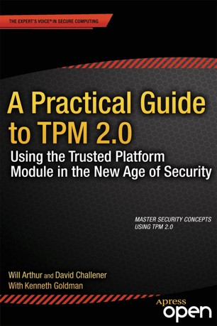
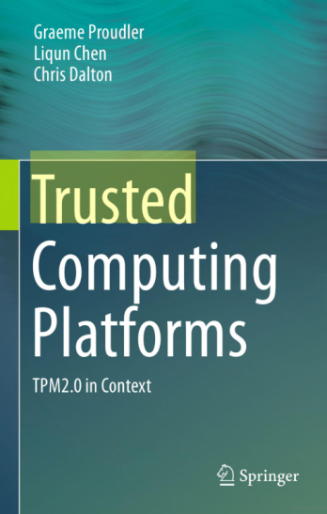
Recommended books - TPM 2.0
A Practical Guide to TPM 2.0
Will Arthur, David Challener, Kenneth Goldman
Apress, 2015
ISBN: 978-1-4302-6583-2
https://link.springer.com/book/10.1007/978-1-4302-6584-9#about
Trusted Computing Platforms, TPM 2.0 in Context
Graeme Proudler, Liqun Chen, Chris Dalton
Springer, 2014
ISBN 978-3-319-08743-6

Slide 23
Zoltán Hornák
Zoltan.Hornak@scademy.com

