Slide 1
Password policy myths
Common misconceptions
Erno Jeges
May 19, 2021
Company
HWSW SecDev meetup

Slide 2
Introduction to software security
May 19, 2021, HWSW SecDev meetup
D1 > 2

Slide 3
| AppSec: The weakest link in cybersecurity
Most security incidents are consequences of bugs
Murphy's Law of coding: "Each computer code has five bugs, and this number does not depend on how many bugs have already been found" ☺
Implication: there is no such thing as 100% security
The good news is however that if we follow the best practices, 90% of trivial bugs can be avoided
"The goal here isn't 100% perfect security, but rather adequate security at a reasonable cost." (Bruce Schneier)
Infinite game: instead of beating the enemy → goal is to stay in the game
May 19, 2021, HWSW SecDev meetup
D1 > 3

Slide 4
Managing passwords the right way
May 19, 2021, HWSW SecDev meetup
D1 > 4

Slide 5
| Managing passwords the right way | Password policy
An enforced guide to choosing satisfactory passwords
To ensure enough entropy (randomness)
To prevent users from picking common words (dictionary attack)
Enrolling with non-compliant passwords should be rejected
The user should be notified about the reason
But keep in mind psychological acceptability
Security and usability are usually enemies
"If you push it too hard, it will break"
If a security solution is too inconvenient, people will find a way to circumvent it
May 19, 2021, HWSW SecDev meetup
D1 > 5

Slide 6
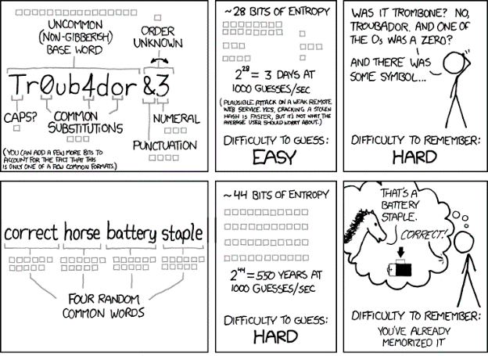
| NIST authenticator requirements for memorized secrets
NIST Special Publication 800-63B Digital Identity Guidelines, Section 5.1.1
Length: at least 8 characters (6 for servers-generated)
Input should support at least 64-char passwords
NO truncation!
Unicode should be supported
Password hints
E.g. "The name of your first pet?"
Low-entropy knowledge-based authentication "backdoor"
Must NOT be implemented in any form
Enforced password change
NO periodic expiration!
OK only in case of a breach
https://xkcd.com/936/
Ji32k7au4a83
→ 我的密碼 ("my password") ☺
May 19, 2021, HWSW SecDev meetup
D1 > 6

Slide 7
| NIST authenticator requirements for memorized secrets
NIST Special Publication 800-63B Digital Identity Guidelines, Section 5.1.1
Accept/reject passwords: only based on blacklists!
Such as dictionary words, repetitive characters, context-specific words (username…)
Do not reject based on composition rules NO mixed characters!
Cryptographic requirements
Use an adaptive hash function (Argon2, PBKDF2 or bcrypt)
With at least a 32-bit salt (we suggest 16 bytes!)
Pepper (>112 bits): an additional system- or server-specific secret salt
User-friendliness
Masking password with an option to display it
Paste support for password managers
Bill Burr: "Much of what I did I now regret" he told to The Wall Street Journal in 2017
→ $0rR¥ and N3v$r M1^d ☺
May 19, 2021, HWSW SecDev meetup
D1 > 7

Slide 8
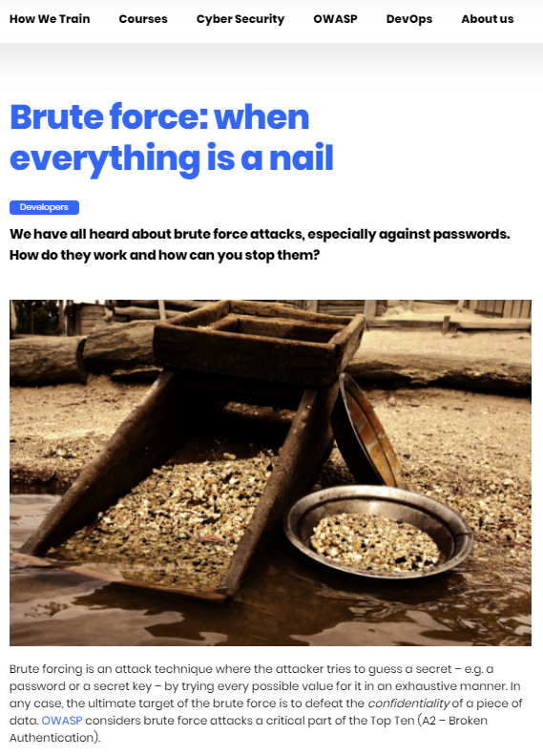
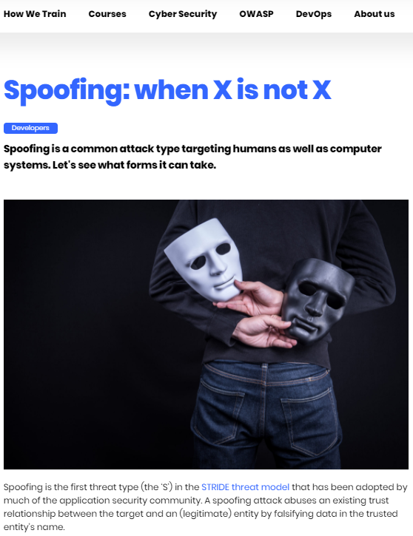
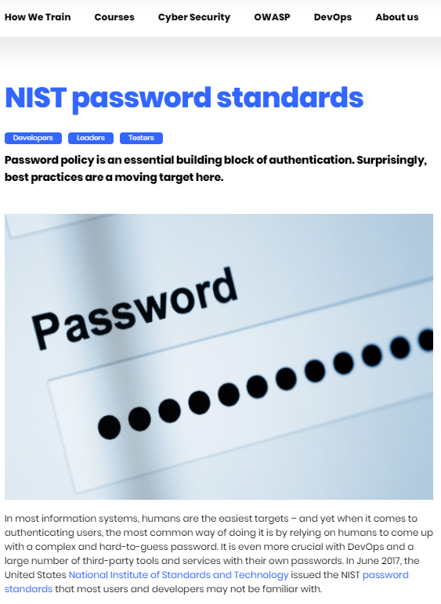
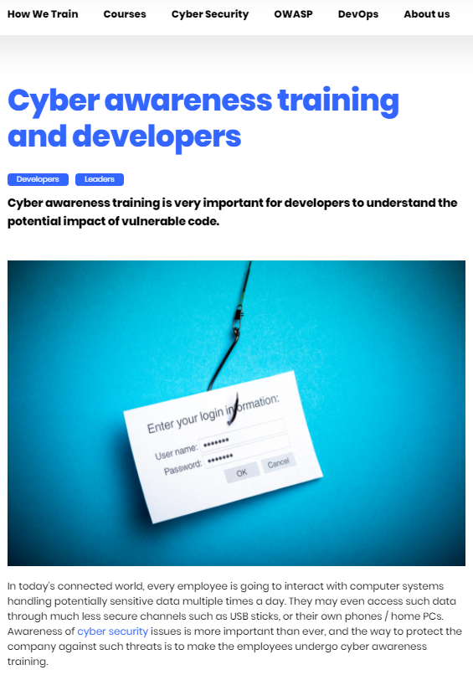
| Read more at articles on this topic at http://www.cydril.com
May 19, 2021, HWSW SecDev meetup
D1 > 8

Slide 9
Thank you!
Web
www.cydrill.com
LinkedIn
https://www.linkedin.com/company/cydrill
Instructor
Erno Jeges
E-mail
ernesto@cydrill.com

