Slide 1
$ git truth --all
GitOps:
In the middle of the journey from on-premise to cloud

Slide 2
Bence Wax
2013: HP
  Infrastructure Engineer & Application Operations
2018: LHSystems
  System Engineer & GitOps thingy
  e-mail: wax@ducatimonster.hu
  github: https://github.com/waxb/gitops-demo.git
Notes:
bemutatkozas
hp
lsy

Slide 3

DISCLAIMER:

Slide 4









:(
Notes:
favagas/kezi deploy -> scriptek -> toolok[iac] -> rendszertelen
drag and drop, shell script, ansible/terraform/vagrant <- local run -> snowflake effektus

Slide 5

Notes:
Uptime pl regi bllling, a jozsi gepe

Slide 6


Slide 7
GitOps in one slide (not mine)
system development/management pattern:
GIT as the single source of truth of a system
GIT as the single place where we operate (create, change and destroy) all environments
All changes are observable/verifiable

Slide 8
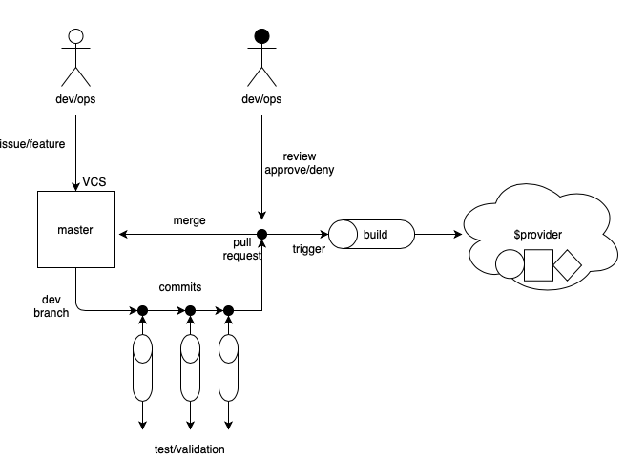
GitOps high level
Notes:
master branch represents the live infra
Pull request merge triggers auto-build pipeline
orchestration
provision
configuration
Review by Ops
Autovalidation/testing

Slide 9
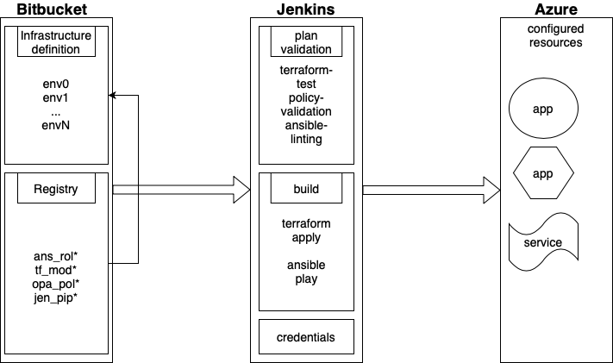
GitOps implementation 1.0
Notes:
Hogy nez ki nalunk, miert
Github infrastruktura definico

Slide 10
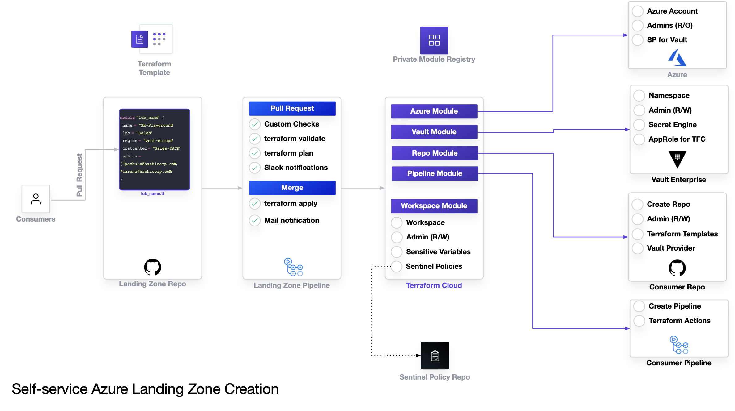
GitOps implementation 2.0
Notes:
Landing zones, sentinel, vault, self-service

Slide 11
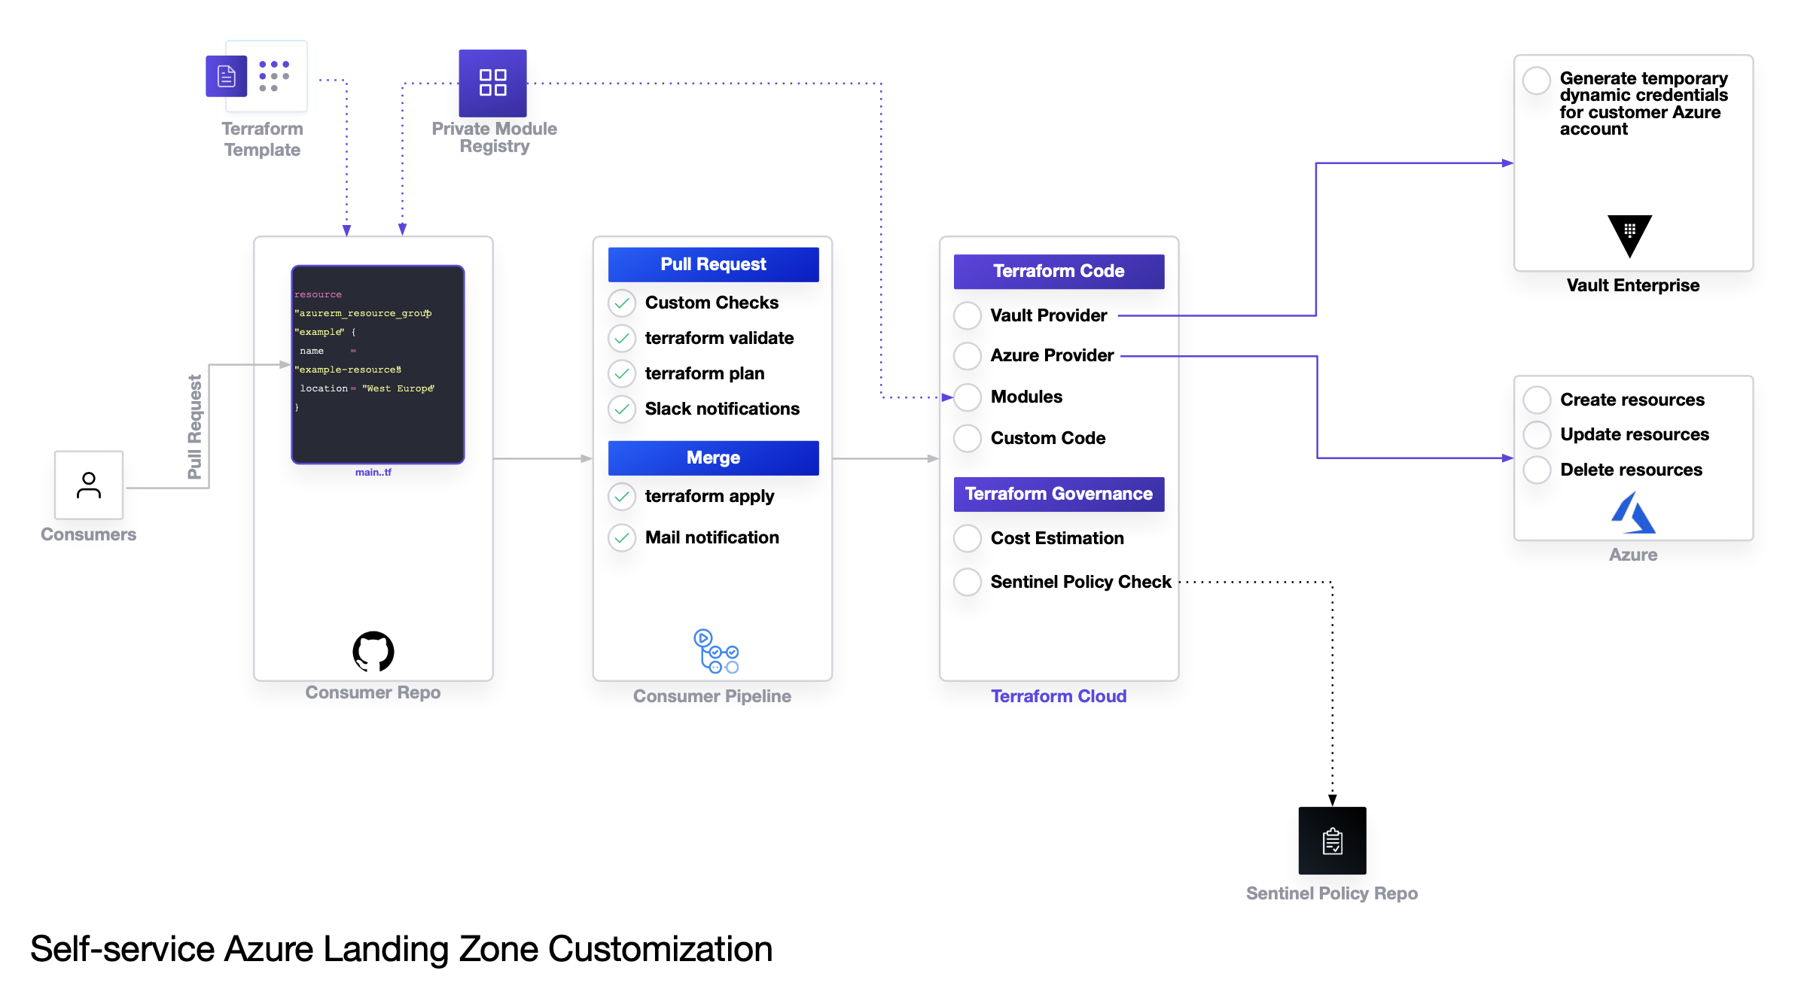

Slide 12
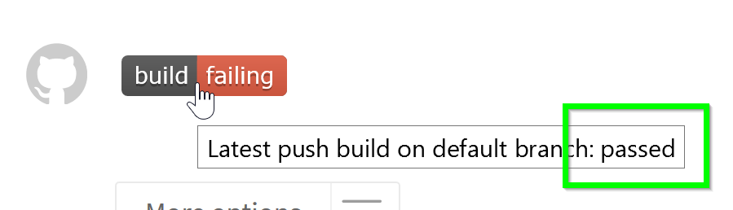
Demo

Slide 13
?

