Slide 1
Drift into Failure
or how to avoid it using Infrastructure-as-Code?

Slide 2
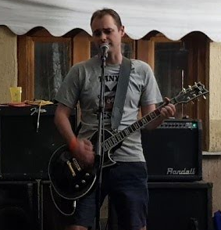
Who am I?
Co-founder & CTO @ LeanNet Ltd.
Consulting, training, implementing
Cloud Native, Kubernetes, Microservices, DevOps
Now part of the
megyesi@leannet.eu
twitter.com/M3gy0
linkedin.com/in/M3gy0

Slide 3
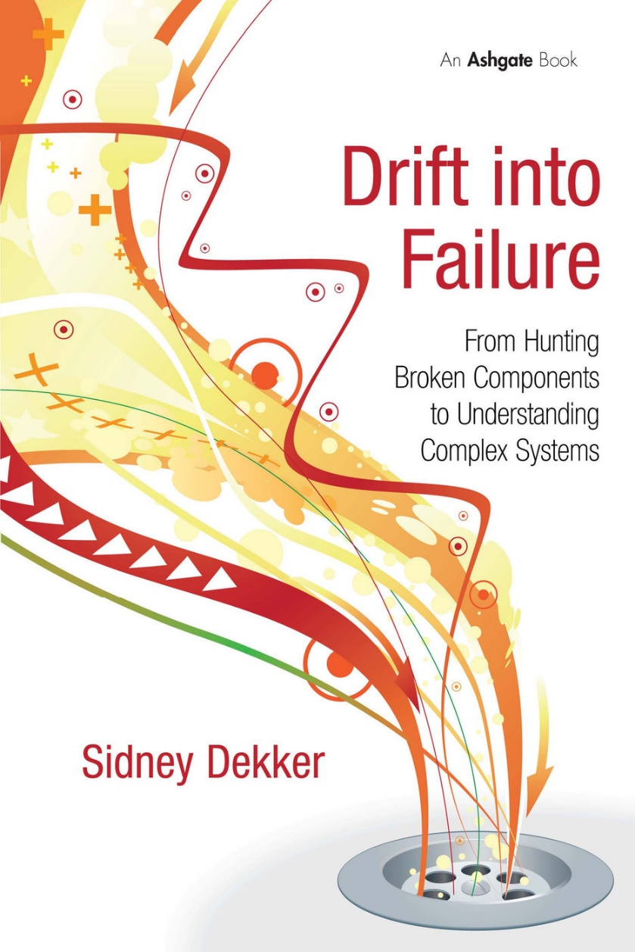
Recommended book
Every complex system naturally drifts into failure!
Too much focus on what we did wrong, and not on how to do it right

Slide 4
The Case of Knight Capital
High-frequency stock trading company
Revenue in 2011: 1.404 billion USD
Net income in 2011: 115.2 million USD
Went bankrupt in one day (August 1, 2012) due to an IT failure
Server
Server
Backend DB
Server
Server
Server
Server
Server
Server

Slide 5
The Case of Knight Capital
High-frequency stock trading company
Revenue in 2011: 1.404 billion USD
Net income in 2011: 115.2 million USD
Went bankrupt in one day (August 1, 2012) due to an IT failure
440 M$ is lost
in 45 minutes
Server
Server
Backend DB
Server
Server
Server
Server
Server
Server

Slide 6
What is Configuration Drift?
As time goes on infrastructure become more and more different from what we expect
manual ad-hoc changes
updates
general entropy
Config
Actual configuration
Use automated configuration tools
Infrastructure-as-code
1
2
Rebuild machine instances frequently
Immutable infrastructure
Expected configuration over time e.g. staging environment
Time

Slide 7
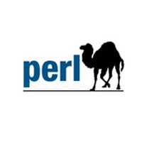
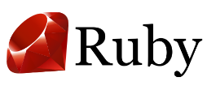
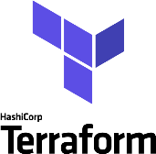
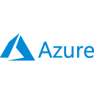
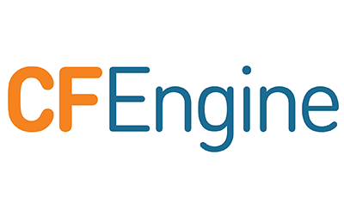
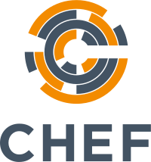
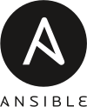
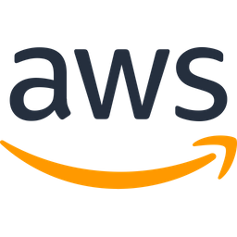
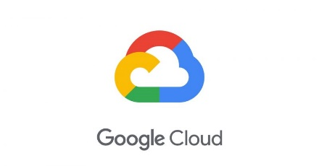
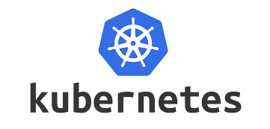
Brief History of Infrastructure-as-Code
Rise of scripting
Beginning of virtualization
Reduce toil by scripts
Cloud and PaaS
Rise of APIs
Focus on applications
Early 2000s
Late 2000s – Early 2010s
Late 2010s
Mid 2000s
Mid 2010s
The manual era:
Psychical servers
Ad-hoc ops
True configuration management:
Idempotency
Git based workflow
Beginning of DevOps era
Cloud Native:
Cloud first
Containers
Microservices
Notes:
Toil = küszködés, érőfeszítés
The CFEngine project began in 1993 as a way for author Mark Burgess (then a post-doctoral fellow of the Royal Society at Oslo University, Norway)
In June 2008 the company CFEngine AS was for
Puppet is produced by Puppet, Inc, founded by Luke Kanies in 2005.
Chef: January 2009
Anible: February 20, 2012

Slide 8
Puppet vs. Chef vs. Ansible
Initial release
2005
2009
2012
DSL
Ruby
Ruby
YAML
Operating model
Agents
Agents
Agentless
Programing paradigm
Declarative
Imperative
Declarative

Slide 9
Cloud and Immutable Infrastructure
Cloud made it incredibly easy to rebuild infrastructure elements
Instead of updating, you can replace it with a new using automation
Can be applied to servers (VMs), or any other element in the app stack
Very resilient and secure
The Netflix model
Always build a new AMI image, never patch
Agents running on VMs to kill it after SSH login
Instance A
Instance A
Instance A
Instance B
Destroy
X
App v1.0
Reboot
App v1.1
App v1.0
App v1.1
OS v1.0
App v1.0
OS v1.0
Provision
OS v1.0
OS v1.0
Mutable infrastructure
Immutable infrastructure

Slide 10
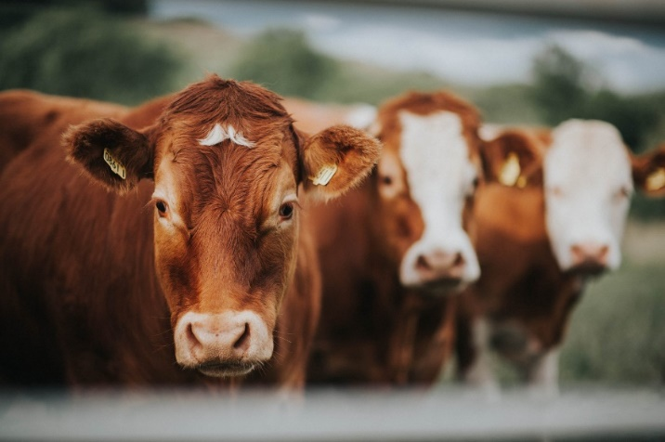
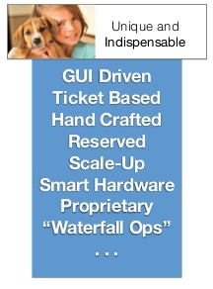
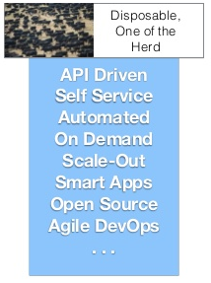
The Pat vs. Cattle Model

Slide 11
Cloud Specific vs. Cloud Agnostic IaC: the Rise of Terraform
Every cloud provider offer their own tool for managing the infrastructure in declarative manner
Terraform can do the same in every cloud ;)
CloudFormation:
from 2011
json / yaml
Cloud Development Kit (CDK):
from 2019
TypeScript, Python, Java and .NET
Azure Resource Manager (ARM):
json
works really neatly with Azre DevOps / GitHub actions
Cloud Deployment Manager:
yaml
Python / Jinja2

Slide 12
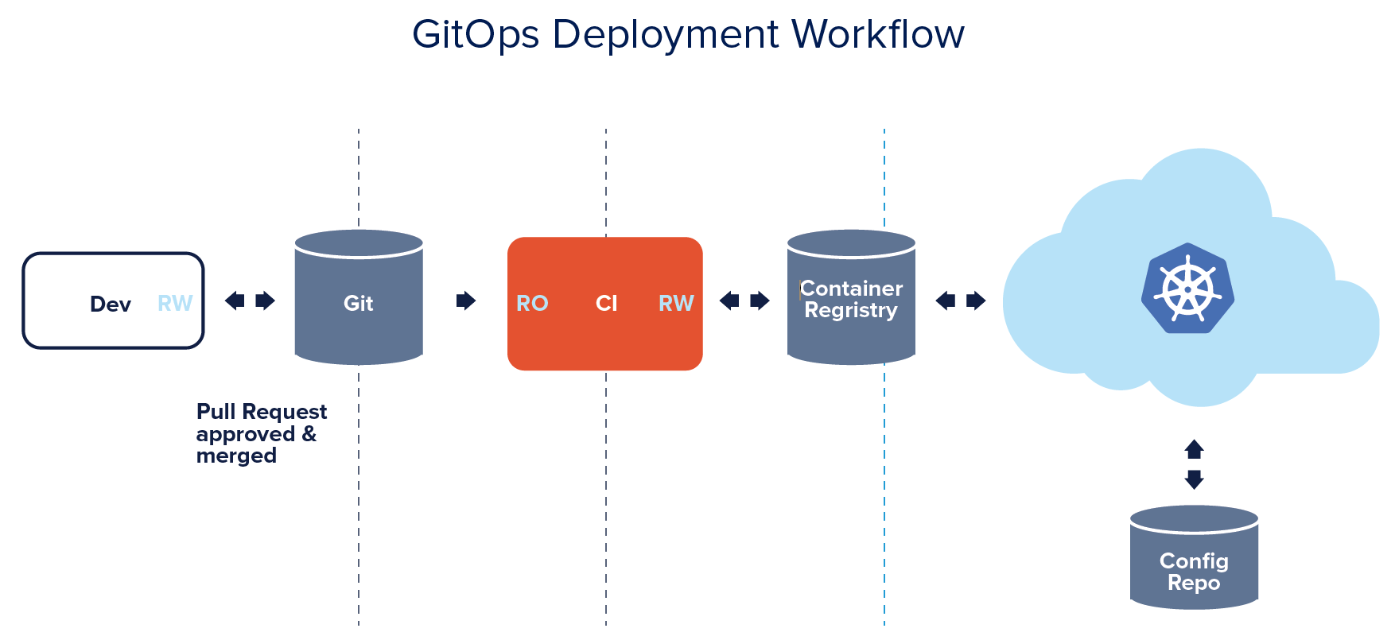
Docker, Kubernetes and GitOps
At the end of the day, you want to run application:
The future is definitely Kubernetes and Docker/containers
A (Docker) container by itself is immutable
Kubernetes is a very sophisticated declarative system

Slide 13
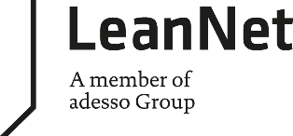
Summary
History of configuration management:
Heroic manual work
Automation scripts
Infrastructure-as-Code: Puppet, Chef, Anisble era
Cloud Native: immutable infrastructure in the cloud
My recommendation for future learning:
Public cloud services
IaC: cloud specific or Terraform
Kubernetes ecosystem

