Slide 1
Docker: past, present, future(?)

Slide 2
Who am I?
Co-founder @ LeanNet Ltd.
Consulting, training, implementing
Cloud Native, Kubernetes, Microservices, DevOps
Now part of the
szabo@leannet.eu
linkedin.com/in/szabvid
twitter.com/szabvid

Slide 3
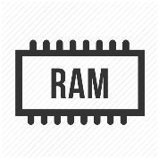
What Everyone Knows: Virtual Machines vs. Containers
Container:
A bundle of the application code along with its runtime and dependencies
App 1
App 2
App 3
OS
OS
OS
App 1
App 2
App 3
Overhead
Container 1
Container 2
Container 3
VM 1
VM 2
VM 3
Container runtime
Hypervisor
Operating System
Physical machine
Physical machine

Slide 4
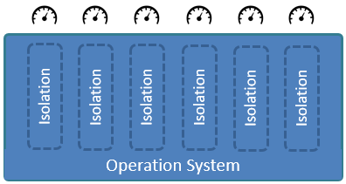
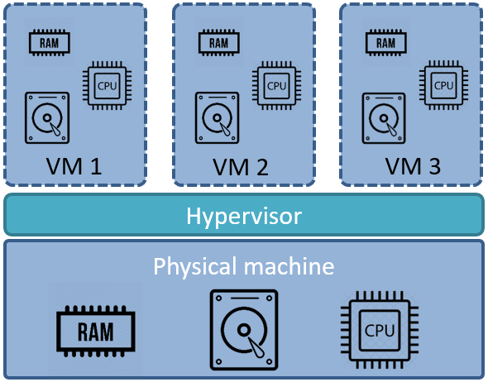
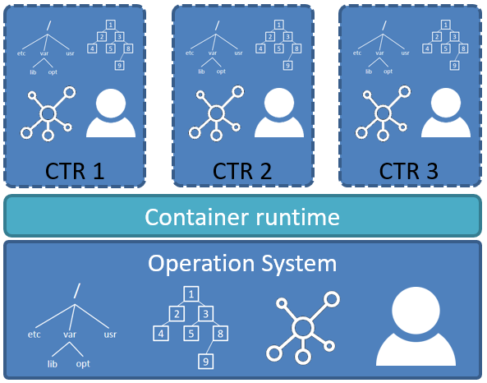
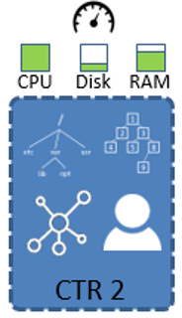
Let’s Go Deeper – Why Docker?
Containers are much older than the ones we know and use nowadays:
They were created by using Linux kernel primitives:
Namespaces:
Makes a global system resource seems as it would belong to one process
Similarly as the Hypervisor abstracts away hardware for VMs
Control Groups
Namespaces
+ Control Groups

Slide 5
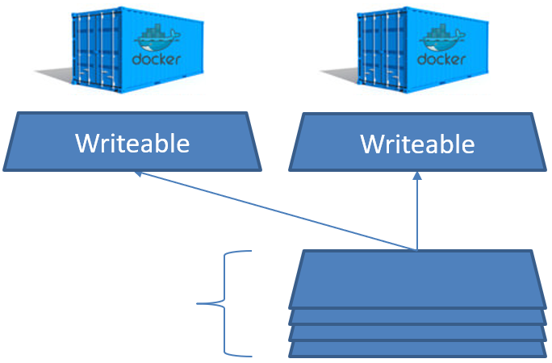
Let’s Go Deeper – Why Docker?
So even before Docker creating containers were possible, but very struggling!
Docker made it very easy, also introducing Docker Layers:
read only union file system (UnionFS)
to be transparently overlaid, forming a single coherent file system
Container
Namespaces
Control Groups
Layers
Image
Read Only

Slide 6
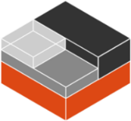
Small History
Docker originally wrapped the LXC (low level tools, templates, libs for creating containers)
However, at one point LXC development broke Docker so they developed their own substitute “libcontainer”
Docker
Namespaces
Control Groups
LXC
UnionFS

Slide 7
Small History
Docker originally wrapped the LXC (low level tools, templates, libs for creating containers)
However, at one point LXC development broke Docker so they developed their own substitute “libcontainer”
Docker
Namespaces
Control Groups
libcontainer
UnionFS

Slide 8
Small History
Docker originally wrapped the LXC (low level tools, templates, libs for creating containers)
However, at one point LXC development broke Docker so they developed their own substitute “libcontainer”
Docker became an ecosystem and added many features as a monolith: registry, orchestration, builds, etc.
registry
runtime
orchestration
Docker
Namespaces
Control Groups
libcontainer
images
UnionFS
builds
compose

Slide 9
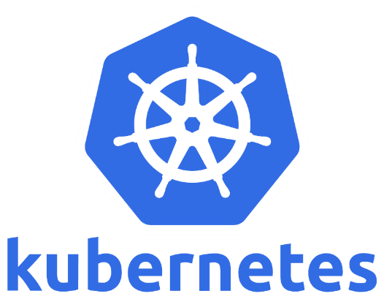
Small History
Docker originally wrapped the LXC (low level tools, templates, libs for creating containers)
However, at one point LXC development broke Docker so they developed their own substitute “libcontainer”
Docker became an ecosystem and added many features as a monolith: registry, orchestration, builds, etc.
Bad since it is a Monolith
Conflicted with other Orchestrators
When OCI (Open Container Initiative) came they rewrite their architecture (abandoned libcontainer in 2015)
OCI: Linux Foundation project to design open standards for OS-level virtualization
registry
runtime
orchestration
Docker
libcontainer
images
UnionFS
builds
compose

Slide 10
Platform and Ecosystem
Client-server architecture
Client uses CLI to send messages that are translated to REST API calls for the Docker Engine
Docker Engine has a modular architecture
It manages (here creates) the container
Client
Docker Engine
$ docker run …
$ docker build …
REST API
$ docker pull …
Docker daemon
runc

Slide 11
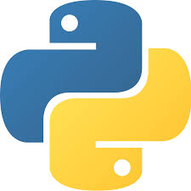
Platform and Ecosystem
Client-server architecture
Client uses CLI to send messages that are translated to REST API calls for the Docker Engine
Docker Engine has a modular architecture
It manages (here creates) the container
Docker Host
Registry
Client
Images
Docker Engine
$ docker run …
$ docker build …
REST API
$ docker pull …
Ecosystem:
Docker Hub
Docker Compose
Docker Desktop
(Docker Swarm)
Enterprise services/versions
Docker daemon
Compute Services
runc

Slide 12
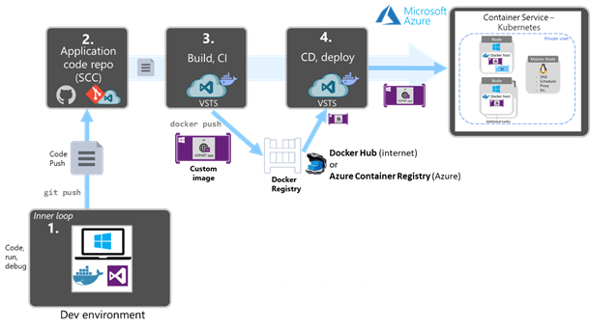
Docker Benefits for Microservices and DevOps
Example scenario for a modern CI/CD pipeline with Kubernetes and Azure
https://docs.microsoft.com/en-us/dotnet/architecture/containerized-lifecycle/docker-devops-workflow/create-ci-cd-pipelines-azure-devops-services-aspnetcore-kubernetes

Slide 13
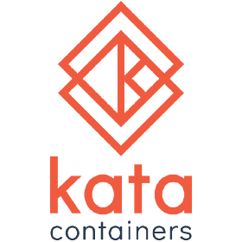
Docker Alternatives
Containers:
Kata
Nabla
FireCracker
Runtime:
CRI-O
ContainerD
Image build:
Kaniko
Buildah
Conainers and Image management:
PodMan

Slide 14
Docker Future
Docker Enterprise:
Was acquired by Mirantis in 2019
Docker Enterprise Engine, Docker Trusted Registry, Docker Unified Control Plane and Docker CLI
Docker:
Expand Docker Desktop and Docker Hub’s roles in the developer workflow for modern apps
2021 March 16: Docker Announces $23M in Series B Funding
Containerization landscape has changed a lot:
There are many alternatives and heterogeneity
E.g. Kubernetes is deprecating Docker…
Docker still has its leading role:
Compatibility, maturity perspective
Ecosystem and platform perspective

