Slide 1
Champs gen3 // Bring .org to S-SDLC gen3
a very short version
Timur Khrotko, Péter Nyilasy
2011 hsws

Slide 2
>_ whowe’r; feedback
Timur Khrotko
defdev.eu
trainings producer
trainer
practical mobile security for execs
secdev.eu
pm, auditor, consultant
hello@defdev.eu
PhD
Nyilasy Péter
defdev.eu
core trainer
Java, JS/TS
enterprise Java dev
secdev.eu
assisted code-review (interview-based)
pentesting
hello@secdev.eu
https://forms.gle/Qv8j1RV2HcC9ApPb7
/org
/champs+cr

Slide 3
/org

Slide 4
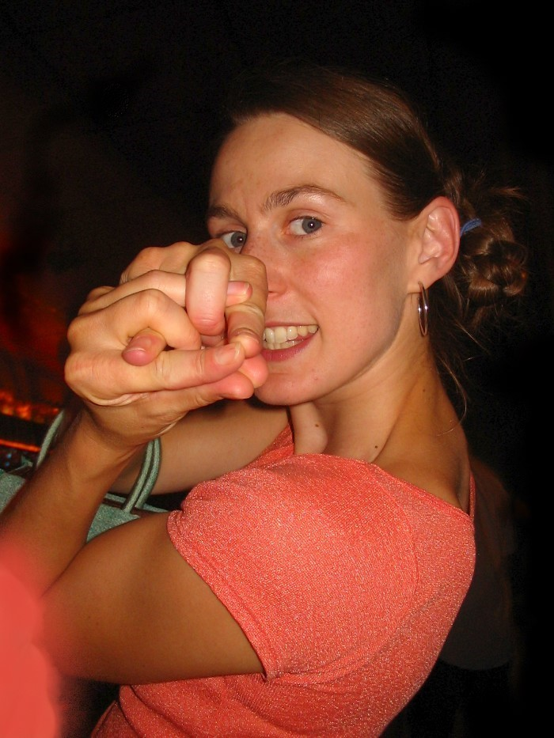
A working S-SDLC -- is it an org problem?

Slide 5
Working S-SDLC -- is it a problem?
Non-problem
If security quality of the production proc is sustainably good
indeed, there're are many organizations doing effective S-SDLC
methodically
mil
fin
organically
quality freaks
Problem
Embedding appsec into the production proc
as an organism
methodically (OD framework)
self-sustainably (reproduces itself)
foolproofly (including the weakest links)

Slide 6
Something is missing here
Even w/ a full OWASP Integration arsenal implemented
Verification/audit (Dyn + Code_review + Interviews), vulns mgmt
Automated AST (AppSec Testing: Dyn+SAST...)
SKF (Security Knowledge Framework)
Threat modeling, risk stories
Security champions
Trainings/education
Policy and project level documentation, guidelines, governance
Culture building & process maturing

Slide 7
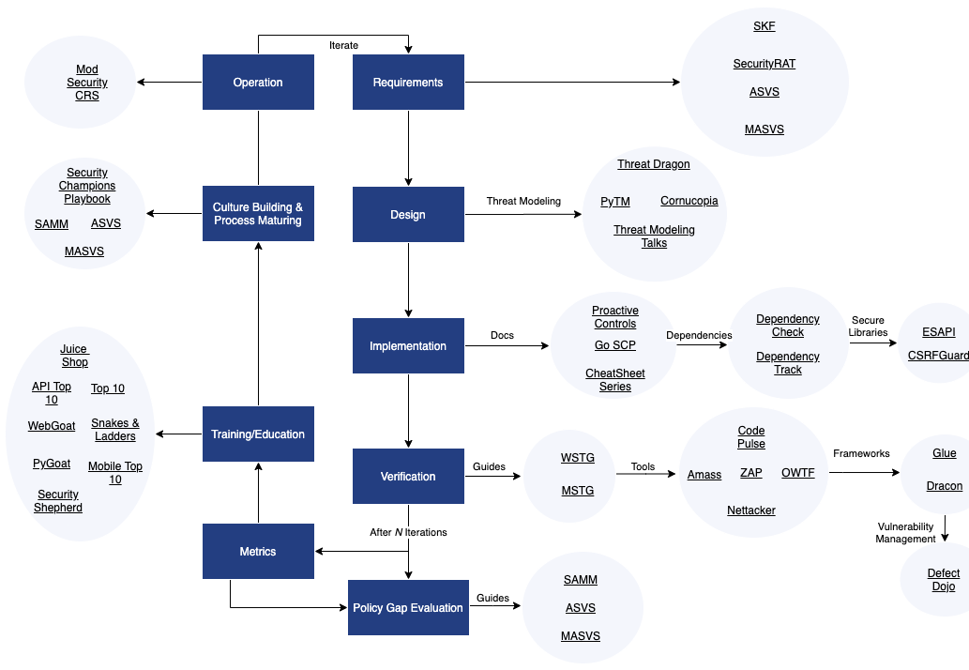
OWASP AppSec Wayfinder

Slide 8
Culture building & process maturing
Something to be added to the below
Security champions
SAMM
ASVS/mASVS
?...

Slide 9
The roots of code quality
per specialist
👨👨👨👩👨👩👩👨👩👨
factory/team/project
design
the code
the collective
👫👫👫👫

Slide 10
To be added with an OD* hat on
* OD = organizational development
Cultivate organizational routines and structures
to glue the engineer-to-engineer designed S-SDLC components
Make security a gut, embedded, ubiquitous routine
in requirements definition, design, coding, testing and follow up
Make security treatment an omnipresent collective interplay
production rituals
Ensure that actionable and governing security knowledge is 1 click away
closer than stackoverflow

Slide 11
The actionable package – in a nutshell
Boot (inject), maintain, improve
trainings (per team/project), structured education flow
onboarding: instant minimal treatment
…
coach-by-code_review
daily sec code-reviews
Make tacit explicit
documentation, guidelines, SKF
Infiltrate your agents
specialized champion roles

Slide 12
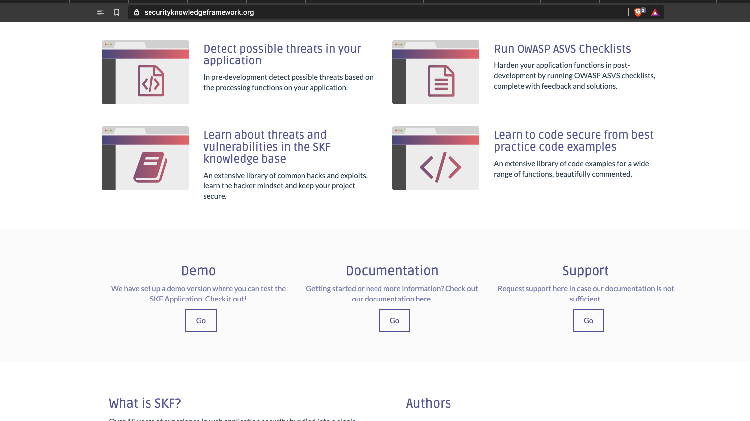
SKF: Security Knowledge Framework .org
Your first gen3 move

Slide 13
/ Champions + Code_review

Slide 14
Security champions Gen3

Slide 15
Security champion roles
Roles
Reviewer champion
Design -”-
Devops -”-
Test -”-

Slide 16
Code-review
Do it regularly
Also from a security point-of-view

Slide 17
Q+A
.finalize
Thanks!
.tap
Slack
.queue
https://youtu.be/OsHNYG8uciM
OWASP Global Appsec 2020 prezo

