Slide 1
Kubernetes: The Platform of the Decade Szabó Dávid Software Architect @szabvid

Slide 2
$> whoami
PhD in Telecommunications @ Budapest University of Technology
Worked with 5G technology
Software Defined Networking
Graduated in the EIT Digital Doctoral School
Co-founder @ LeanNet Ltd.
Consulting, training, implementing
Cloud Native, Microservices, DevOps

Slide 3
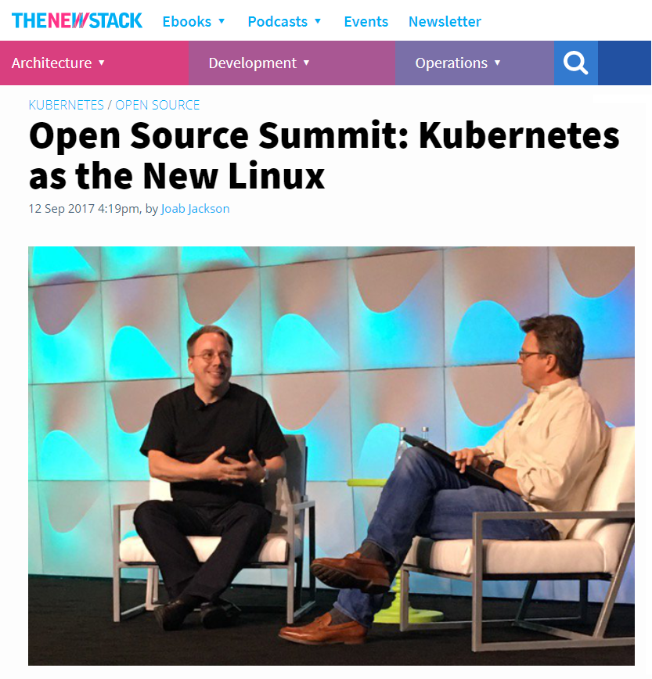
Notes:
Nem lecseréli, hanem olyan fontos lesz, mint a linux és rá épül.
Ugyanannyira nehéz róla általánosságban beszélni róla, mint a linux-ról (az egy oprendszer, ez meg egy konténer orkesztrátor)
A linux egy fantasztikus cucc, de alapvetően azért az, mert segít, hogy fantasztikus megoldásokat hozhassunk létre. A kubernetes is inkább egy út kezdeteként fogható fel és nem végeként. Mi is ez az út?

Slide 4
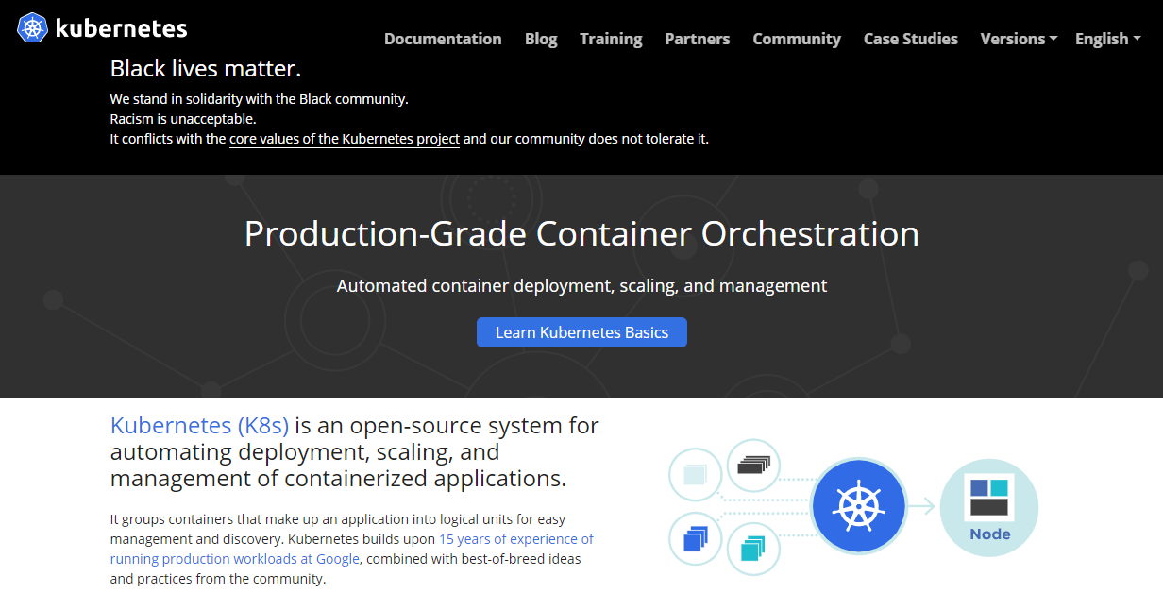
What is Kubernetes?
https://kubernetes.io/

Slide 5
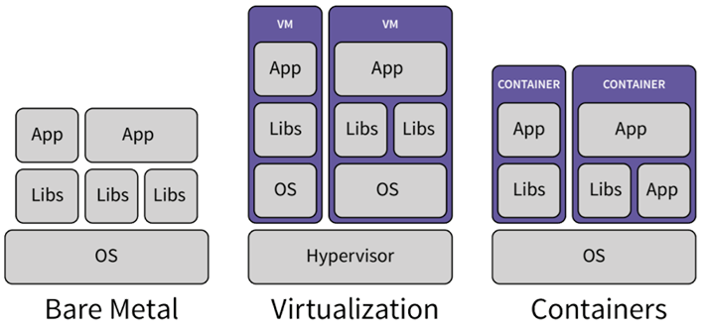
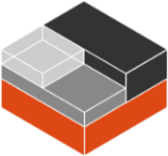
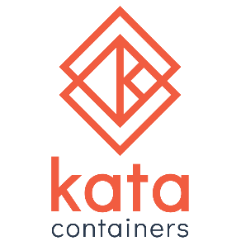
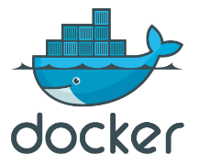
What is a Container?
A bundle of the application code along with its runtime and dependencies
It creates a container image: a lightweight, standalone, executable package of software
It can be deployed on the platform of your choice, such as desktops, servers, VMs or in the cloud
Application-centric way to deliver high-performing, scalable applications on the infrastructure of your choice
LXC LXD
Deploy in months
Live for years
Deploy in minutes/hours
Live for weeks
Deploy in seconds
Live for hours/days
Notes:
Lehetővé teszi egy cég számára, hogy alkalmazás centrikus fejlesztést, üzemeltetést végezzen. Vagyis a legtöbb időt fordíthassa hasznos tevékenységre: ami az applikáció maga, nem pedig annak futtatása, configurálása.
Futtató környezet + függőségek
Ha historikusan nézzük, miben más: izolált futás, gyors, kicsi
With a container image, we bundle the application along with its runtime and dependencies. We use that image to create an isolated executable environment, also known as container. We can deploy containers from a given image on the platform of our choice, such as desktops, VMs, cloud, etc.
Cri-o -> RedHat (biztonságos)
Kata -> Intel (minimal)
LXC/LXD -> standard linux conténerek
A konténer jó: mindenképpen ezt szeretnénk futtatni!!!

Slide 6
What is Container Orchestration?
Running a few containers on a server is easy ☺
Running hundreds of containers on dozens of servers cannot handled manually ☹
So container orchestration:
group hosts together to form a cluster
optimally schedule containers to run on different hosts
guarantees that every container can talk to each other
can expose certain workloads to the outside
can scale out containers on-demand
can do update/rollback without any downtime

Slide 7
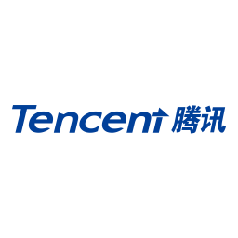
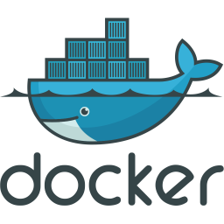
And I Bet You’ll Need Orchestration
Why? Because all these companies have built a similar systems:
Sigma by
Apollo by
Apache Mesos
Matrix by
Cloud Foundry
Fleet by
Swarm by
Tupperware by
Borg and Omega by
Nomad by
Platform Symphony by
Triton by
v3 Infra by
Service Fabric by
Titus by
Cattle by
OpenShift v2 by
Helios by
Gaia by
Aurora by
Peloton by
@dankohn1: Stitching Things Together – KubeCon EU ‘19 Keynote

Slide 8
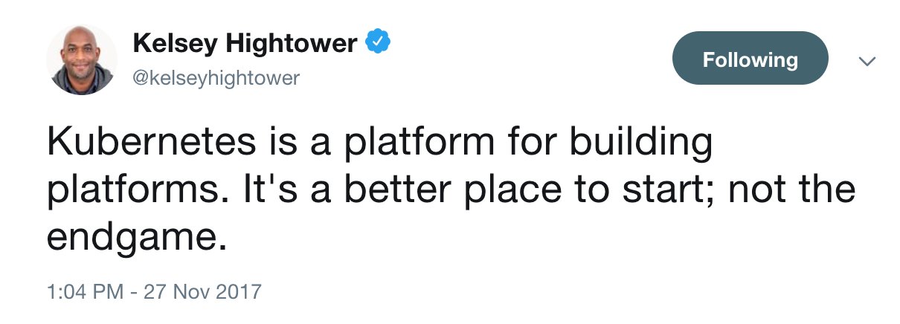
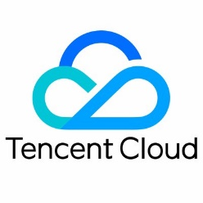
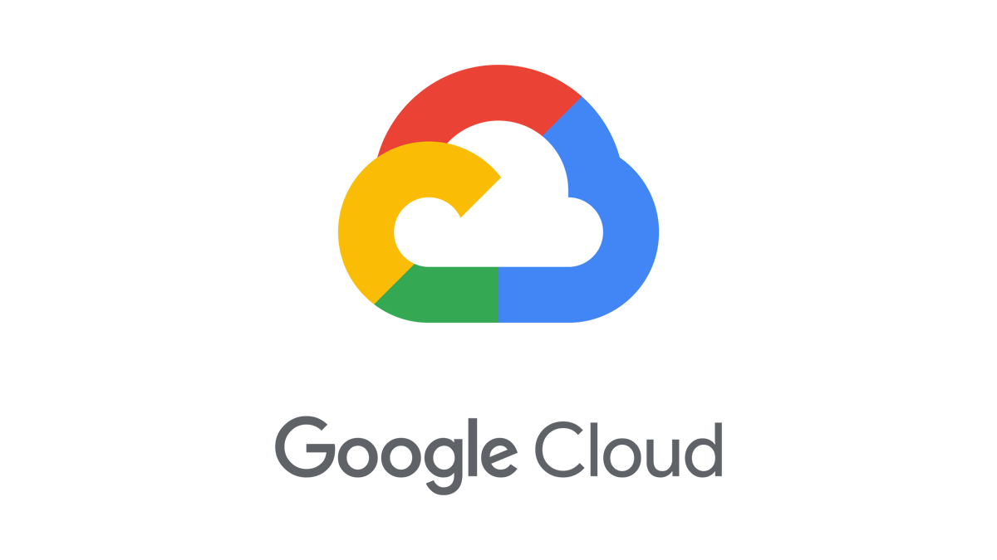
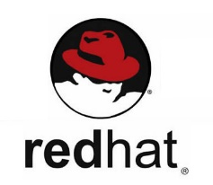
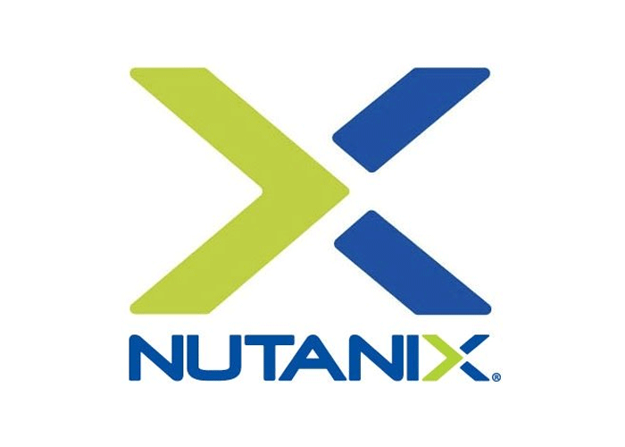
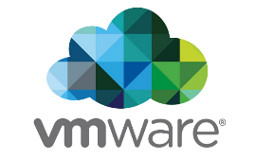
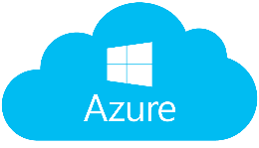
So Why Kubernetes?
Open-source system for automating deployment, scaling, and management of containerized applications
Builds upon 15 years of experience of running production workloads at Google (predecessor is Borg)
Designed to be extendable, so that future solutions could be integrated into it
Avoids vendor or cloud-provider lock-in, trademark the CNCF (Cloud Native Computing Foundation)
Basically the whole IT industry is backing it:
Notes:
Cloud Native trend egyik leg

Slide 9
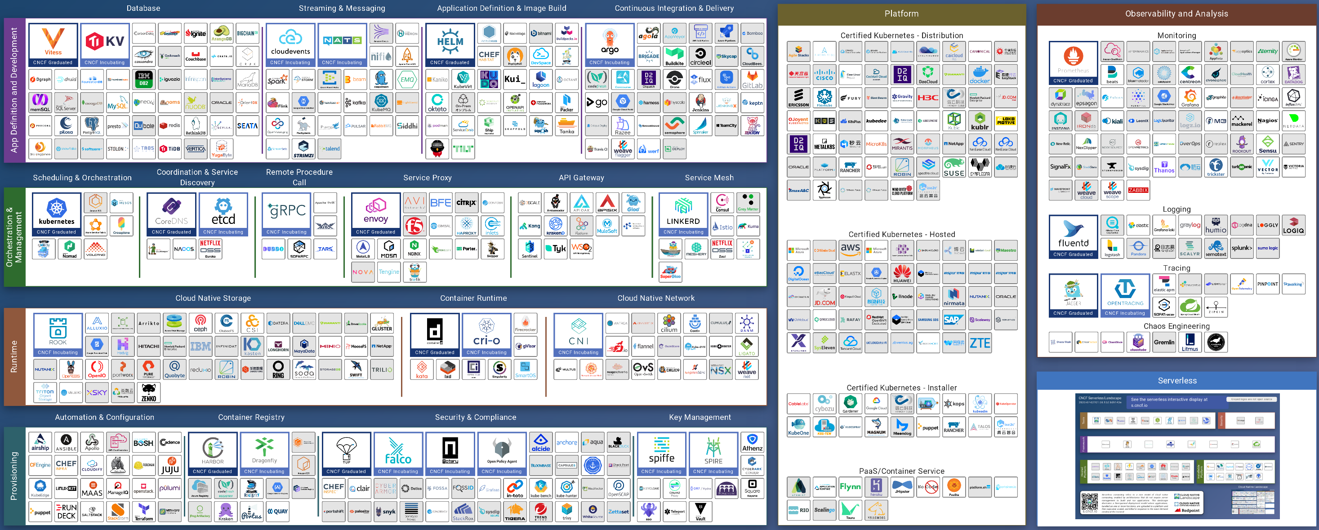
Cloud Native Landscape
Notes:
-> CNCF (Linux Foundation része, mert a google odaadta)-nek át let adva, az nagyon fontos (vendor neutrális)
-> Azért alakult, hogy kezelje a K8s-t, majd Prometheus-t, majd …
-> többi is open source volt, de a vendor neutralitás eléggé előnyös -> community

Slide 10
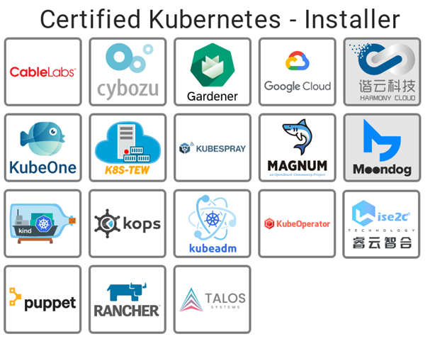
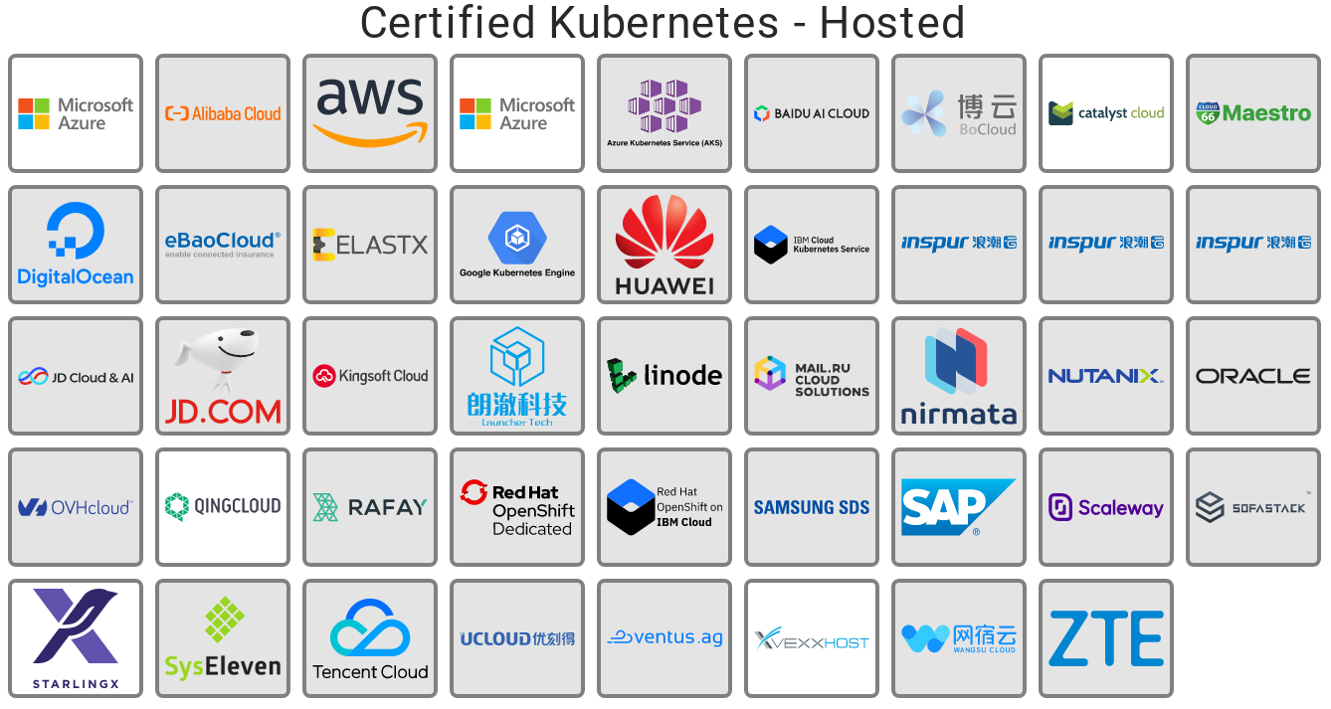
Where to Start: Installers and Hosted Kubernetes
Notes:
Microsoft -> open source

Slide 11
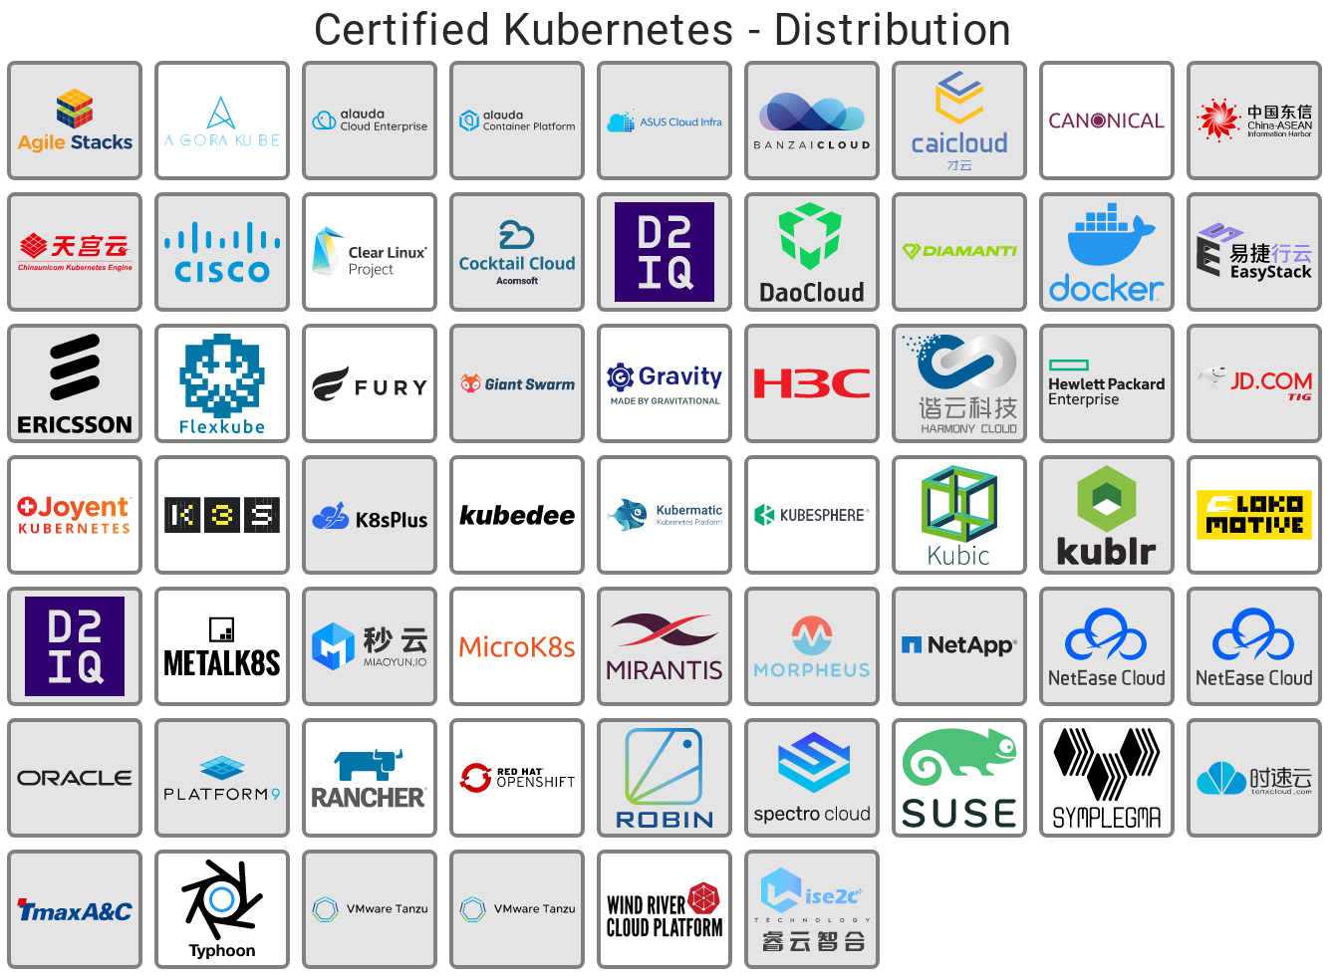
Certified Kubernetes Distributions
Notes:
Mint a linux distribúciók –> opinionated K8s. Network plugin + CRD, add-onok, monitoring, logging, stb. (100%-ban kompatibilis a k8s api-val)

Slide 12
Kubernetes Architecture
Cloud Provider
Controller Manager
Cloud
Controller
kube-proxy
kube-proxy
kube-proxy
API server
kubelet
kubelet
kubelet
cont.runtime
cont.runtime
cont.runtime
etcd
Scheduler
Worker Nodes
Control Plane

Slide 13
Okay, But Should I Use Kubernetes???
I’m certain that you will use it at some point in the future!
Good reasons to use it:
If you already using containers and CI/CD in your DevOps processes
Your application needs more resilience and scalability
You have micro(ish)services environment, written in multiple languages, that needs more than one server
You want to build cloud native application that are cloud agnostic (e.g. can run in every cloud, even in on-prem)
You need to apply more advanced deployment patterns (e.g. canary, blue/green), since your current one is too slow
Notes:
Data Plane vs. Control Plane

