Slide 1
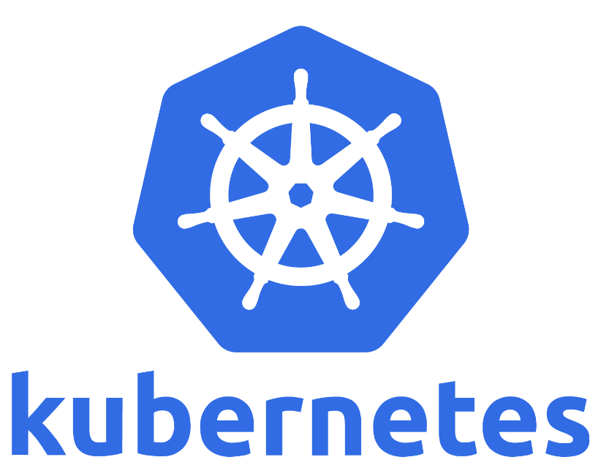
Extending Kubernetes with Custom Resources

Slide 2
$> whoami
Co-founder & CTO @ LeanNet Ltd.
Consulting, training, implementing
Cloud Native, Kubernetes, Microservices, DevOps
PhD in Telecommunications @ Budapest University of Technology
Worked with 5G technology
SDN & NFV → Cloud Native Network Functions
Graduated in the EIT Digital Doctoral School
megyesi@leannet.eu
twitter.com/M3gy0
linkedin.com/in/M3gy0

Slide 3
Kubernetes Architecture
Cloud Provider
Controller Manager
Cloud
Controller
API server
kube-proxy
kube-proxy
kube-proxy
kubelet
kubelet
kubelet
etcd
Scheduler
cont.runtime
cont.runtime
cont.runtime
Control Plane
Worker Nodes

Slide 4
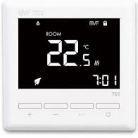
Control Loops
Temp
22.5
Time

Slide 5
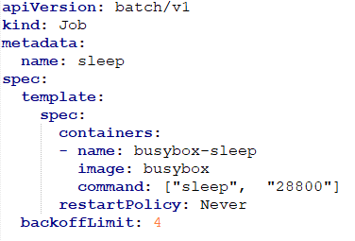
Control Loops in Kubernetes
Job Controller
create a job via an API call
Controller Manager
1
kubectl create –f job.yaml
2
persist state to etcd
the job controller sees the newly crated job and creates a pod based on the template
7
3
1
3
the scheduler sees that there is a pod without an assigned node, so it does the assignment
API server
4
the kubelet on the node sees that there is a pod assigned to it, and starts it via the CRI
kube-proxy
5
2
4
6
kubelet
after the container exits, kubelet reports back the exit code to the pod’s state
etcd
Scheduler
6
5
cont.runtime
7
the job controller notices the change in the pod’s state and makes a decision
exit code = 0 → marks the job as complete
exit code ≠ 0 and reached the backoff limit: → marks the job as failed
else → increases the count and starts a new pod (back to step 4)
Control Plane
Worker Node 1

Slide 6
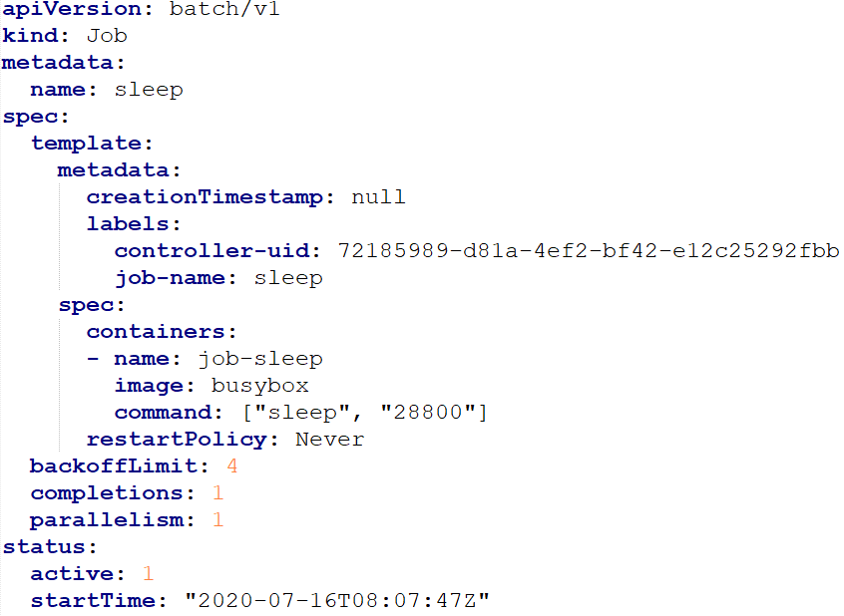
Kubernetes Controllers
Watch the changes in the API server and compares the desired state with the current state
If these states differ they carry out actions to bring the current state closer to the desired state
The spec field describes the desired state
The status field describes the current state

Slide 7
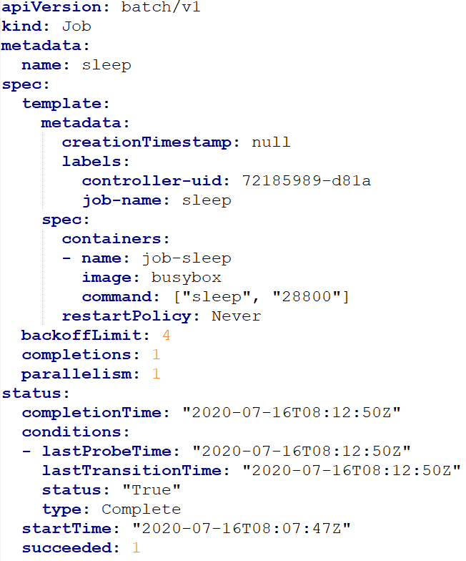
Kubernetes Controllers
Watch the changes in the API server and compares the desired state with the current state
If these states differ they carry out actions to bring the current state closer to the desired state
The spec field describes the desired state
The status field describes the current state

Slide 8
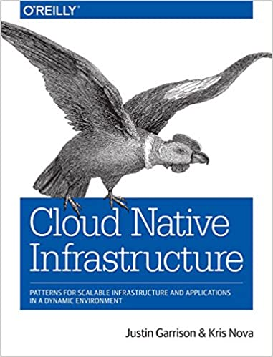
Kubernetes Controllers
Watch the changes in the API server and compares the desired state with the current state
If these states differ they carry out actions to bring the current state closer to the desired state
working with desired states is also referred as declarative infrastructure
acting on the deference between the desired state and the current state is also referred as reconcile pattern
foundation of every cloud native infrastructure

Slide 9
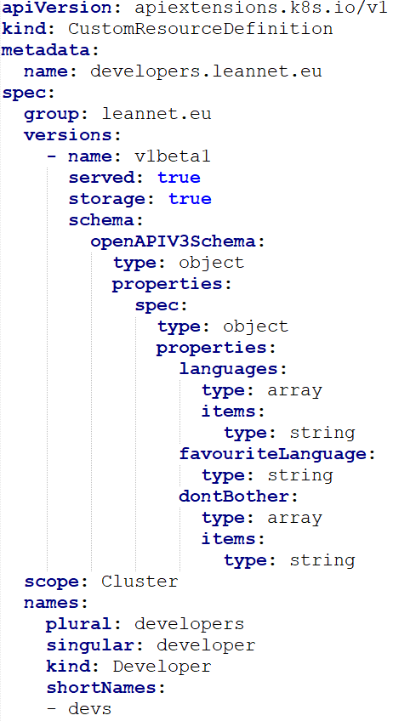
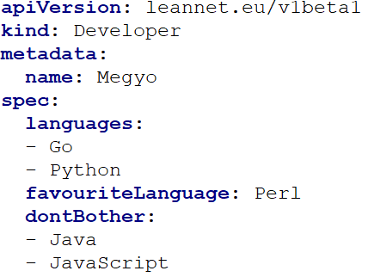
Custom Resources
Custom resources are extensions of the Kubernetes API
Built-in object: e.g. pod, job, deployment, service, ingress, persistent volume
Custom resources simply let you store and retrieve structured data
kubectl create –f Megyo.yaml
kubectl get developers
kubectl get developer Megyo
kubectl get devs
Notes:
Viziló →CrunchyData

Slide 10
Custom Resources + Custom Controllers = Operators
You can write your own controller logic
Works the same way as built in controllers:
watches resources in the Kubernetes API
carry out action if there are changes in either the spec (desired state) or the status (current state)
watch build-in resources and config your own software e.g. Ingress controllers (e.g. Nginx, Traefik, Envoy), KubeDNS/CoreDNS, Prometheus SD
change the behavior of your software based on a CRD → use the Kubernetes API as your API e.g. Calico, OpenShift, Istio
interact with external systems / APIs e.g. kubelet, kube-proxy, DynamoDB operator
create other Kubernetes resources (e.g. pods, deployments, statefulsets, services, ingresses) e.g. MySQL operator, GitLab operator
A custom controller working over a custom resource is usually referred as an Operator
Notes:
Viziló →CrunchyData

Slide 11
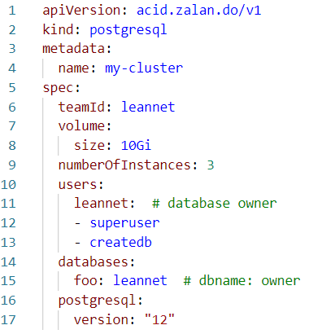
Example: Zalando Postgres Operator
Postgres Operator
Kubernetes API
kubectl
create
Secrets
Users
Robots
Standby
StatefulSet
Services
Primary
Replica
Pod Template
Pods
Endpoints
Primary
Replica
Replica
Primary
Replicas
Persistent Volume Claims
Primary
Replica
Replica

Slide 12
Example: Zalando Postgres Operator
Postgres Operator
Kubernetes API
kubectl
create
Secrets
Users
Robots
Standby
StatefulSet
Services
Primary
Replica
Pod Template
Pods
Endpoints
Primary
Primary
Replica
Replica
Replica
Primary
Replicas
Persistent Volume Claims
Primary
Replica
Replica

Slide 13
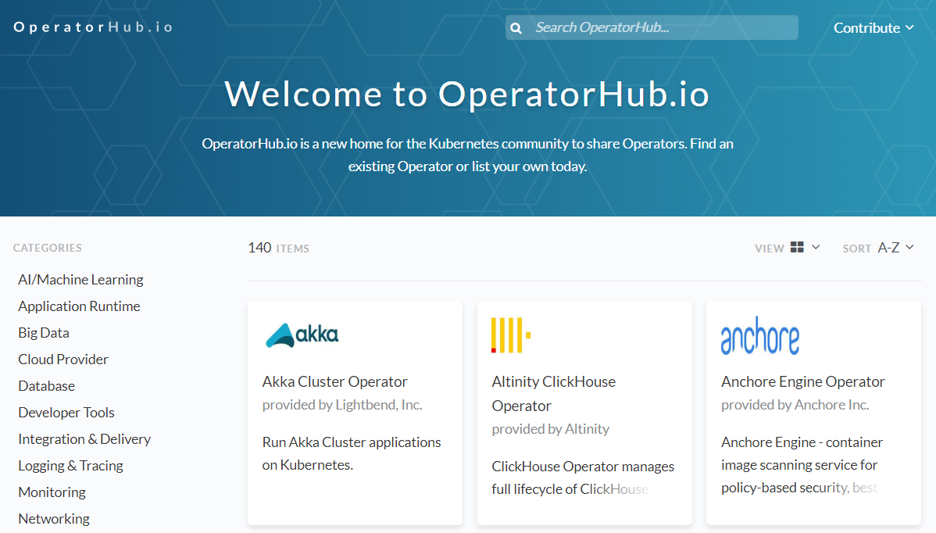
Where to Find Operators
Notes:
Viziló →CrunchyData

Slide 14
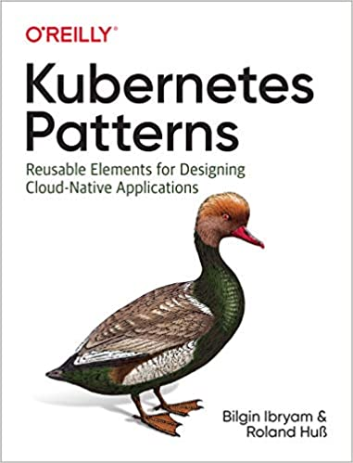
Write Your Own Operator
KOPF
Kubernetes Operator Pythonic Framework
https://github.com/zalando-incubator/kopf
java-operator-sdk
https://github.com/ContainerSolutions/java-operator-sdk
Notes:
Július 9 óta CNCF incubation project

Slide 15
Remember: Custom Resources + Custom Controllers = Operators
Custom resources are extensions of the Kubernetes API
Built-in object with controllers: e.g. pod, job, deployment, service, ingress, persistent volume
Custom resources simply let you store and retrieve structured data
Schema is defined with OpenAPI spec
But you can write custom controllers over custom resources: operator pattern
Example operators:
Virtual Machines
Machine Learning
Serverless
CI/CD
MySQL
PostgreSQL
Cassandra
Kafka
Notes:
Viziló →CrunchyData

