Slide 1
Kubernetes security, SUSE image patch/CVE audit
Notes:
<number>

Slide 2
Contact.
Lajos Kovács
Senior Consultant
lajos.kovacs@suse.com
<number>
Copyright © SUSE 2020

Slide 3
BREADCRUMBS
DevOps vs DevSecOps
<number>
Copyright © SUSE 2020

Slide 4
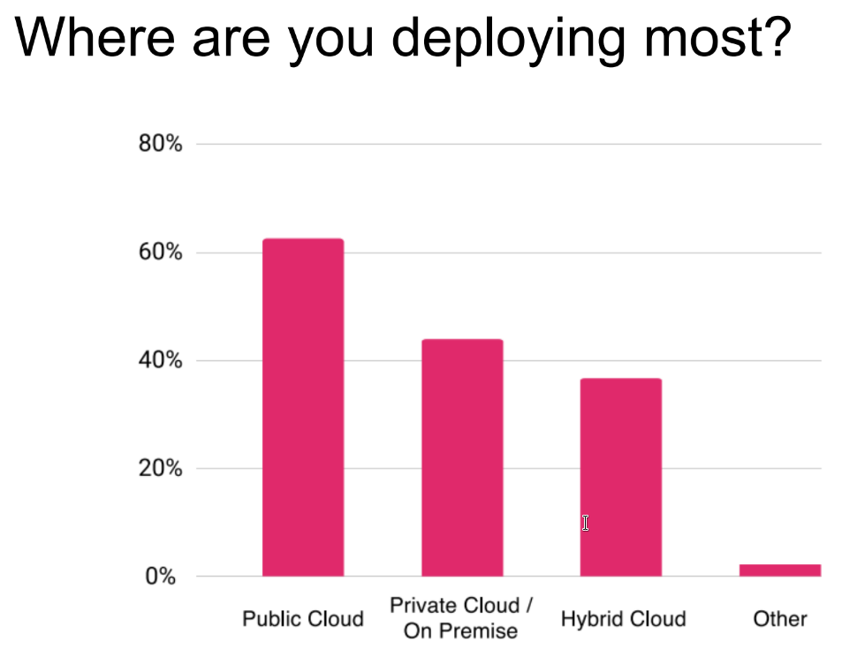
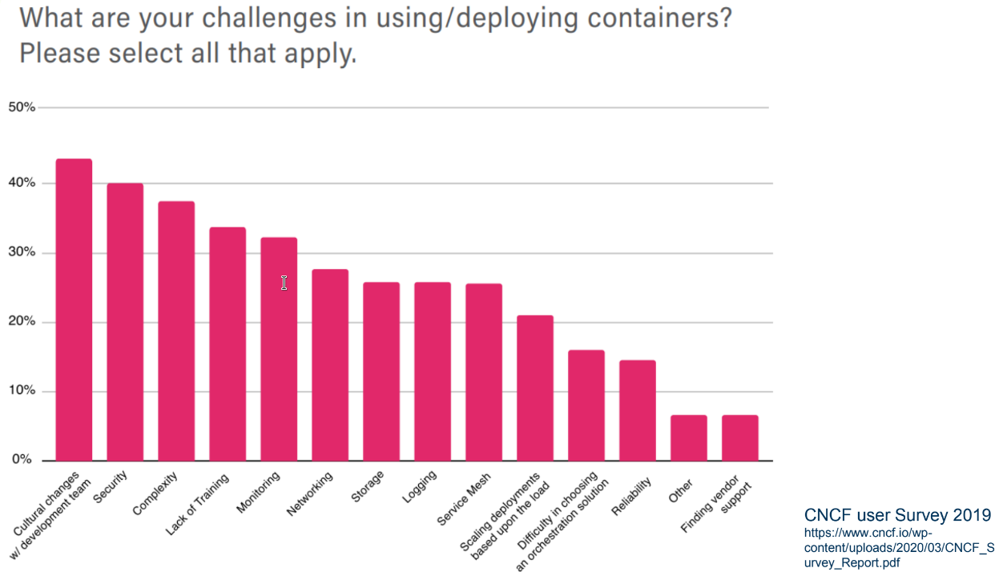
BREADCRUMBS
<number>
Copyright © SUSE 2020

Slide 5
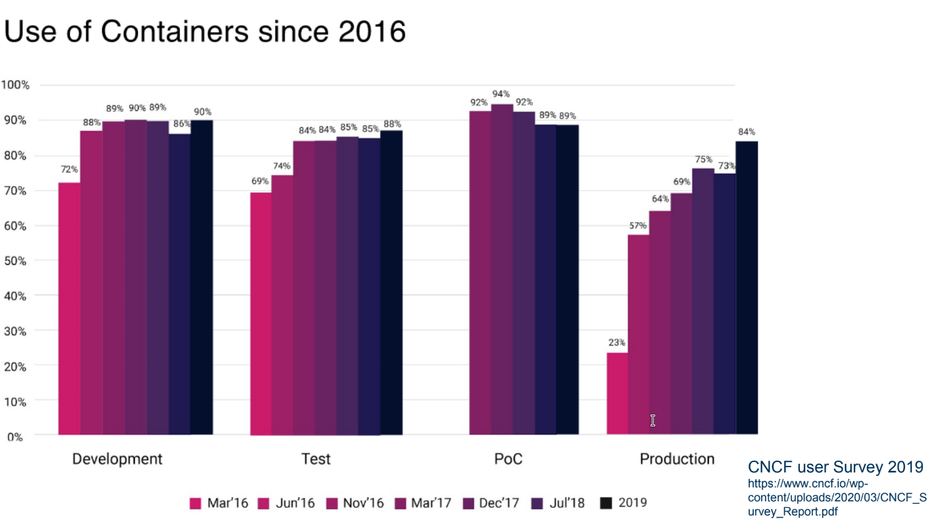
BREADCRUMBS
<number>
Copyright © SUSE 2020

Slide 6
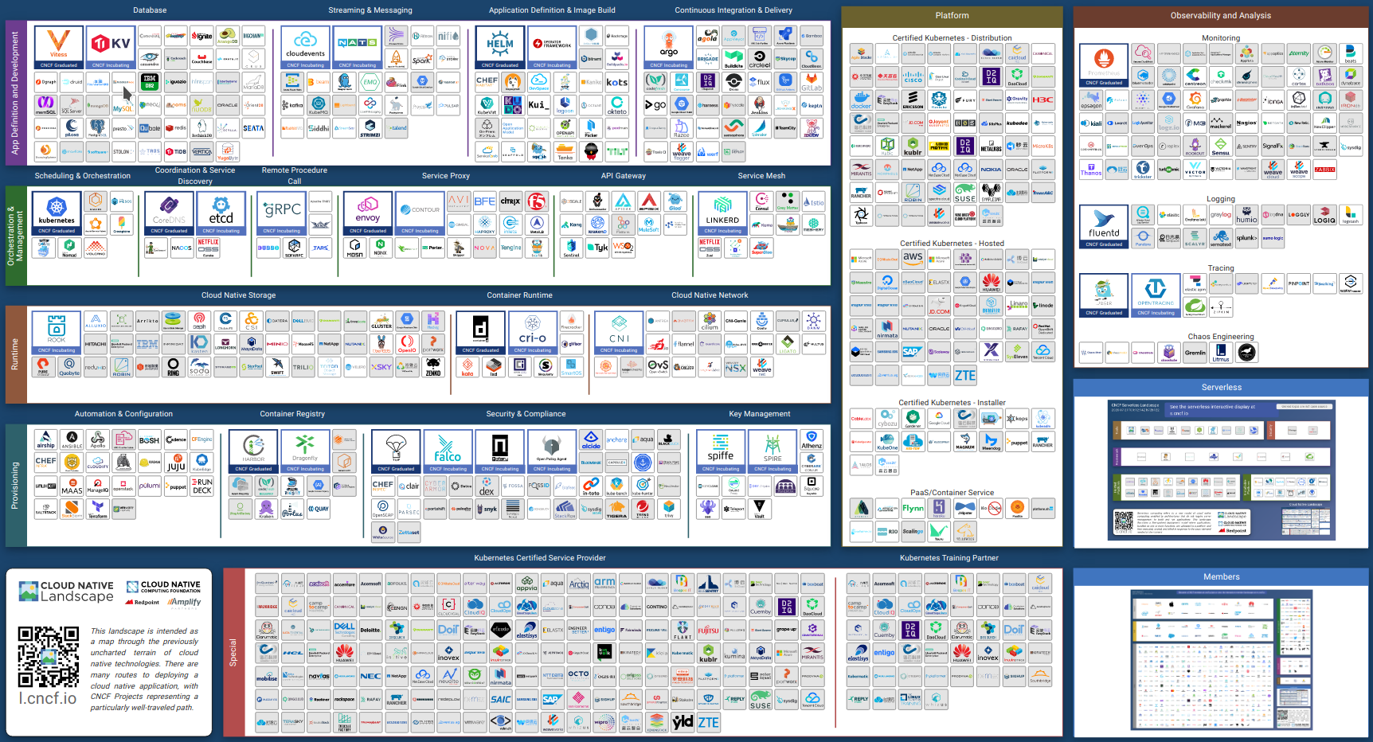
BREADCRUMBS
<number>
Copyright © SUSE 2020

Slide 7
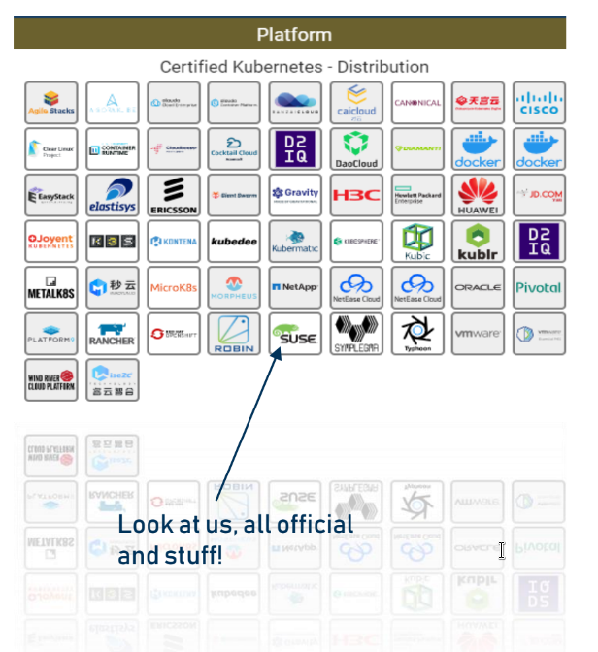
Kubernetes distributions
“Collections” of software
Each one brings different things to table
Software components
Services
Support
Which one is right for you?
<number>
Copyright © SUSE 2020
Notes:
<number>

Slide 8
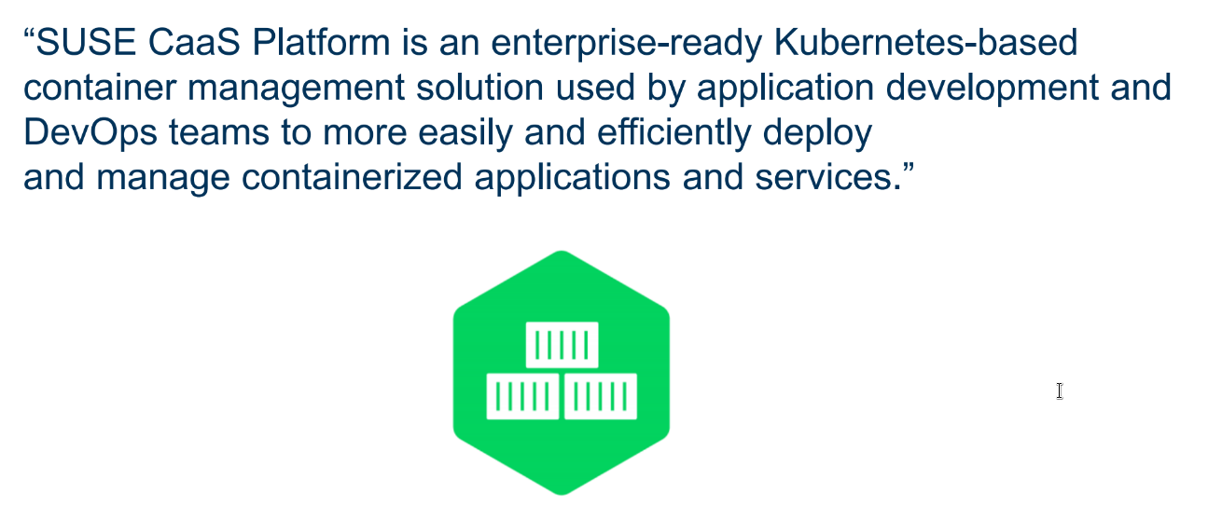
SUSE CaaS Platform
<number>
Copyright © SUSE 2020
Notes:
<number>

Slide 9
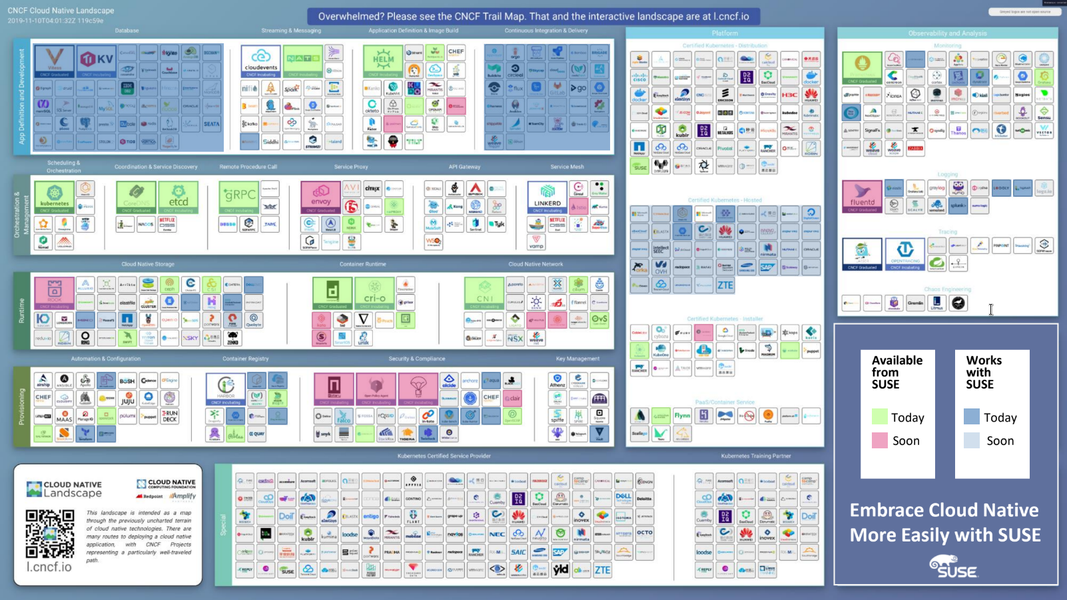
<number>
Copyright © SUSE 2020
Notes:
<number>

Slide 10
SUSE image patch/CVE audit
<number>
Copyright © SUSE 2020

Slide 11
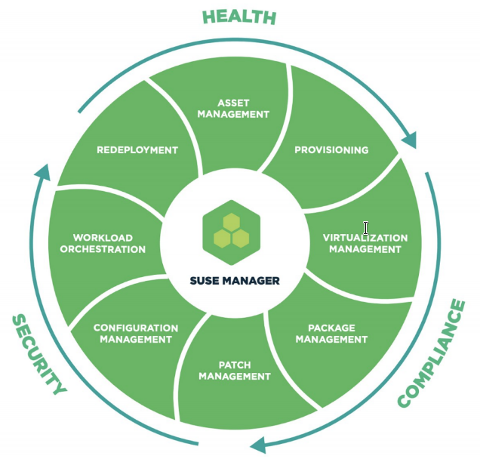
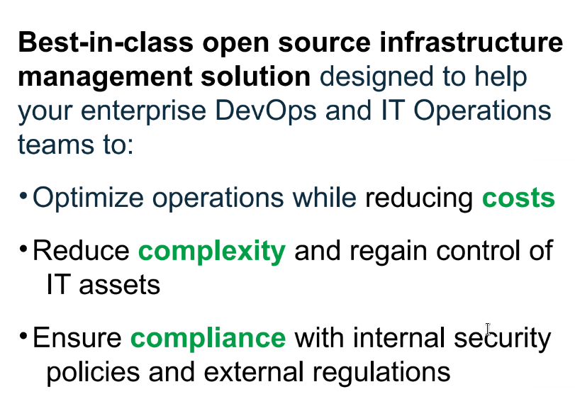
SUSE Manager
<number>
Copyright © SUSE 2020
Notes:
<number>

Slide 12
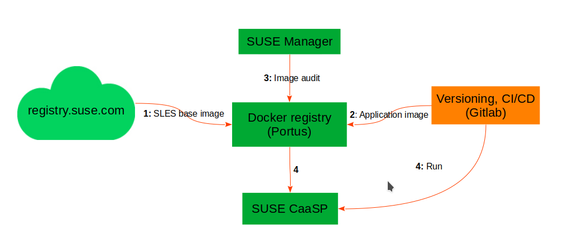
SUSE Manager security/CVE audit
<number>
Copyright © SUSE 2020
Notes:
<number>

Slide 13
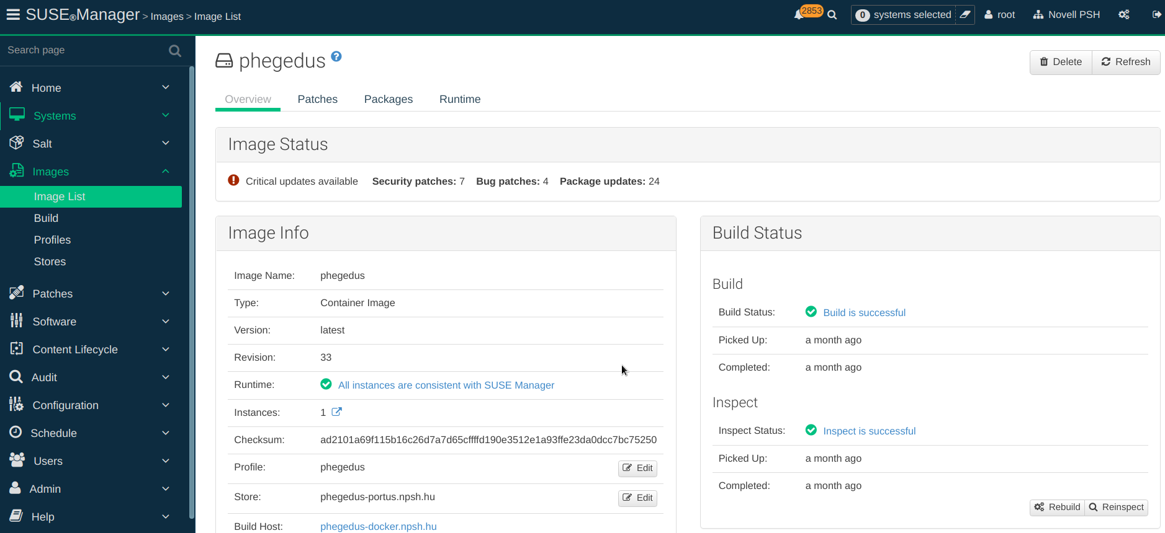
BREADCRUMBS
<number>
Copyright © SUSE 2020

Slide 14
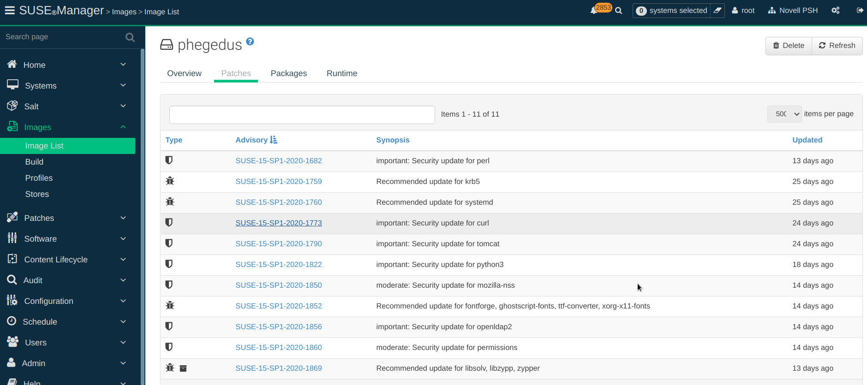
BREADCRUMBS
<number>
Copyright © SUSE 2020

Slide 15
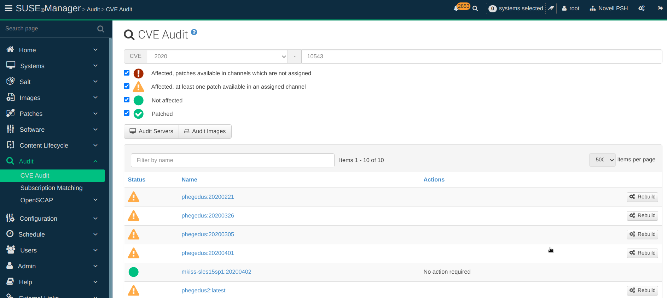
BREADCRUMBS
<number>
Copyright © SUSE 2020

Slide 16
SUSE Kubernetes BrightTALK webinar 2020.09.03.
<number>
Copyright © SUSE 2020
Notes:
<number>

