Slide 1
Agile Crisis Management
by

Slide 2
Crisis – what is it?
A Crisis is a single event or row of happenings, which bring about internal or external conditions in course of disruptive change that pose a potential threat to the subject organization, may it be an individual or a corporation.
Not necessarily BAD,
only UNEXPECTED, FAST
and RADICAL
Notes:
2

Slide 3
Nature of a crisis
CRISIS
CHANGE
CHANGE
CRISIS

Slide 4
The DREAM – we are a HIT over night
+
Entering new markets
Sudden rise in demand
Branching out
“Who are these people, buying all this?”
„I never heard
about
this country“
“If we don’t serve them, we can close the shop”
“I need 600 Account Managers”
Notes:
4

Slide 5
The Nightmare – the way we work is not working anymore
“Nothing’s wrong with our product, still noone is buying it anymore”
-
Loss of demand
Staff revolt
Vis Maior
„Sales are down,
I repeat,
Sales are down!“
“If we shut down now, we might save costs, but nobody can guarantee we will relaunch”
“We are doing stuff we can’t afford.”
Notes:
5

Slide 6
Reasons and symptomes
External | Internal
 | Organization | Process | Skill/Tech | Culture
Market demand +/- | Missing function | Slow | Missing knowledge | Bureaucracy
Regulation | Overhead | Parallelities | Obsolete knowledge | Dictature
Geography | Fragmentation | Loops | Lacking IT support | Sects
Competition | Unnecessary work | Overcomplication | IT tool based business operation | Escalation focus

Slide 7
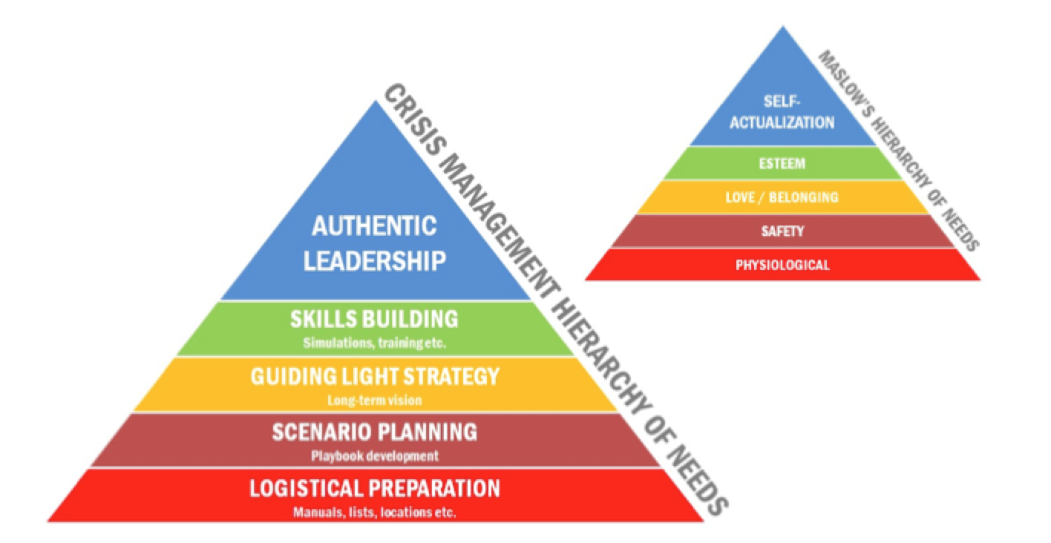
A completely different concept needed
Notes:
7

Slide 8
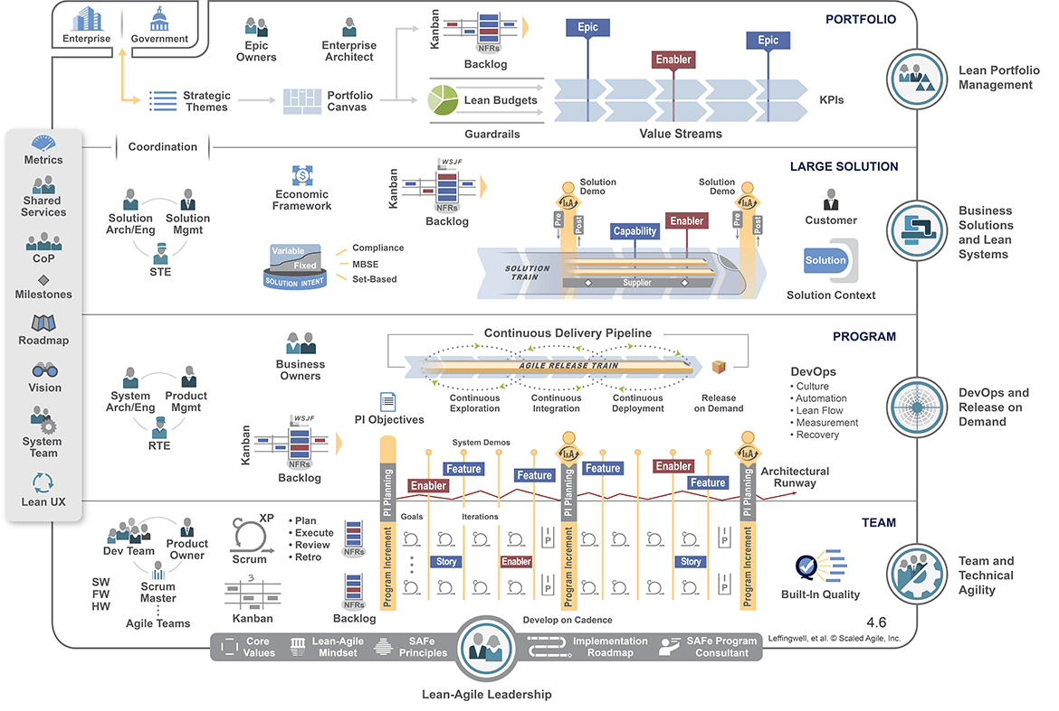
Agile answers – Organizational structure

Slide 9
Agile answers – Delivery processes and technology

Slide 10
Agile answers – Skills and culture

Slide 11
Levels of Crisis Management + application of Agility
Crisis level
Character
Management strategy
Agile answer
Complete disaster,
no point in pursuing current activity
Profit,
Market share
Organizational change
Future-proofing
Scaled frameworks, Operating models
Time to market, quality
Runtime,
ValueCreation
Process improvement
SCRUM, Kanban, CDCI
Portfolio Management
New technology, or new skills and mindset needed
Sourcing,
Training
Soft/Hard skills
Product and delivery oriented R&R, DEVOPS

