Slide 1
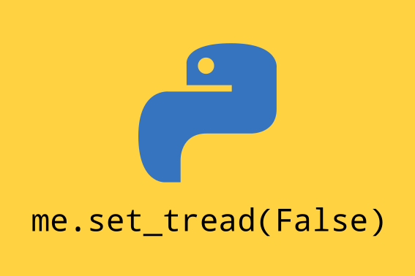
Python for Security

Slide 2
$ whoami
Jozsef Ottucsak (@fuzboxz)
OSCP, SLAE, CCSKv4, eCPPT, CEH, MCP
Senior AppSec Engineer @TrueMotion

Slide 3
Expectation Management
What this talk is:
High level overview on how security uses Python
What it isn’t:
Not a deep dive, this topic is too broad to cover in 15 minutes or even a day

Slide 4
The good old days...
More fragmented language preferences
Network - Perl, Bash, C/C++
Web - Txt (RTFM!), Perl, PHP
Windows - Batch, VBS (🤢)
Steeper learning curve
Interactive exploits are rare

Slide 5
Why we use Python for security?
Easy to learn
Cross-platform
Perfect for rapid prototyping
Thousands of libraries
Awesome community
… we don’t really care about performance, do we?

Slide 6
Frequent use cases
Security tooling
Automating tools/processes
PoC for exploiting vulnerabilities
Parse output from other tools

Slide 7
Python for Network Attacks
Easy interaction with a range of network protocols
Application layer libraries (HTTP, FTP, SMB, SSH)
Low-level networking (scapy)
ICMP, TCP, UDP
WiFi, Bluetooth, BLE
Server with a single line of command

Slide 8
Python for Web Attacks
Most web technologies support Python… duh?
Wide range of parsers (html, xml, json, ...)
Libraries for SaaS APIs (Slack, Dropbox, etc)
Lots of examples, PoCs for common use cases

Slide 9
Python for Blue Teaming
Offload/automate manual work
Python SDK for enterprise tools
Log analysis, visualization
VirusTotal, Shodan integration
Chaos engineering

Slide 10
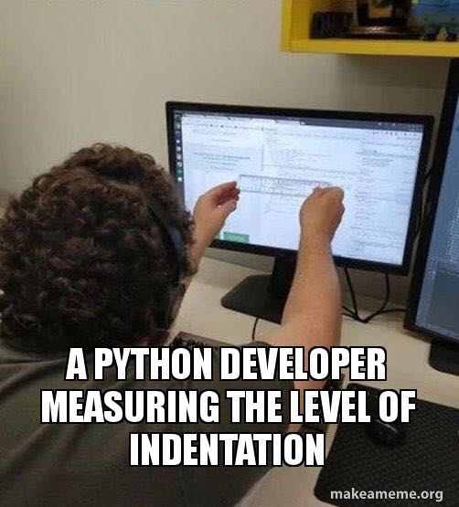
Python for DevSecOps
Same as blue teaming… PLUS
Interaction with cloud provider/developer tooling
Automated policy enforcement
Research
Monitoring
CI/CD wrappers for traditional tools

Slide 11
More use cases
Car hacking
Software defined radio
Hardware hacking
CircuitPython / MicroPython for MCU
WiFi, BL(E), MQTT, ZigBee libraries
Reverse engineering - binwalk

Slide 12
Thank you

