Slide 1
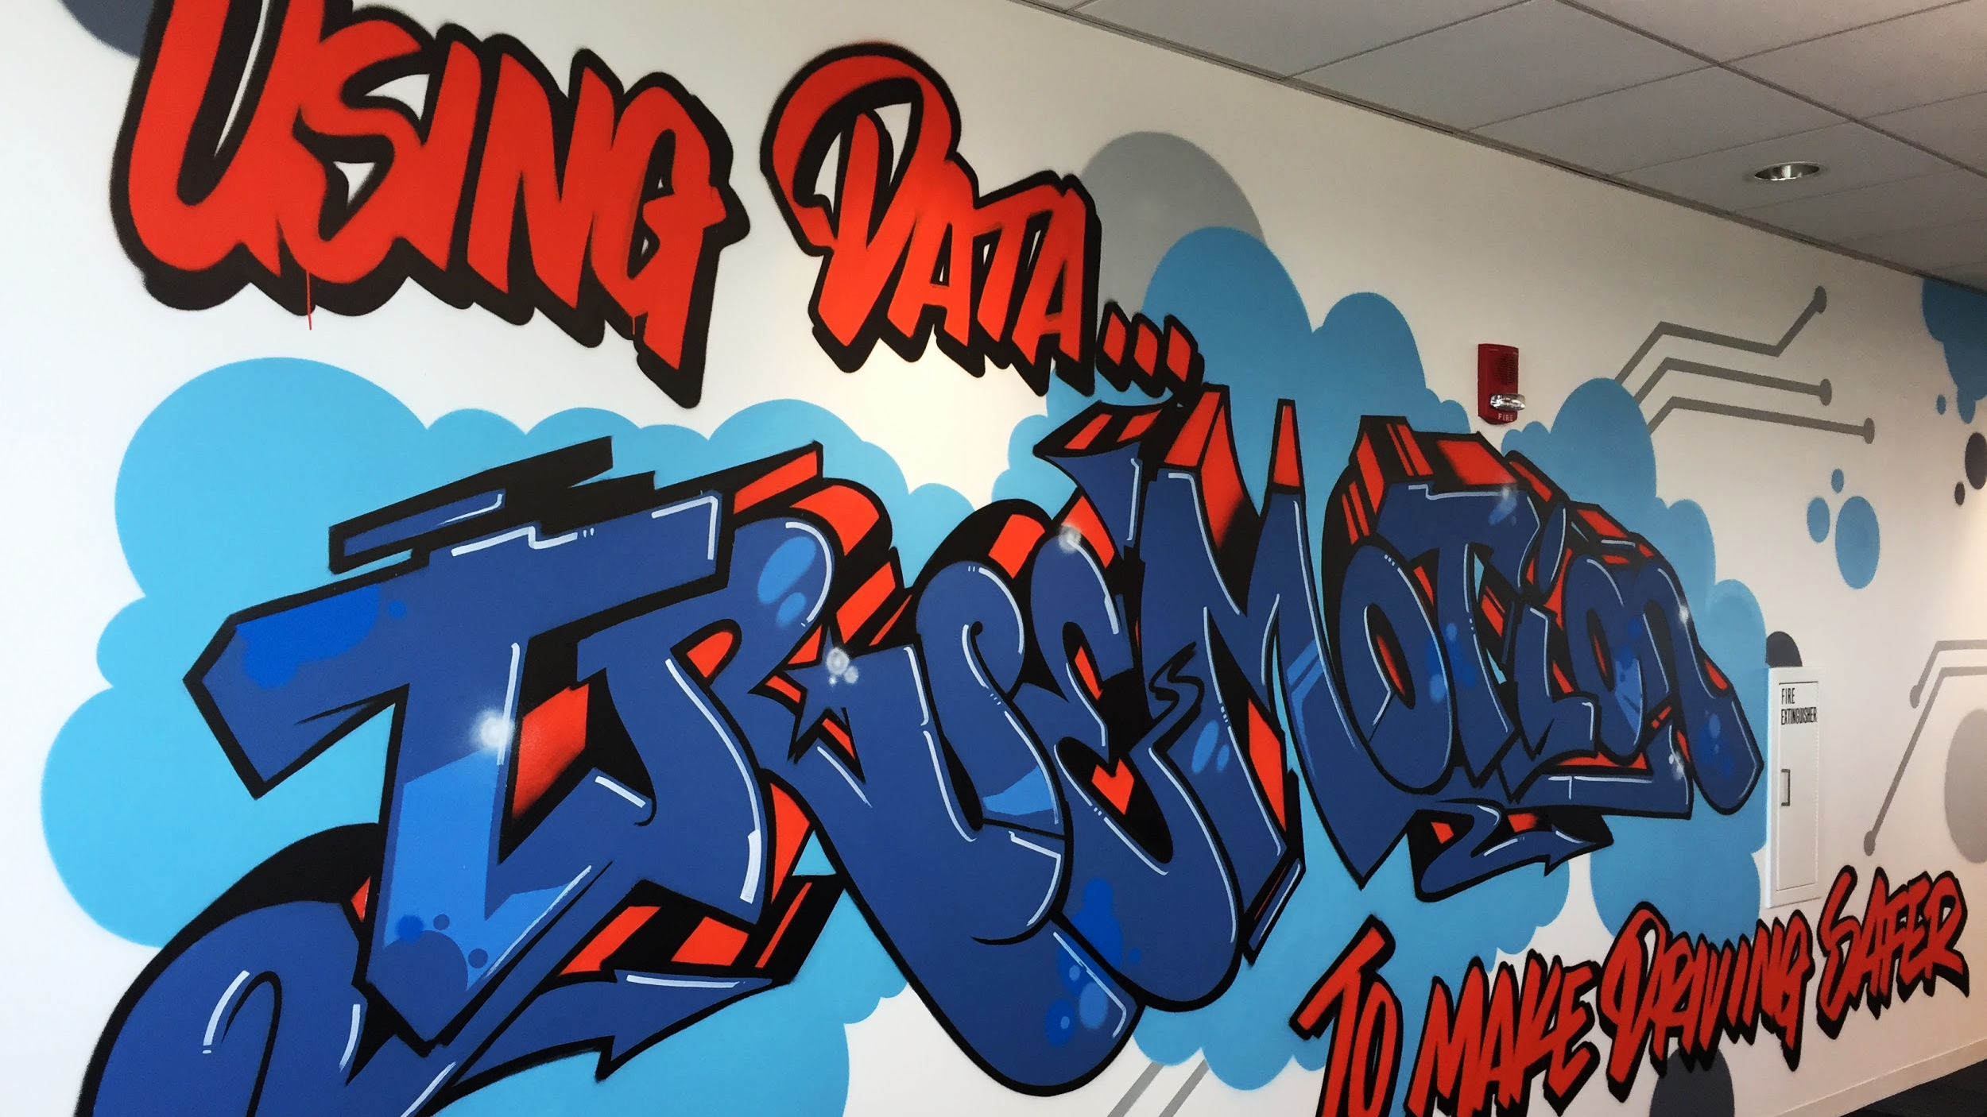
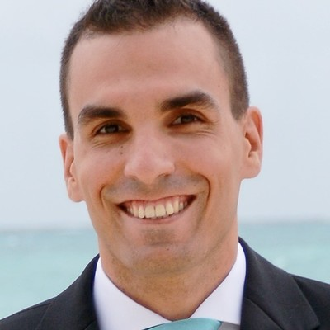
Python for QA
Peter Viskovics
27-Feb-2020
Automate everything

Slide 2
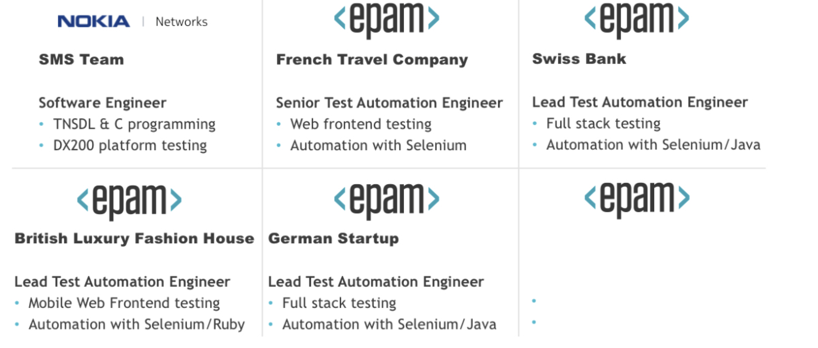
ABOUT ME
Advanced Level, Technical Test Analyst
Senior Test Automation Engineer
• Suggest, plan, implement and evaluate QA improvements
• Create and improve test automation frameworks
Enterprise Analytics
QA Consultant
Test Strategy for EA projects
Automation and CI/CD

Slide 3
AGENDA
QA subtask generator
Test data generator and verifier
Automate release administration
Test metrics collector and dashboard

Slide 4
JIRA QA SUBTASK GENERATOR
Epic
Business Story 1
Business Story 2
Dev subtask A
QA auto comp. testing
Dev subtask C
QA auto comp. testing
Dev subtask B
QA auto sys. testing
Dev subtask D
QA auto sys. testing
QA test design
QA write manual tests
Dev subtask E
QA write manual tests
QA run manual tests
QA test design
QA run manual tests

Slide 5
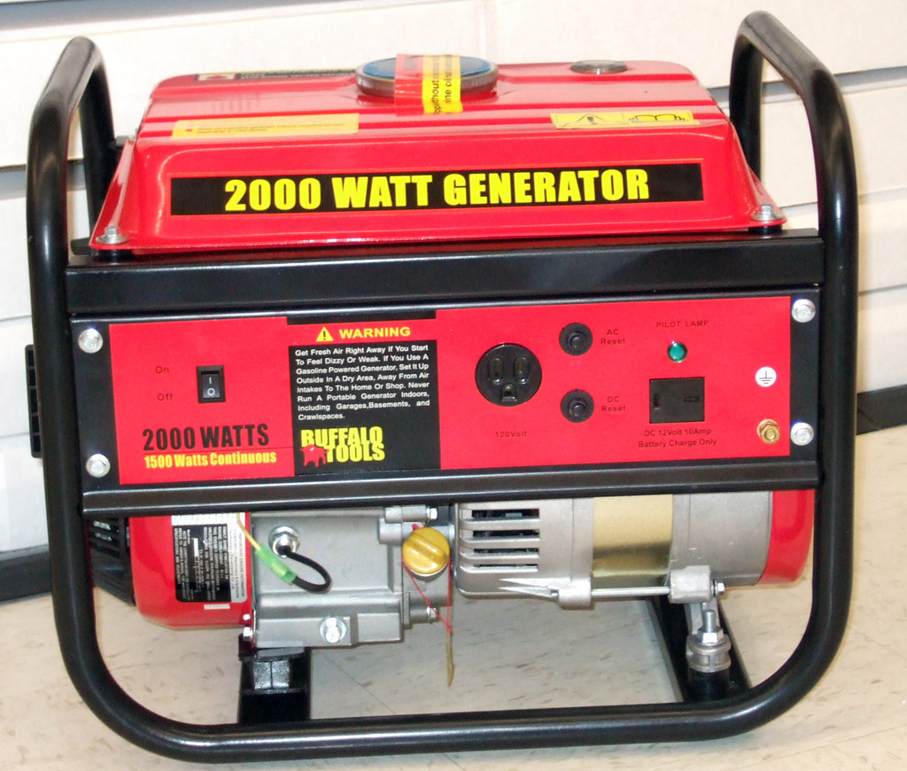
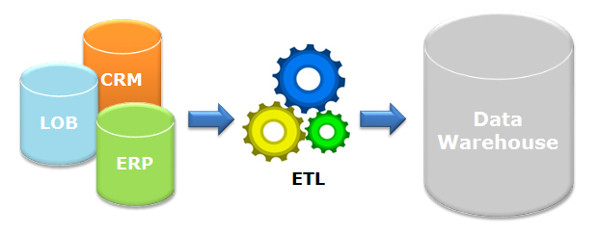
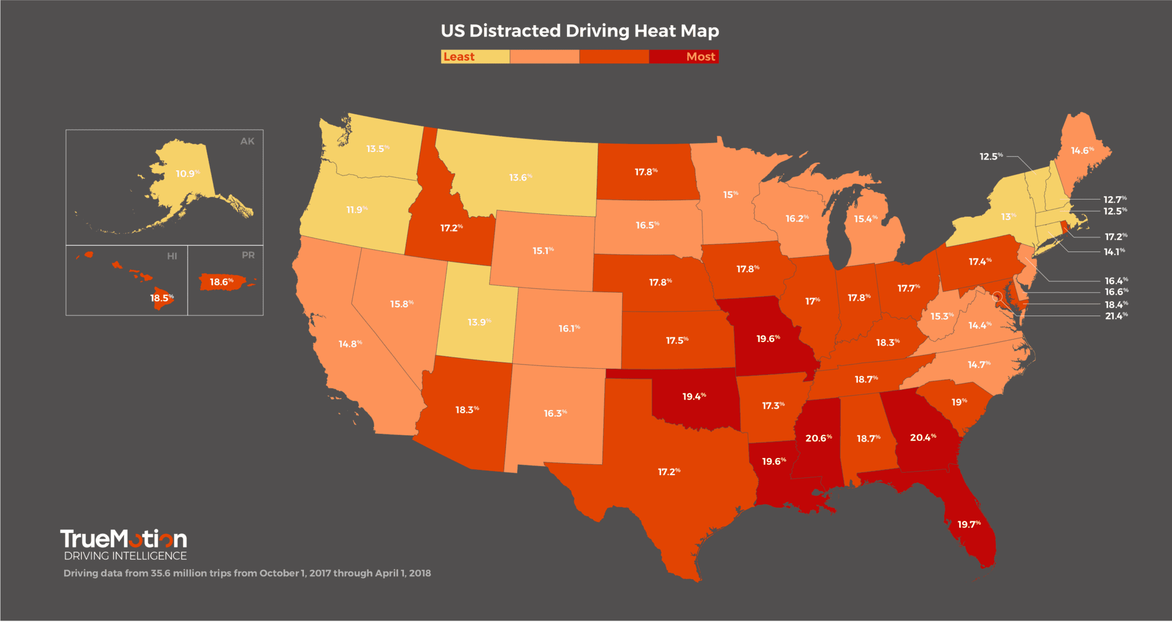
TEST DATA GENERATOR AND VERIFIER

Slide 6
TEST DATA GENERATOR AND VERIFIER
Sandbox
Test
UAT
PROD
Test
Driver Trip Data
Live Driver Trip Data
Find trip
Who is allowed?
Search criteria?
ML classifier?

Slide 7
AUTOMATE RELEASE ADMINISTRATION
Version
Commit messages
Diff
Tag (refs)
Release
notes
template
Sandbox
Test
UAT
PROD
login: feat-123
detect: 1.5.0
driver: dev
event: feat-25
login: 3.0.3
detect: 1.5.1
driver: 5.1.0
event: 13.0.0
login: 3.0.2
detect: 1.5.0
driver: 5.1.1
event: 13.0.0
login: 3.0.1
detect: 1.5.0
driver: 5.1.0
event: 12.5.0

Slide 8
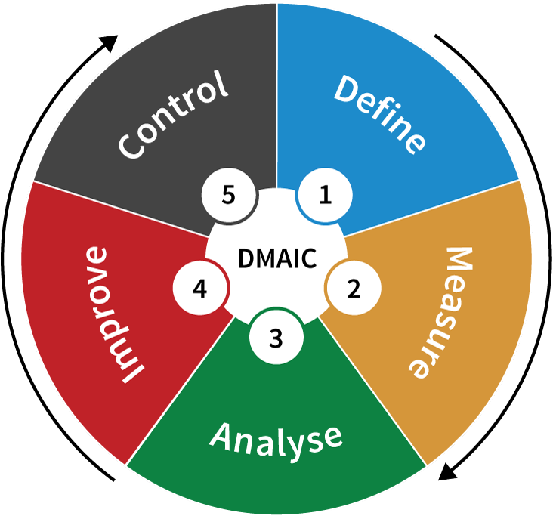
TEST METRICS COLLECTOR AND DASHBOARD
Collect data:
Junit.xml
Related requirement / Story / bug
Related interface
Integrate with
Issue tracker
Test case management tool
Source control management

Slide 9
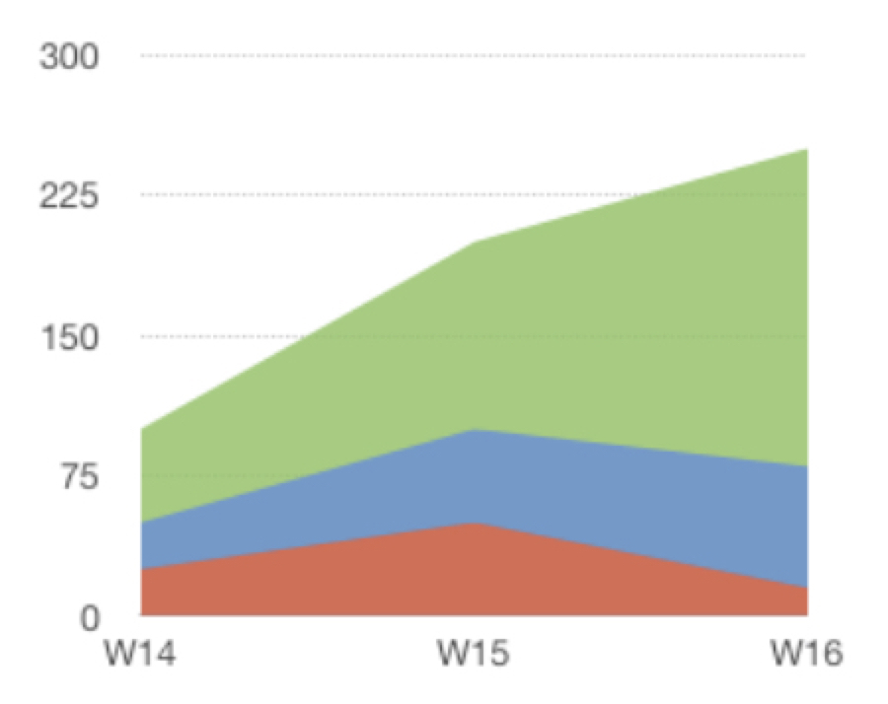
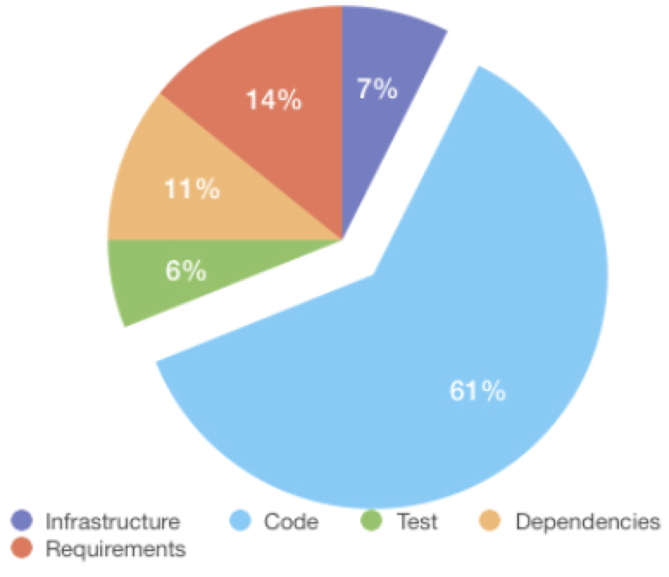
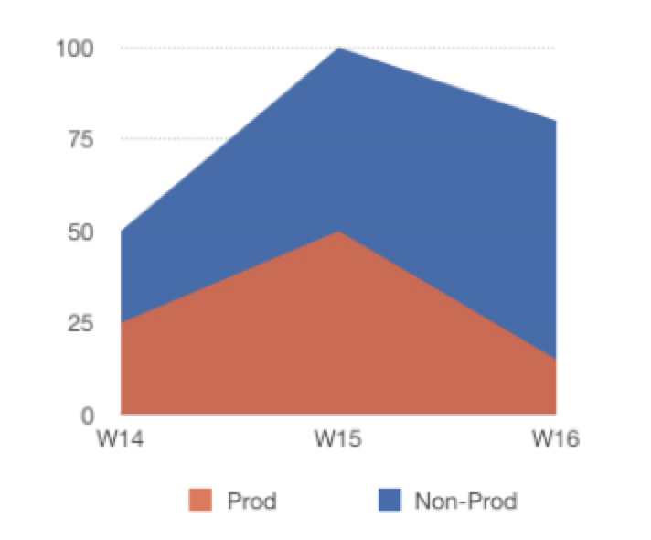
TEST METRICS COLLECTOR AND DASHBOARD
Test Execution
Root Cause Analysis
Defect Heatmap
 | login | detect | driver | event
high | 5 | 21 | 0 | 18
medium | 0 | 6 | 2 | 9
low | 3 | 2 | 11 | 3
•
•
passed
skipped
•
failed
Automation coverage | Avg. Suite Run Time | Avg. TC Run Time | Level coverage | Flakiness
42% | 1h16m29s | 1m22s | 92% AC | 13%
67% | 22m16s | 29.6s | 78% Story | 8%
100% | 12m57s | 2.7s | 100% API | 0%
100% | 42.84s | 629ms | 72% line | 1%
Bug Trend
UAT
SYS
COMP
UNIT

Slide 10
Thank you

