Slide 1
Scaling in Kubernetes

Slide 2
Who am I?
Co-founder & CTO @ LeanNet Ltd.
Consulting, training, implementing
Cloud Native, Kubernetes, Microservices, DevOps
Now part of the
megyesi@leannet.eu
twitter.com/M3gy0
linkedin.com/in/M3gy0

Slide 3
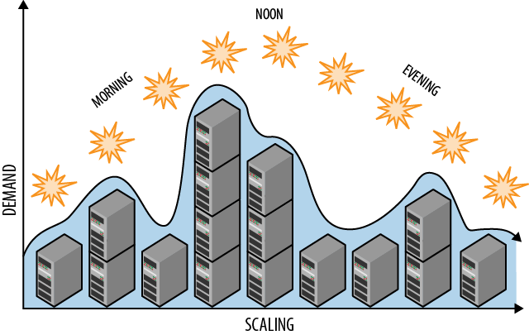
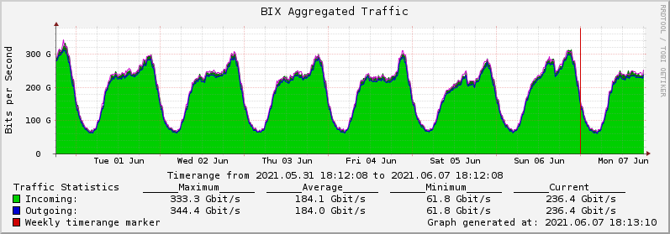
Scaling in General

Slide 4
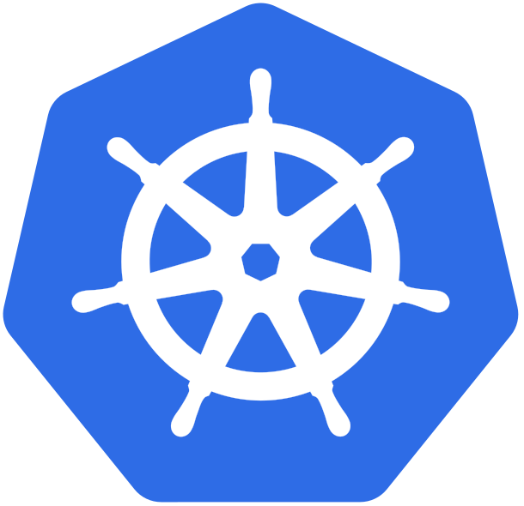
Scaling in Kubernetes – Quick Summary
Nodes in the cluster
Pods of a service
Cluster Autoscaler
Horizontal
Vertical
Vertical Pod Autoscaler
Regular
Scale to 0
Horizontal Pod Autoscaler
Serverless Frameworks

Slide 5
Cluster Autoscaler
Scales your cluster nodes up based on pending pods
There are pods that failed to schedule on any of the current nodes due to insufficient resources
Adding a node similar to the nodes currently present in the cluster would help
Scales your cluster nodes down if pods could be rescheduled on other available nodes
Pods will be evicted and restarted on another node
Many things can prevent the removal of a node:
PodDisruptionBudget
Kube-system pods
Pods with local storage
Pods that are not backed by a controller object (e.g. deployment, replicaSet)
Various constraints (lack of resources, non-matching node selectors or affinity, matching anti-affinity)

Slide 6
Cluster Autoscaler – High Level Workflow
Cloud Provider
CA
1: pods are in pending state
?
?
2: additional node(s) are needed
Node
Node
Node
Node
3: node is provisioned

Slide 7
Cluster Autoscaler – High Level Workflow
Cloud Provider
CA
1: pods are in pending state
?
?
2: additional node(s) are needed
Node
Node
Node
Node
3: node is provisioned
4: pods are scheduled

Slide 8
Vertical Pod Autoscaler
Set up-to-date resource limits and requests for the containers in their pods
Down-scale pods that are over-requesting resources
Up-scale pods that are under-requesting resources
Remember
Resource request → used for scheduling only (overprovisioning)
Resource limit → hard limits on your containers (CPU throttling, OOM Killed)

Slide 9
Vertical Pod Autoscaler - Example
apiVersion: autoscaling.k8s.io/v1
kind: VerticalPodAutoscaler
metadata:
name: prometheus-recommender
spec:
targetRef:
apiVersion: "apps/v1"
kind: Deployment
name: prometheus-server
updatePolicy:
updateMode: "Auto"
resourcePolicy:
containerPolicies:
- containerName: "prometheus"
minAllowed:
cpu: "300m"
memory: "512Mi"
maxAllowed:
cpu: "1800m"
memory: "3600Mi"
- containerName: "configmap-reload"
mode: "Off"
which pods to target
automatically update resource
resource request boundaries for this container the limit will have preserve the original ratio
don‘t scale the sidecar

Slide 10
Horizontal Pod Autoscaler
Automatically scales the number of Pods based on observed metrics
Set a target metric (e.g. 50% CPU utilization)
The controller takes the mean of a per-pod metric value
Calculates whether adding or removing a replica would get closer to the target value.
apiVersion: autoscaling/v1
kind: HorizontalPodAutoscaler
metadata:
name: nginx
spec:
maxReplicas: 10
minReplicas: 1
scaleTargetRef:
apiVersion: apps/v1
kind: Deployment
name: nginx
targetCPUUtilizationPercentage: 50
75%
75%
75%
75%
75%
+3 replicas
47%
47%
47%
47%
47%
47%
47%
47%
Notes:
5 * 0.75 = 3.75
3.75 / 8 =~ 0.47
3.75 / 7 =~ 0.54
3.75 / 9 =~ 0.42

Slide 11
Integrating Metrics into Kubernetes
Metrics server
Most easy to use, a single deployment that works on most clusters
Collects CPU/Memory metrics every 15 seconds
Scalable with very low footprint (1 mili core of CPU and 2 MB of memory per node)
Custom metrics
Metrics collected from your application running inside Kubernetes
Typically integrated using Prometheus
External metrics
Metrics collected from an application or service not running on your cluster, but whose performance can impact your Kubernetes application
Typically collected from cloud services (e.g. message queues)

Slide 12
Scale to 0 – Serverless Frameworks
You can’t use HPA to scale you pods down to 0 when there is no traffic ☹
You need something very different → Serverless (a.k.a. Function-as-a-Service) framework
Typical use-cases:
HTTP trigger: functions serves one HTTP request then exits
Message trigger: functions serves one message from a queue then exits
General advantages of functions:
Improved developer velocity
Built-in scalability
Cost efficiency
Common disadvantages:
Less system control
Complex system testing and operations
Notes:
What are the advantages of using FaaS?
Improved developer velocity
With FaaS, developers can spend more time writing application logic and less time worrying about servers and deploys. This typically means a much faster development turnaround.
Built-in scalability
Since FaaS code is inherently scalable, developers don’t have to worry about creating contingencies for high traffic or heavy use. The serverless provider will handle all of the scaling concerns.
Cost efficiency
Unlike traditional cloud providers, serverless FaaS providers do not charge their clients for idle computation time. Because of this, clients only pay for as much computation time as they use, and do not need to waste money over-provisioning cloud resources.
What are the drawbacks of FaaS?
Less system control
Having a third party manage part of the infrastructure makes it tough to understand the whole system and adds debugging challenges.
More complexity required for testing
It can be very difficult to incorporate FaaS code into a local testing environment, making thorough testing of an application a more intensive task.

Slide 13
CNCF Serverless Landscape

Slide 14
Summary
The 3(+1) ways to scale in Kubernetes:
Cluster Autoscaler
Automatically provision new nodes or remove existing ones in your cluster
Very good option in cloud managed options, quite hard to DIY
Vertical Pod Autoscaler
Used to increase/decrease resource requests/limits
Typically good for stateful workloads
Horizon Pod Autoscaler
Used to increase/decrease the number of pods in a deployment
Very good integration with Prometheus via Custom Metrics
Horizon Pod Autoscaler
Implement scale-to-0 serverless behavior
+

