Slide 1


AGILE IN ACTION
How to organize teams for enterprise scale
based on a true story
HWSW free!

Slide 2




Gabor’s FAST FACTS
PROJECTS
30+ done
<404> budget
SUCCESSFUL DELIVERY
WORLDWIDE
WORK IN IT
18 years
80+ FTE
Team size
4
continents
23
countries
managed
EXPERIENCE
BROAD INDUSTRY KNOWLEDGE
PORTFOLIO
Development
QA
BA
UI/UX
Management
4+ yrs
4+ yrs
3+ yrs
5+ yrs
10+ yrs
Digital & B2C
TCCC | Tesco
CMS CRM DAM Cloud
Insurance
VIG Group
Online broker
Presales, scoping & estimations
Project initiation & ramp up
Consultancy: digital & mngnt
Delivery & governance
Digital transformation
Online Media
The Coca-Cola Company
Gambling
Szerencsejatek Plc.
Health Care
Eli Lilly
Energy Trade
powerforum

Slide 3























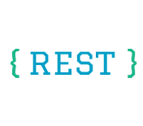

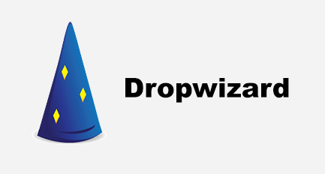
ThE STORY BEGINS…
We NEED A WEBSITE!
B2C
millions of users
high-availability / scalable
modern tech stack
50+ non-prod instances
greenfield development
“should do the same as the old site”
Notes:
All the fancy stuff, Microservices, with NoSQL, Blue-green deployment,

Slide 4

LET’S DO IT!
IN SCRUM!
3x agile teams (30+ engineers)
  Including BA, QA, AQA, Team lead, devs
2x DevOps
2x Architect
2x PM
Notes:
We are <EPAM> this is what we are great at! Enterprise SW Engineering! Let’s put the teams there and GO!

Slide 5


LET’s DO SCRUM!
Individuals and interactions – Daily SU & ceremonies with Client
Working software – Sprint demos
Customer collaboration – Client is there
Responding to change - retros, requirement changes
Notes:
Client is agile, we can do agile, let’s use SCRUM!

Slide 6
WHAT DID WE DO?
#1 WE NEEDED SUCCESS & TRUST
Smaller & achievable goals defined together with Client
Improved Client facing communication
#2 REORGANISED Communication
#3 CLARIFIED Leadership RESPONSIBILITIES
BA: goal is to have 2 sprints worth of work ready to play
Dev Lead: ensure sprint work completion; confirm if story is ready to play
QA lead also has veto on rtp
Dev team standup without Client
SOS with Leadership & Client
Weekly backlog review (Leads, BAs & Architects & Mngt)
Weekly: Architecture (Architects & Mngt)
Notes:
Achievable goals ! Regain Team & Client’s trust!
Communication:
-meetings are not enough, we MUST have meaningful communication.
If I did not like a meeting, I explicitly tell them what’s the agenda, what I’m going to ask, and what I’m expecting to hear. Simple: are we on track with spritn, or not, what do we depend on, what help is required?
- SOS: squad integration checkpoint & standup w Client
Weekly BA & Architecture boards:
Review prioritization
Review stucked work
Validate if we have enough work for next sprints
Weekly- to transparently articulate blockers, challenges & progress and prioritization & align on actions jointly

Slide 7
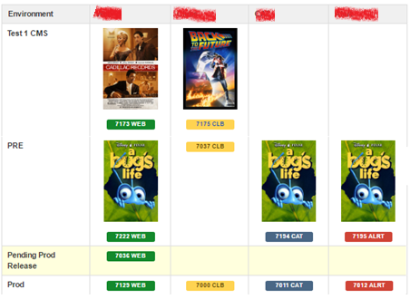
WHAT’s NEXT? IMPLEMENT A.R.T.
A.R.T. RELEASE PLANNING
RELEASE
Defined version of one of the four products, with a planned & final go-live date, containing stories & bugfixes developed (and going live) when this particular version goes to PROD
Names after it’s content (what feature it contains )
LAUNCH
A bundle of product releases (1 to 4) going live on every Tuesday
Named after a movie nominated by team members (in ABC order).
Notes:
After successful golive:
Business timelines need to be mapped to delivery plans and communicated
Plans (release, resourcing, timelines, scope, prioritisation
We aligned that we will try A.R.T.
Nominated, fixed slots for release
If a story slips, missed the train. It will come with the next release – surprisingly easy for the business to accept, as they knew the next train is coming!
Of course you had to have the basics right:
Right test pyramid (codecoverage, test automation)
Mature microservices
Large amount of infrastructure
GREAT TEAM!

Slide 8
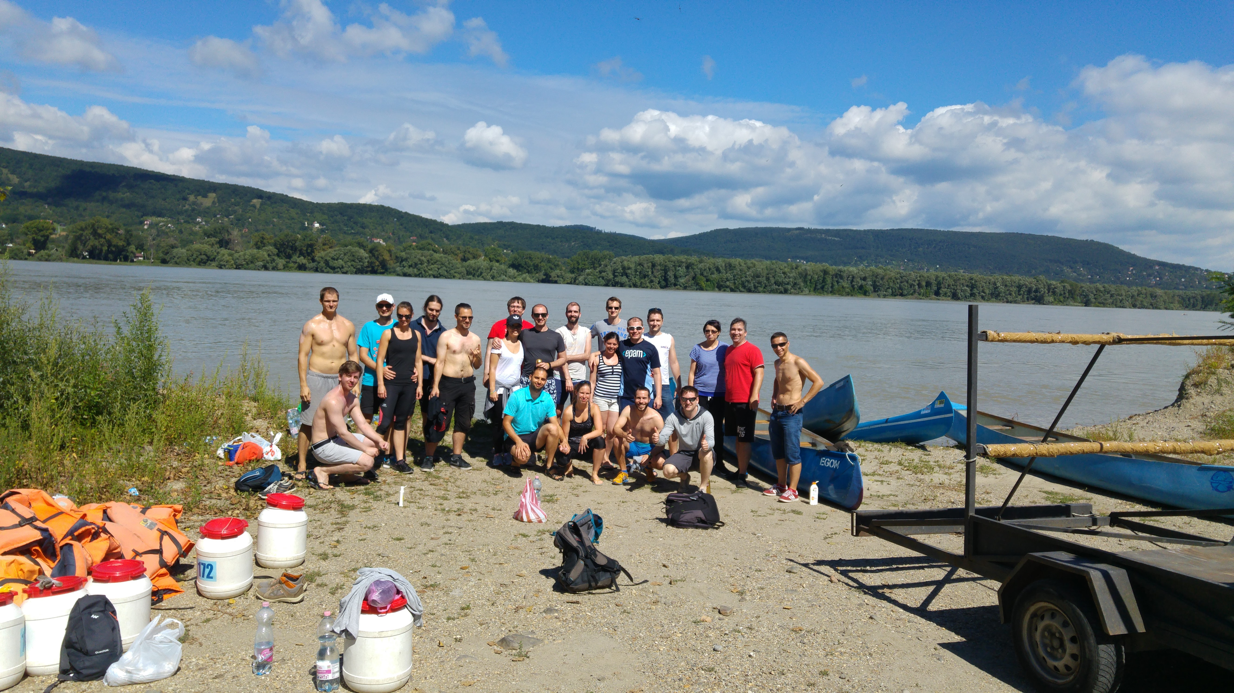
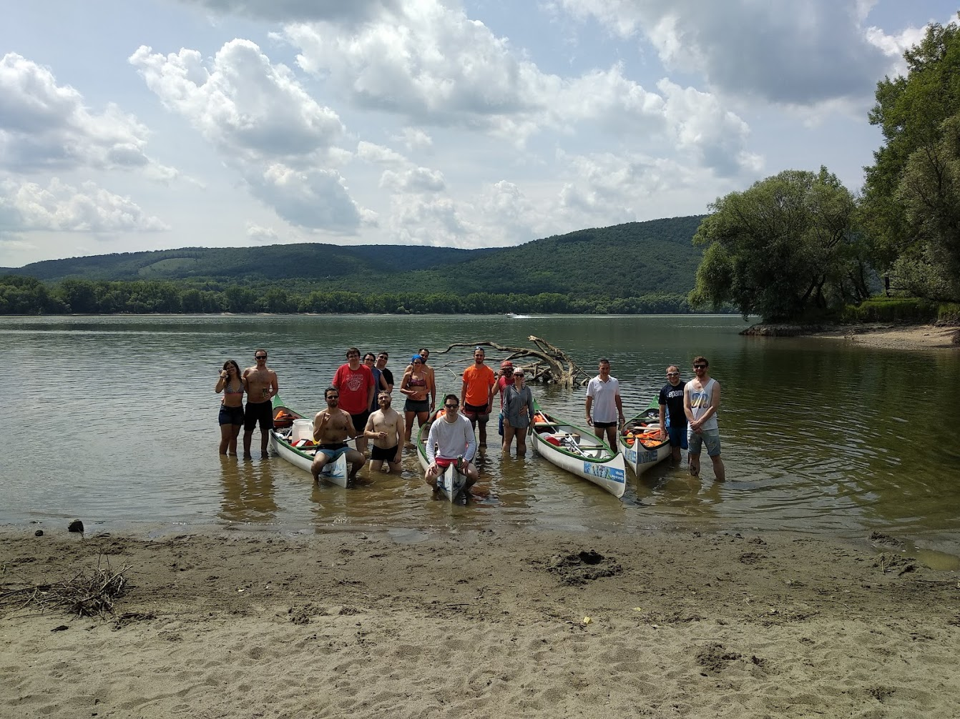
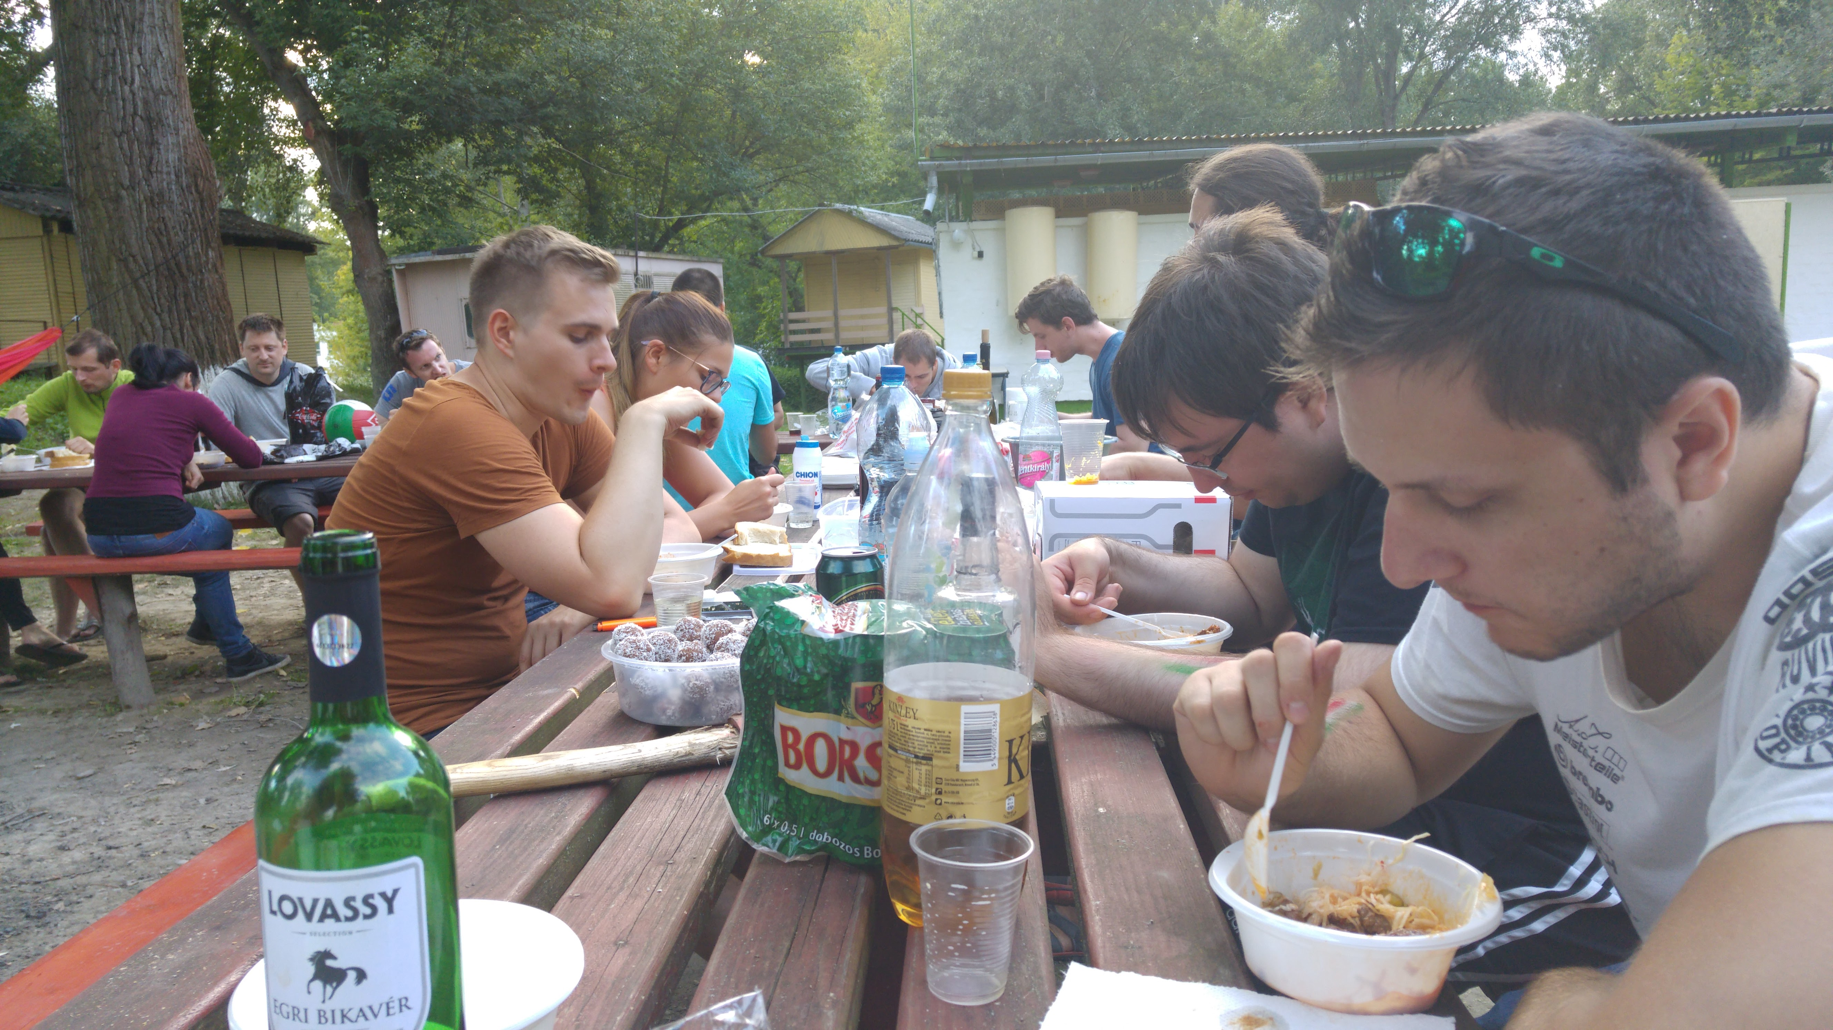
HAPPY END
Great Product & satisfied Client
Productive, resilient, and united team!
CONTACT
linkedin.com/in/gaborhalaszi/

