Slide 2
A STORY

Slide 3
200%
SCRUM
AGILE
300%
400%

Slide 9
LET ME INTRODUCE MYSELF

Slide 10
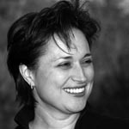
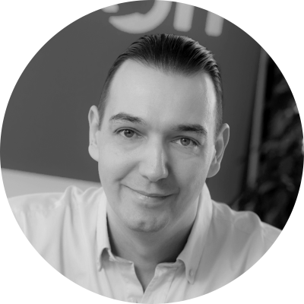

Slide 11
25
YEARS XP
1500+
TRAINED
BME
PRO BONO

Slide 12
WHAT IS ZOMBIE SCRUM?

Slide 14
MINDSET

Slide 17
EXAMPLE #1
Notes:
transparency

Slide 18
EXAMPLE #2
Notes:
timeboxing

Slide 19
EXAMPLE #3
TIME
RESOURCES
PRODUCT FEATURES
Notes:
scope management

Slide 20
EXAMPLE #4
Notes:
self organozation

Slide 21
EXAMPLE #5

Slide 22
WHY AGILE TRANSFORMATIONS FAIL?

Slide 23
MINDSET
MINDSET

Slide 24
HOW DOES IT SPREAD?

Slide 25
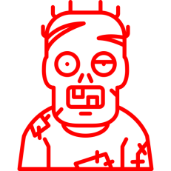

Slide 28
WHAT CAN WE DO?

Slide 31
HOW TO GET GREAT SCRUM MASTERS?

Slide 32
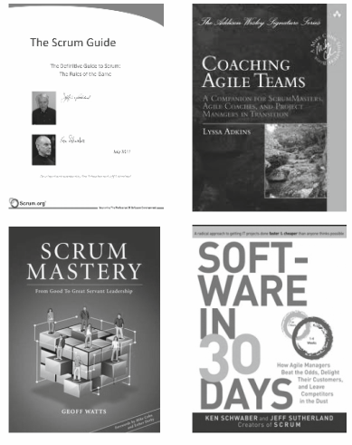
BOOKS

Slide 33
TRAINING
MINDSET

Slide 35
THE AGILE BRAIN IS IMMUNE

Slide 36
TEAM THAT CAN
DO ANYTHING
EMPOWERED
COMMITTED TO
TEAM SUCCESS
GET THE RIGHT
BUSINESS VALUE
OUTSTANDING
RESULTS
CONSENSUS DRIVEN
OWNS ITS DECISIONS
AND COMMITMENT
CONSTANT CONSTRUCTIVE
DISAGREEMENT
GET BUSINESS VALUE
FASTER
TRUST MOTIVATES THEM
ROOM FOR TEAM
& INDIVIDUAL GROWTH
SELF-ORGANIZING
BELIEVE THEY CAN
SOLVE ANY PROBLEM
COMMITMENT
RESPECT
FOCUS
COURAGE
OPENNESS

Slide 38
WWW.BIROTOM.COM

