Slide 1
DATA DRIVEN SKILL MANAGEMENT IN HR
- Use Case Study
ITware Intelligence Unit
Hungary 1117 Budapest, Budafoki út 209. Tel: +36 (1) 4630620 Email: ITW_sales@itware.hu

Slide 2
Problem Definition
Business Goal: keep employees' skills sharp by providing them regular skill trainings based upon their existing skills.
Product: Data Driven Recommender App for HR
Hungary 1117 Budapest, Budafoki út 209. Tel: +36 (1) 4630620 Email: ITW_sales@itware.hu
Notes:
Return of the dead: Record and Playback, Selenium UI, Cucumber
Con-mans: A lot of people are selling snake oil in both Test Automation and AI
Fragmentation: Everyone have done their own tools, JS Ecosystem

Slide 3
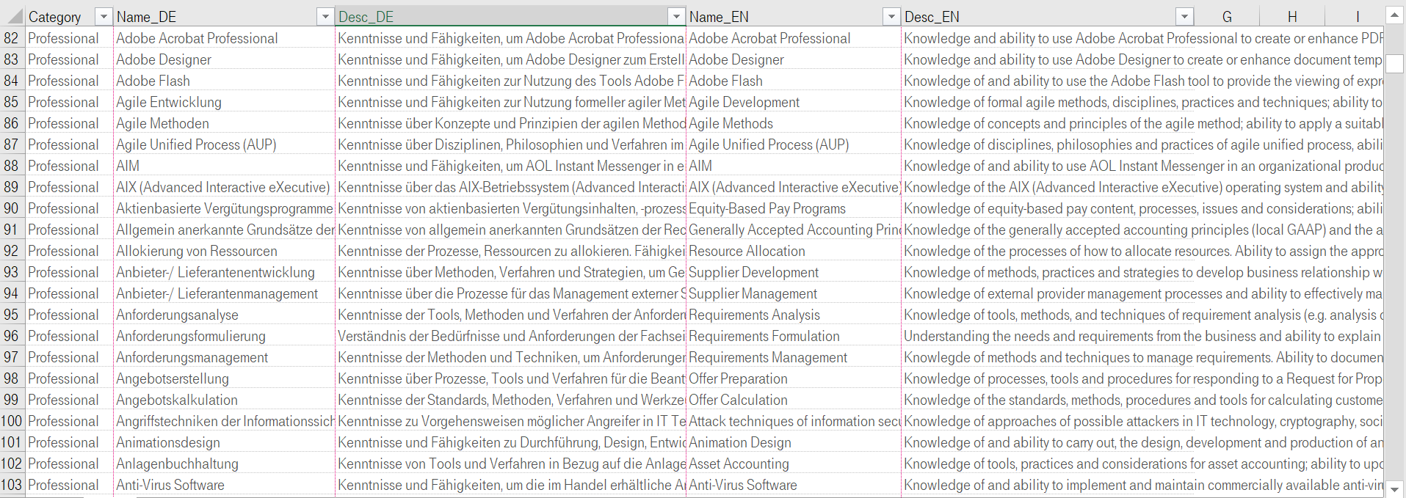
Data – Skills Set
Hungary 1117 Budapest, Budafoki út 209. Tel: +36 (1) 4630620 Email: ITW_sales@itware.hu
Notes:
Return of the dead: Record and Playback, Selenium UI, Cucumber
Con-mans: A lot of people are selling snake oil in both Test Automation and AI
Fragmentation: Everyone have done their own tools, JS Ecosystem

Slide 4
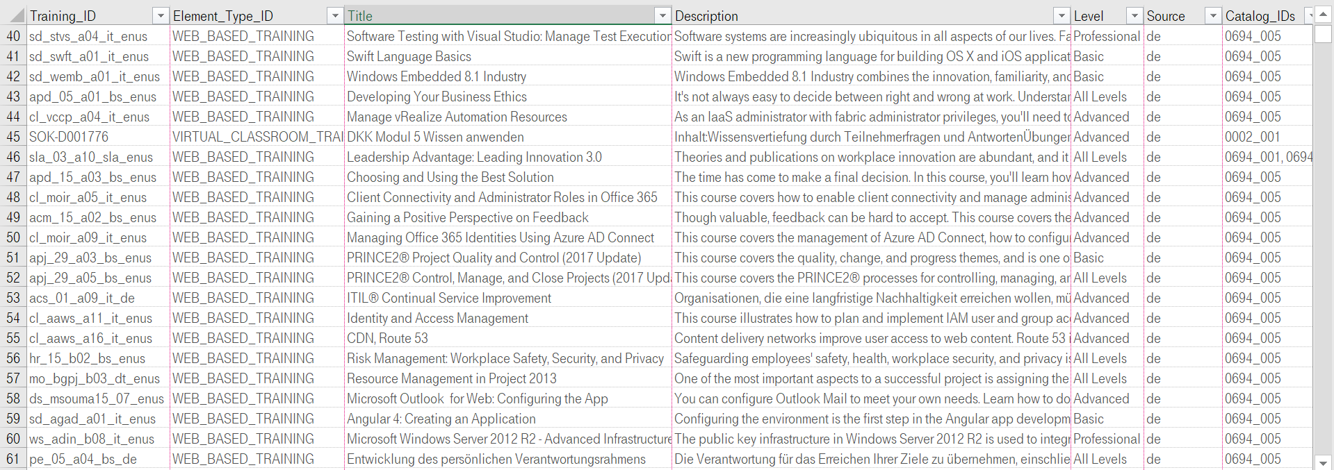
Data – Trainings Set
Hungary 1117 Budapest, Budafoki út 209. Tel: +36 (1) 4630620 Email: ITW_sales@itware.hu
Notes:
Return of the dead: Record and Playback, Selenium UI, Cucumber
Con-mans: A lot of people are selling snake oil in both Test Automation and AI
Fragmentation: Everyone have done their own tools, JS Ecosystem

Slide 5
Product Interface (PoC)
Hungary 1117 Budapest, Budafoki út 209. Tel: +36 (1) 4630620 Email: ITW_sales@itware.hu
Notes:
Return of the dead: Record and Playback, Selenium UI, Cucumber
Con-mans: A lot of people are selling snake oil in both Test Automation and AI
Fragmentation: Everyone have done their own tools, JS Ecosystem

Slide 6
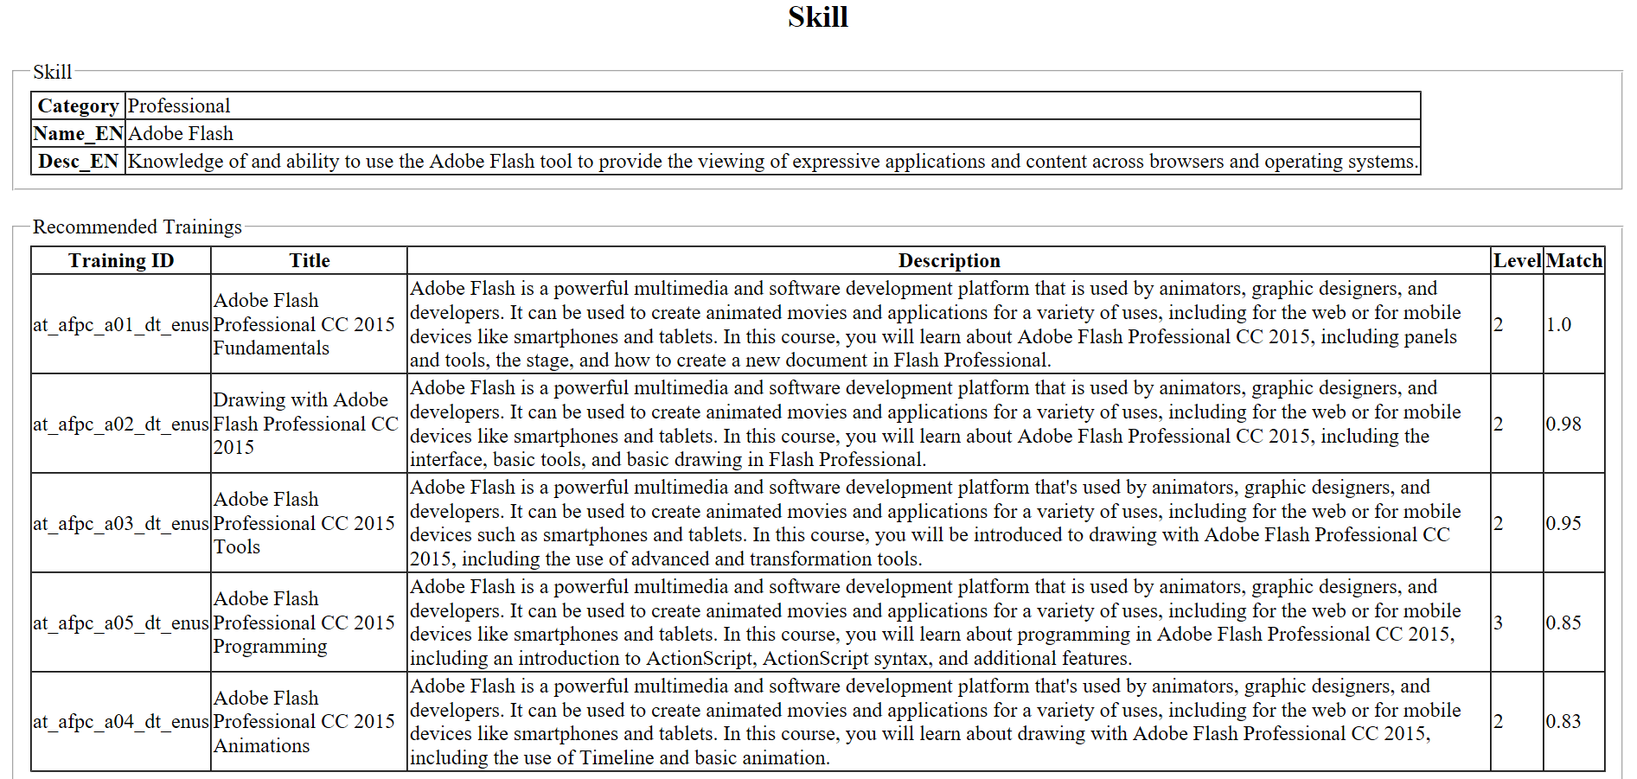
Product Interface (PoC)
Hungary 1117 Budapest, Budafoki út 209. Tel: +36 (1) 4630620 Email: ITW_sales@itware.hu
Notes:
Return of the dead: Record and Playback, Selenium UI, Cucumber
Con-mans: A lot of people are selling snake oil in both Test Automation and AI
Fragmentation: Everyone have done their own tools, JS Ecosystem

Slide 7
Technology
Stack:
Python
Sklearn, gensim, NLTK
Docker, OpenShift
Core Solution Steps:
Text Data Preparation
Text Encoding
Similarity Calculation
Hungary 1117 Budapest, Budafoki út 209. Tel: +36 (1) 4630620 Email: ITW_sales@itware.hu
Notes:
Return of the dead: Record and Playback, Selenium UI, Cucumber
Con-mans: A lot of people are selling snake oil in both Test Automation and AI
Fragmentation: Everyone have done their own tools, JS Ecosystem

Slide 8
Thank you for your attention!
gabor.budahazy@itware.hu
hrfest.com
Hungary 1117 Budapest, Budafoki út 209. Tel: +36 (1) 4630620 Email: ITW_sales@itware.hu

