Slide 1

MACHINE LEARNING
-
Phases of productization
Csaba Zsolnai,
Docler

Slide 2




ASSUMPTIONS

Slide 3




ML PHASES
Data preparation
Model research
Optimization
and training
Productization
Data sources
Collection and storage
Annotation
Literature research
Collecting viable models
Model selection
Implementation
Optimizing for inference
Creating ML service
Deployment

Slide 4



DATASET
(Some) Common problems
Not enough data
Causes training and testing problems
Deep learning models are very data-hungry
Edge cases
Lack of annotated data
The distribution of training and test set is different.
Annotation can be a bottleneck.

Slide 5
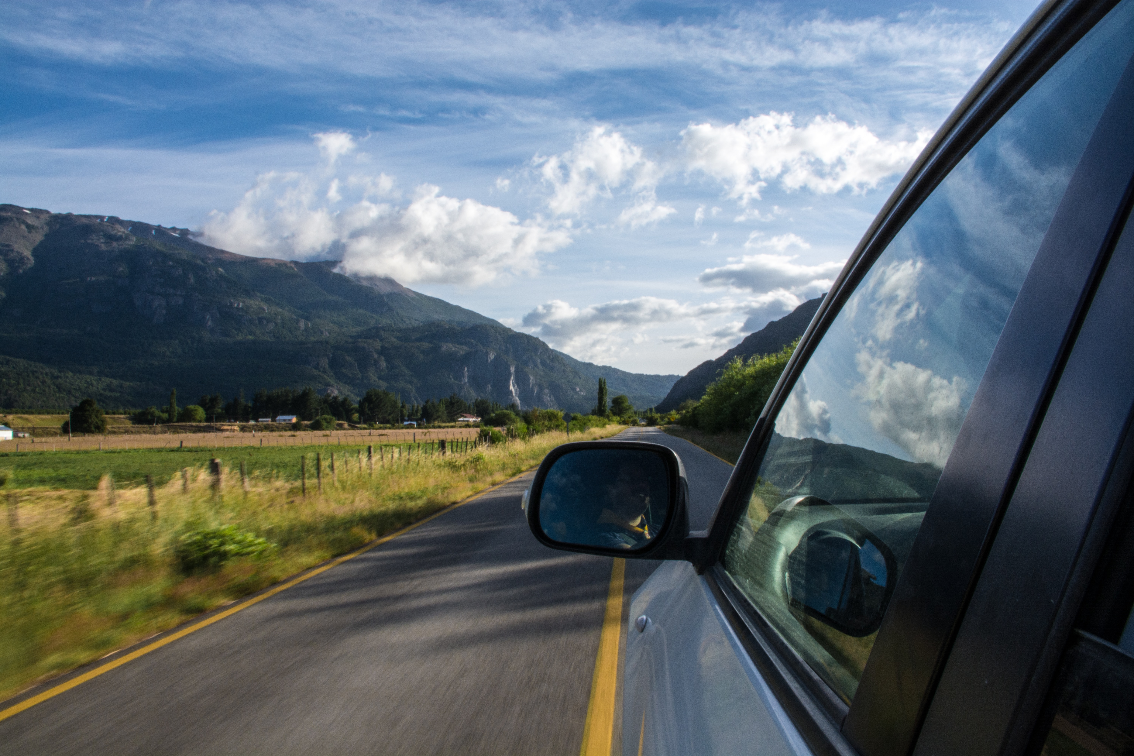

EDGE CASE
An example
Training dataset
Test dataset

Slide 6
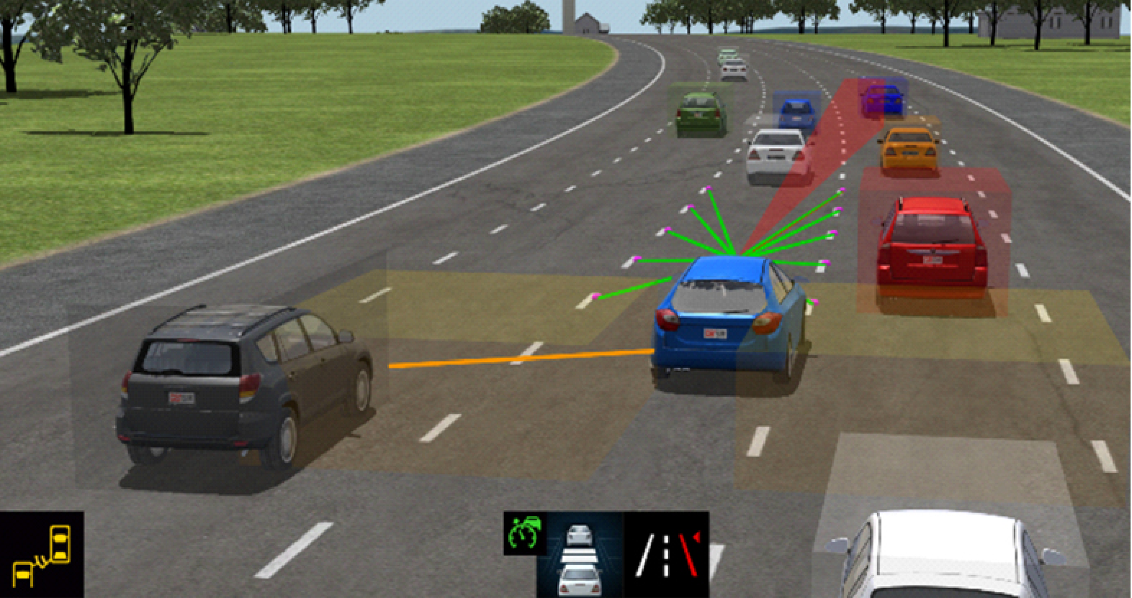
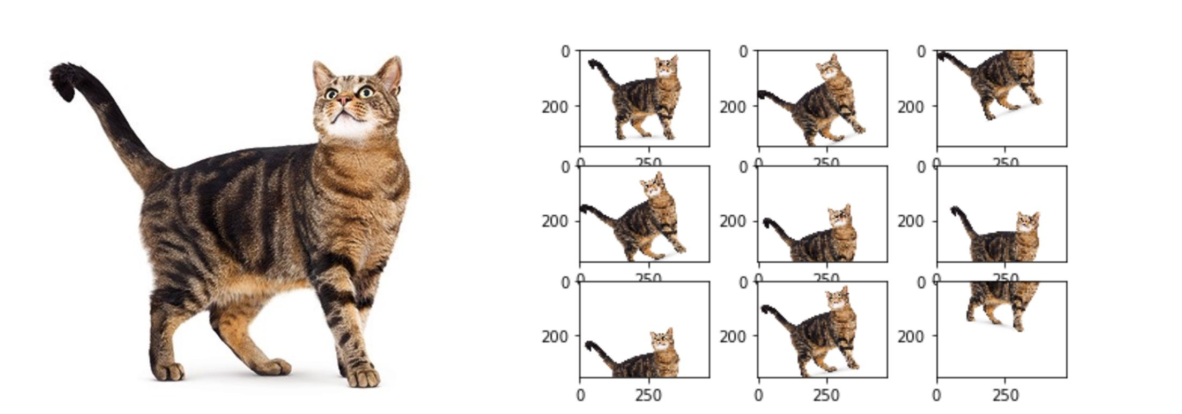
SOLUTION 1
Data synthesis
Data simulation
Simulate the real world environment where you would take your data from
Data augmentation
Simplest way to create more data. In case of images, add simple random transformation, e.g. translation, rotation, gaussion noise, etc.

Slide 7





SOLUTION 2
Outsourcing annotation
Usually we dont have an army to do the annotation
If money is less of an issue, annotation can be crowdsources

Slide 8

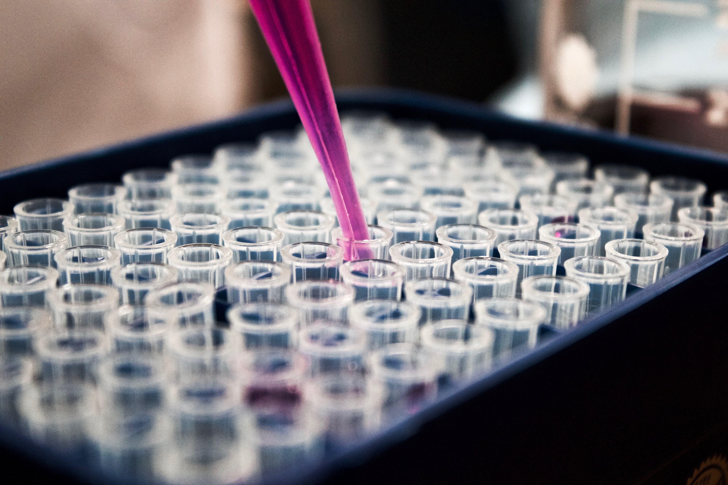



MODEL RESEARCH
Specifying metrics
Literature research
Comparing models
Testing models

Slide 9





IMPLEMENTATION
Model architecture
Metrics and evaluation
Testing models

Slide 10
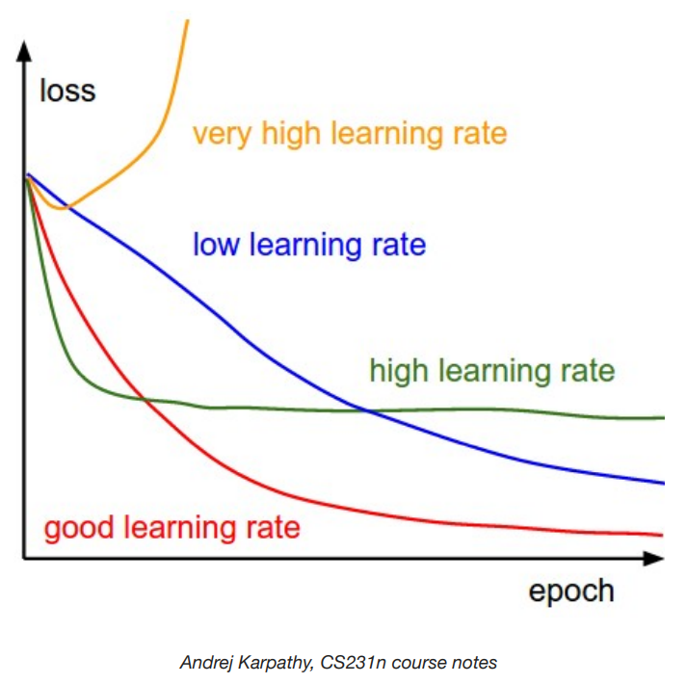

OPTIMIZING FOR ACCURACY
Training quality is sensitive to many model (hyper)parameters
Testing models
Examples
Learning rate
Optimizer algorithm
Activation function of layers
Testing models

Slide 11
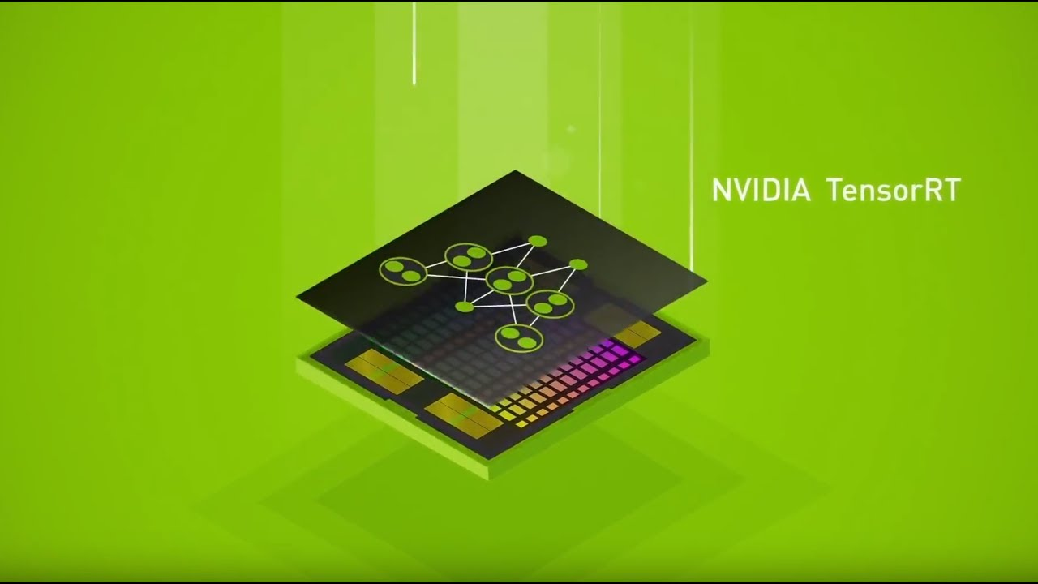

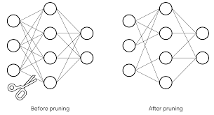

OPTIMIZING FOR INFERENCE
Why optimize for inference ?
Example methods:
tensorRT
neural pruning
many more...

Slide 12

WE MADE IT !
Questions ?

Slide 13
GRAPHICS SOURCES
Graphics:
Images:
www.freepik.com
www.flaticon.com
www.unsplash.com

Slide 14
INFORMATION SOURCES
Sources:
https://devblogs.nvidia.com
https://medium.com

