Slide 1
When data science meets product development Göbölös-Szabó Julianna Skyscanner

Slide 2
Some definitions
Data science produces insights
Machine learning produces prediction
Artificial intelligence produces action AI is anything that has not been done yet https://en.wikipedia.org/wiki/AI_effect

Slide 3
Common misconceptions

Slide 4
ML is a blackbox
ML takes away
control from us
Data scientist
Educate and evangelize
Product Owner
Listen to concerns
ML is
undeterministic!
Translate them to requirements
Designer

Slide 5
A Skyscanner example
Let's interactively learn which widget combo is the best!!!
How do I help users if UI is randomized?
widgets
Support agent

Slide 6
ML is a silver bullet
Is ML really required for this business problem?
Let's use
ML for
ALL THE THINGS!
1
Always start with analysis
2
Implement a baseline
approach first (No ML!)
3
Check if ML can improve on your baseline

Slide 7
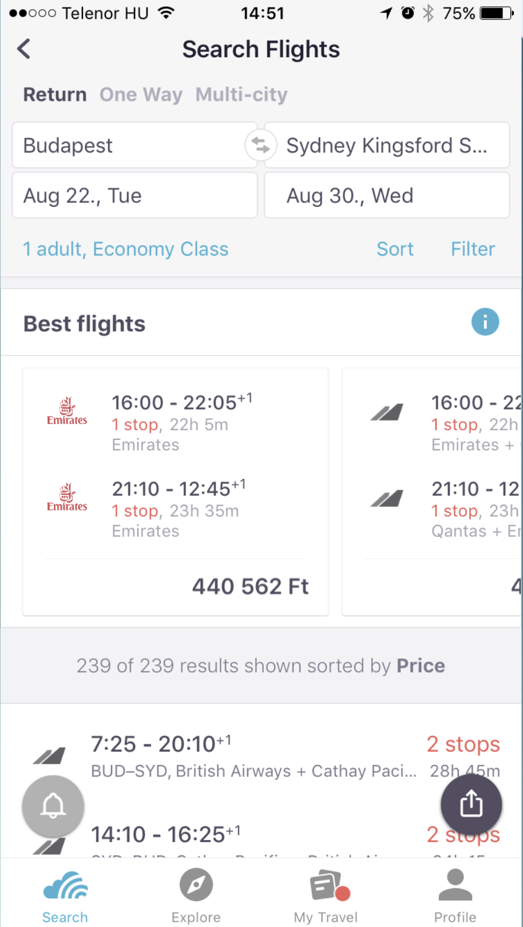
All we need is a good ML model
How do you
know what’s best for me?
Is this
an ad?

Slide 8
Model deployment is engineering's problem
Here’s my ML model, put it into
production!
Iterate together from early on

Slide 9
How to avoid them?

Slide 10
Team work with other disciplines is key

Slide 11
Questions

