Slide 1
Service Mesh:
A DevOps világ következő kedvence
Április 2.
Szabó Dávid
Senior Software Engineer
@szabvid

Slide 2
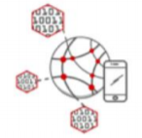
The Way Applications Are Developed and Deployed Has Fundamentally Changed
Development Process
Application Architecture
Deployment & Packaging
Application Infrastructure
Waterfall
Monolithic
Psychical Servers
Server Room
Agile
SOA
Virtual Machines
Data Center (IaaS)
Time
DevOps
Cloud Native
Microservices
Containers
Cloud Platform
Notes:
Az első oszlop a módszertan, a többi pedig a technológia rész. Ha ehhez az OS community növekedését is hozzáadjuk, akkor talán ma tartunk igazán ott, hogy a legjobban/legkönnyebben megközelítsük az általános DevOps célokat. Én innen a microservice-t ragadnám ki.
Egy aspektust emelnék ki az előadás alatt, ez pedig az, hogy ezekben a környezetben mi a legnagyobb kihivás és mit lehet tenni…

Slide 3
Introduction – DevOps Drivers
Lead Time
DEV
OPS
wall of confusion

Slide 4
Introduction – DevOps Drivers
Lead Time
Service Mesh
Microservices
DEV
OPS
wall of confusion
Service Mesh
Amplify Feedback
Notes:
Nézzük meg milyen kihívásokkal szembesülünk a microservice-ek esetén

Slide 5
How does microservices typically looks like?

Slide 6
This is not a Microservice Architecture!
Web Server
App Server
DB Server

Slide 7
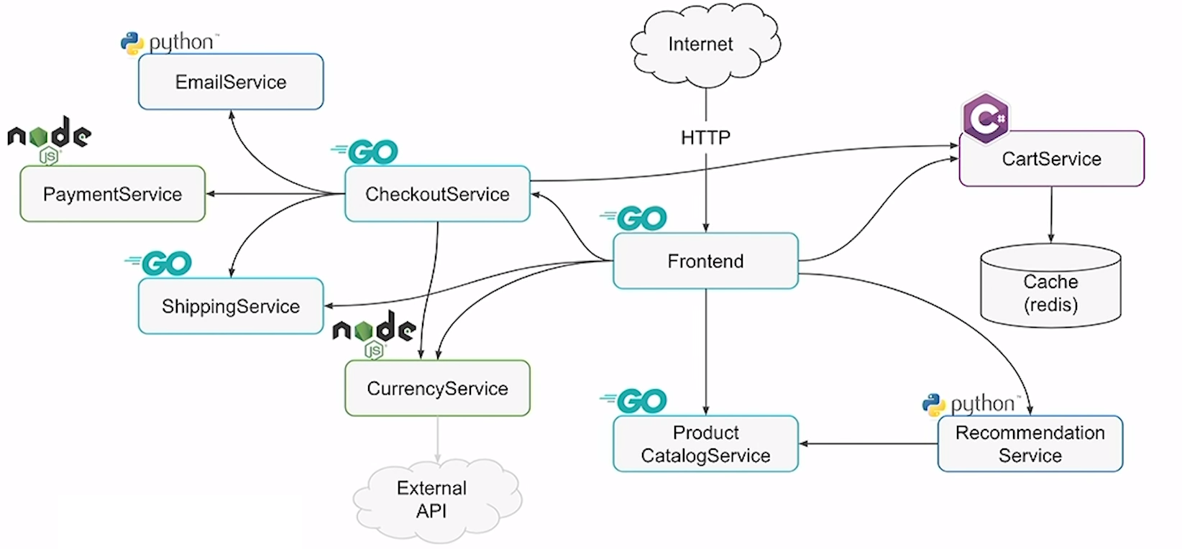
This is Getting There….

Slide 8
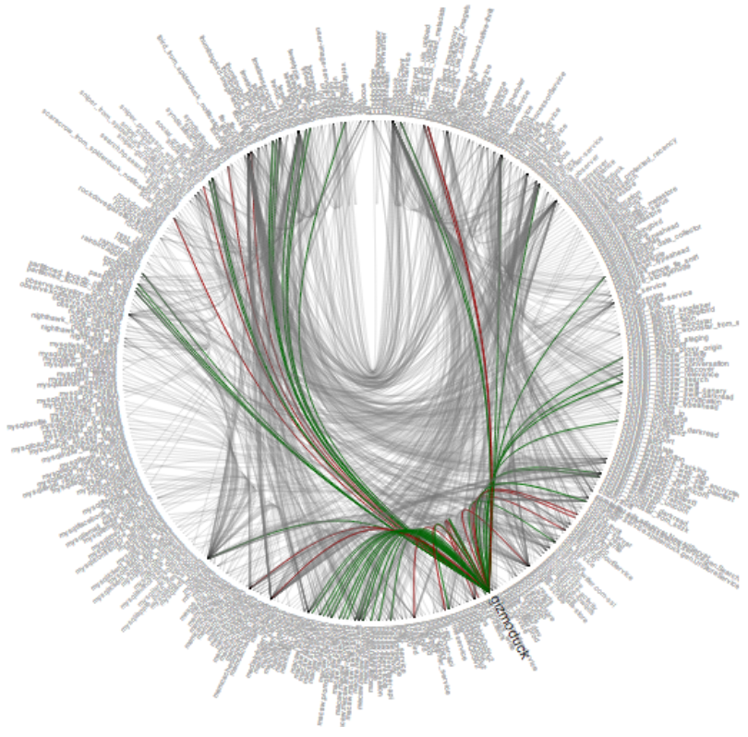
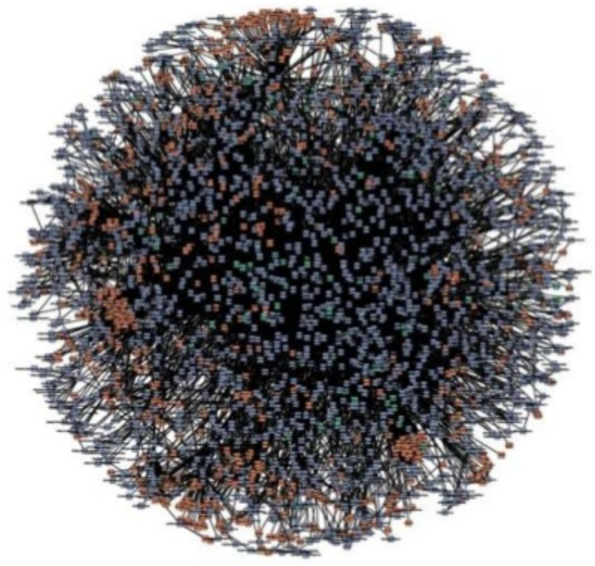
But These are True Microservice Architectures!
Twitter
Amazon Web Service
Complexity moved from application into the network!
Notes:
Szóval a microservice-ek tök jók, de cserébe bonyolult lett a hálózat. Monolith vs. micro.

Slide 9
The Need of Common Features in Service Components
Dynamic service discovery
Load balancing
Health checks
Service B
1
Service A
2
3
Notes:
circuit-breaking, latency-aware load balancing, eventually consistent (“advisory”) service discovery, retries, and deadlines.

Slide 10
The Need of Common Features in Service Components
Dynamic service discovery
Load balancing
Health checks
Timeouts
Retries
Web
timeout = 400ms
retries = 3
User Auth
timeout = 400ms
retries = 2
800ms!
App
timeout = 200ms
retries = 3
600ms!
DB
Notes:
circuit-breaking, latency-aware load balancing, eventually consistent (“advisory”) service discovery, retries, and deadlines.

Slide 11
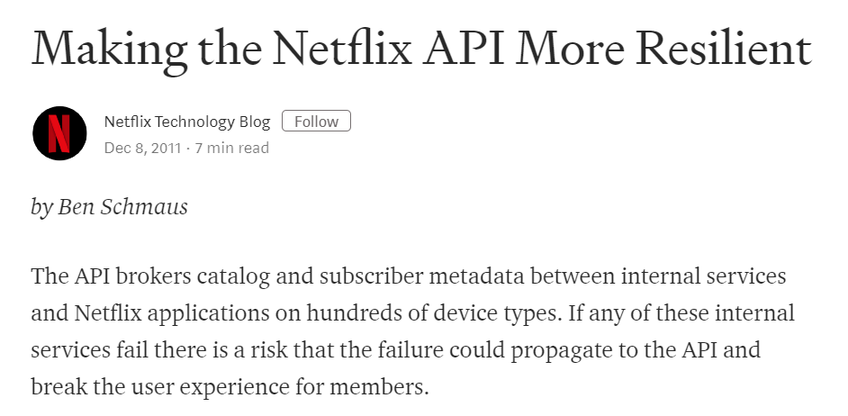
The Need of Common Features in Service Components
Dynamic service discovery
Load balancing
Health checks
Timeouts
Retries
TLS termination
Monitoring and tracing via rich metrics
Fault injection
Circuit breakers
Service B
1
Service A
X
2
3
Notes:
circuit-breaking, latency-aware load balancing, eventually consistent (“advisory”) service discovery, retries, and deadlines.

Slide 12
What is a Service Mesh?
Service Mesh is dedicated infrastructure layer in a microservice environment to consistently manage, monitor and control the communication between services across the entire application
Notes:
A service mesh is a dedicated infrastructure layer for handling service-to-service communication. It’s responsible for the reliable delivery of requests through the complex topology of services that comprise a modern, cloud native application. In practice, the service mesh is typically implemented as an array of lightweight network proxies that are deployed alongside application code, without the application needing to be aware.

Slide 13
Evolution: 1G - Shared Libraries
Examples for such fat libraries:
Hystrix @ Netflix
Stubby @ Google
Finagle @ Twitter
Advantages:
Simple
Customizable
Disadvantages of shared libraries:
Have to be implemented in multiple languages
If the library changes the entire service has to be redeployed
Too tight involvement of dev teams
SVC
Nginx
DB
SVC
Nginx
DB
SVC
Nginx
DB
SVC
SVC
Library
Notes:
Stubby is the basis of gRPC
Finagle is the basis of Linkerd

Slide 14
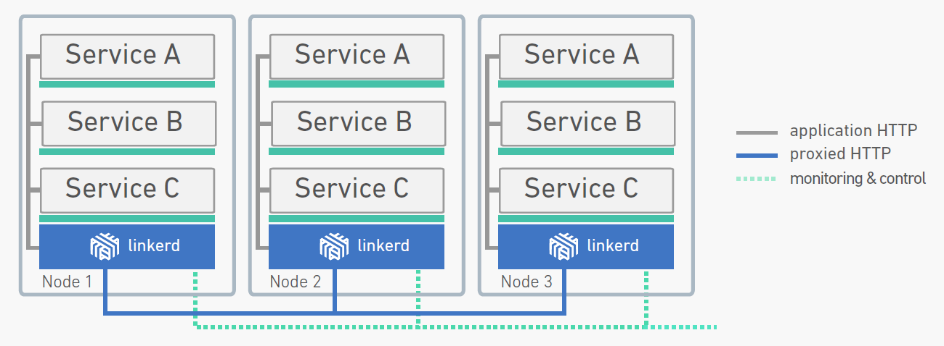
Evolution: 2G - Linkerd
A service mesh that adds reliability, security, and visibility to cloud native applications
Official CNCF Project
Originally created by Buoyant Inc. based on Finagle
Written in JAVA
This is the control plane that programs the individual dataplane proxies
These are the dataplane components (proxies)
namerd
Notes:
Data Plane vs. Control Plane

Slide 15
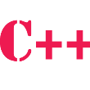
Per-node vs. Sidecar Model
The per-node model and its disadvantages:
Raises security concerns in multi-tenant environments (shared TLS secrets, etc.)
Can only be scaled vertically, not horizontally (more memory and CPU handle more conns.)
Not optimized for container workloads
The sidecar model:
Put a proxy next to every container
This is supported by the POD abstraction in Kubernetes
Linkerd is considered to be too heavy for such environment!
Proxy
Proxy
Proxy
Proxy
Proxy
Proxy
Proxy
Proxy
Proxy
Proxy
Proxy
Proxy
Node 1
Node 2
Node 3
Notes:
Data Plane vs. Control Plane

Slide 16
Evolution: 3G - Service Meshes
Linkerd2 (Conduit):
Specifically designed for Kubernetes: control plane is written in Go
Data plane is written in Rust: fast and lightweight to sidecar operations (~5MB container size)
Can be deployed service-by-service (it’s not an all-or-nothing choice…)
Envoy
Open source edge and service proxy, designed for cloud-native applications
Official CNCF Project, originally created by Lyft
Written in C++, built on the learnings of solutions as NGINX, HAProxy, hardware LBs and cloud LBs
Istio
Service mesh control plane which uses Envoy as data plane
Originally created by Google and IBM
Written in GO
Notes:
Most akkor linkerd2 vagy conduit?
- Linkerd nem opensource? Conduit?
Rust is a systems programming language that runs blazingly fast, prevents segfaults, and guarantees thread safety.
Featuring
zero-cost abstractions
move semantics
guaranteed memory safety
threads without data races
trait-based generics
pattern matching
type inference
minimal runtime
efficient C bindings

Slide 17
Examples: routing
Service B
Service B1.1
1
1
User-agent: Android
2
Service A
2
Service A
95%
Current version
3
3
5%
User-agent: iPhone
Service C
Service B1.2
4
4
Canary version
Service A
Service B
TCP 8080
/api/v1/t-shirts GET
/api/v1/t-shirts PUT
/api/v1/jeans *
1000/day
Notes:
The core component used for traffic management in Istio is Pilot, which manages and configures all the Envoy proxy instances deployed in a particular Istio service mesh. Pilot lets you specify which rules you want to use to route traffic between Envoy proxies and configure failure recovery features such as timeouts, retries, and circuit breakers. It also maintains a canonical model of all the services in the mesh and uses this model to let Envoy instances know about the other Envoy instances in the mesh via its discovery service.
Each Envoy instance maintains load balancing information based on the information it gets from Pilot and periodic health-checks of other instances in its load-balancing pool, allowing it to intelligently distribute traffic between destination instances while following its specified routing rules.
Pilot is responsible for the lifecycle of Envoy instances deployed across the Istio service mesh.
As shown in the figure above, Pilot maintains a canonical representation of services in the mesh that is independent of the underlying platform. Platform-specific adapters in Pilot are responsible for populating this canonical model appropriately. For example, the Kubernetes adapter in Pilot implements the necessary controllers to watch the Kubernetes API server for changes to the pod registration information, ingress resources, and third-party resources that store traffic management rules. This data is translated into the canonical representation. An Envoy-specific configuration is then generated based on the canonical representation.
Pilot enables service discovery, dynamic updates to load balancing pools and routing tables.
You can specify high-level traffic management rules through Pilot’s Rule configuration. These rules are translated into low-level configurations and distributed to Envoy instances.

Slide 18
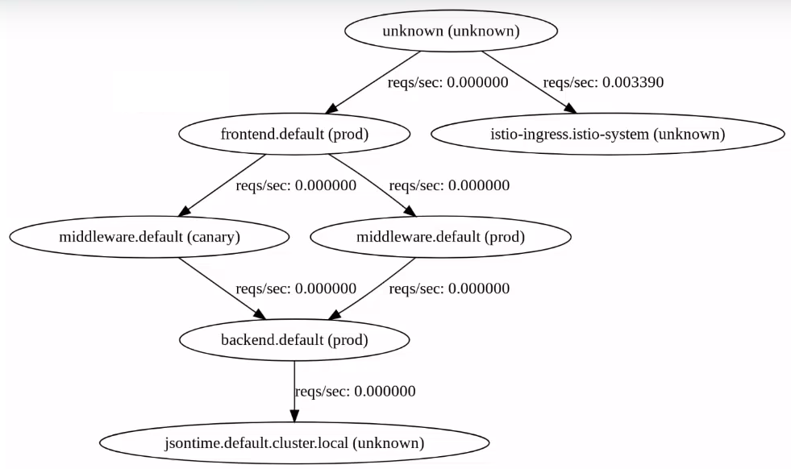
Examples: visibility
Notes:
The core component used for traffic management in Istio is Pilot, which manages and configures all the Envoy proxy instances deployed in a particular Istio service mesh. Pilot lets you specify which rules you want to use to route traffic between Envoy proxies and configure failure recovery features such as timeouts, retries, and circuit breakers. It also maintains a canonical model of all the services in the mesh and uses this model to let Envoy instances know about the other Envoy instances in the mesh via its discovery service.
Each Envoy instance maintains load balancing information based on the information it gets from Pilot and periodic health-checks of other instances in its load-balancing pool, allowing it to intelligently distribute traffic between destination instances while following its specified routing rules.
Pilot is responsible for the lifecycle of Envoy instances deployed across the Istio service mesh.
As shown in the figure above, Pilot maintains a canonical representation of services in the mesh that is independent of the underlying platform. Platform-specific adapters in Pilot are responsible for populating this canonical model appropriately. For example, the Kubernetes adapter in Pilot implements the necessary controllers to watch the Kubernetes API server for changes to the pod registration information, ingress resources, and third-party resources that store traffic management rules. This data is translated into the canonical representation. An Envoy-specific configuration is then generated based on the canonical representation.
Pilot enables service discovery, dynamic updates to load balancing pools and routing tables.
You can specify high-level traffic management rules through Pilot’s Rule configuration. These rules are translated into low-level configurations and distributed to Envoy instances.

Slide 19
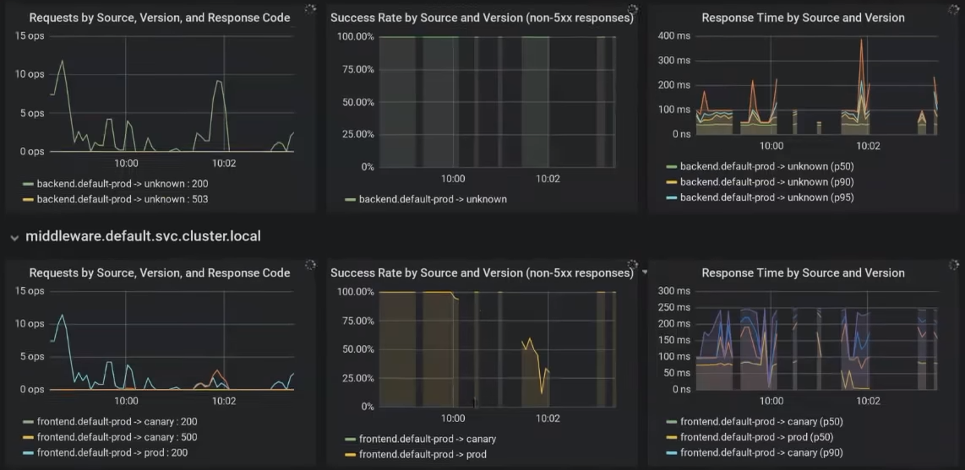
Examples: visibility
Notes:
The core component used for traffic management in Istio is Pilot, which manages and configures all the Envoy proxy instances deployed in a particular Istio service mesh. Pilot lets you specify which rules you want to use to route traffic between Envoy proxies and configure failure recovery features such as timeouts, retries, and circuit breakers. It also maintains a canonical model of all the services in the mesh and uses this model to let Envoy instances know about the other Envoy instances in the mesh via its discovery service.
Each Envoy instance maintains load balancing information based on the information it gets from Pilot and periodic health-checks of other instances in its load-balancing pool, allowing it to intelligently distribute traffic between destination instances while following its specified routing rules.
Pilot is responsible for the lifecycle of Envoy instances deployed across the Istio service mesh.
As shown in the figure above, Pilot maintains a canonical representation of services in the mesh that is independent of the underlying platform. Platform-specific adapters in Pilot are responsible for populating this canonical model appropriately. For example, the Kubernetes adapter in Pilot implements the necessary controllers to watch the Kubernetes API server for changes to the pod registration information, ingress resources, and third-party resources that store traffic management rules. This data is translated into the canonical representation. An Envoy-specific configuration is then generated based on the canonical representation.
Pilot enables service discovery, dynamic updates to load balancing pools and routing tables.
You can specify high-level traffic management rules through Pilot’s Rule configuration. These rules are translated into low-level configurations and distributed to Envoy instances.

