Slide 1
Open Source
Friend or Enemy?

Slide 3
Agenda
What is open source
Open source software licenses
OSS Compliance
Examples and interesting cases

Slide 4
Basics
Definition by the Open Source Initiative
Use, distribute, modify

Slide 5
Basic rights
Retain copyright
Display
Perform
Copy
Modify
Distribute
Sublicense

Slide 6
Copyright
Immediate legal right
Exclusive to the author
Protects the author
Copyleft
Protects the user
Hereditary or viral effect
Strong and weak

Slide 7
Categories
Permissive Licenses
Restrictive Licenses
MIT License
BSD License
Apache License
General Public License
Mozilla Public License
Eclipse Public License

Slide 8
OSS Compliance

Slide 9
License file Libraries Source code Incompatibilities

Slide 10
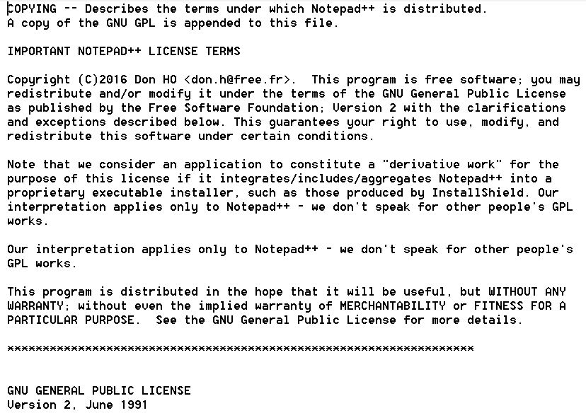
Example
Notepad++ 7.6

Slide 11
Not being compliant might result in lawsuits

Slide 12
Advice and best practices
Evaluate the applicability of licenses
Know your components
Build of your source code
Analysis - tools
Monitor the software that you use
Contact with team
License requirements
Track changes and releases
Up to date
Licensing of software releases
Communication
Consult your legal team when in doubt

Slide 13
Examples
Linux Kernel v4.4
1900 licenses, 1600 copyrights and 5200 files (identified with a customized tool based on FOSSology); (multiple “not for commercial” use licenses found)
Trade secret of Emagic, and which may not be reproduced, used, sold or transferred to any third party without Emagic's written consent
It can be used under the terms of the license that comes along with PC/FlexNet
May not be reproduced, used, sold or transferred to any third party without FORE's prior written consent
For use only on Windows operating systems

Slide 14
Examples
Pillow 2.3.0
\PIL\GimpGradientFile.py
Code was taken from GIMP component - licensed under GPL
The author, Federico Mena Quintero, agreed for the code to be relicensed under PIL License for use in Pillow
The relicensing was made after we pointed the error to the author of the file
For more information, see https://github.com/python-pillow/Pillow/issues/2353

Slide 15
Patrick’s case
Copyright infringement
Patrick McHardy
Author at Linux - Netfilter utility in the Linux Kernel component
Monitoring of authors who did not respect the requierements of the GPL – retaining his copyright
Lawsuit threats: ≈50
Agreements outside of court

Slide 16
Thank you!
P.S.: Read the terms and conditions ☺

Slide 17
Sources
Images:
https://iwastesomuchtime.com/52556
https://slp.somerset.org.uk/sites/infrastructure/SitePages/officeproplus.aspx
https://github.com/
https://sourceforge.net/
https://maven.apache.org/
https://yourstory.com/2015/06/tds-laws/
Information:
https://opensource.org/
https://www.blackducksoftware.com/
https://opensource.com/article/17/8/patrick-mchardy-and-copyright-profiteering
https://www.linux.org/
https://www.softwarefreedom.org/resources/2014/SFLC-Guide_to_GPL_Compliance_2d_ed.html#copyright-and-copyleft
Years and years of experience!

