Slide 1
DISTRACTED DRIVING KILLS
9 people a day
3,500 people a year
Injures 390,000 a year
In the US alone
https://www.nhtsa.gov/distracted-driving/distracted-driving-kills

Slide 2
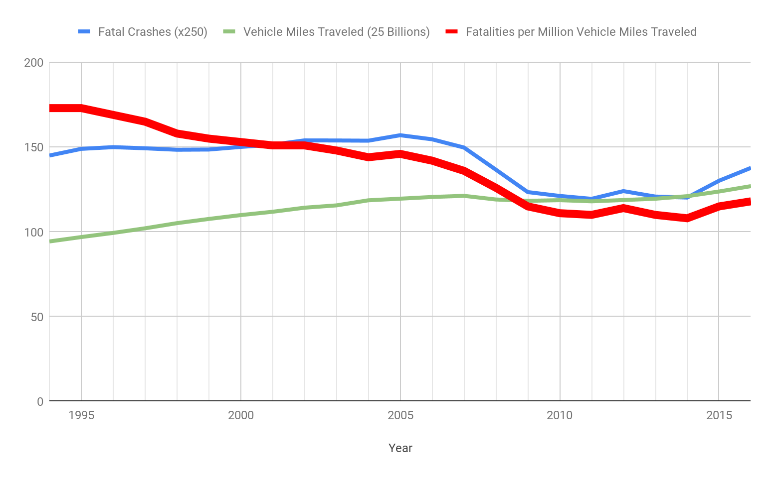
AND IT’S GETTING WORSE
https://www-fars.nhtsa.dot.gov/Main/index.aspx

Slide 3
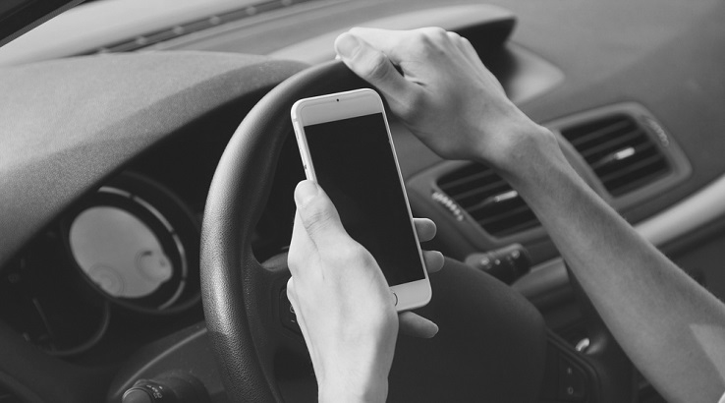
ARE YOU DISTRACTED?
Distraction
Phone Use
Phone Calls
Active Use
Passive Use
Handheld
Handsfree

Slide 4
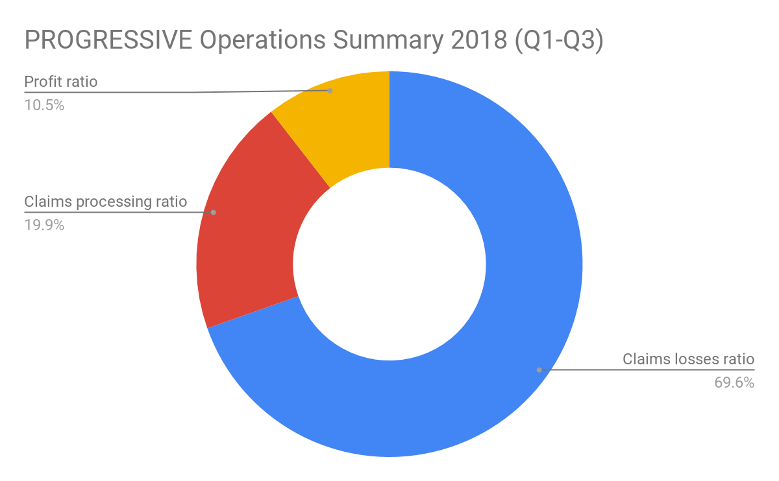
IMPACT ON BUSINESS = OPPORTUNITY
UBI
Risk profiling
Data driven pricing
Behavior modification
CLAIMS
Investigate crashes
Submit claims, Prefill FNOL
ENGAGEMENT
Increase retention
Reduce distracted driving
COST EFFICIENCIES
http://media.corporate-ir.net/media_files/IROL/81/81824/qInter/2018/18Q3/operations.html

Slide 5
CUSTOMER EXPECTATIONS = OPPORTUNITY
Breakdown services
Repair shop discounts
Safe driving alerts
Safe driving rewards
Theft and damage alerts

Slide 6
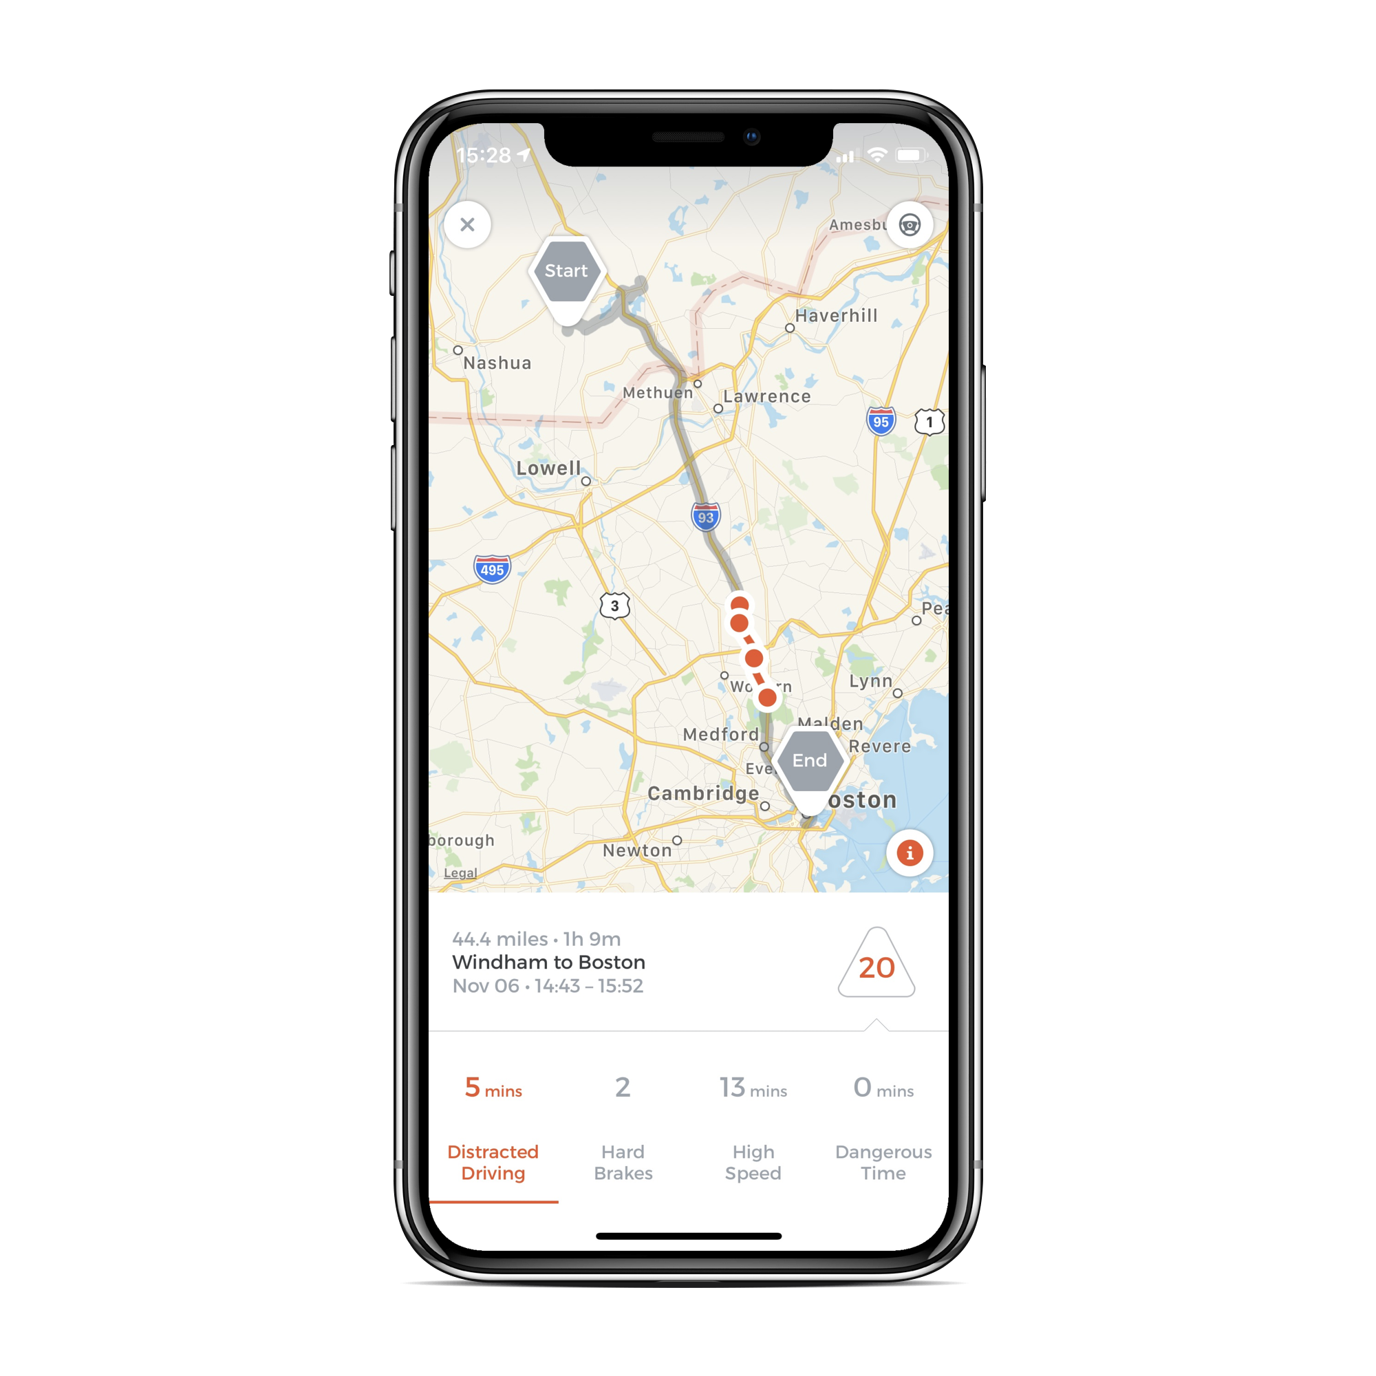
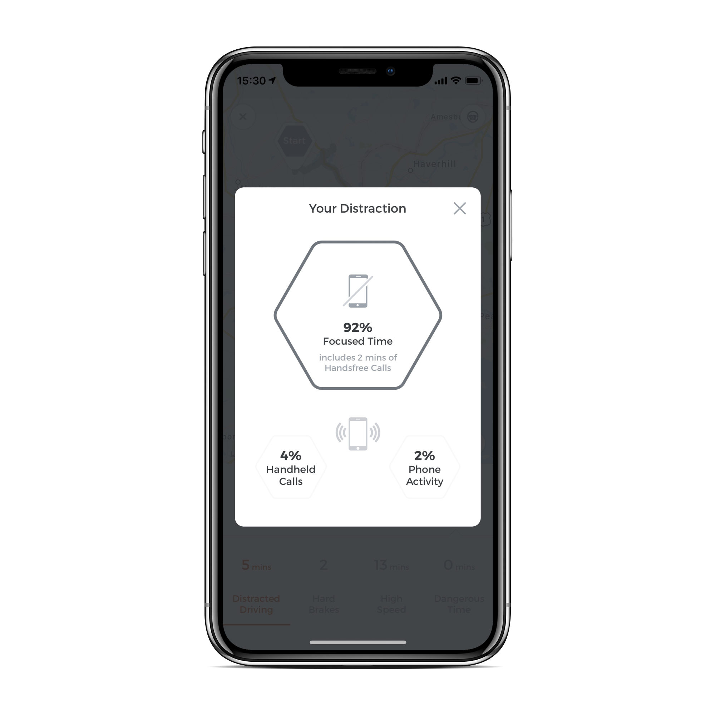
DRIVING DATA ENABLES NEXT-GEN INSURANCE
Machine Learning at the core
Contextualizes raw sensor data
GPS
Gyro, Mag, Accelerometer
Barometer
Identifies
Trips
MOT, Driver
Events
Already processed 110TB data!

Slide 7
DRIVING DATA ENABLES NEXT-GEN INSURANCE
Ride Sharing Indicator
Fraud Indicators
Crash Notification
Pre-fill FNOL
Engagement
Garaging Data
Driver
Coaching
Distraction Data
Lead Generation
Reward Programs
UBI

Slide 8
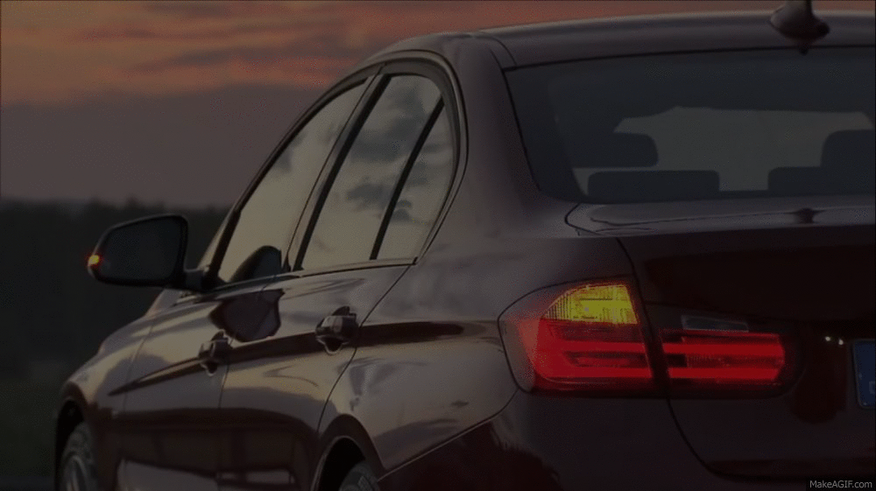
TELEMETRY + ML
Makes people safer drivers and saves lives!
Transforms insurance companies into profitable, big data (driven) businesses
Our solution in production at 11 out of TOP 20 US auto insurers

Slide 9
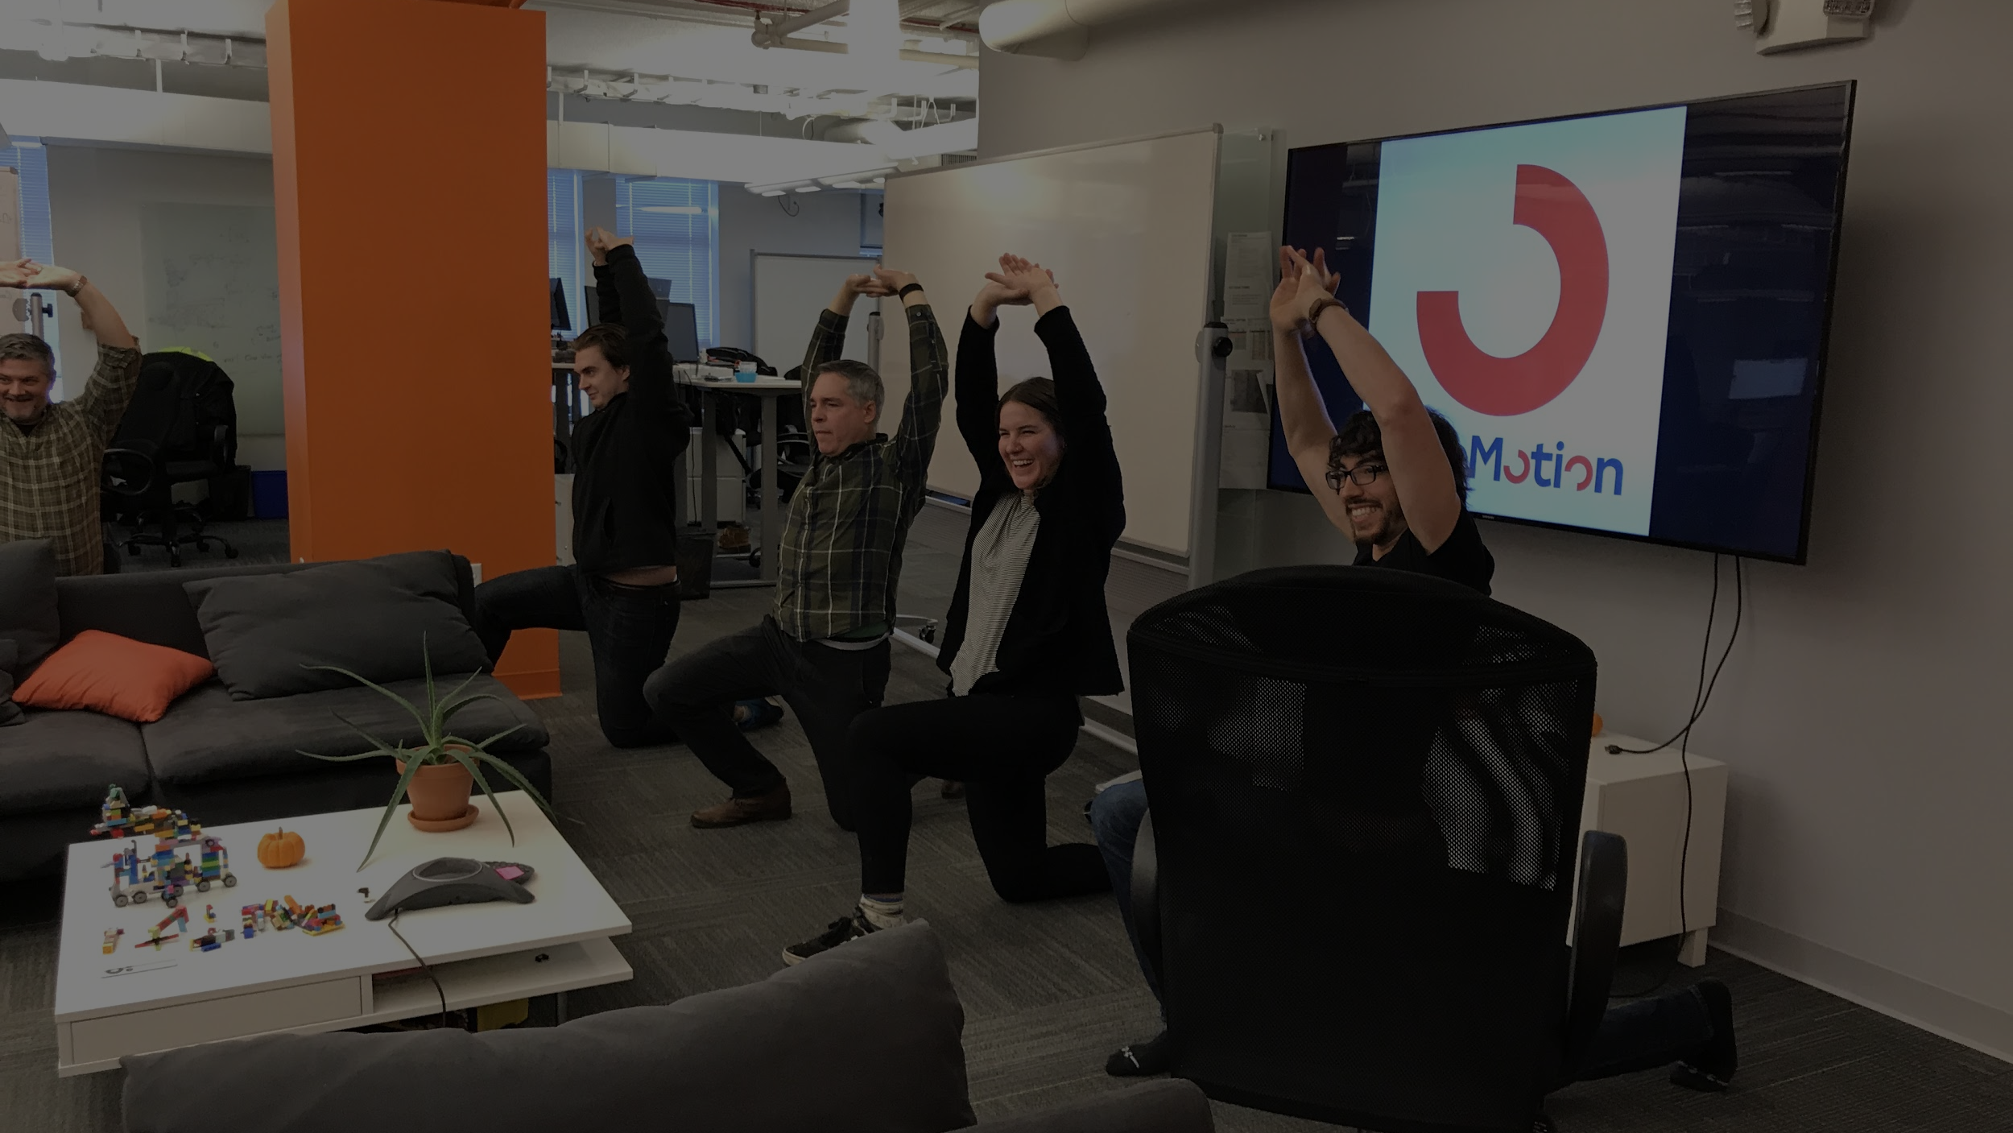
We are hiring!
hello@gotruemotion.com

