Slide 1
Future of Work:
What if there wouldn’t be any bosses?
Enikő Balint, 21.11.2018, Budapest HWSW Mobile 2018
Notes:
Start with a fable: https://josephnoone.com/2010/05/08/the-lion-and-the-ant-some-lessons-for-managers-and-hr/

Slide 4
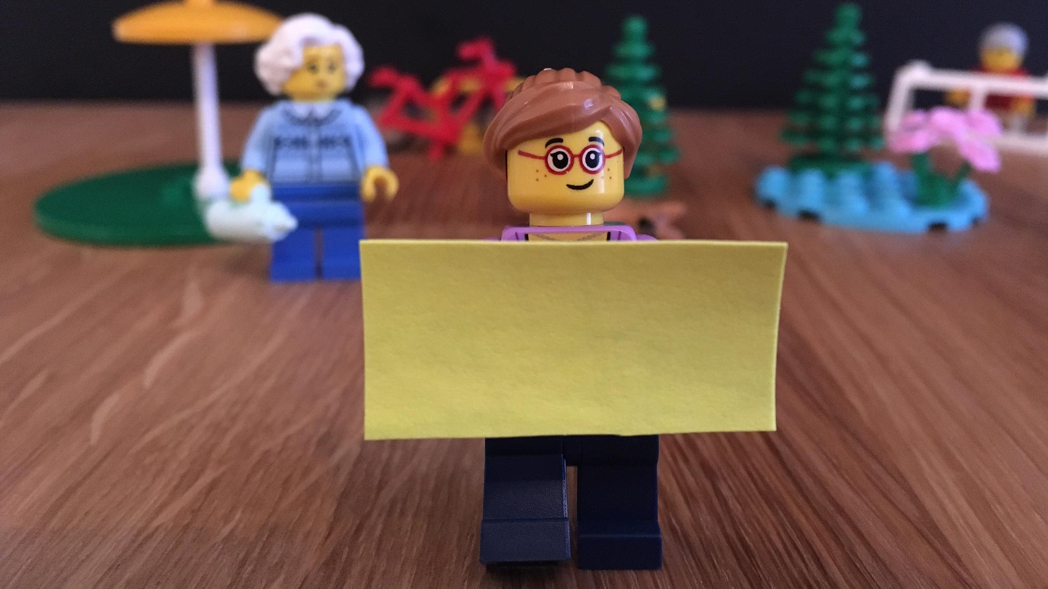
Creativity

Slide 5
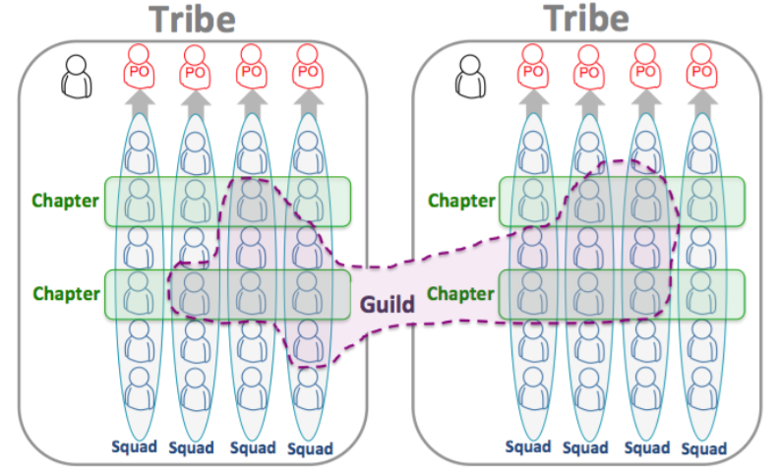
Scaling Agile at Spotify
Henrik Kniberg &
Anders Ivarsson
October 2012

Slide 6
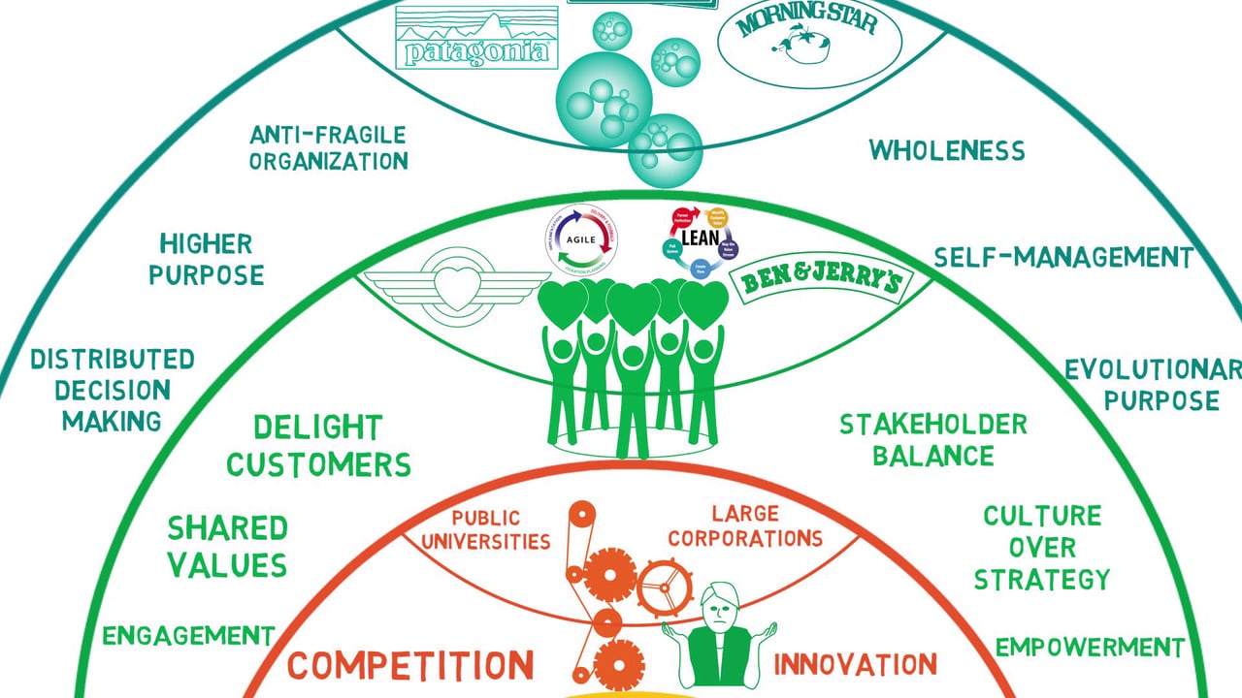

Slide 7
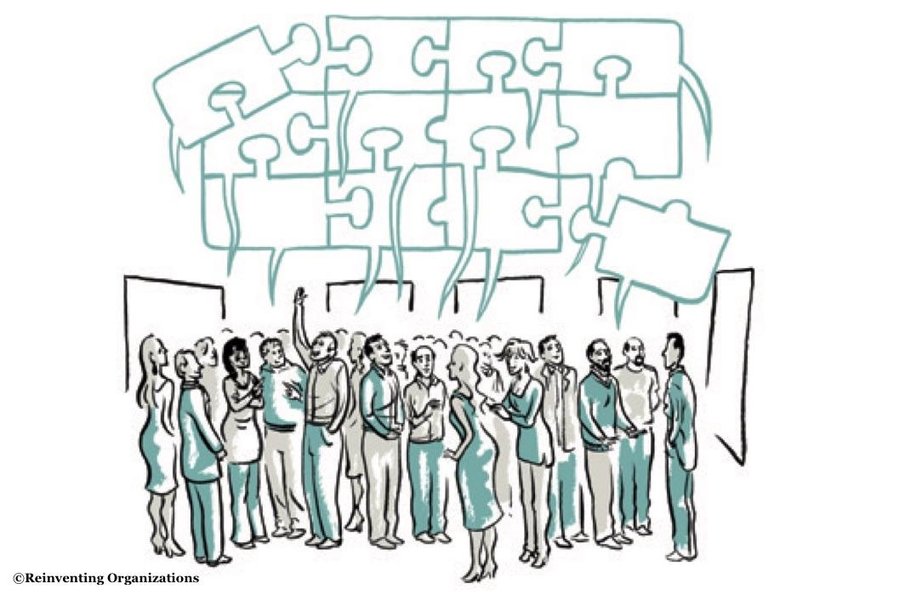

Slide 8
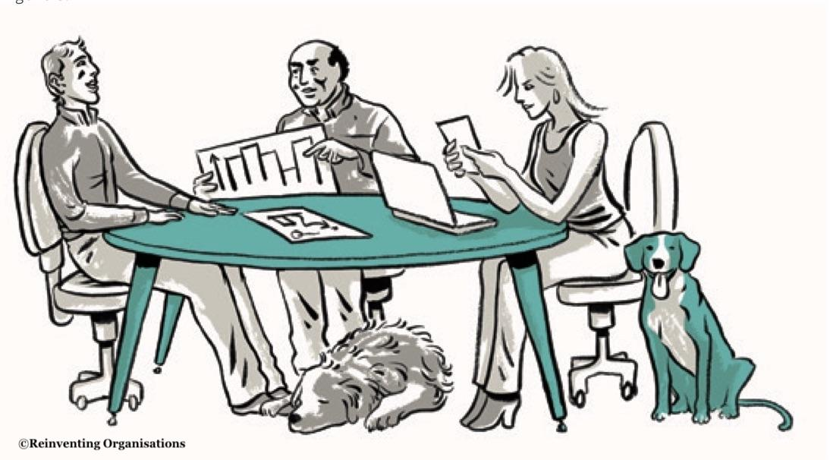

Slide 9
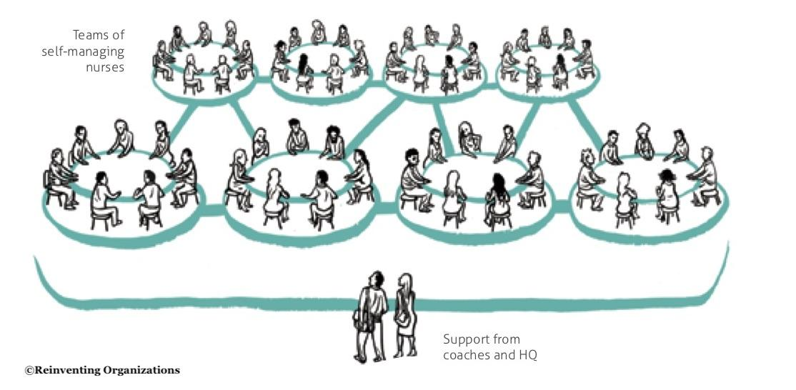

Slide 10
Learn
Notes:
Learn about it:
Read the book Reinventing organizations
Learn from peer and like minded companies
Go to conferences, for example Freiräume in Graz

Slide 11
Experiment
Notes:
Embrace failure as a learning opportunity
MailPoet example 4 day workweek

Slide 12
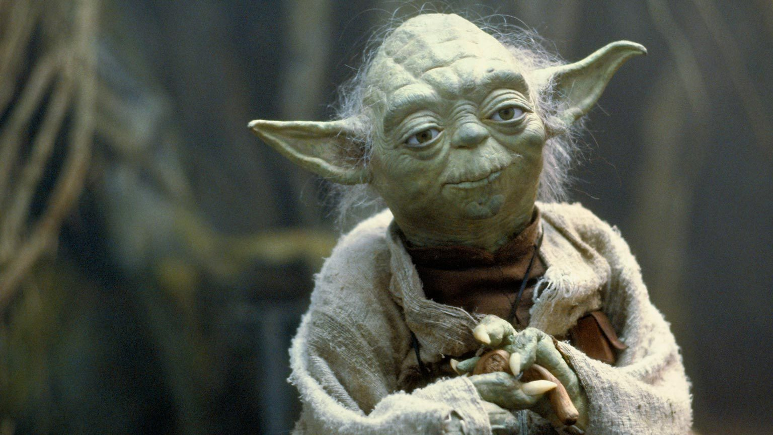
Get a mentor
Notes:
Find somebody, who have done it to guide you through the process
Or ask us anytime ;)

Slide 13
www.be-teal.com
solve complex problems
supportive CEO
creative solutions
Prerequisites of teal
mature team
agile mindset
MAIL info@be-teal.com
facebook.com/betealinnovation
linkedin.com/beteal

Slide 14
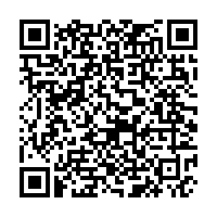
www.be-teal.com
Future of Work Meetup:
How new organizational
structures change how
we work?
MAIL info@be-teal.com
facebook.com/betealinnovation
linkedin.com/beteal

Slide 15
www.be-teal.com
Drop me a line, let’s talk
Enikö Bálint
Organisational Coach
+43.680.312.90.20.
eni@be-teal.com
MAIL info@be-teal.com
facebook.com/betealinnovation
linkedin.com/beteal

