Slide 1
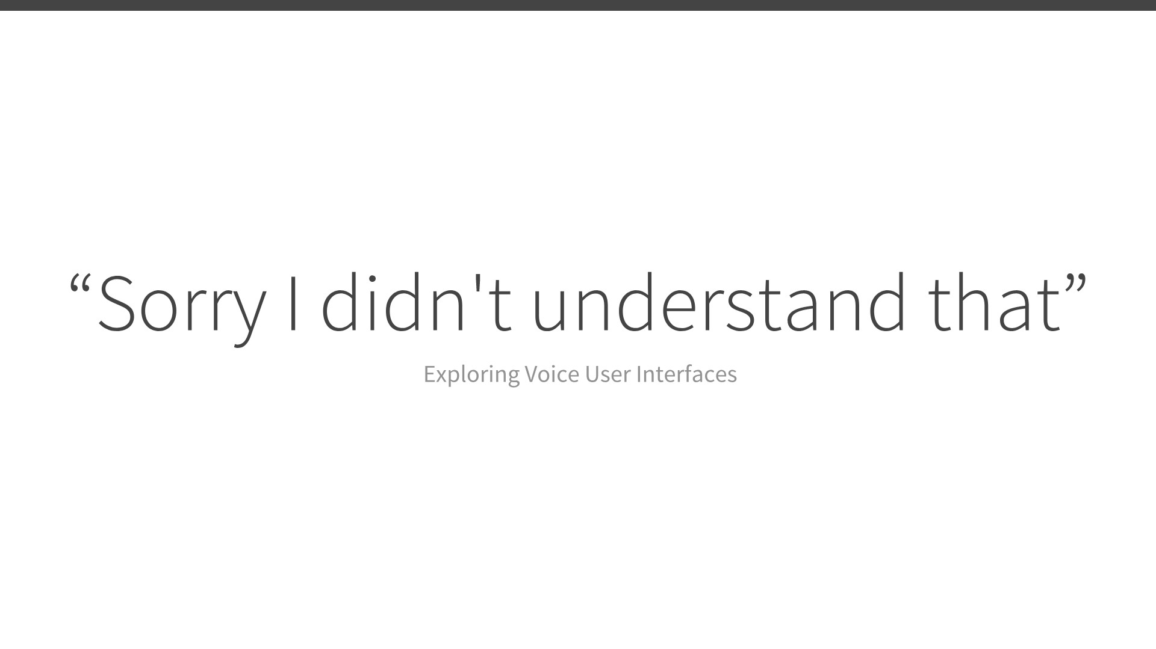

Slide 2
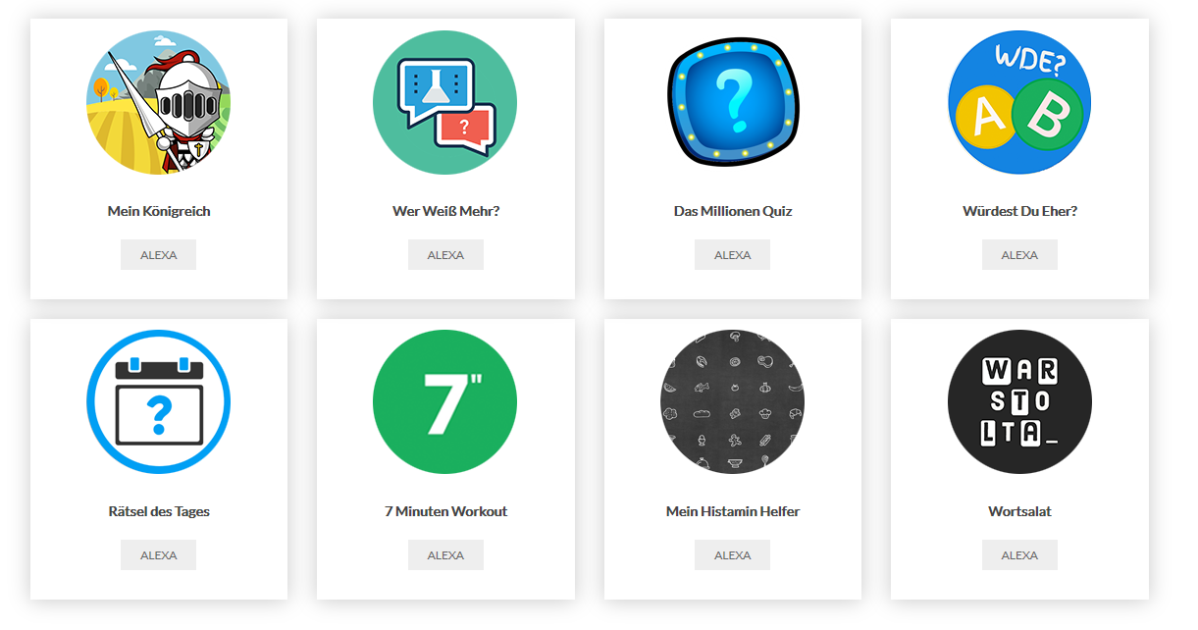
Roland Tiefenbrunner
Voice App Developer
Notes:
And that is what I am going to talk about now: explaining voice apps and the current status quo

Slide 3
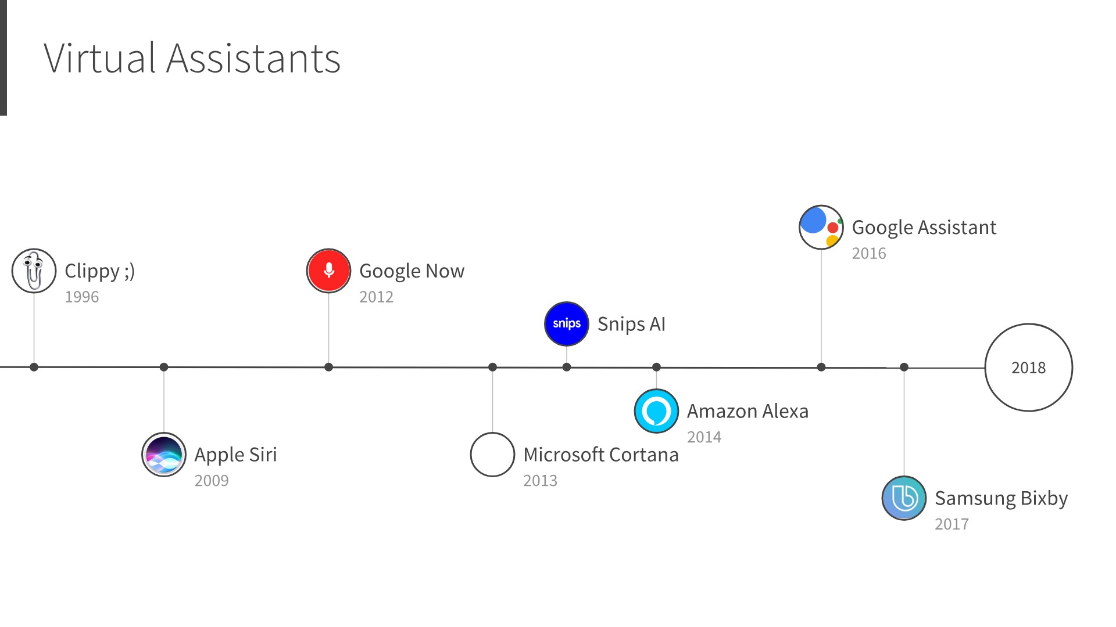

Notes:
A virtual assistant or intelligent personal assistant is a software agent that can perform tasks or services for an individual.
Siri voice interface:
Set a timer
Call someone

Slide 4
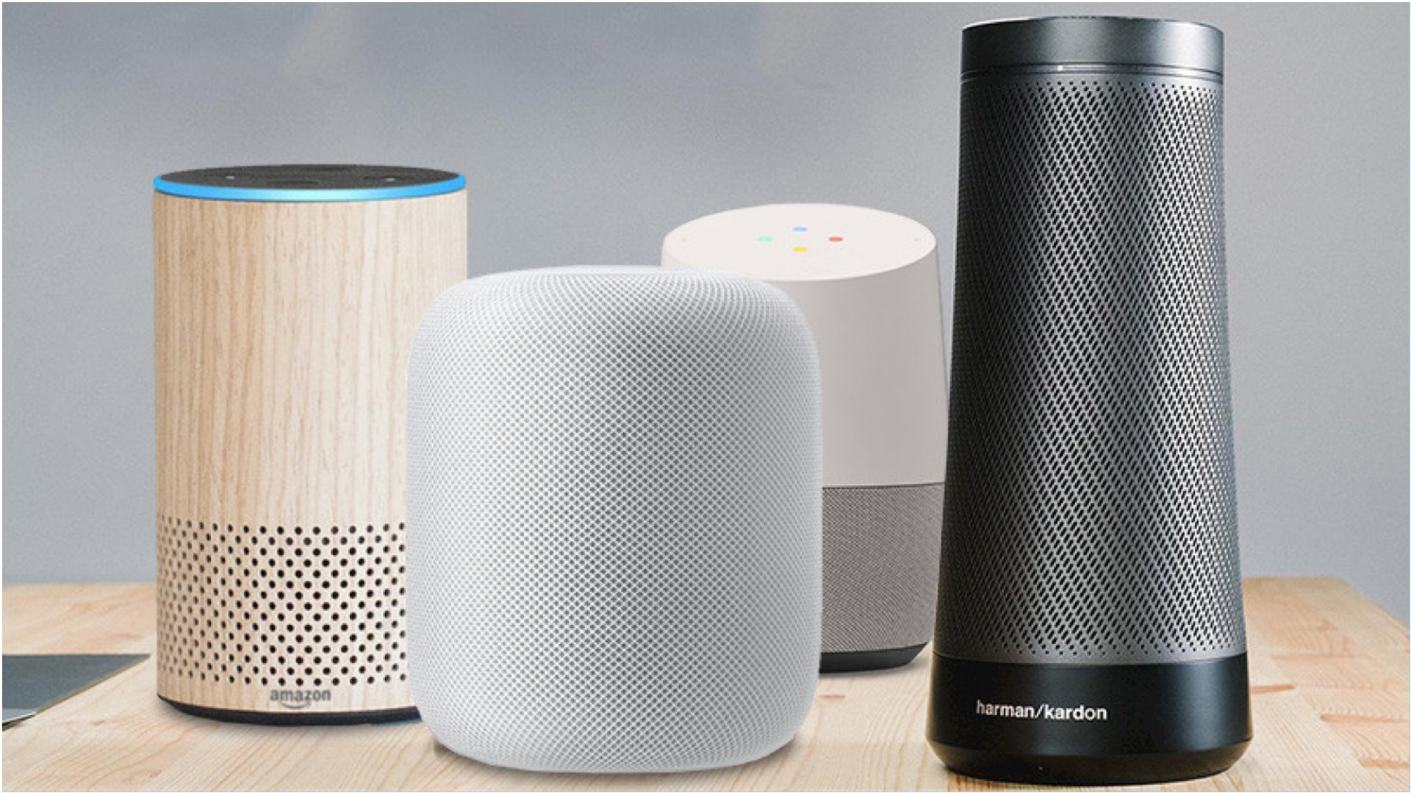
Notes:
bold move from amazon – dedicated device for your home
Basically a speaker you can talk to
after amazon many joined

Slide 5
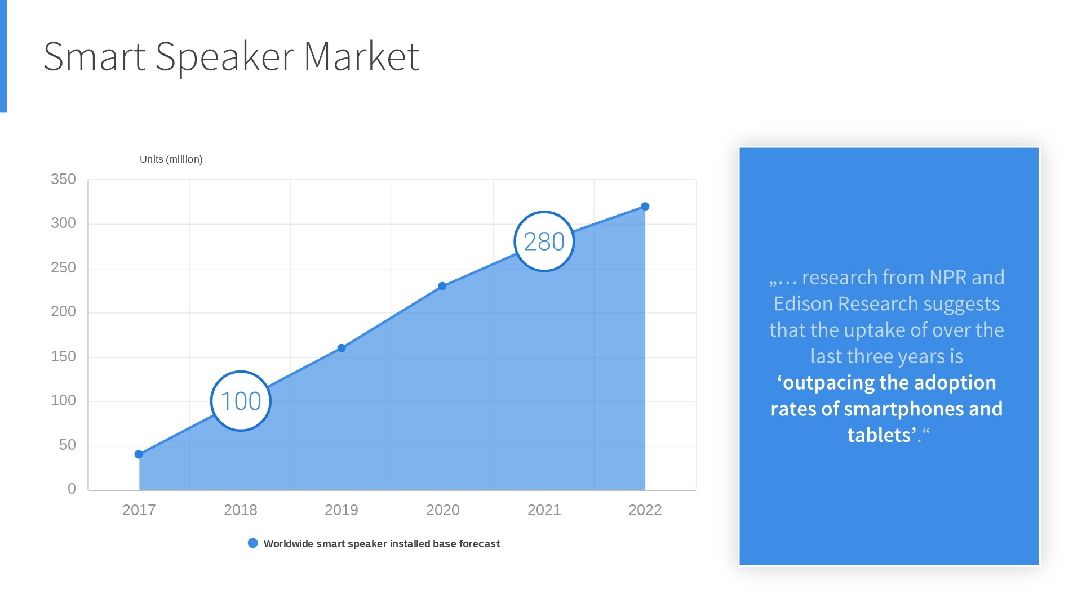

Slide 6
User Base
“Would You Rather“ Alexa Skill

Slide 7
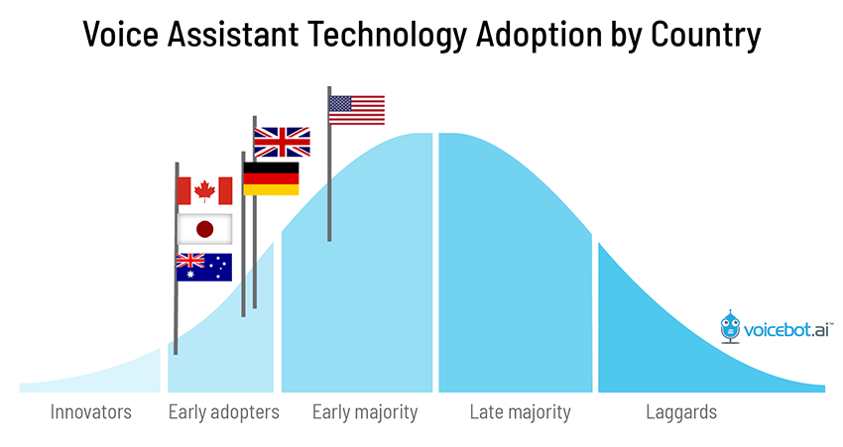
Notes:
Supported languagegs by google and amazon
Supported countries

Slide 8
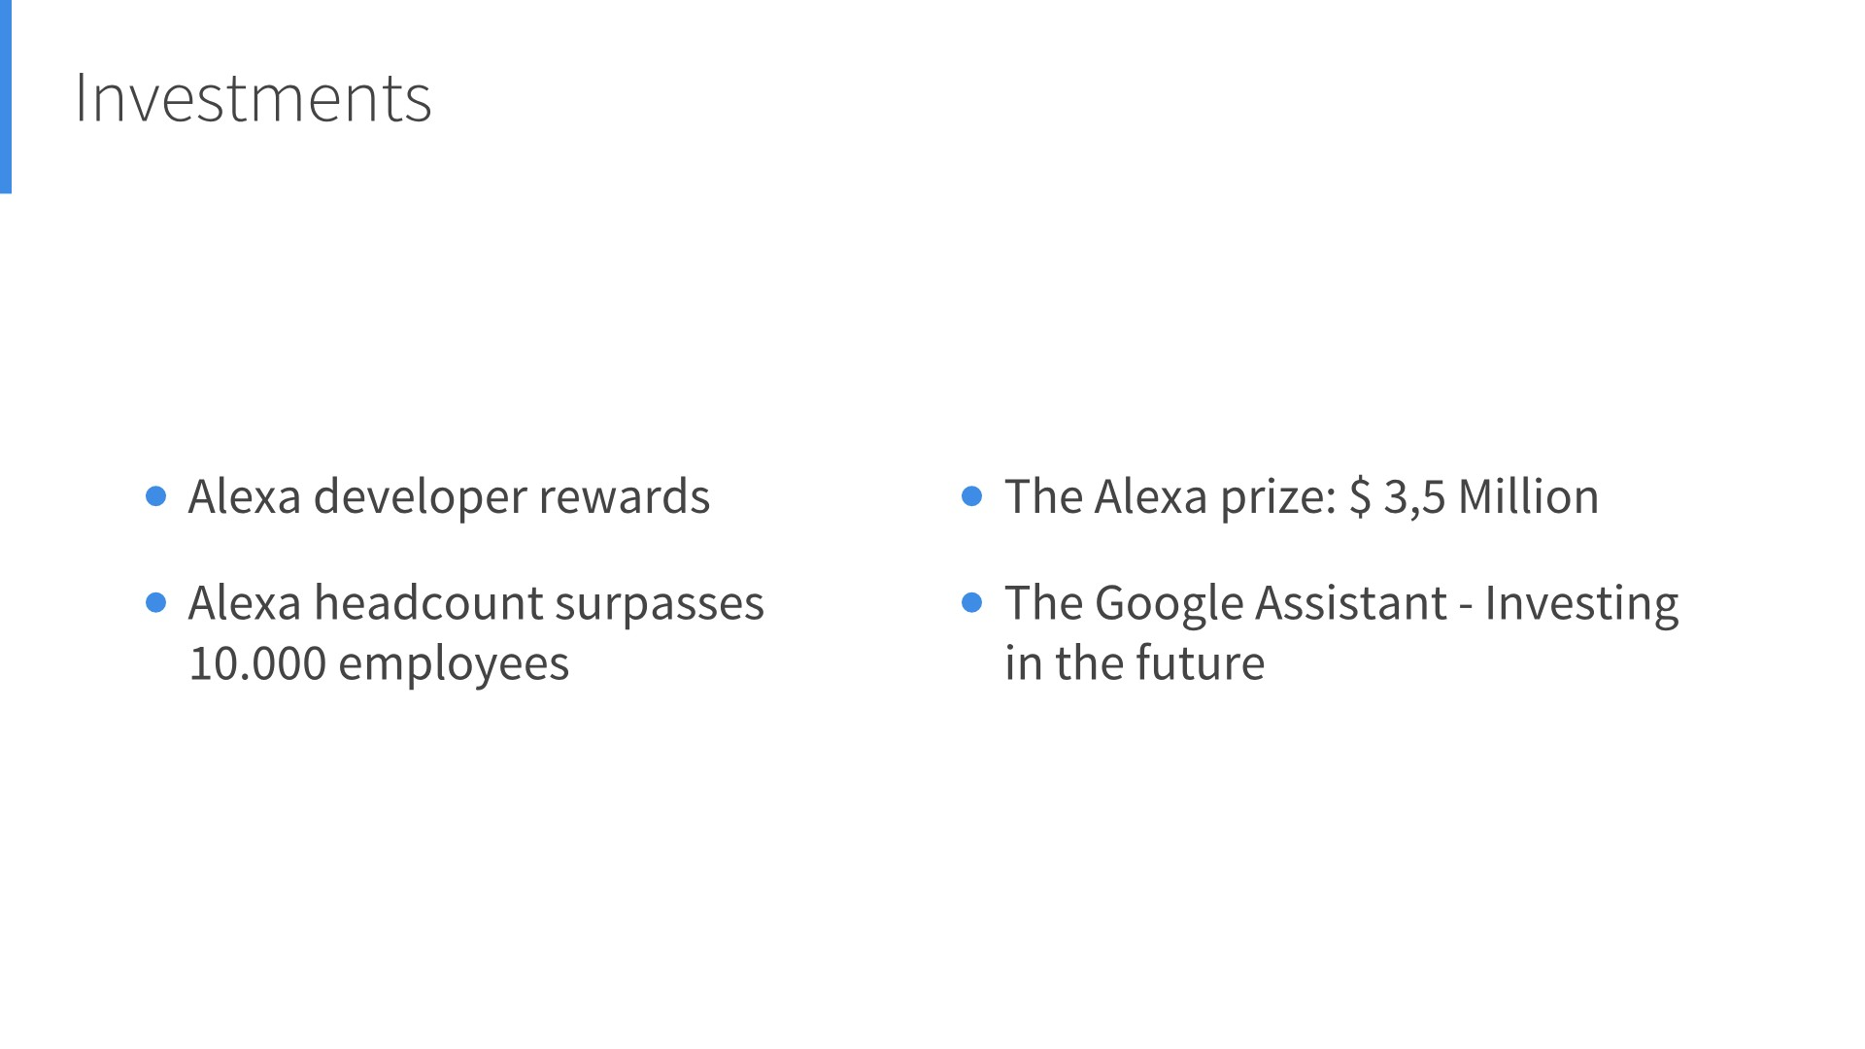

Slide 9
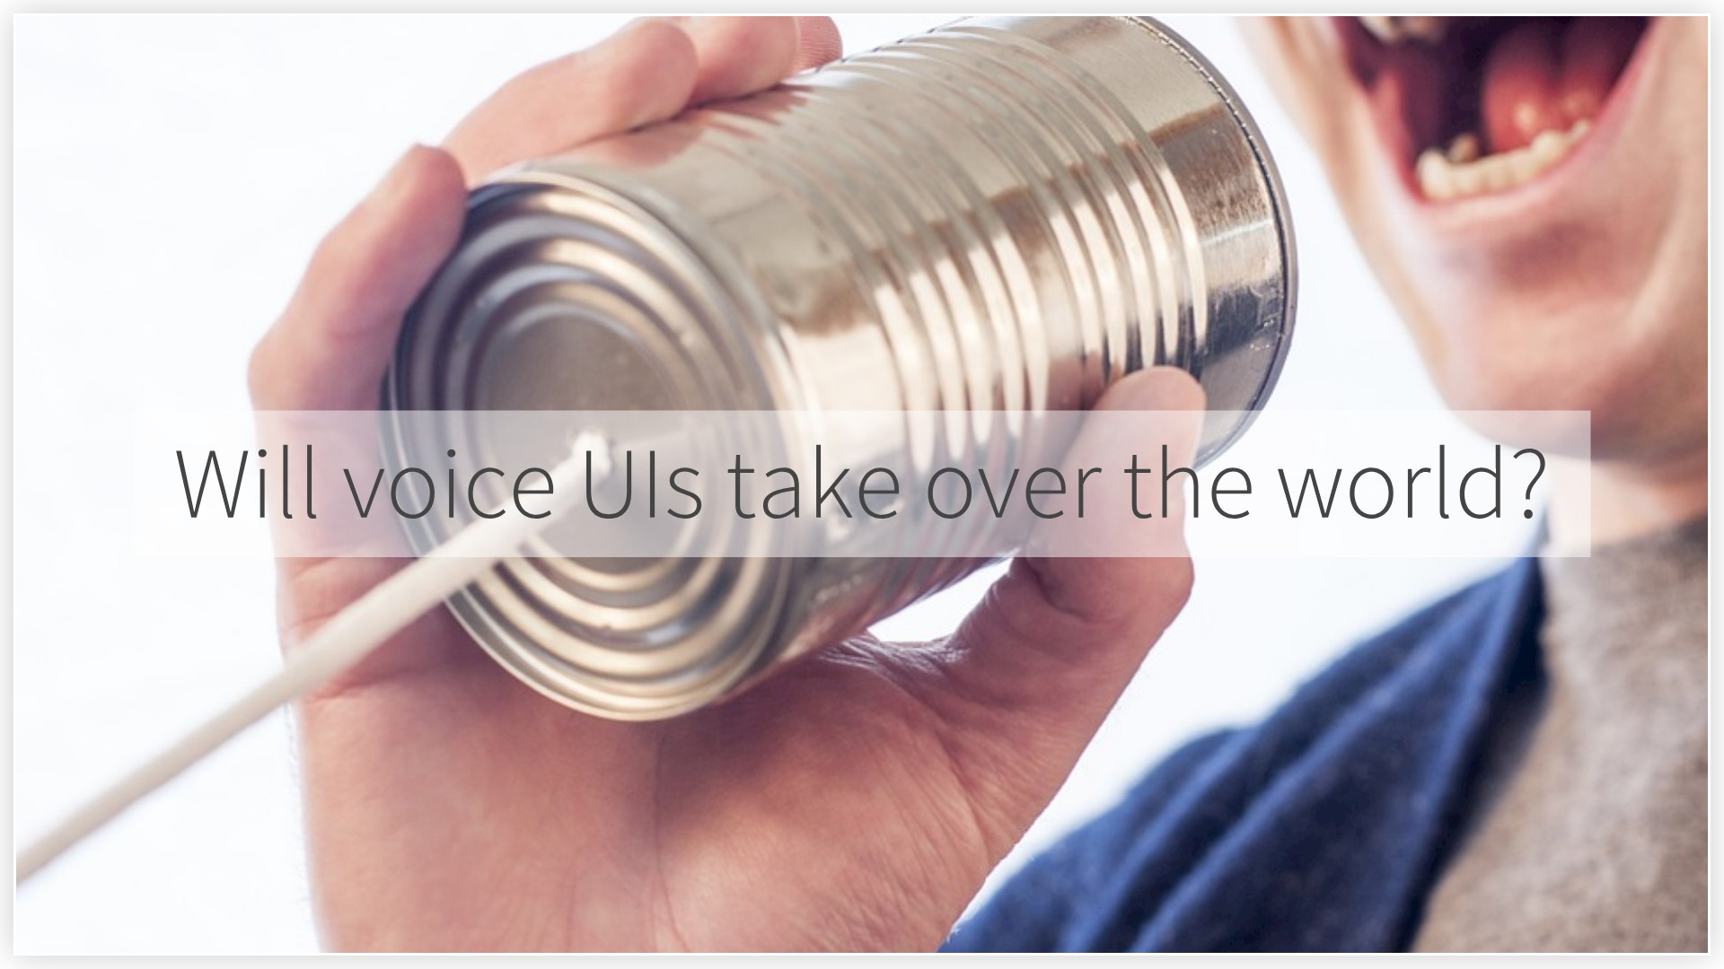

Slide 10
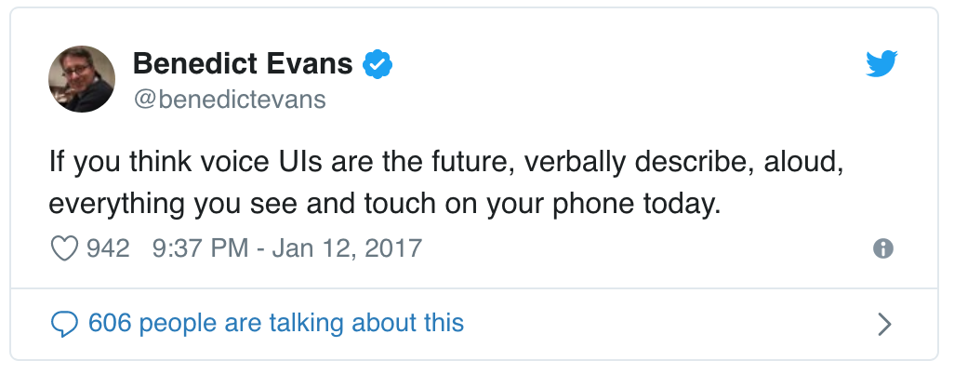
Notes:
https://www.intercom.com/blog/benefits-of-voice-ui/
Smart speaker: device i can talk to vs. Smart assistant

Slide 11
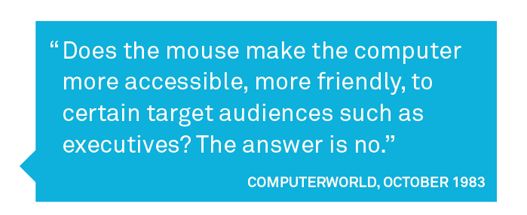
Notes:
https://www.intercom.com/blog/benefits-of-voice-ui/
Smart speaker: device i can talk to vs. Smart assistant

Slide 12
Notes:
Not replacing screens => multi modal
Great as an input – if you are specifc (current state – maybe if it improves, also good for being vage like a sales person)
Output is rather bad – low bandwith – how much information can you submit

Slide 13
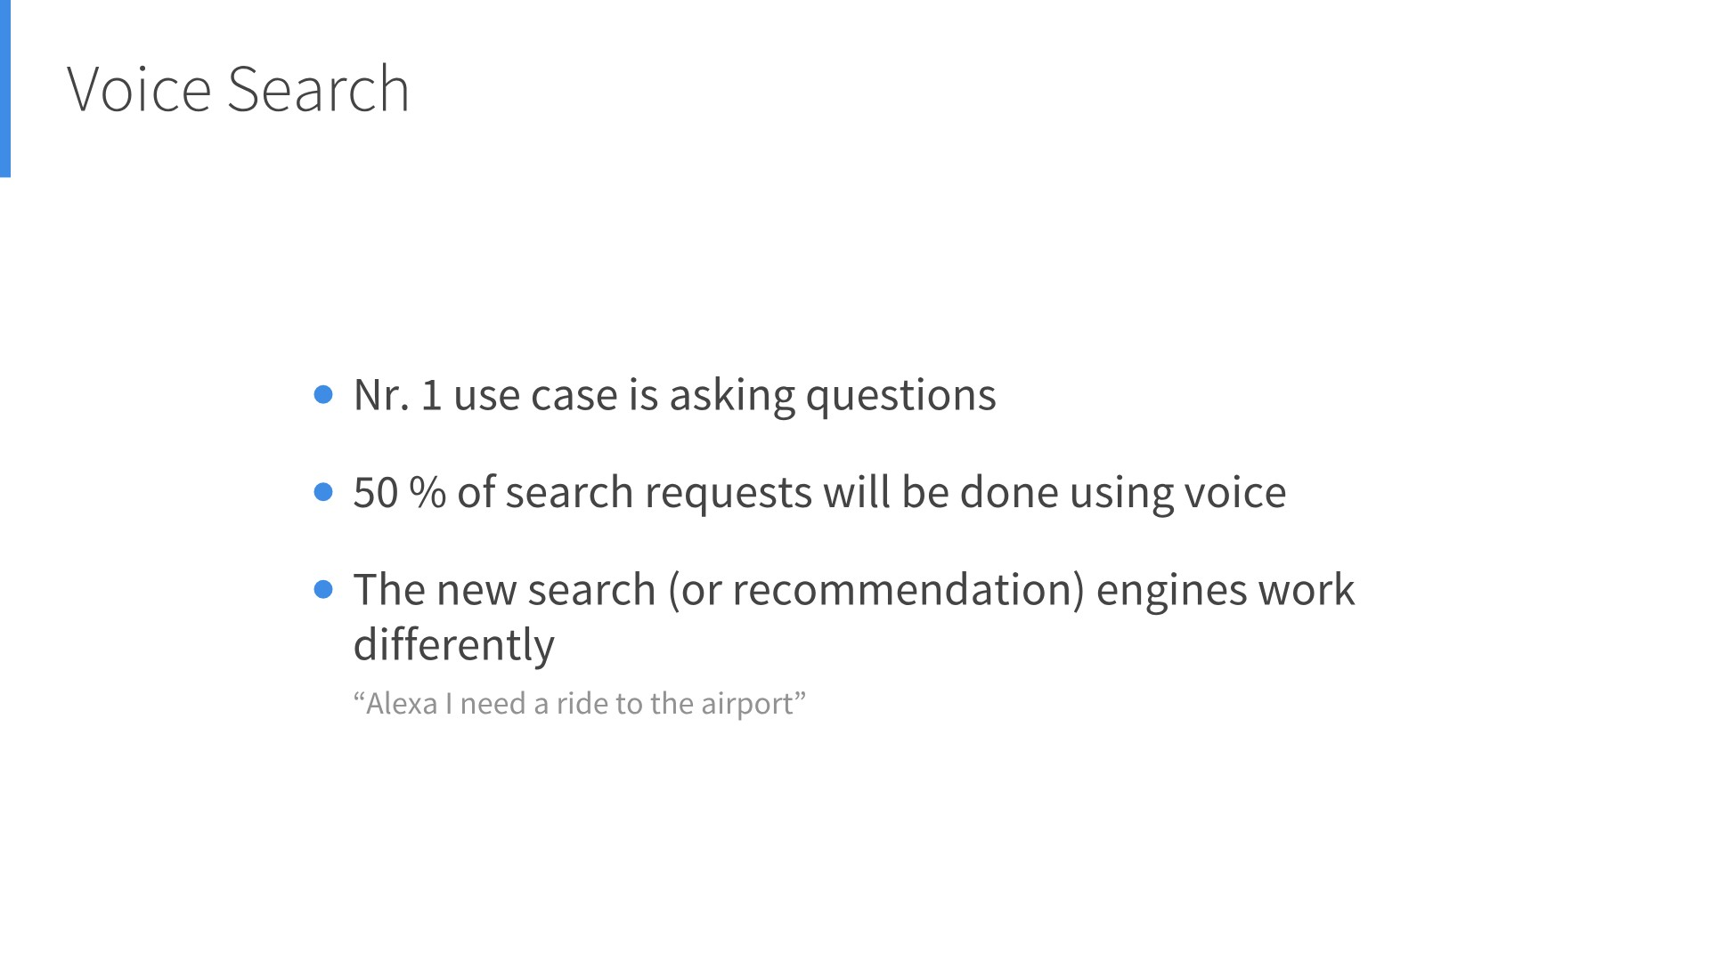
Notes:
what can you do about it?

Slide 14
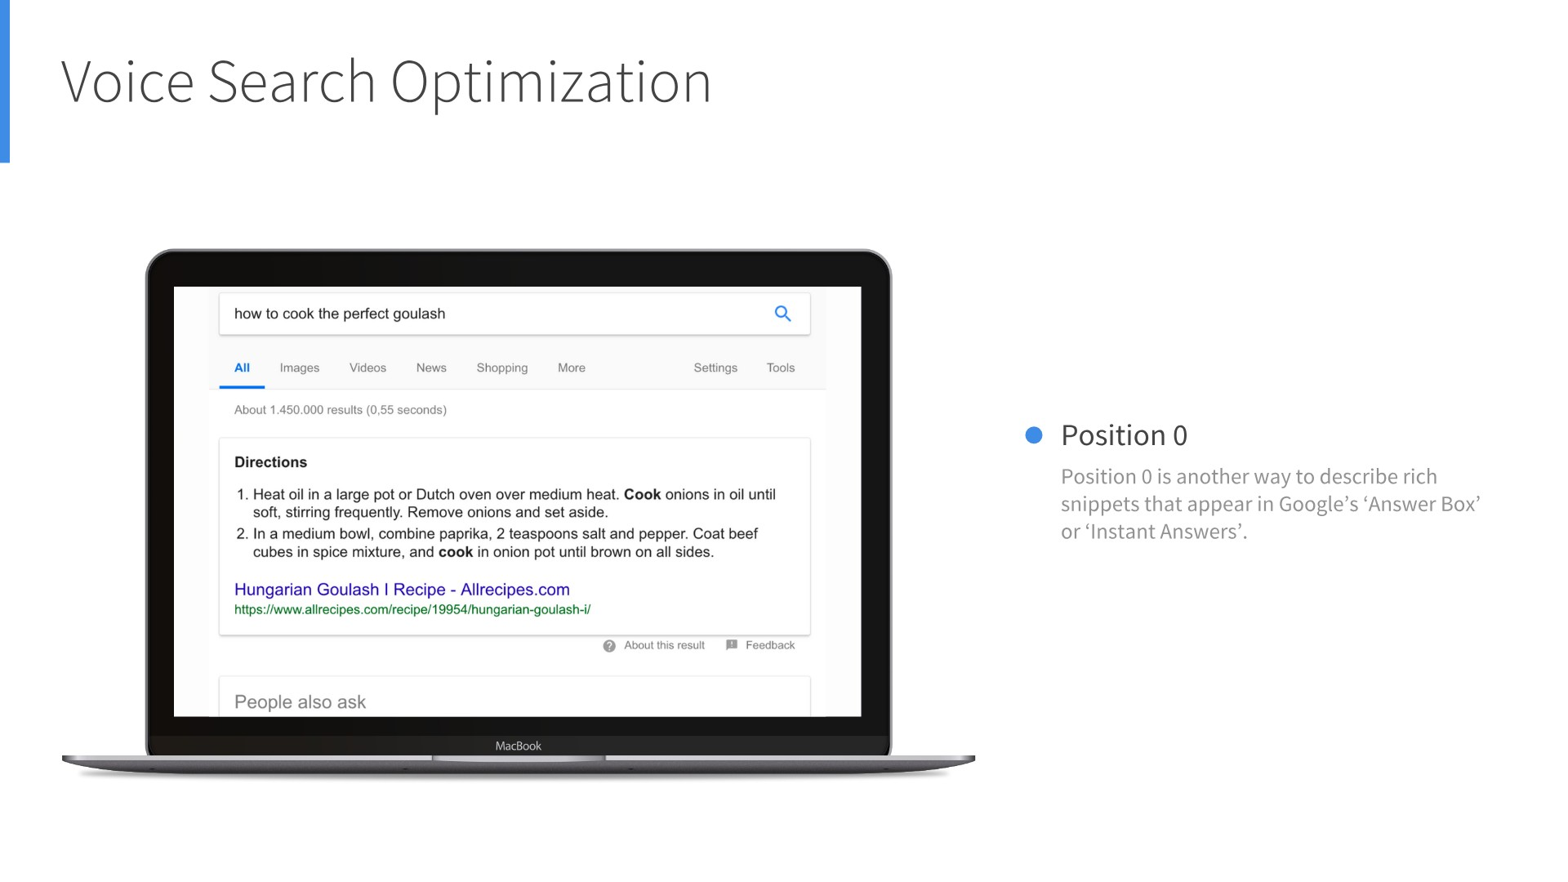

Slide 15
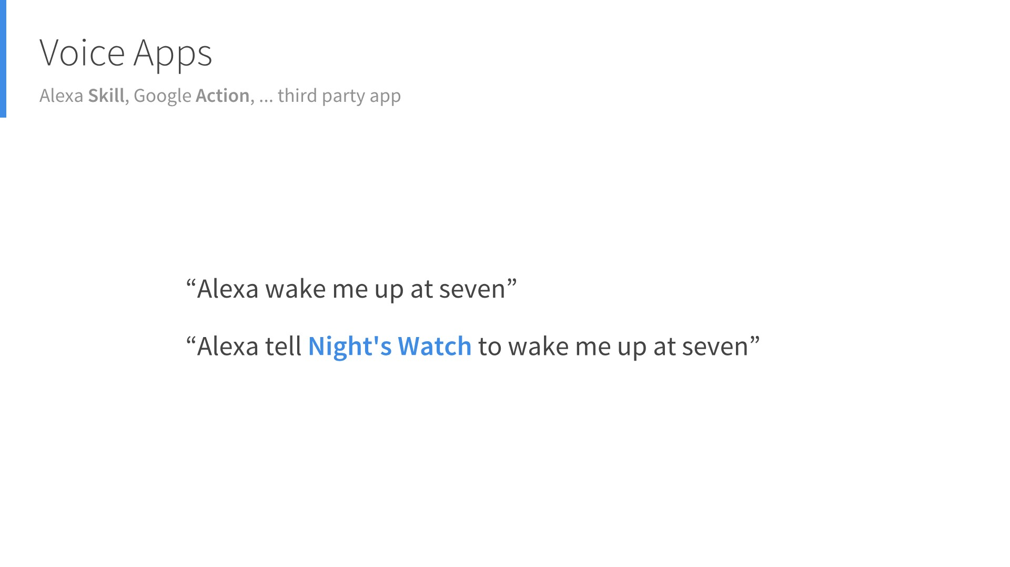

Slide 16
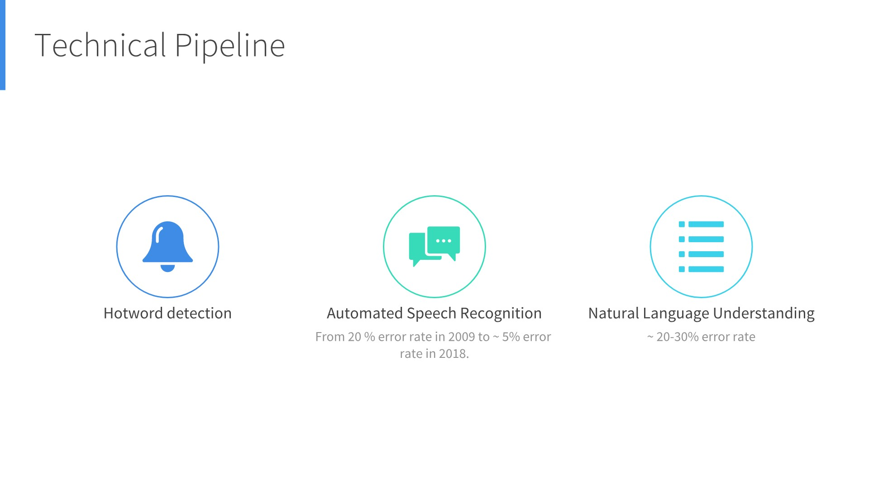
Notes:
Do you need language scientist?

Slide 17
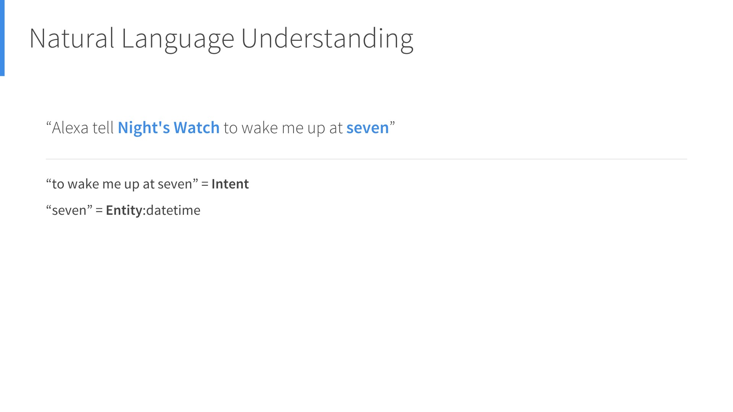
Notes:
It‘s about finding intents
Map intent to a function or method in the backend

Slide 18
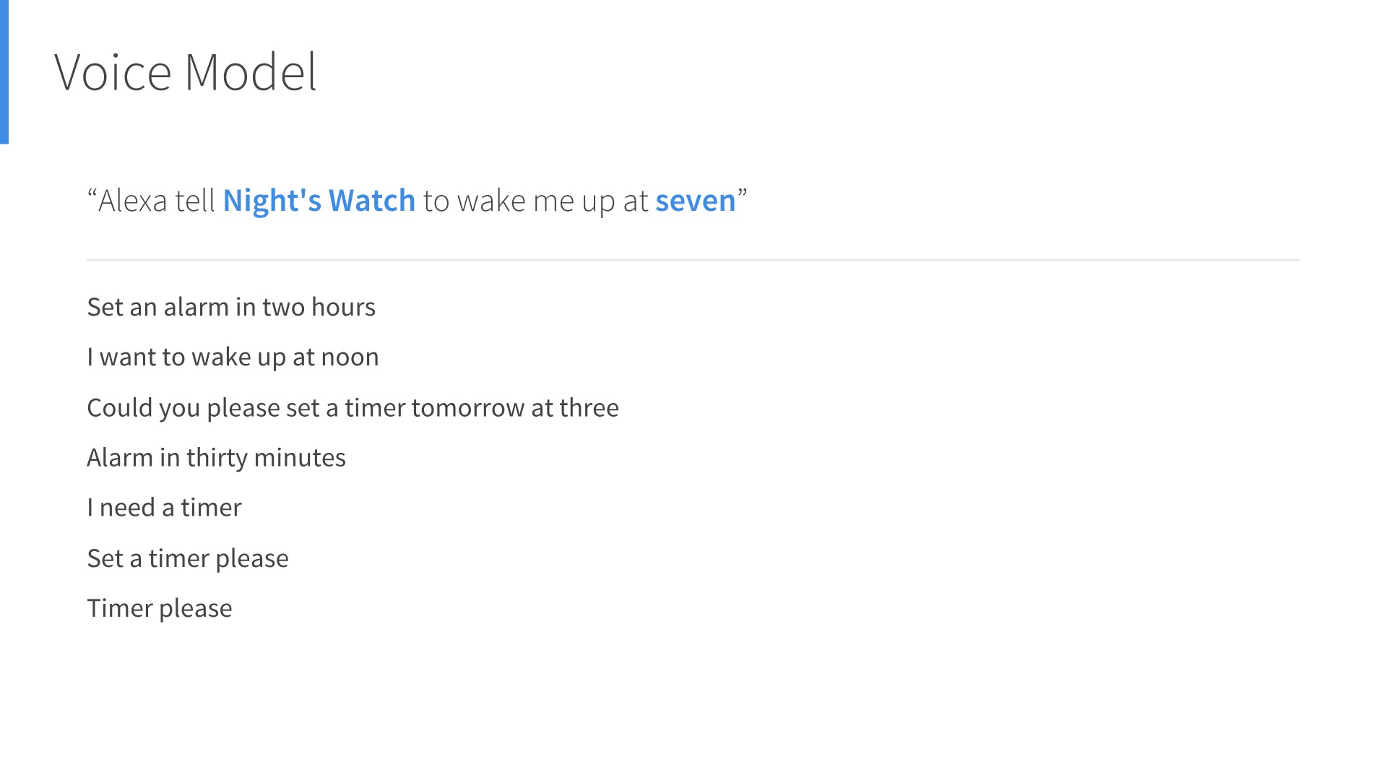
Notes:
And to help the system we need training data.

Slide 19
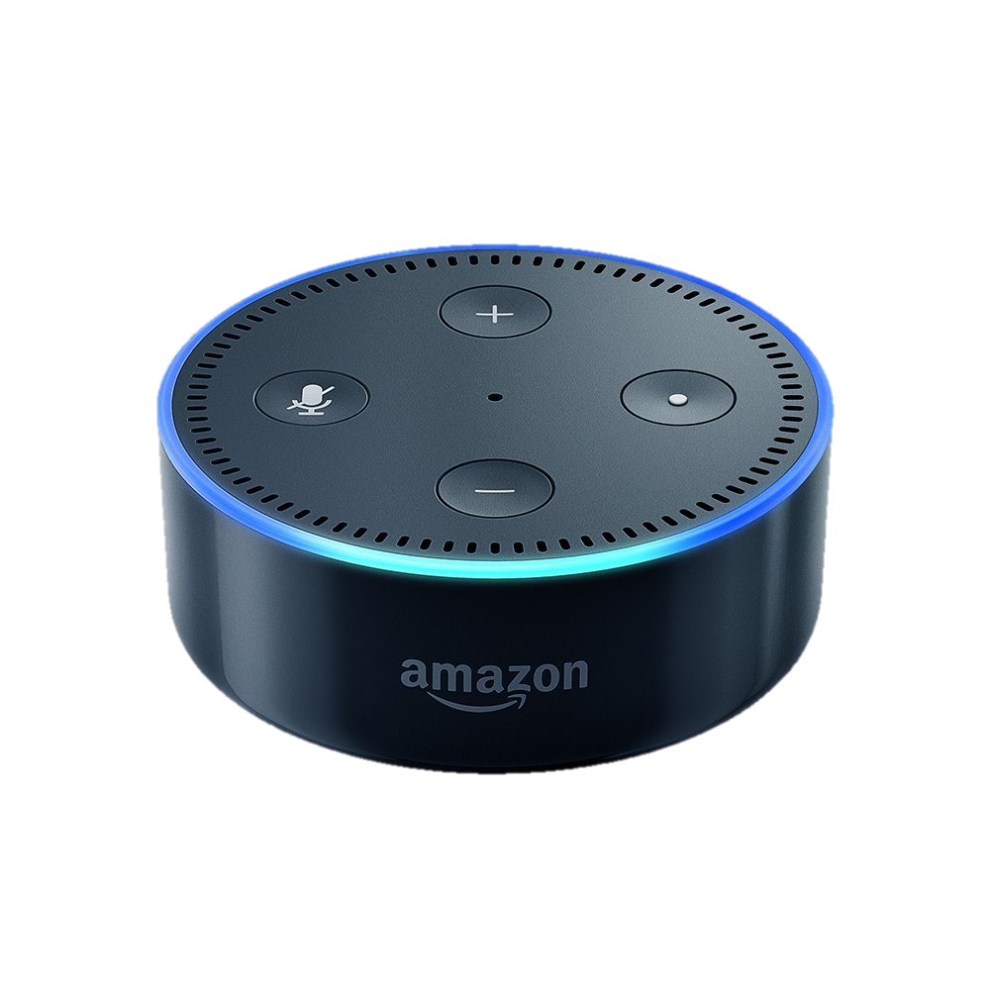

"Alexa tell Night's Watch to wake me up at seven"
Amazon Alexa Service
Developer’s
Application
Service
JSON
“Alright, our watch will end at seven am.”
Amazon
Developer
Portal
Presentation Language
Configuration & Voice Model
Notes:
You don’t need a language scientist or ai developer etc.
What makes Amazon Alexa’s platform so appealing is the neatly-packaged and convenient full-stack combination of a beautiful end consumer device, which is used by millions of users, and a fully-integrated solution with a developer platform, which takes care of all the heavy-lifting.

Slide 20
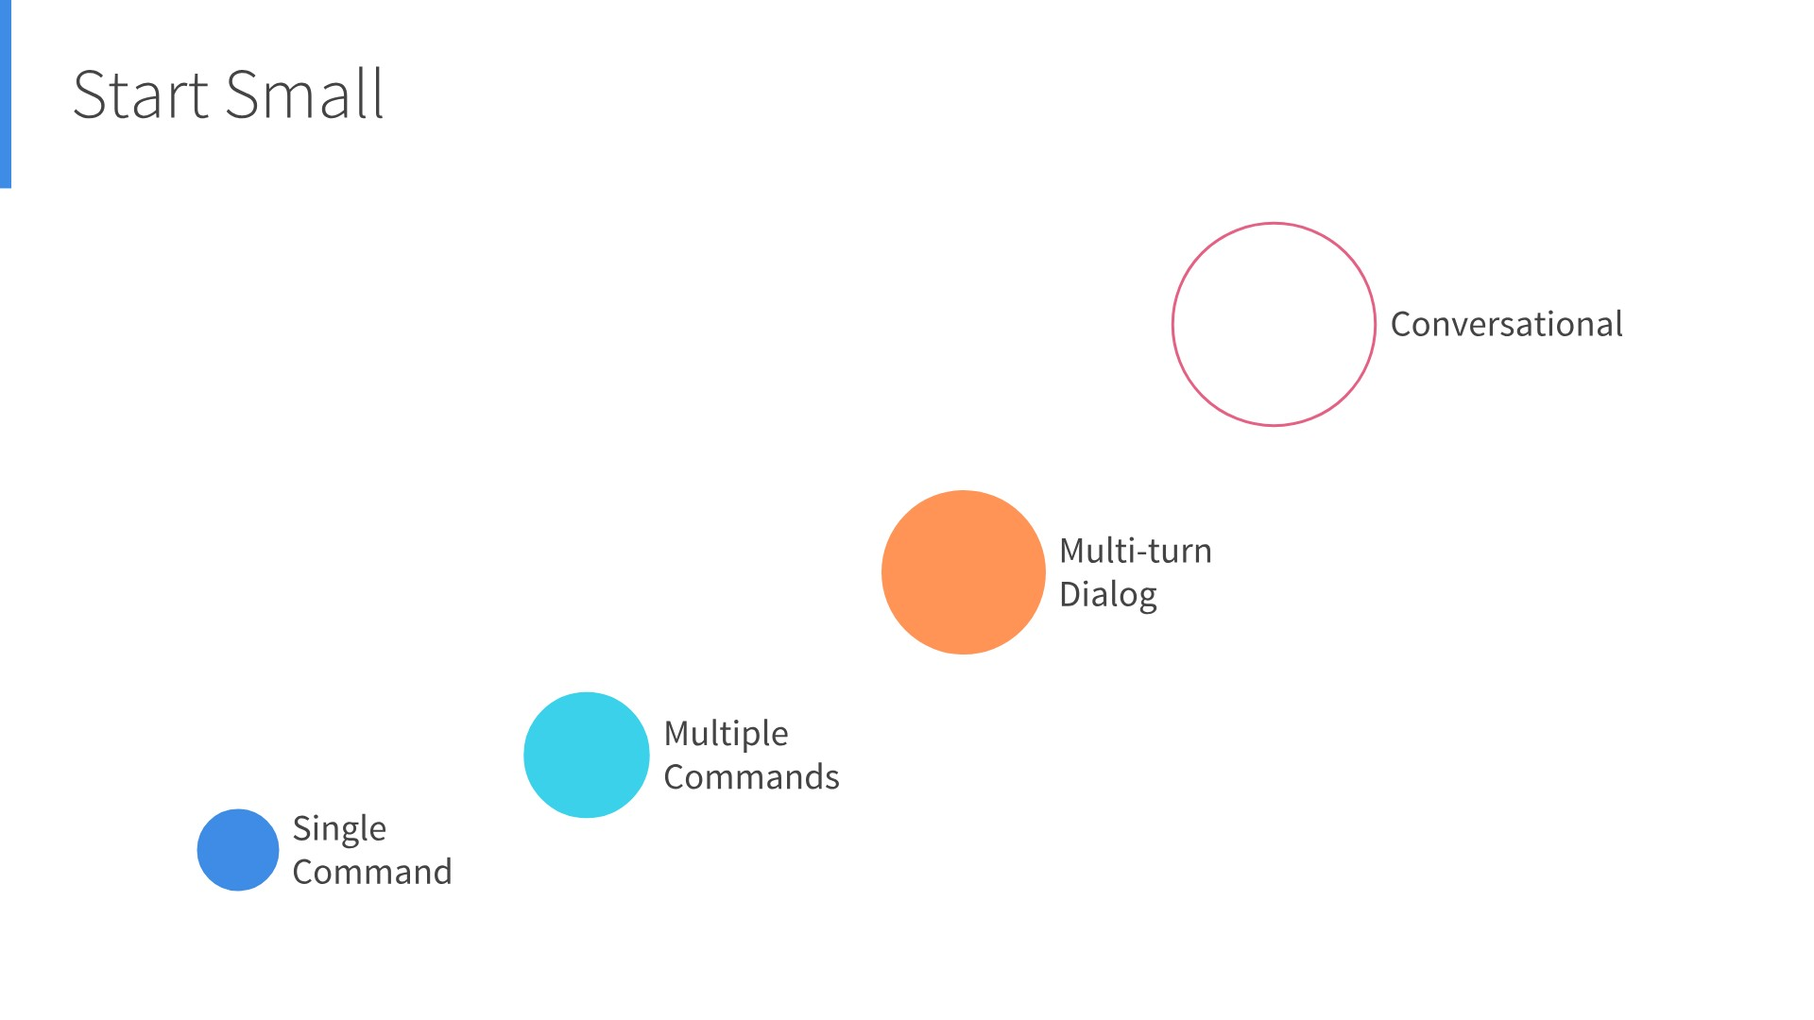

Slide 21

https://amazonalexa.slack.com/

Slide 22
Thank you!
roland.tiefenbrunner@gmail.com
@rolti

